Slide 1
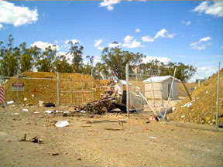
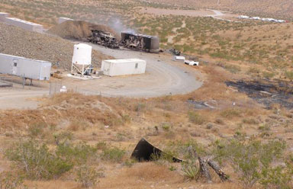
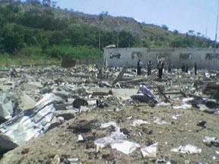
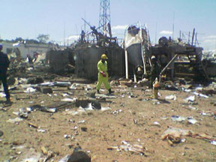

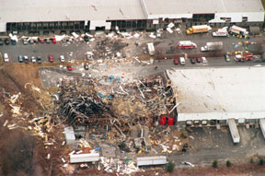


CEAEC Fall Meeting Nov 2017
QRA &
IMESAFR 2.0

Slide 2
QRA: Introduction & History
Risk = Probability of an event x the Consequence
The ‘answer’ is generally in risk outcomes/year
This is the classic generic risk equation which covers almost all activities
  IMESAFR uses a third term, probability of ‘being there’
The use of risk analysis is not new
  The first practical use was game theory, i.e., gambling
  The second practical use was actuarial (in use by the mid 1660s)
  Blaise Pascal is generally considered the father of (quantitative) risk analysis
  The development of the mathematical science of Probability and Statistics was driven by this
Most of the science has been on the Probability side with the consequence being ‘simple’ (e.g. life expectancy/death for actuaries, win/lose for odds makers)
Most large companies and many regulators use forms of Risk Analysis

Slide 3
QRA Introduction: Q/D vs QRA
Q/D Overview
Historically, most explosives regulations are Consequence based. Q/D is an example of this, it is designed to provide acceptable consequences given an explosion
Q/D is only concerned about the minimization of fatalities
  It is important to note that Q/D circles are not bordered by force fields, i.e., the risk is not zero outside the circle
  It is also important to note that the ‘iso-risk’ lines around explosives inventories are almost never circles
  Note there is a hidden risk value embedded in most Q/D models
Q/D does not guarantee safety
Q/D does not guarantee a uniform risk level outside the Q/D circle
  It does not even guarantee an acceptable risk level outside the Q/D circle
It does say that on average you are pretty unlikely to be killed by an explosion when outside the Q/D circle
  An analysis of historical accidents by the IME suggests that this is also true when inside the Q/D circle

Slide 4
Risk Analysis Overview
Risk Analyses come in three ‘flavours’
  Risk Analysis (RA): no formal quantification, e.g.
    Consensus opinion of experts tasked with decision
  Semi-Quantitative Risk Analysis (SQRA): some quantification, e.g.
    Bowties, Risk Matrix (see Orica example)
  Quantitative Risk Analysis (QRA): full quantification, e.g.
    Fault Trees, LOPA (Layer of Protection Analysis), SAFER/IMESAFR
For explosives / Q/D variances
  RA: some amount of people are likely to die sometime
  SQRA: between 1 – 100 will die in the next 100,000 to 2,000,000 years
  QRA: For the person most at risk, the probability of fatality is less than 1 / 1,000,000 years; the Group Risk is less than 10 fatalities/1,000,000 years
Clearly, only one of these works for Q/D variances

Slide 5
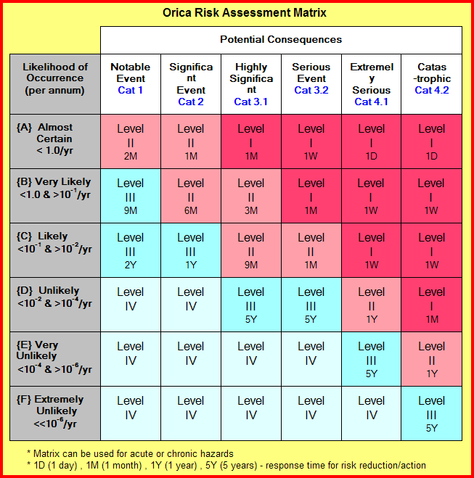
Orica Risk Matrix

Slide 6
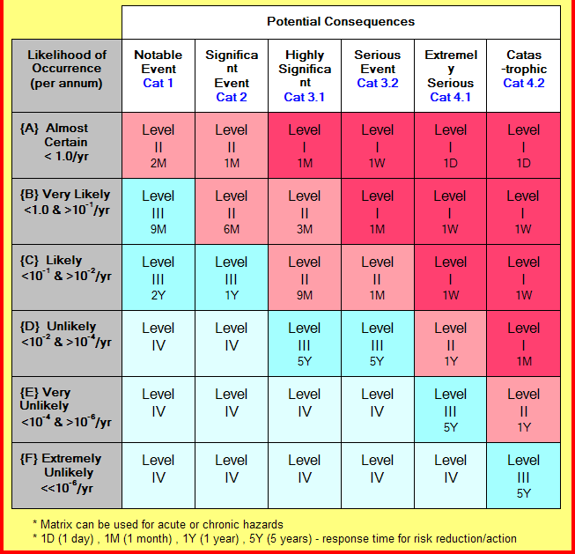
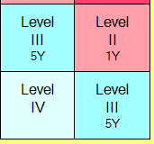
Orica Risk Matrix (Q/D Relevant)
Manage the risk of high consequence, low probability events
ie lower right area of risk matrix
Main concern is accidental explosions

Slide 7
QRA vs Q/D
Consequence only regulations can become punitive as, e.g., products or processes become safer, NEEQs drop, etc
  Even in big countries, availability of property for new sites is becoming more limited and more expensive
  Encroachment on existing sites is becoming more and more prevalent
The Consequence model is also extremely simplistic:
  Two factors are taken into account – quantity and distance. But
    Is the risk higher in a glass house near a concrete explosives building or a concrete house near a glass explosives building?
    Explosions are directional and debris generation from explosions in buildings is generally highly directional
    It is easy to generate scenarios where risk outside the Q/D arc can be 2-3 orders of magnitude higher than areas well inside the Q/D arc
QRA ensures that the desired risk level is met

Slide 8
IMESAFR: Background
IMESAFR is a fast running program that calculates the consequences and risk (consequence with frequency) of explosions
  It is based on SAFER, which was developed for the US DDESB by APT when the US DoD recognized that standard Q/D was often too rigid/limiting for their applications
    The algorithms are mostly based on full-scale tests for both PES (Potential Explosion Sites) and ES (Exposed Sites)
    The USDoD adopted SAFER in 1998
  The IME (Institute for Makers of Explosives) recognized the potential of such a program in commercial explosives applications and contracted APT to develop IMESAFR
  IMESAFR has been in use since 2007 and is gaining regulatory acceptance
    Regulators (ATF, ERD, CERL, HSE, MSHA) have been part of the Dev’t Team
      The ATF has accepted several IMESAFR based requests for variance and is ‘negotiating’ with the IME on numerical risk targets
      Canada, Australia, the UK and Germany have also accepted IMESAFR based QRAs for Q/D variances
      Scandinavia has used Amrisk and is now converting to IMESAFR

Slide 9
IMESAFR: Risk Calculations
IMESAFR considers three factors: likelihood (event frequency), consequence and exposure (presence)
  It is the capability to generate realistic consequences that makes IMESAFR so powerful/useful
Likelihood (Pe) is determined by historical accident frequency
  As products and processes have become safer, this has become more conservative
  User Defined Pe values are allowed (and flagged)
IMESAFR calculates the consequences and risk using a series of complex algorithms covering a large number of factors
  To the extent possible, these are built on test data
    The IME, member companies and the ATF are sponsoring new tests
  Where not, conservative assumptions are made
    The ISP (IMESAFR Science Panel) will also be reviewing some of these
Exposure is occupancy of an ES which includes the probability of explosives being present in the PES while the ES is occupied

Slide 10
IMESAFR: Inputs
IMESAFR considers many input factors
  Quantity (can be TNT equivalence)
    The AN Module is ‘now’ available to all; does not use TNT equivalence
  Type of explosives
  Activity at PES (Potential Explosion Site)
    ‘Environmental’ factors
  Distance
  Direction (more important than distance in many cases)
  Construction of PES
    Walls, floor, roof, area
  Construction of ES (Exposed Site)
    Walls, roof, % windows
  Occupancy

Slide 11
IMESAFR Algorithm Outputs
IMESAFR takes the large number of inputs listed previously
  It then converts the input to a large number of outputs
    Thermal (Fireball intensity at any point and radius of effect)
    Pressure (at any point)
    Impulse (at any point)
    Primary fragments (direction and velocity)
    Secondary fragments (direction and velocity)
      ‘Fly through’ horizontal debris
      High angle horizontal debris
      Vertical debris
  The trajectory distribution for Fly Through horizontal debris is calculated
    This debris is lethal along the path but can be blocked by barricades
  The trajectory/landing point distribution for vertical and high angle horizontal debris is calculated
    This debris is only lethal at the landing point

Slide 12
IMESAFR: Risk Outputs
IMESAFR then calculates:
  The fireball lethal radius intersecting an ES
  The path of low angle horizontal debris intersecting an ES
  The distribution of horizontal and vertical debris end points vs ES’s
  The pressure-impulse curves and values at every ES, including people in open (true for all effects)
    Whether this is enough to kill a person directly/collapse a building/shatter windows into lethal shards
IMESAFR finally calculates:
  The damage to every ES ‘in range’
  The probability of fatality of every person ‘in range’
    Note that an ES can provide significant protection or add significant risk
    Serious and minor injuries are also calculated
  The Risk for the person most at risk
  The Group Risk for ‘everyone’ at risk
  The probability of fatality given the event (pure consequence)

Slide 13
IMESAFR: Risk Outputs
For complex analyses, i.e. multiple PESs and/or ESs
  IMESAFR will provide the individual and group risk for
    Any PES-ES pair
    Any PES to all ESs
    Any ES from all PESs
IMESAFR also calculates the damage to structures
  The P-I value at any point will determine damage to a structure
    This can be minor damage to building collapse – which is a fatality mechanism
    This is highly dependent on building construction
    Some are more vulnerable to ‘I’, others to ‘P’
IMESAFR can be used as a post accident forensic tool
  Camp Minden propellant magazine explosion
  West TX AN explosion (belatedly)
  Orica EHM Plant in Chile

Slide 14
IMESAFR: Coming Soon to a PC Near You
IMESAFR 2.1
  Release date IME Spring Meeting
  Major Improvements
    AN Engine fully integrated
    Much better handling of effectiveness of barricades
    Much better handling of location of inventories in a PES (vertical component)
    Capability to block vertical debris with ‘barricades’
    Both horizontal and vertical barricade capabilities are direction dependent
    Generation of debris from the PES will be much more realistic
      This is dependent on PES construction and ‘loading’ (based on real test data)
  Dozens of minor tweaks to improve functionality, improve performance and reduce conservatism
    Last driven by CERL and ATF NCETR
IMESAFR 3.0 (2021?)
  Topography Matters!
Training: ISEE @ San Antonio; CIE Meeting @ Ottawa

