Slide 1

New UN Classification for Electronic Detonators:
UN0511 / UN0512 / UN0513
Manufacturing / Technology Update
WHY?
  Electronic and Electric Detonator assemblies have historically had the same UN classification.
  Separating them will have a positive impact with respect to the risk profile of the transportation of Electronic Detonators.

Slide 2
New UN Classification for Electronic Detonators:
UN0511 / UN0512 / UN0513
UN0030, 1.1B, DETONATORS, ELECTRIC
UN0255, 1.4B, DETONATORS, ELECTRIC
UN0456, 1.4S, DETONATORS, ELECTRIC
Current UN numbers, will continue to be used for electric detonators !
UN0511, 1.1B, DETONATORS, ELECTRONIC
UN0512, 1.4B, DETONATORS, ELECTRONIC
UN0513, 1.4S, DETONATORS, ELECTRONIC
New UN numbers, will be used for
electronic detonators going forward !

Slide 3
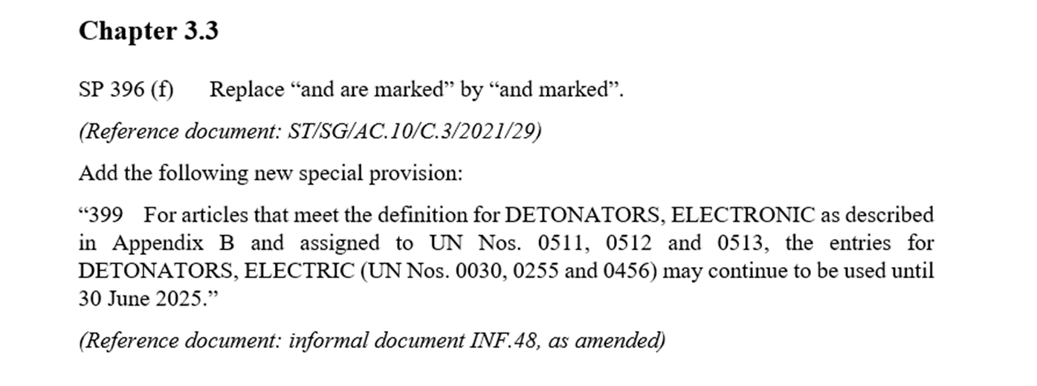
New UN Classification for Electronic Detonators:
UN0511 / UN0512 / UN0513
UN TDG Subcommittee session – Outcome of session held July 02,2021
  Special provision was adopted at the UN TDG Subcommittee session 2nd July 21 to allow continued use of old UN # for electronic detonators until 30th June 2025.
  All Electronic detonators must be classified under new UN # by 30 June 2025

Slide 4
New UN Classification for Electronic Detonators:
UN0511 / UN0512 / UN0513
Regulation Implementation
  ICAO ( Int Civil Aviation Org) /IATA (Int Air Transport Ass) have adopted the new UN #’s already in their regulations.
  New UN numbers need to be published/ amended into receiving country regs. Licences and permits may need to be updated as well.
  NRCAN has not yet adopted new UN #s into TDG Regulations (CGSB-43.151 standard)
  US DOT revised 49CFR to include new UN #s for Electronic detonators in Hazardous material table – July 26, 2022

Slide 5
Questions?

