Slide 1
June 06 2019
Dangerous goods transport – Fire and explosion with one fatality
CEAEC Meeting, Quebec city
noël hsu

Slide 2
Why do old accidents happen to new people?

Slide 3
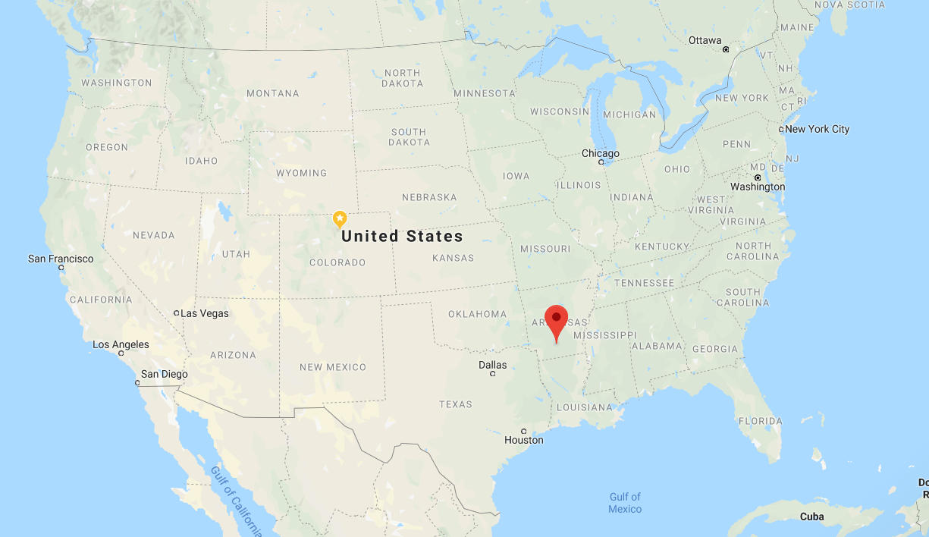
Location: Camden, Arkansas

Slide 4
AN Prill Transport Accident
On Wednesday March 27 a truck carrying fertiliser grade ammonium nitrate prill exploded following a tire fire.
The explosion killed the truck driver, injured three fire fighters, and created a crater 5m deep and over 10m wide.
Other damage was to two police cruisers, two fire trucks, and several homes in the vicinity.
This event underscores the need for ensuring that:
transport vehicles are in good working order
there is an emergency response plan (ERP) in place
the driver(s) of the vehicle and the emergency responders who may be called upon have the information to safely handle the emergency, and
they are trained in the ERP.

Slide 5
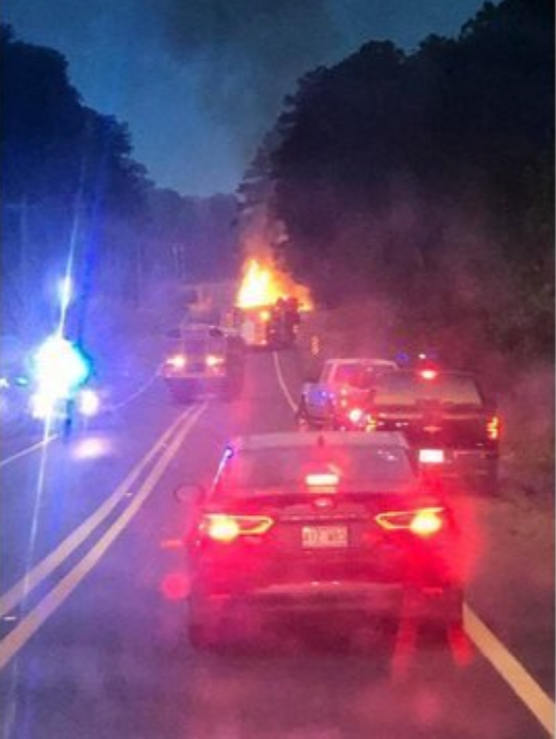
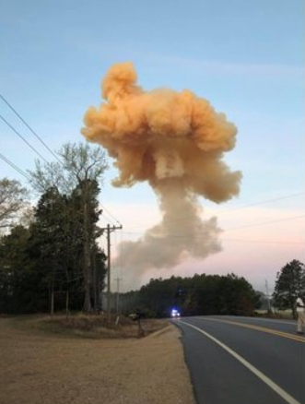
March 27, 2019
Fire initiated in tire (from faulty brake). Call made to emergency services at ~06:40. They were told what the truck was carrying.
Fire fighters started evacuating people in surrounding area.
Driver headed back to truck.
Mass explosion at 07:03 (from seismograph)

Slide 6
Images from Online Media
This is only published image of the fire. The extent of the flames indicate that it is more than tires alone.

Slide 10
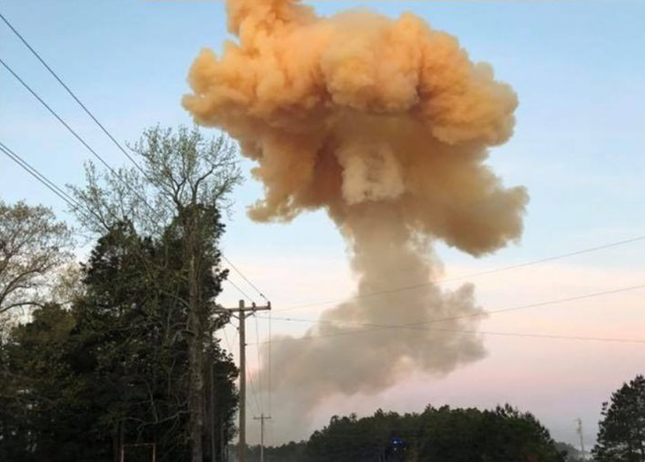
NOx cloud typical of unfueled AN explosion

Slide 11
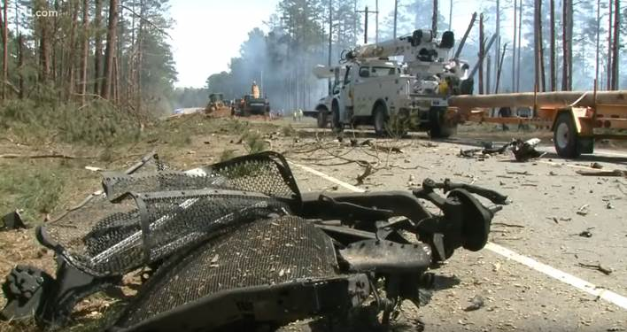
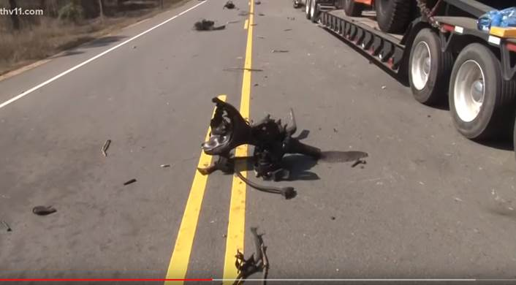
Truck fragments post explosion

Slide 12
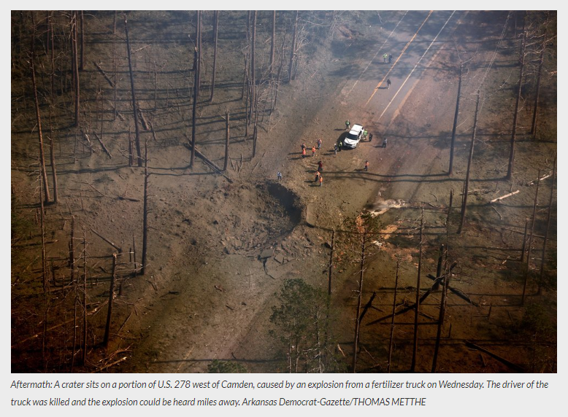
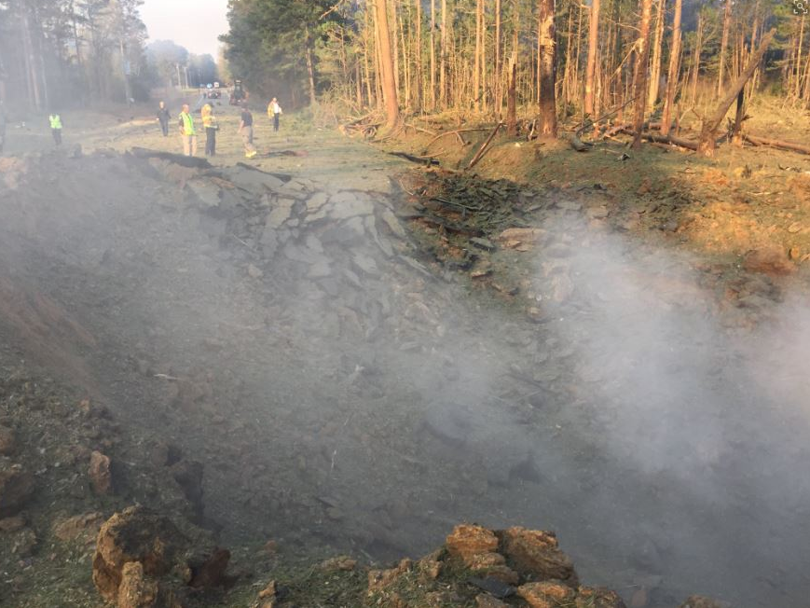
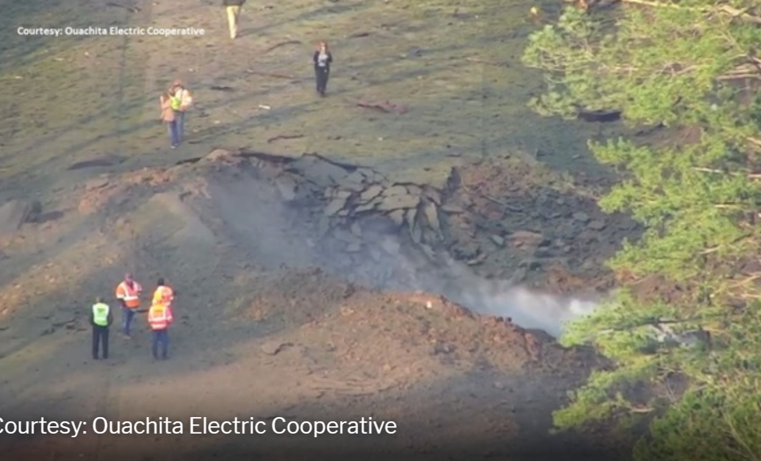
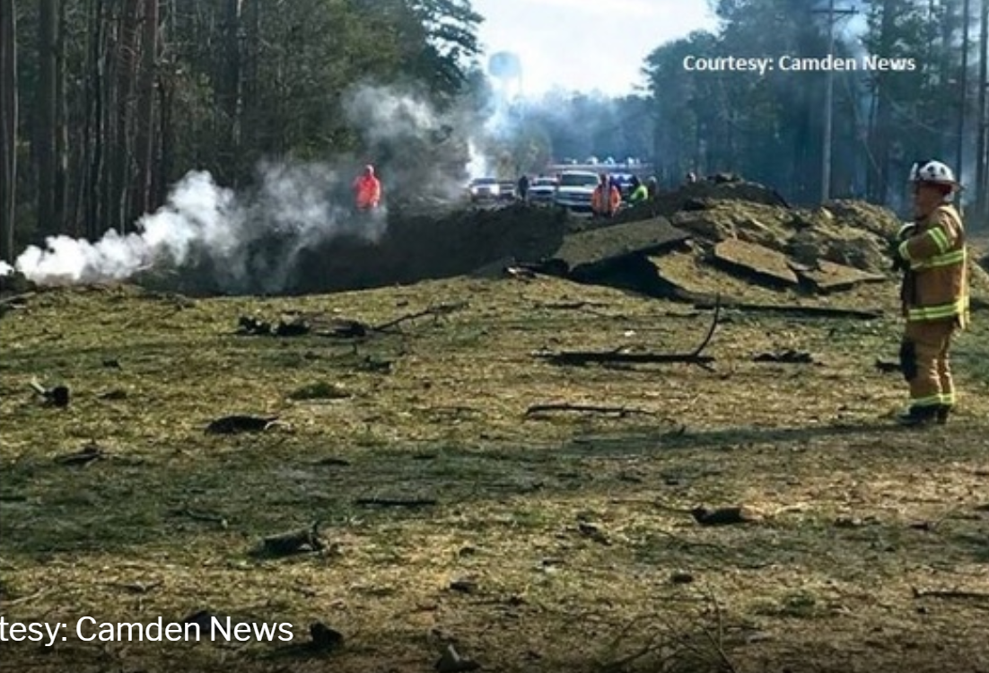
Images showing crater from explosion

Slide 13
What caused the fire?
“The Arkansas State Police said Wednesday that the brakes of the commercial carrier truck were on fire and the driver was trying to out the blaze when the blast happened.”

Slide 14
What caused the fatality?
“Area fire department personnel were notified about 6:40 a.m. that the truck brakes (tires) of the commercial carrier truck believed to be driven by McDougal were on fire and the driver was trying to put out the blaze.
The first fire department personnel on the scene had begun to evacuate residents who live in the area and reportedly witnessed McDougal return to the truck when it exploded. ”

Slide 15
OUACHITA COUNTY, Ark.- First responders are recovering mentally and physically, after not only seeing a truck explosion, but feeling it.
"There's hundreds of things that are going through our minds," says Camden Fire Chief Robert Medford.
Medford learned a truck carrying highly flammable material was on fire Wednesday morning.
"We realized at that point that it was too far gone," Medford recalls. "We didn't have enough water to fight this fire."
Chief Medford had already made the call to evacuate people living within a mile radius of the burning truck.
Moments after he and his crew made contact with the driver and headed back to their units, the worst possibility happened.
"This was a bigger explosion, a bigger explosive event than I have ever witnessed," the fire chief says.
It knocked the chief and several firefighters to the ground, blew out an engine's windshield and made nearly every airbag in the chief's truck deploy.
"At first, I didn't realize the damage was quite as extensive as it was," Medford says.
https://www.kark.com/news/local-news/camden-fire-chief-recalls-ouachita-county-deadly-explosion/1882101498

Slide 16
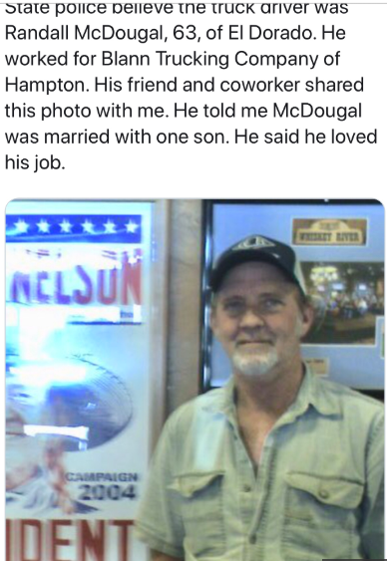

Slide 17
Is the vehicle in good working order? Is an Emergency Response Plan in Place? Is it up to date? Have the personnel/responders been trained?

Slide 18
Thank you

