Slide 1
Explosives Safety & Security Branch (ESSB)
Explosives Program - Update
Meeting with CEAEC
Ottawa – November 2019

Slide 2
Agenda – Explosives Program
  ESSB Activities S Dionne
  Licensing & Inspections Update D Hilliker
CEAEC List of Questions All
ESSB New Business M Lafleur

Slide 3
ESSB Activities

Slide 4
Explosives Regulations, 2013 –Amendment 3
ESSB is currently evaluating comments in response to proposed amendments to the Regulations regarding precursor chemicals, and some other administrative changes
Canada Gazette 2 in early 2020

Slide 5
Explosives Regulations, 2013 – Miscellaneous
Miscellaneous amendments - input from stakeholders was sought
List of 22 items received from CEAEC
7 items can be resolved via guidelines / clarifications outside of ER, 2013
12 agreed-in-principle to proposed changes, for example:
  2 boxes of initiation systems can be opened at one time in a mag. – s.150 (4)
  eliminate inspection overlap with provinces for requirements of vehicles to be in good condition - s.193 (3)
  clarify s. 199 (2) - up to 25 kg of high explosives (type E) and up to 100 detonators (type I) may be left unattended in a vehicle if the explosives are not transported in bulk

Slide 6
Explosives Regulations, 2013 – Miscellaneous
Proposed changes (cont.):
  clarify the intent of what types of accidents/incidents require notifications to police, NRCan, and carrier – s.201(1)
  give sellers more flexibility on what information can be on record of sale – s.219
  better describe intent, and language to align with definition of a ‘magazine’ in the Explosives Act – s.217 (1)
  CEAEC / NRCan - expand security requirements of tracking and communication systems of section 198 (1). An exemption would only apply to vehicles in which a manufacturing operation may be carried out if they remain on a mine site at all times

Slide 7
Future Amendments / Regulatory Reviews
Amendment #4 – access controls
Analyze current security requirements, identify gaps and high risks, and propose streamlined regulatory measures for access controls to all types of explosives
Seek other proposals from CEAEC to update ER, 2013
New form includes: background and current issues, proposed intent, justification, substantiation and consideration of impacts

Slide 8
ESSB International Activities
Active involvement in the U.S. – Canada Regulatory Cooperation Council Partnership:
  working with the Department of Homeland Security on security concerns related to Precursor Chemicals
Working at the international level on changes to the UN Model Regulations and Manual of Tests and Criteria

Slide 9
Update
Licensing & Inspections

Slide 10
Overview – Risk-Based Inspection Plan
Goal: Focus inspection resources on higher risk licenced sites
Method
- Identify and quantify risk criteria to rank licenced sites by risk order
- Use a fact-based methodology to build inspection plans based on well-founded risk criteria
Impact
- Inspection site visits are prioritized based on the sites’ risk
- Time and capital are freed for important outreach programs
- Fewer overall trips, but focus on highest risk

Slide 11
Risk-Based Inspection Plan - Summary
Compared to the previously-used methodologies, the risk-based inspection plan:
Reduces the number of site visits by 9%
Increases the ratio of visits to high-risk sites by 24%
Time and resource savings
Outreach programs

Slide 12
ESSB Statistics
Activity |  | FY 18-19 | FY 19-20 (Q1-Q2)
Authorization | Applications received [indefinite period] | 369 | 207
 | Products tested | 43 | 41
 | Products approved | 9748 | 3335
Active Import Permits | Annual | 248 | 252
 | Single Use | 119 | 124
Restricted Components | Sites | 2139 | 2014
 | Sellers | 1646 | 1528
Mobile Process Units | Active and in operation | 206 | 203
Active Licences | F&S - Factory & Satellite, Bulk | 175 | 180
 | F&C - Factory & Certificate, Other | 92 | 99
 | F/PE - Factory, Perforators | 75 | 70
 | V (E, Y, D, DS) - Magazine, Vendor | 118 | 113
 | U (E, D, Y, I) - Magazine, User | 806 | 737
 | U/Z - Magazine, User – Zone | 355 | 332
 | U + V (P, PP, C, R, S) - Magazine | 329 | 287
 | U/F and V/F - Magazine, Fireworks | 99 | 88
 | TOTAL | 2049 | 1906

Slide 13
ESSB Statistics (Inspections)
Inspections |  | FY 18-19 | FY 19-20 (Q1-Q2)
Inspections by activity | F&S - Factory & Satellite, Bulk | 62 | 47
 | F&C - Factory & Certificate, Other | 26 | 14
 | F/PE - Factory, Perforators | 57 | 19
 | V (E, Y, D, DS) - Magazine, Vendor | 38 | 14
 | U (E, D, Y, I) - Magazine, User | 217 | 119
 | U/Z - Magazine, User – Zone | 57 | 48
 | U + V (P, PP, C, R, S) - Magazine | 115 | 25
 | U/F and V/F - Magazine, Fireworks | 31 | 12
 | Restricted Component sites | 1501 | 859
 | Mobile Process Units (MPU) | 38 | 24
 | Unlicensed [provincial magazines, trucks, fireworks events, port surveys, technical inspections, importation or expired licences] | 2 | -
 | TOTAL | 2144 | 859

Slide 14
Inspection Deficiencies
    Operations / Housekeeping:
    Incorrect inventory records
    Expired/poor stock condition
    Storage of incompatible explosives
    Process building not meeting the requirements of the Bulk Guideline including emergency exits, exposed brass, and electrical fixtures
    Quantity/Distances not met
    Magazines not meeting BNQ standard, including insufficient bullet resistance
    MPU maintenance not up to date
    Pump maintenance not up to date
    Explosive and explosive components leaking
    Support Plans / Administration:
    Procedures not up to date (maintenance, operating)

Slide 15
Factory Licencing and Inspection
Factory licences are being processed in the regions where they are located
  inspections of the sites are conducted primarily from the licensing regions

Slide 16
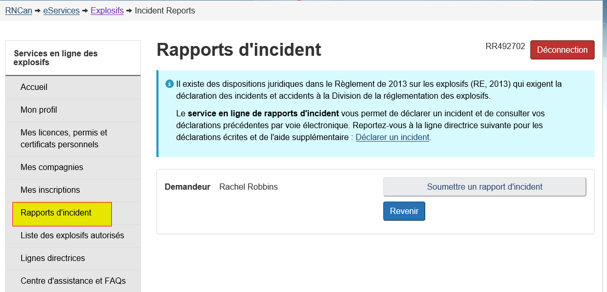
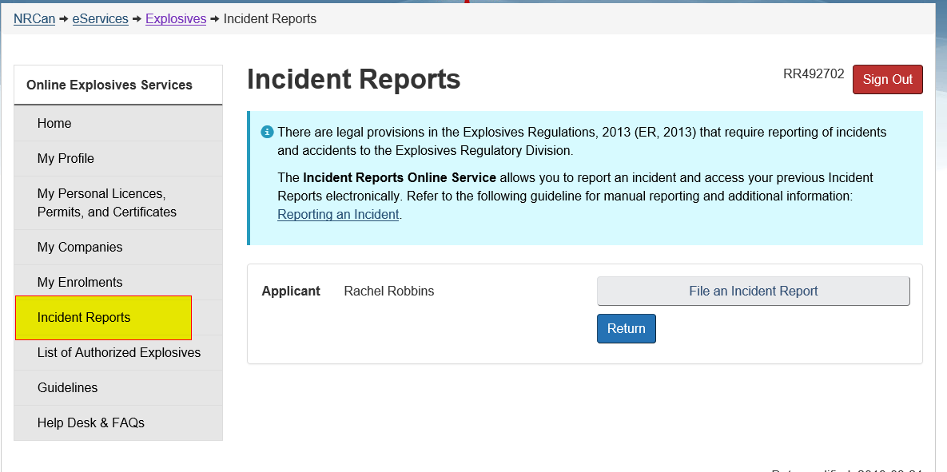
Reporting Incidents using eLMS

Slide 17
Transport under an In Transit Permit
In Transit Permit applicants must provide the location of secure storage sites that will be used if transit is interrupted. (s.50 (j))
  for industrial explosive this must be a licenced site
  where provided, a secure storage site is the only location allowed by the Regulations for interrupted transit
  where no secure sites are mentioned on the permit application, the shipment must proceed directly from port of entry to the port of exit without delay
Notes:
This slide is in response to a complain from CBSA where an In Transit shipment took 2 weeks to cover a six hour drive.
After ERD follow up the following Regulatory Reminder that In Transit shipments must not stop and may not be directed to stop where secure storage has not been requested on the permit.

Slide 18
CEAEC List of Questions
General
  eLMS, BNQ etc.
Storage
  Federal – Provincial alignment
Transport
  ESSB expectations

Slide 19
General eLMS
ESSB has received CEAEC concerns regarding eLMS
We will continue to address eLMS concerns as funding allows

Slide 20
G.2 Bulk Delivery with MPU at a Mine or a Quarry
Explosives provider is to ensure that the location is registered as a provincial mine or quarry
The requirements in Section 20 and subsection 99(4) are required to be met.
Due diligence for reducing the potential harm to people and property should be demonstrated.

Slide 21
G.3 and G.4 BNQ standards
BNQ has conducted outreach regarding their published standards
  BNQ will pursue review of the standards in accordance with their Standards Council of Canada accreditation
  ESSB as the AHJ will participate as required

Slide 22
G.5 UN 3375
ESSB has conducted outreach with Transport Canada
  many provisions of TDGR would need to be amended
Explosives Regulations will need to be amended
  regulatory framework and CEAEC participation to follow
  ESSB will form a working group and discuss relevant policy decisions

Slide 23
G.6 Drop Ship
Drop Ship licences are issued for vendors/distributors who never store explosives
ESSB expects suppliers to follow Section 13 (a) and 21 with respect to supplying explosives for third party resale
Drop Ship licences can be subjected to relevant terms and conditions

Slide 24
G.7 Changes to Underground
ESSB to conduct additional outreach
  focus on education and safety requirements
  support from mine inspectors and labour departments
Possible compliance verifications
  to include:
    Self-Declarations, review of maintenance records, training records, etc.
    ESSB and provincial inspectors to perform joint inspections underground
Longer term, consider amending Section 136

Slide 25
S.1 Storage
Amendments to Explosives Regulations must process through Canada Gazette thereby formally notifying interested parties
Federal – Provincial/Territorial alignment
  ESSB is attending Chief Mine Inspector meetings
  Senior Inspector at ESSB reviewed regulations for Saskatchewan
  ESSB has strengthened its relationship with Quebec Public Safety
    ESSB looks forward to regulatory discussions with Quebec
  work is in progress for remote sites to be inspected by RCMP, SQ, etc.

Slide 26
S.2 QD
Row 18, of table C.1 from QD standard, Critical power lines shall use D-7: how is the owner of the PES to determine if a power line is critical
  ESSB relies on the ES owner to provide the relevant technical information related to the criticality of a power line

Slide 27
T1. No stopping on route
Please explain ERD’s position on meeting the intent of 196 (5) “no stopping on route”
  carryover from Previous meetings
  the transport of explosives must be planned and prepared for ahead of time.
  examples of unnecessary stopping:
    fueling just after departure
    stop to eat shortly after departure
    stopping for more than 30 min for lunch

Slide 28
T2. Overnight Parking
Part 200 of the ER-2013 references “Overnight parking” what are ERD’s expectations?
  carryover from Previous meetings
  the vehicle is attended in person (Section 199 (1)) when not parked at a licenced factory site
  overnight parking location, when at a licence factory must in accordance with the licence. i.e. must park at location specified on licence and overnight parking must be allowed by the licence.

Slide 29
T2. Overnight Parking
Overnight parking not at a licence factory, must be in accordance with Section 200 (1).
Park away from sources of open flame, etc.
Follow the QD standard for how to comply.

Slide 30
T3. Trucking associations
ESSB outreach to various trucking associations is ongoing
  ESSB has recently reached out to the CTA, and will continue efforts to engage with associations
CEAEC is encourage to direct trucking companies to ESSB for clarification on meeting Regulatory Requirements.
Any CEAEC suggestions on this matter are encouraged

Slide 31
ESSB New Business
Risk-Based Inspection Plan

Slide 32
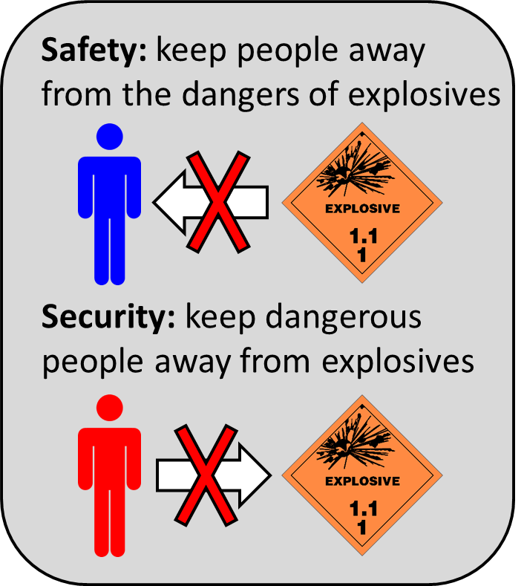
Introduction – Risk-Based Inspection Plan
Risk in the context of explosives comes from one of two factors: safety and/or security
Traditional regulations focused heavily on safety; after 9/11, there was an effort to put more emphasis on security
The compliance level of licence holders (stakeholders) will increase or decrease the risk presented by each factor

Slide 33
Introduction – Risk-Based Inspection Plan
In the risk-based inspection plan, risk levels are quantified based on the following criteria:
  Inspection Rating: used to identify previously inspected poor performers
    sites are assigned an inspection rating after an inspection based their on compliance with the Explosives Act and Regulations
  Safety & Security Risk Level: used to identify the risk of accidental detonation and/or criminal use
    a heuristic computer algorithm is used to assign a Safety & Security Level to licenced sites on a relative scale
  Temporal Factor: used to prioritise sites which have not been recently inspected

Slide 34
Safety & Security Risk Level
The Safety & Security Risk Level is a product of separate Safety and Security Risk Levels which are independently determined by:
  (1) explosives type being manufactured/sold/stored at the licenced site
  (2) site-specific characteristics and activities
Examples:
  the activity of manufacturing increases the Safety Risk Level
  a remote site has a decreased Security Risk Level

Slide 35

Safety & Security Risk Level - Comments
Provides information for the focus of inspections
  Safety vs. Security → Friction, Impact, Static and Heat (FISH) & Quantity Distance (QD) vs. Inventory, buyer registry and stakeholder accountability

Slide 36
Questions?
Headquarters (Ottawa)
(613) 948-5200
ERDmms@NRCan.gc.ca
Daniel Hilliker
National Manager, Licensing and Inspection
613-298-4262
Michael Lafleur
Senior Inspector of Explosives, A/Manager Specialist Inspectors
343-292-8681
Sebastian Towler
Senior Inspector of Explosives, Port QRA, MPU, Transport
343-292-8734

