Slide 1
Explosives Safety & Security Branch (ESSB)
General Update
Meeting with CEAEC
Ottawa – November 2017
Jean-Luc Arpin Director, CIE
Daniel Hilliker National Manager, L&I
Serge Dionne Manager, Specialists

Slide 2
Agenda
  ERD Personnel / On-going initiatives J-L Arpin
  Organization Charts / Personnel
  New Licence Management System (LMS) – Current Status (M. Pinco)
  Explosives Regulations, 2013 / Amendment 2
  Regulatory Cooperation Council
  Budget 2017
  Explosives Regulations, 2013 / Amendment 3
  General Update (Licensing & Inspections) D. Hilliker
  Activity Statistics / Licences Breakdown
  Accidents / Incidents
  Standards and Guidelines S. Dionne
  Bulk Guidelines
  Compatibility Guidelines
CEAEC List of items (15)

Slide 3
Organization Charts /
On-going Initiatives

Slide 4

ESSB Organizational Chart
Explosives Safety Security Branch
(ESSB)
Explosives Regulatory Division
(ERD)
Canadian Explosives Research Lab
(CERL)
Program Policy and Administration Division
(PPAD)

Slide 5

ERD Organizational Chart
Director / CIE
Restricted Components
Explosives Specialists
Licensing
&
Inspections
Pacific Region
British Columbia /
Yukon
Western Region
Alberta / Saskatchewan / Northwest Territories
Headquarters
Ontario /
Manitoba
Eastern Region
Quebec / Nunavut / Atlantic Provinces
Operational Policies
- Authorization / Import / Export / In-transit
Storage / QD
Standards / Guidelines
Transport
Fireworks Program
Security Screening

Slide 6
ERD Personnel
Director/CIE – Jean- Luc Arpin
National Manager, Licensing & Inspections Daniel Hilliker | Specialists Manager Serge Dionne
Pacific Region Manager – Rod Boulay Inspector – David Murdoch Assistant – Kelp Watson Western Region Manager – David Mohn Inspectors – Rebecca Holmberg Tushna Soonawalla Assistant – Wanda King HQ Region Sr. Inspector – Isabelle Gagné Inspectors – Greg Choryhanna Mike Farbod Charles Montpetit Eastern Region Inspectors – Jacques Beaupré Jean-Francois Viger | Security Maurice Pinco Fireworks Rachel Robbins Authorization, Import/Export Mark Wilansky Magazines, Security, QD Sebastian Towler Specialist Support Michael Lafleur
 | Restricted Components Manager Marie Vachon
 | RC Specialist Meagan Martin
 | Projects / Regulations Pavel Zraly

Slide 7
New Licence Management System –
Current Status

Slide 8
eLMS
Single Window Initiative – Explosives
Licence Management System (LMS)
New electronic LMS (eLMS)
eLMS/Single Window Initiative Release Schedule
eLMS Enrolment Process
Sample Screen Shots
  Portal Registration
  Explosives Services
  Authorized Products Search
  Enroll a Company
  Enroll Individual
  Enrolment Activation
  My Companies
  Managing “Company” LPCO’s
  Managing “Personal” LPCO’s

Slide 9
Single Window Initiative – Explosives
The SWI Project was part of the “Beyond the Border: A Shared Vision for Perimeter Security and Economic Competitiveness” initiative and focused on integrating, automating and simplifying the process for importing regulated goods (including Explosives) while ensuring appropriate security
The Canadian Border Services Agency (CBSA) was the lead department with nine other participating departments including NRCan
NRCan has successfully implemented all of its regulated importation programs:
  Kimberley Process Rough Diamonds (Kimberley)
  Energy Using Regulated Products (Energy Program)
  Explosives Program (Explosives) – Explosives includes key components of ESSB’s Licence Management System (LMS)
The LMS system is used for the management of licenses, permits/certificates and compliance verification activities mandated by the Explosives Act

Slide 10
Licence Management System (LMS)
The LMS system supports all of ESSB’s licensing, compliance, product authorization and functions:
1863 active licences;
900 annual renewals of licences (including new applications);
900-1200 annual inspections carried out;
100 lab tests for product authorizations;
2,000 authorizations of new articles per year;
350 annual importation permits and 200 general import permits that have been issued to 290 companies. Each year ESSB receives about 50 requests for amendments on existing importation permits;
230 active Mobile Process Units (MPUs) with 15 new requests annually for MPU reviews, and
12,455 active pyrotechnic certificates that are issued with 1000 new requests annually.

Slide 11
New Electronic Licence Management System (eLMS)
The modernization of the LMS system will provide significant benefits to explosives stakeholders. An integrated, easy-to-use secure web application that will allow stakeholders to apply, renew and make adjustments to licences online.
Services include:
  licences and certificates for manufacturing explosives – includes receiving and responding to new requests, amendments, renewals and fee payment;
  explosives storage licences (magazines) – includes receiving and responding to new requests, change of location, renewals and fee payment;
  processing of MPU reviews prior to licensing – includes receiving and responding to new requests and change of location;
  fireworks supervisor and pyrotechnic certification – includes application, certification, renewal course scheduling and fee payment;
  import, export, in-transit and authorizations includes receiving and responding to new requests, amendments, renewals and fee payment;
  security screening for individuals; and,
  7 X 24 access.

Slide 12
eLMS/SWI Release Schedule
New Functionality In Production
eLMS Release 1 | Single Window Initiative Explosives
Import permit & Product authorization functionality NRCan registration e-Services (eLMS) enrollment Cyber Authentication Receiver General Buy Button | On-line Integrated Importation Declaration (IID) Requires certification with CBSA Pre-clearance IID is validated electronically against Permit Data
eLMS Release 2
Annual Maintenance Fee

Slide 13
eLMS Release Schedule
Scheduled eLMS Releases
Release 3 Early Fall 2017 | Release 4 January 2018
Export In-Transit Security Screening | Fireworks Restricted Components Mobile Processing Units Manufacturing
Release 5 March 2018
Magazines Annual Reporting

Slide 14
eLMS Enrollment Process
Users will require either a Government of Canada GCKey or a Partner User Id and password
Registration will include a ‘Request for Enrollment’ to enroll as either a company or an individual and a confirmation of applicant’s email address for email verification
Once an enrollment request is approved, applicants will receive an Enrollment Letter in the mail that provides the User Access Code needed to complete the enrollment process

Slide 15
eLMS Sample Screen Shots

Slide 16
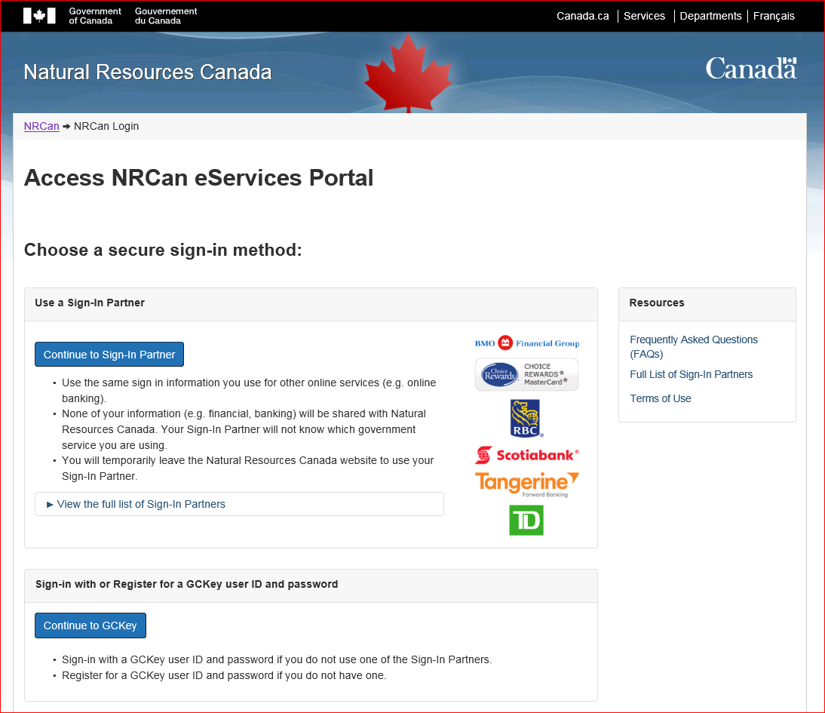
NRCan eServices Sign-In Page

Slide 17
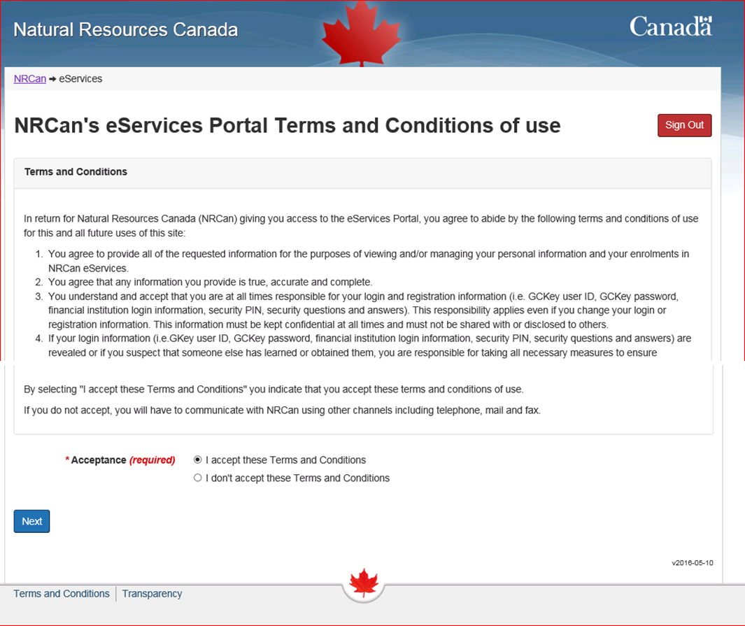
Initial eServices Sign-In Continued

Slide 18
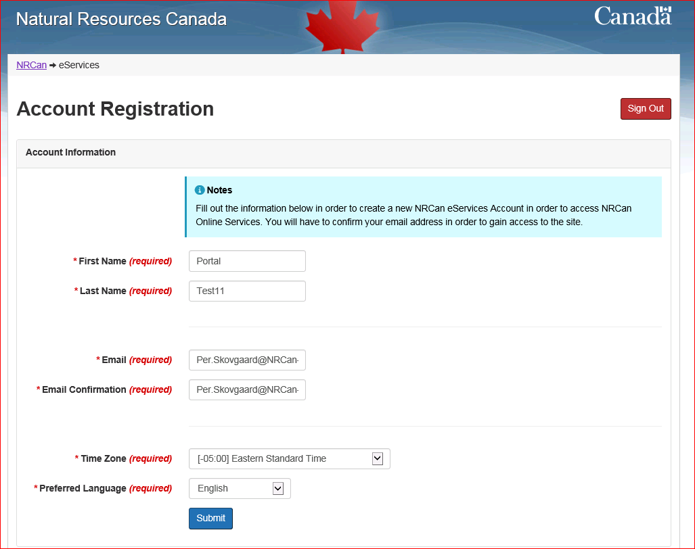
Initial eServices Sign-In Continued

Slide 19
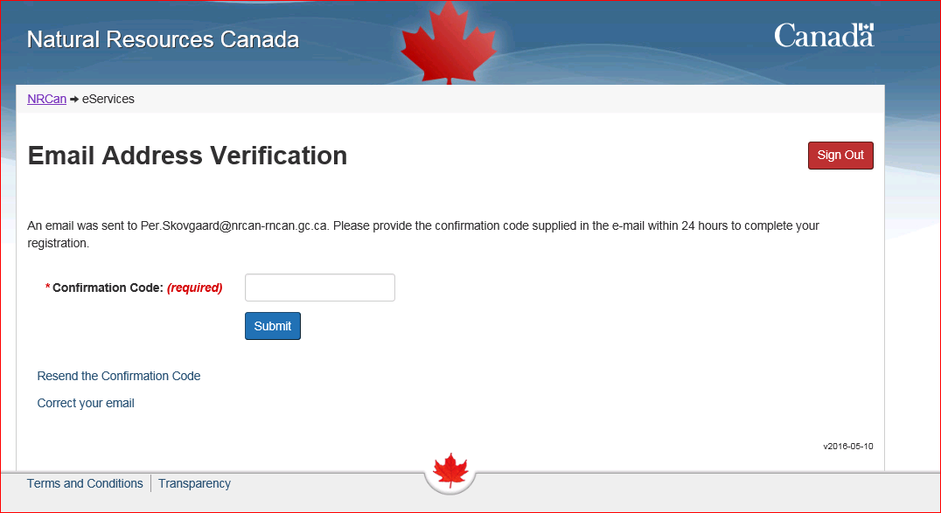
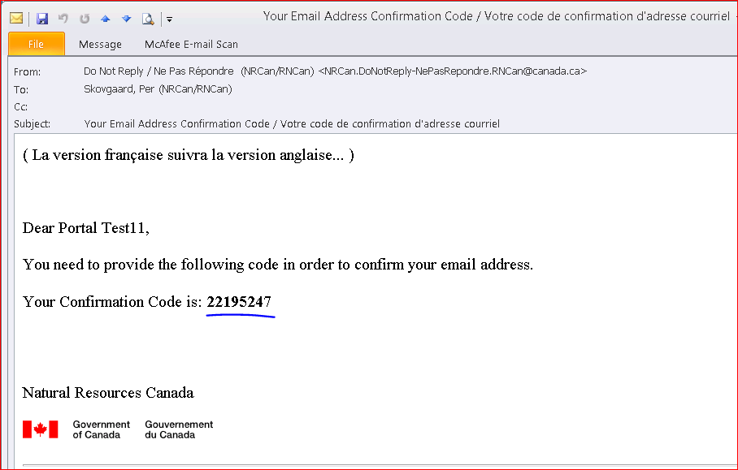
Initial eServices Sign-In Continued

Slide 20

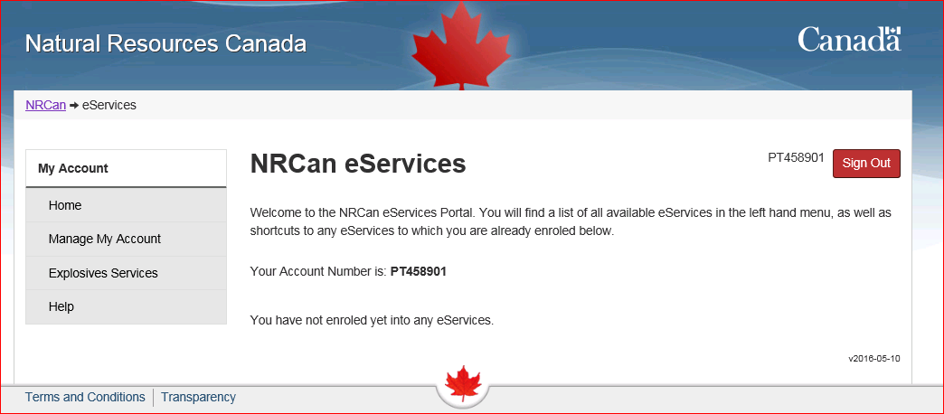
Initial eServices Sign-In Continued

Slide 21
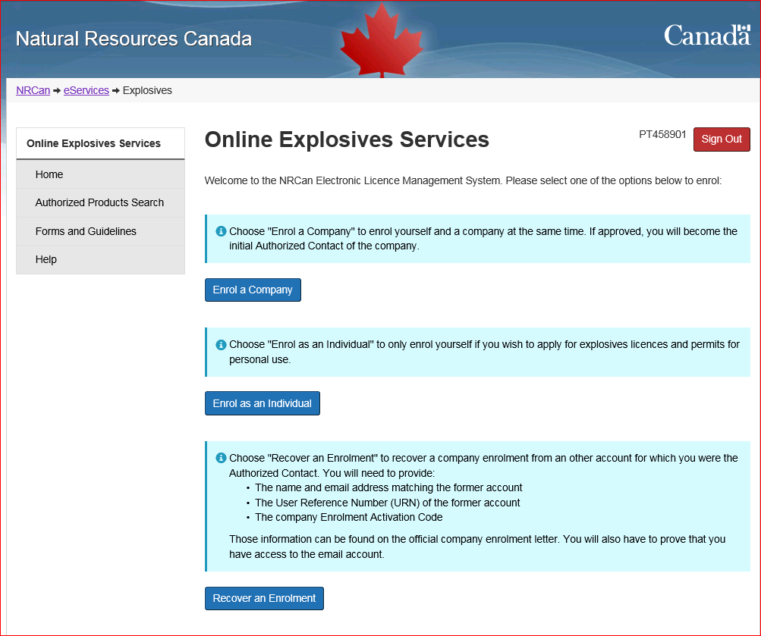
Explosives Services – Option Page

Slide 22
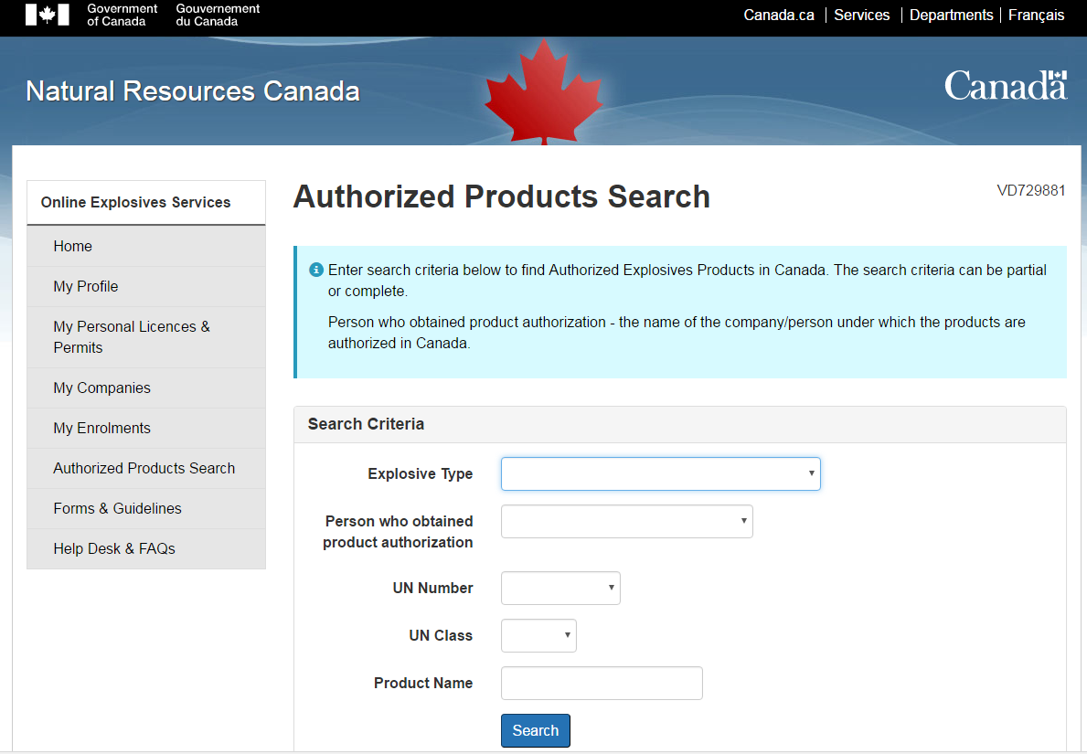
Authorized Products Search

Slide 23
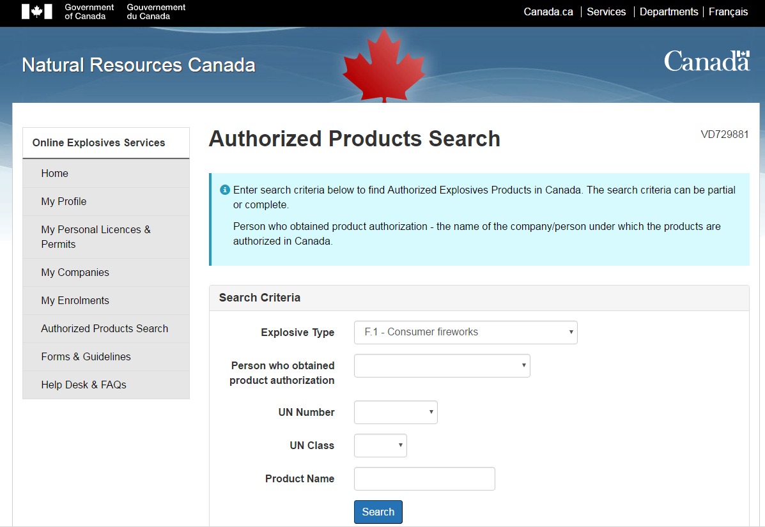
Authorized Products Search

Slide 24
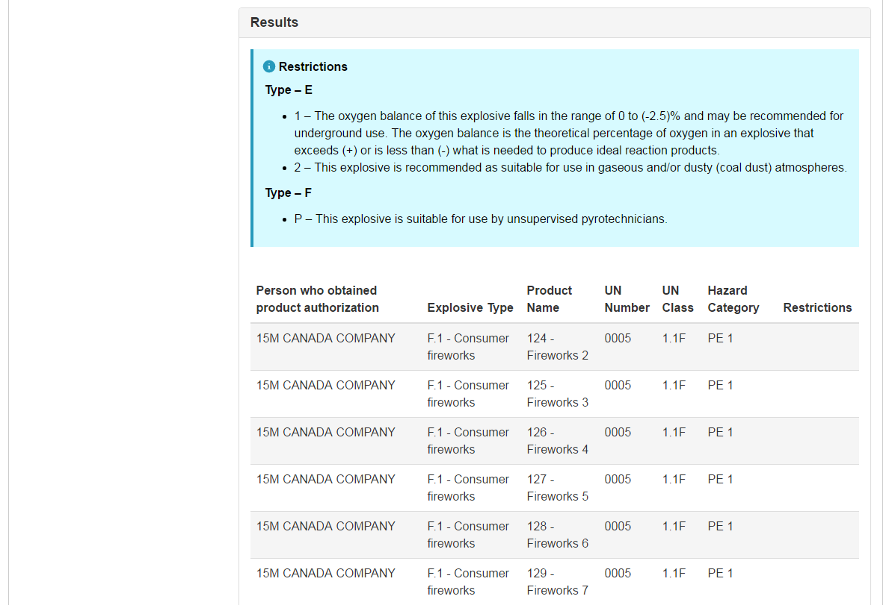
Authorized Products Search

Slide 25
Explosives Services – Option Page

Slide 26
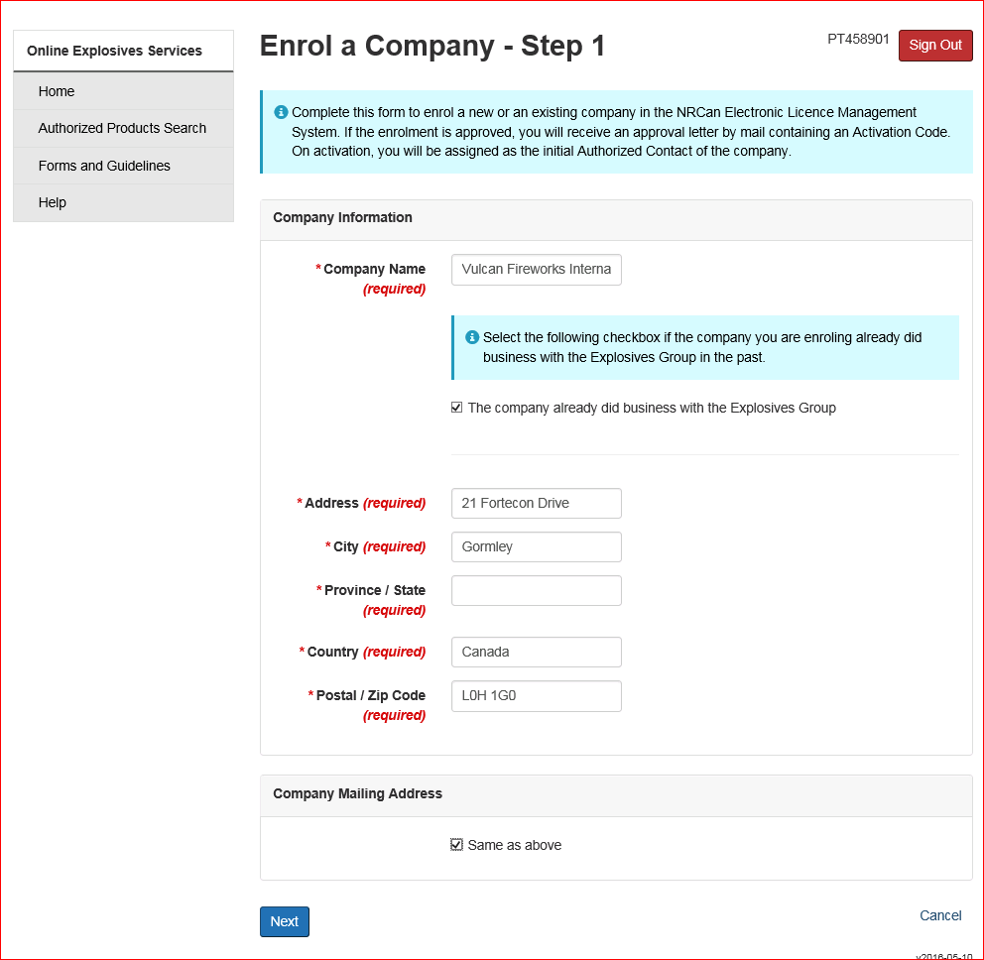
Enrol a Company

Slide 27
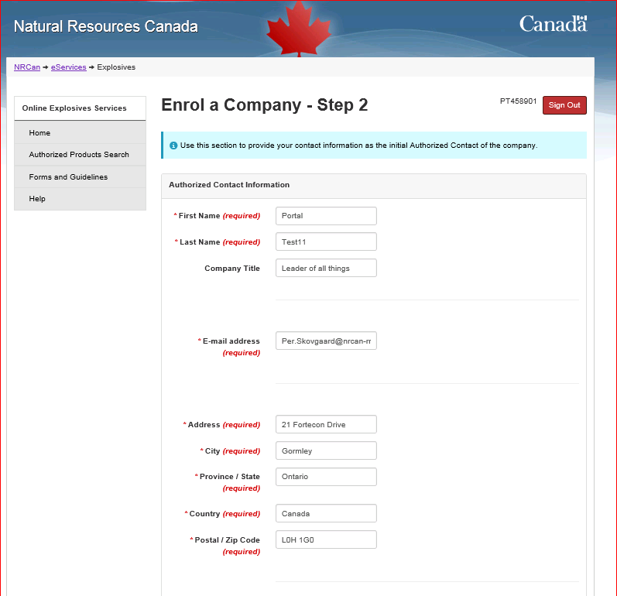
Enrol a Company

Slide 28
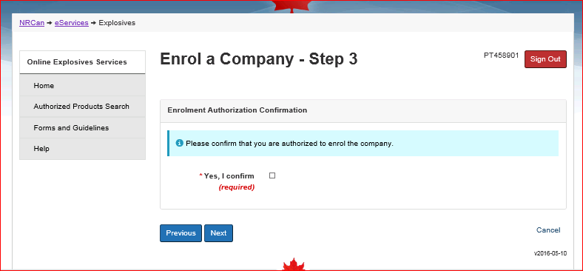
Enrol a Company

Slide 29
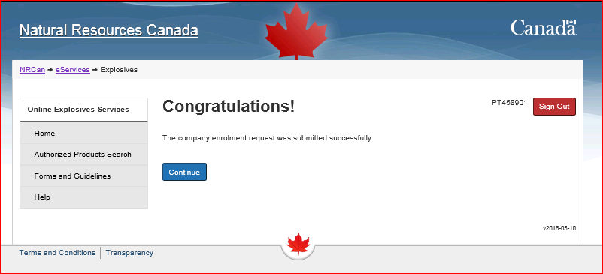
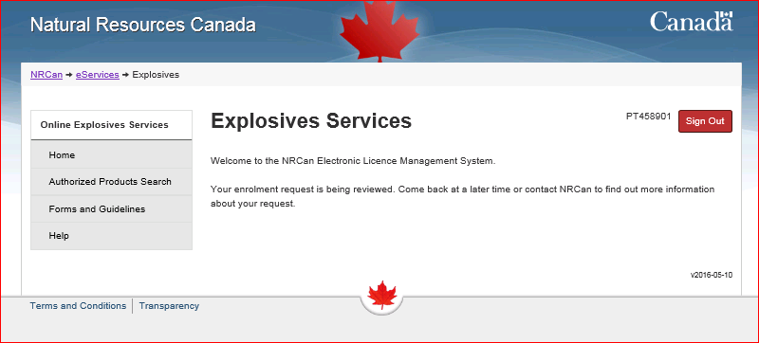
Enrol a Company

Slide 30
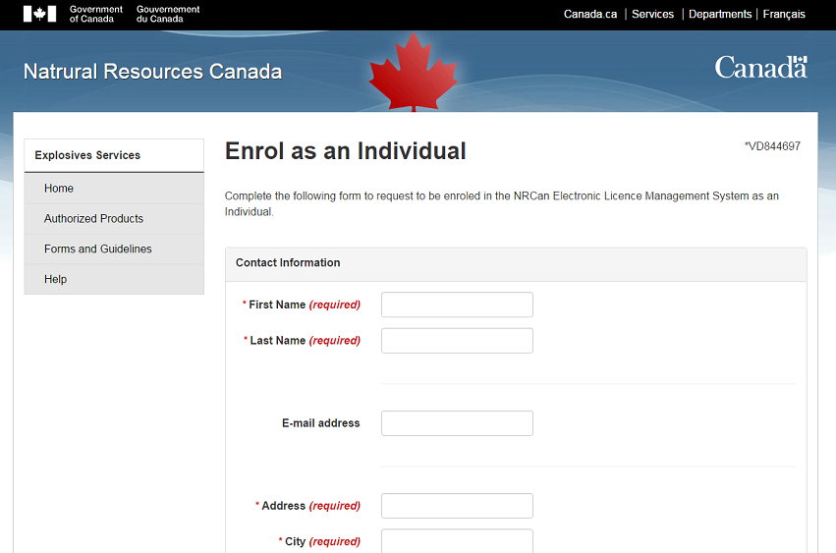
Enrol as an Individual

Slide 31
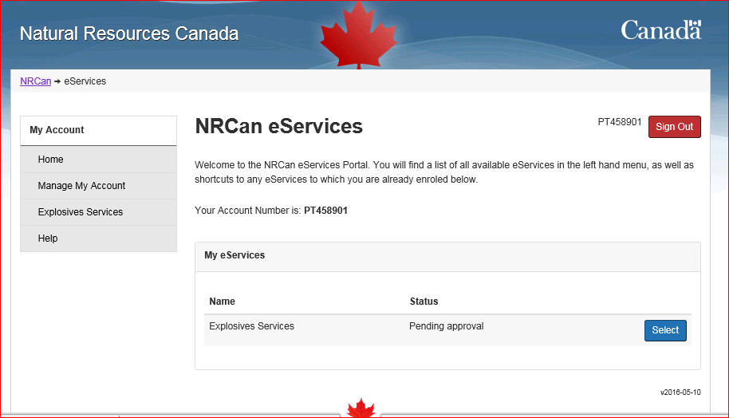
Enrolment Activation
Once Enrolment Letter Received
Sign into Explosives Services

Slide 32
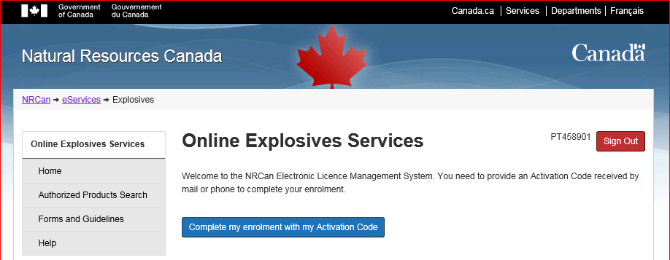
Enrolment Activation

Slide 33
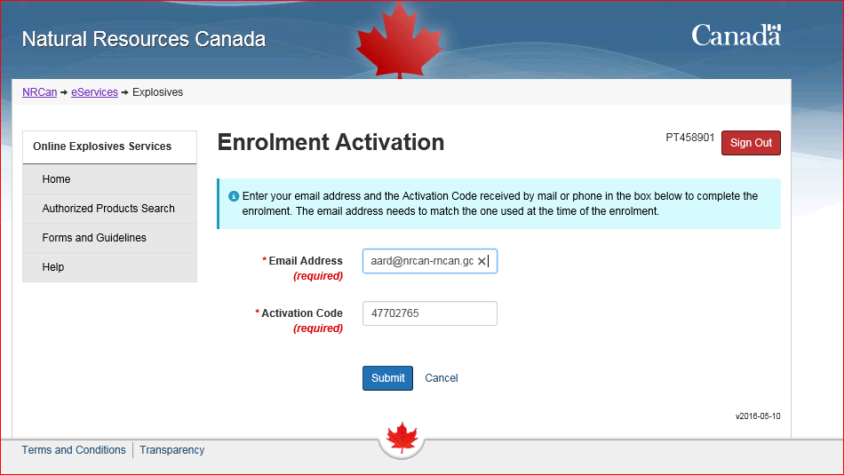
Enrolment Activation
Enter Email
Enter Activation Code

Slide 34
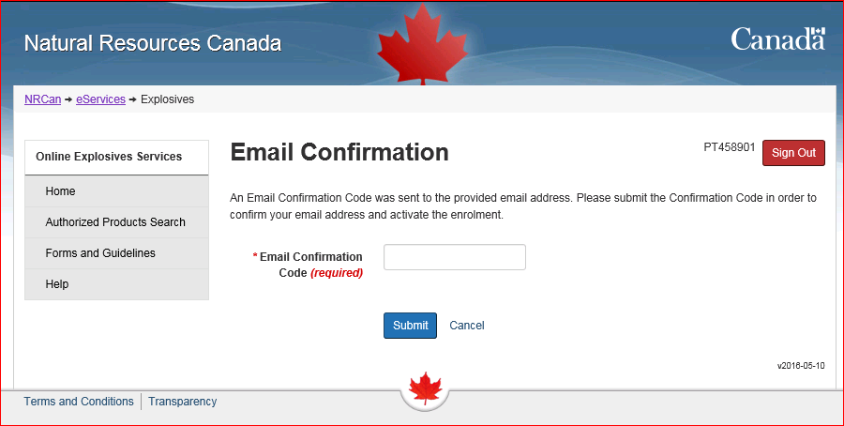
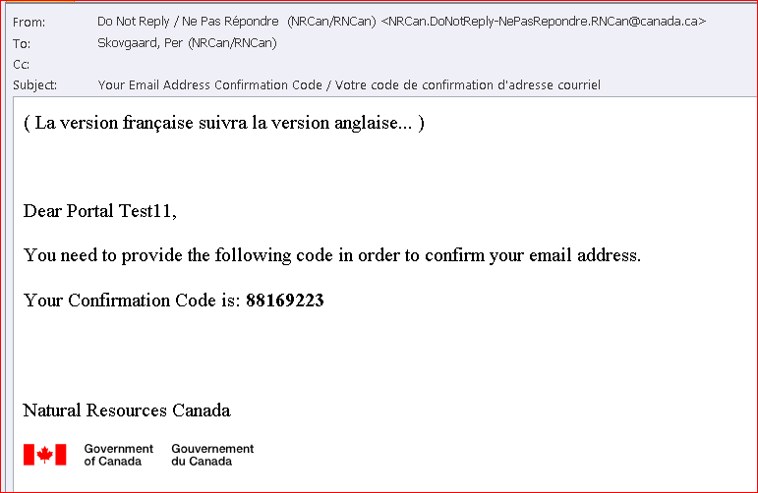
Enrolment Activation
Enter Email Confirmation

Slide 35
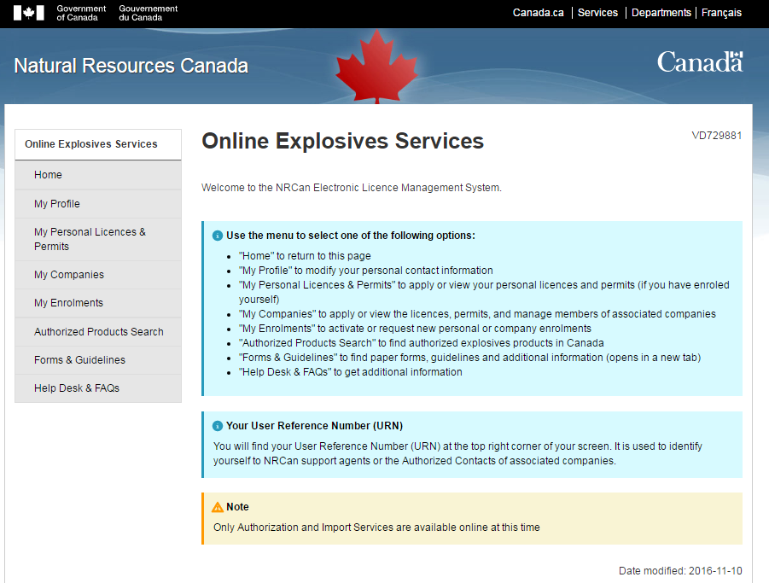
Explosives Services Home Page

Slide 36
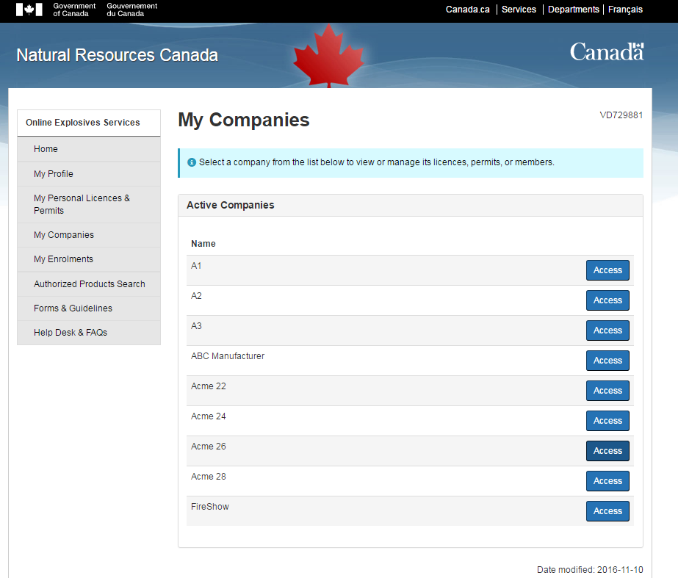
My Companies Page

Slide 37
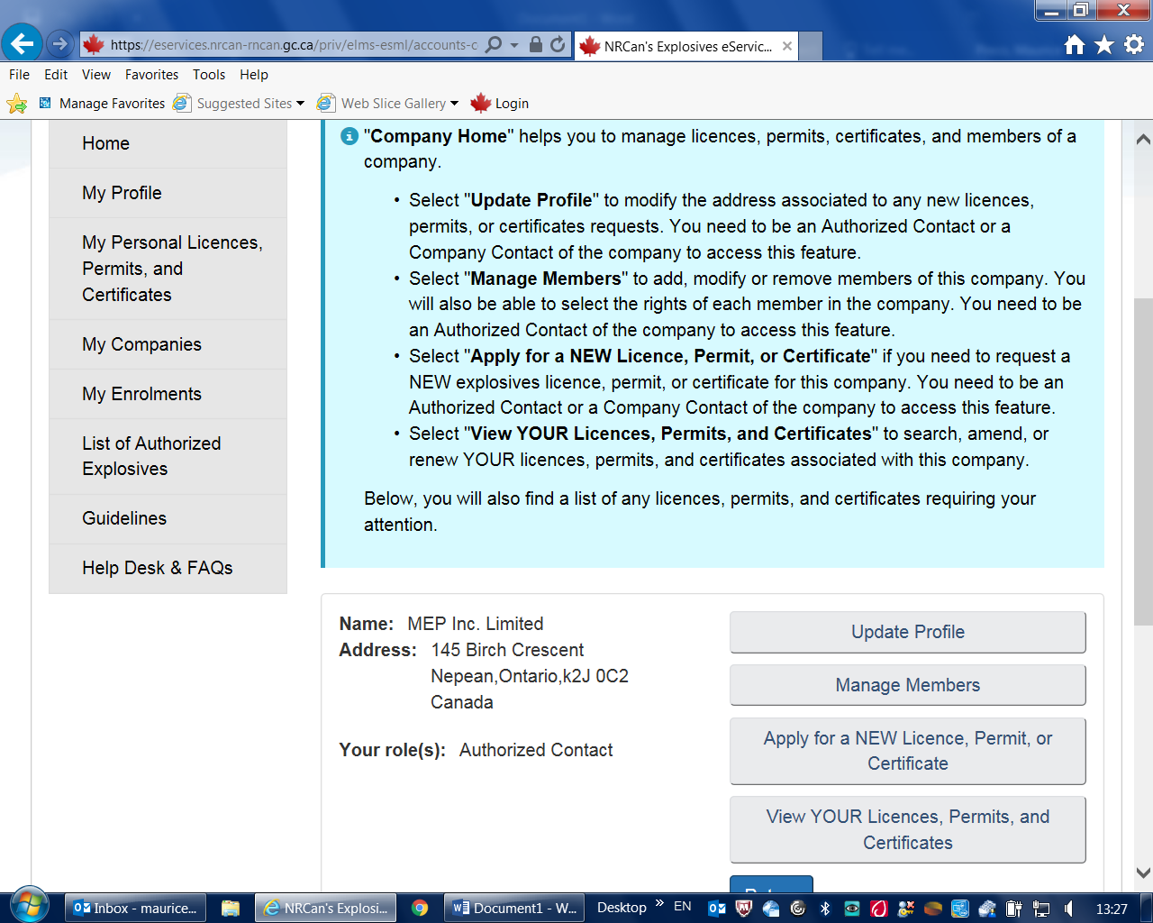
Home Page

Slide 38
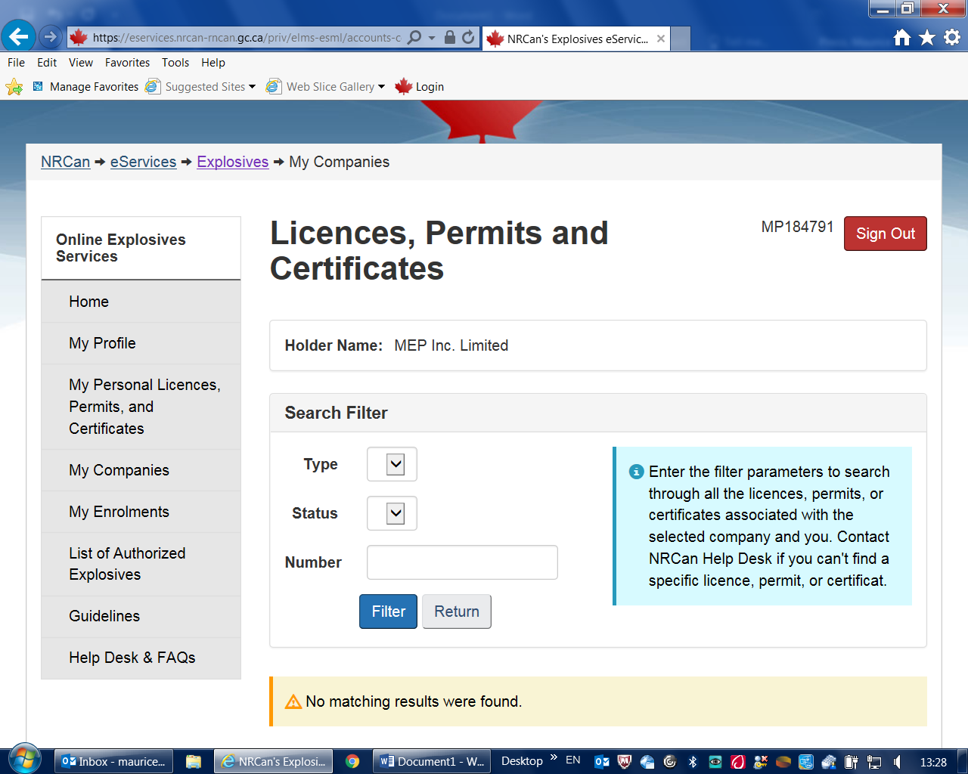
My Companies Licence, Permit or Certificate

Slide 39
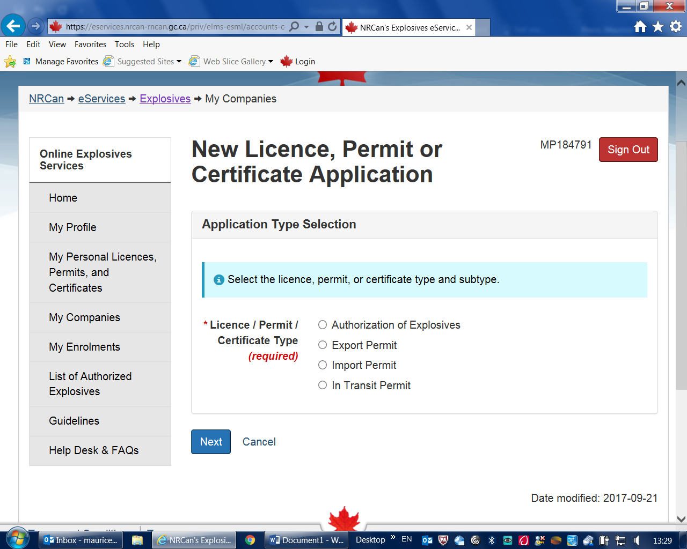
My Companies Licence, Permit or Certificate - Application

Slide 40
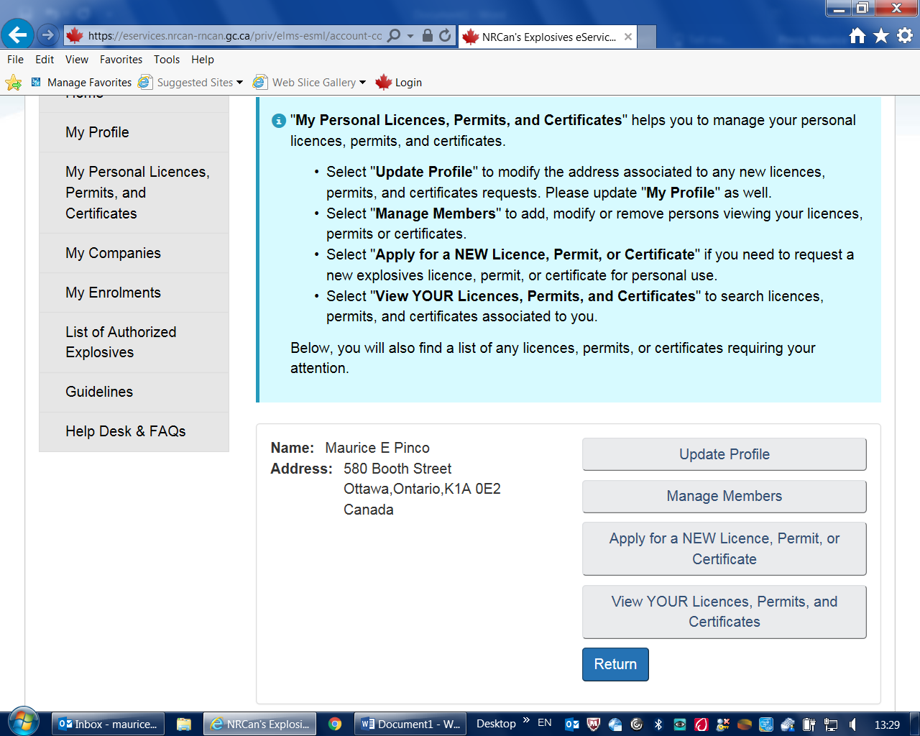
My Personal Licences, Permits and Certificates

Slide 41
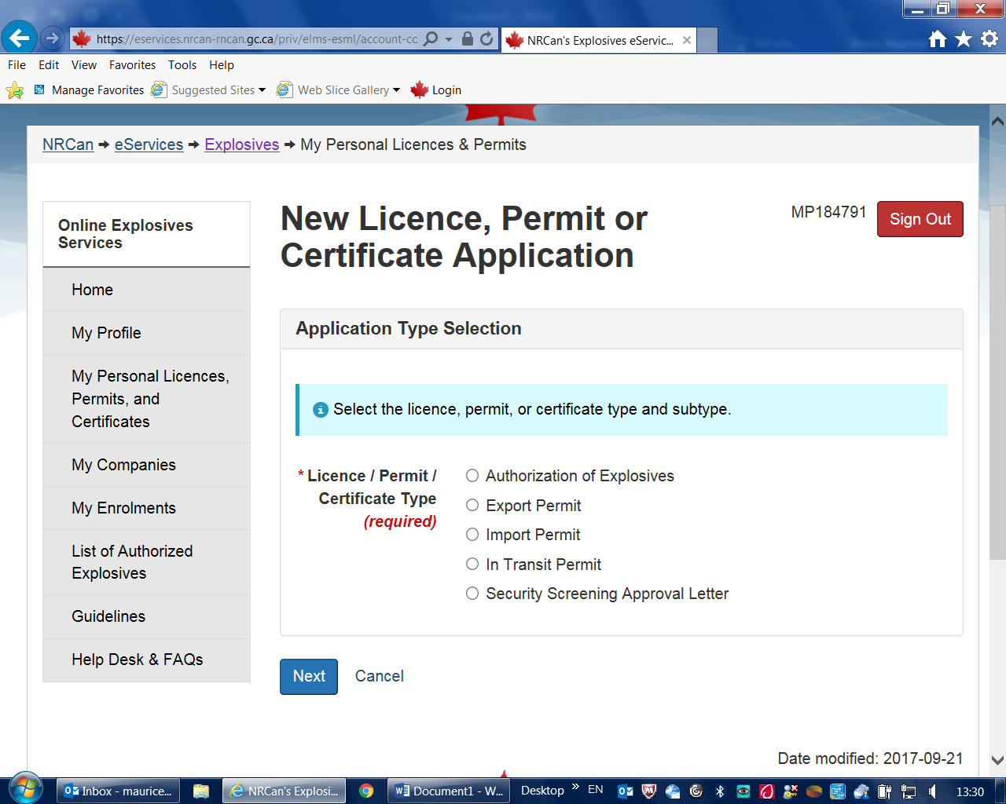
My Personal Licences, Permits and Certificates - Application

Slide 42
Screening
How do I apply for an Approval Letter?
To apply for an approval letter, you must first enrol as an individual. Once you have completed the enrollment, select "My Personal Licences, Permits and Certificates" from the left menu. Select "Apply for a NEW Licence, Permit or Certificate" and select "Security Screening Approval Letter".
How can I let my employer see my approval letter?
As part of the application process, you are asked if you wish to share your approval letter with your employer. There are two options, a copy can be mailed to your employer, or you can share it online with your employer. If you select to share your letter online with your employer, only the employer’s security officer will be permitted to view the letter. If the company has not been enrolled in the Electronic Licence Management System (eLMS) and assigned a security officer, your letter will not be available to your employer to view even if you selected this option.

Slide 43
Questions?

Slide 44
Explosives Regulations (ER) – Amendment 2
Amendment 1 in 2016
  Updates to the references
    Magazine Standards
    Quantity-Distance Principles
  Series of administrative amendments
Amendment 2
  Main objective is to amend Part 9 for Port Surveys
    Allowance for using Risk Assessment techniques
    CFTR will be amended in parallel
  Series of minor amendments being considered
    List of proposals made by CEAEC were reviewed
  Regulatory drafting was completed – Gazette process underway

Slide 45
Port Surveys
Current regulatory requirements
  S. 155 of Cargo, Fumigation and Tackle Regulations require:
    Inspection to be conducted by an Inspector of Explosives as per Q-D manual as if a licence is issued under the Explosives Act
    Issue: assessment of loading/unloading is done as if it were for fixed facilities
Case Study of Port of Halifax, with IMESAFR completed in October – using an hourly risk approach to better address short-duration activity
Regulatory initiative underway to amend ER, 2013 & CFTR – acceptance of risk based surveys

Slide 46
U.S. – Canada Regulatory Cooperation Council
Regulatory Partnership
Explosives Classification Initiative
  Workplan was updated (PHMSA / ESSB)
    http://www.nrcan.gc.ca/explosives/regulatory-partnership/17312
  Recent focus:
    Revision of Chapter 2.1 GHS / Explosives
    Revision of UN MTC; amendments for GHS needs

Slide 47
Budget 2017
Enhancing explosives safety (security) including stronger measures / restrictions on commercial explosives and precursor chemicals ($9M over 5 years)
Primary focus:
  Increase the number of inspections of sites enrolled
  Conduct more S&T work - specialists and scientists to monitor emerging threats, help support policies and provide assistance
  Develop policies, address regulatory initiatives and conduct outreach activities

Slide 48
Explosives Regulations (ER) – Amendment 3
Amendment 3
  Part 20 – Restricted Components
    Review of the list
    Review of regulatory requirements
  Miscellaneous amendments
    CEAEC input being sought
Future Amendments / Review
  Seeking views

Slide 49
Part 20 – List of Restricted Components
The following components are prescribed for the purpose of the definition restricted component in section 2 of the Explosives Act:
Ammonium nitrate in solid form at a concentration of at least 28% nitrogen
Hydrogen peroxide at a concentration of at least 30%
Nitromethane, UN 1261
Potassium chlorate, UN 1485
Potassium perchlorate, UN 1489
Sodium chlorate in solid form, UN 1495
Nitric acid at a concentration of at least 75%
Potassium nitrate, UN 1486
Potassium nitrate and sodium nitrate mixture, UN 1499
Sodium nitrate in solid form, UN 1498

Slide 50
Restricted Components List Review
Current list is based on a 1995 US study
Being reviewed based on current lists of Allies and organizations e.g.:
  World Customs Organization – Programme Global Shield
  European Union explosives precursors regulated list
  US CFATS
Review is also being done based on recent years incidents
Thresholds being reviewed
List of unregulated chemicals of concern being considered

Slide 51
Proposed List of Regulated Chemicals
Precursor Chemicals | Canada ER, 2013 | World Customs Organization Programme Global Shield | European Union Regulation No. 98/2013
Ammonium Nitrate | X | X | X
Acetic Anhydride |  | X
Acetone |  | X | X
Urea |  | X
Aluminium Powder & Flakes |  | X
Hydrogen Peroxide | X | X | X
Nitric Acid | X | X | X
Nitromethane | X | X | X
Potassium Chlorate | X | X | X
Potassium Nitrate | X | X | X
Potassium Perchlorate | X | X | X
Sodium Chlorate | X | X | X
Sodium Nitrate | X | X | X
Sodium Perchlorate |  |  | X
Calcium Ammonium Nitrate |  | X | X
Hexamine |  |  | X
Sulphuric Acid |  |  | X
Calcium Nitrate |  |  | X
Proposed Regulated Chemicals

Slide 52
Amendment 3
Process and Timeline
Consultations / Q4 2017
Drafting of regulatory amendments / Q1 2018
Approval process and pre-publication in Canada Gazette – Part I / Q2 2018
Publication in Canada Gazette – Part II / Q4 2018

Slide 53
RC - Future Initiatives
Ongoing reviews will be required to keep up with emerging threats
  List of components
  Regulatory requirements
  Non-regulatory measures/initiatives
Outreach activities with stakeholders on requirements and best practices for secure commerce

Slide 54
General Update

Slide 55
ERD Statistics Activity / Licences
Activity |  | FY 16-17 | FY 17-18 Q1
Authorization | Applications received [indefinite period] | 232 | 51
 | Products tested | 73 | 13
 | Products approved | 5237 | 2301
Import Permits | Annual | 304 | 309
 | Single Use | 59 | 96
Restricted Components | Sites | 2085 | 2180
 | Sellers | 1591 | 1686
Mobile Process Units | Active and in operation | 234 | 230
Licences | F&S - Factory & Satellite, Bulk | 160 | 156
 | F&C - Factory & Certificate, Other | 75 | 93
 | F/PE - Factory, Perforators | 60 | 64
 | V - Magazine, Vendor | 101 | 103
 | U - Magazine, User | 765 | 766
 | U/Z - Magazine, User – Zone | 283 | 316
 | P - Magazine, Propellant | 277 | 269
 | X - Magazine, Fireworks | 117 | 120
 | TOTAL | 1838 | 1887

Slide 56
ERD Statistics Inspections
Inspections |  | FY 16-17 | FY 17-18 Q1
Inspections by activity | F&S - Factory & Satellite, Bulk | 68 | 18
 | F&C - Factory & Certificate, Other | 19 | 15
 | F/PE - Factory, Perforators | 44 | 8
 | V - Magazine, Vendor | 47 | 18
 | U - Magazine, User | 234 | 64
 | U/Z - Magazine, User – Zone | 52 | 21
 | P - Magazine, Propellant | 134 | 39
 | X - Magazine, Fireworks | 48 | 11
 | Restricted Component sites | 38 | 11
 | Mobile Process Units (MPU) | 47 | 27
 | Unlicensed [provincial magazines, trucks, fireworks events, port surveys, technical inspections, importation or expired licences] | 24 | 6
 | TOTAL | 755 | 238

Slide 57
ERD Statistics Inspection Ratings
Activity |  | FY 16-17 | FY 17-18 Q1
Average Inspection Rating | F&S - Factory & Satellite, Bulk | 2.0 | 1.8
 | F&C - Factory & Certificate, Other | 2.6 | 2.4
 | F/PE - Factory, Perforators | 2.5 | 2.9
 | V - Magazine, Vendor | 2.5 | 3.5
 | U - Magazine, User | 3.1 | 3.3
 | U/Z - Magazine, User – Zone | 2.4 | 2.8
 | P - Magazine, Propellant | 2.9 | 3.4
 | X - Magazine, Fireworks | 3.2 | 3.6

Slide 58
Inspection Deficiencies
    Operations / Housekeeping:
    Presence of tetra-ammine copper nitrate
    Combustible material in vicinity of explosives / AN hopper
    Mixed storage of contaminated / non-contaminated equipment parts
    Electrical components, non-conforming (non-CEMA 4X, electrical box weatherproof seals)
    Pumps, requiring maintenance (seals)
    Containment dyke, requiring maintenance/repair
    Door, requiring panic hardware
    Support Plans / Administration:
    Plans not up to date / not available at site (fire safety, site security, emergency response)
    Procedures not up to date (maintenance, operating)
    Fire extinguisher monthly checks not conducted/recorded (much better!)

Slide 59
ERD Statistics Accident and Incidents
Activity |  | FY 16-17 | FY 17-18 Q1
Accidents / Incidents | Manufacture | 22 | 4
 | Transport | 27 | 9
 | Thefts / Break and Entry | 14 | 1
 | Fireworks | 12 | 3
 | Restricted Components | 3 | 1

Slide 60
Reported Accidents / Incidents
Manufacture (Bulk)
    Inadvertent initiation during manufacturing [ procedural / equipment failure ]
Transport
    Road accidents [ collision ]
    Breakdowns [ mechanical / electrical ]
Mischief / Criminal Intent
  Possible diversion attempt
  High-hazard explosives (Type S.2) used for criminal purposes [ AB ]

Slide 61
Standards and Guidelines

Slide 62
Bulk Guidelines Update
Current status
  Bulk Guidelines (2014) were reviewed by CEAEC’s Regulatory Committee
  Based on CEAEC’s Regulatory Committee proposals, a draft revision was completed by ERD, for a further review by CEAEC
  Key changes and clarifications are as presented

Slide 63
Bulk Guidelines Update
Changes / clarifications
  Distances between sites are being reviewed
    Between factory and satellite sites
    Between satellite and client sites
  Reloading of MPUs is to be done at satellite or factory sites
  Administrative
    References to standards (BNQ, CGSB) were updated
    Duplicate Information available otherwise (e.g. MPU and QD principles requirements) is being removed
    Amendments to reflect new eLMS implementation are being made (e.g. location list of MPUs)
  AN storage at satellite sites
    Maximum of 100,000 kg being proposed, rather than a maximum number of silos
  Insulation in buildings
    Group F, Division 1, mechanical protection required on walls and ceiling

Slide 64
Bulk Guidelines Update
Changes / clarifications
  Multi-wall tanks requirements
    Heating may be required (Section 4.5.3)
  Locking requirements at secure, access controlled mine sites reduced
    Bulk ANE
    AN Storage
  Flammable liquids storage
    CSA-Approved storage cabinet
    Cabinet installed and maintained based on manufacturer requirements
  References to 25 kg bags of AN removed from 4.9.4
  Augers
    Requirements of spacing for augers was clarified

Slide 65
Compatibility Guidelines
Current status
  The document is based on Types of explosives (ER, 2013)
  Compatibility tables for each Type of explosive versus others
  Concepts from ER 2013, old QD Manual, and TDG requirements are integrated
What is ahead?
  Consultation with stakeholders in January

Slide 66
CEAEC - List of Items

Slide 67
CAN/BNQ Quantity Distance Std
Item 4 - Please provide an update as to the request for the revision of Table C.3 of the CAN/BNQ 2910-510/2015 to a donor NEQ up to 300,000 kg?
  Table C.3 applies where there is explosives stored at a site with Bulk AN
    If the distances are not respected between explosives and AN 50% by mass is included for QD purposes.
  Where a quantity of explosives exceeds those shown in Table C.3 contact ERD for guidance.
  ERD will apply d=0.0007*NEQ or a scaled factor of ~2.3 in such cases.
  Expanding the upper limits of the table will be looked at in the next revision of the BNQ/CAN Standard.

Slide 68
CAN/BNQ Quantity Distance Std
Item 9 - Annex G of the Q/D standard details barricades and dividing wall requirements for PES. Section G.2.4 speaks to the minimum separation distance from the centre of the explosives stack to the foot of the earth barricade. The accepted separation distance has been 2.4m regardless of the NEQ. Can ERD provide input as to when the r_{e} = 0.5NEQ^{1/3} formula applies.
    Answer…

Slide 69
Responses to CEAEC Questions
Item 9 - answer
  The equation r_{c} = 0.5NEQ^{1/3} (r_{c} is the crater radius) is always used when determining the separation distance for barricades from an explosives stack or building, for any storage of PE1
    Minimum 2.4 m separation between the stack/building and the foot of the barricade
    The crater radius is measured from the centre of the building/stack
  The crater radius is used in the following way:
    The crater radius cannot undermine more than 1/3 of the earth barricade thickness
    Example: 8000 kg of explosives, 4 m x 4 m building, and a 3 m thick barricade.
      r_{c} = 0.5 x (8000)^{(1/3)} = 10 m.
      Since only 1/3 of the barricade can be undermined (1/3)*3 = 1 m of barricade thickness can be undermined
      Distance from the centre of the building to the edge of the building is 2 m.
      The crater radius extends past the building by 8 m
      The foot of the barricade can be no closer than 8-1 = 7 m from the building, or 9 m from the centre of the building.

Slide 70
CAN/BNQ Quantity Distance Std
Item 10 - Please detail the required D-2 and D-4 barricading requirements, (magazine to magazine / magazine to process).
  Barricade types
  2 degree rule
  Barricade materials, (earth, lego blocks, sand filled FIBC etc)
Answer…

Slide 71
Responses to CEAEC Questions
Item 10 - answer
  All references are to the BNQ QD standard
    Barricade types are explored in G.2 and G.3
    2 degree rule is explained in G.2.2
    Barricade materials are explored in G.2 and G.3
  Note: Barricades are used to stop high-velocity, low-trajectory fragments
  For a pair of sites that can be both a PES and ES (e.g. process building and magazine) as long as one of the sites has an effective barricade, then barricaded distances can apply.
  Effective barricades (as described in G.2 of the BNQ QD Standard):
    Are sited according to the separation distance required (See Question 9)
    Meet the 2° rule
    Are constructed from suitable material
      Materials include: Earth, brick, unreinforced concrete, reinforced concrete and steel
    Meet mandatory sizes (width, length and height)

Slide 72
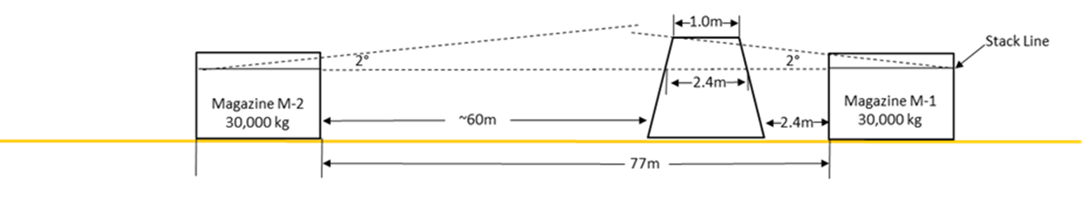
Responses to CEAEC Questions
Item 10 continued…
Each QD evaluation is based on the QD Standard requirements
  Does the following scenario meet QD? No.
  M1→M2 For a magazine smaller than approximately 24 m wide, this scenario does not meet D-2 requirements since the barricade siting does not meet the required separation distance (see question 9)
  M2→M1 Does not meet D-2 requirements since the barricade does not meet the 2° rule
  Neither of these magazines are considered to have an effective barricade

Slide 73
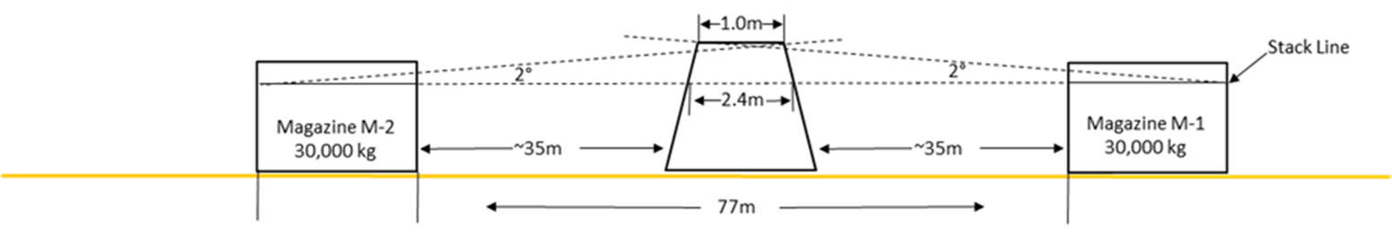
Responses to CEAEC Questions
Item 10 continued…
Each QD evaluation is based on the QD Standard requirements
  Does the following scenario meet QD? Yes.
  M1→M2 and M2→M1 Both scenarios meet D-2 requirements since the barricades are sited according to the required barricade separation distance, and the 2° rule is met
    However, only one magazine must be sited with an effective barricade to use D-2.
  Both M1 and M2 can be sited at D-2 distances, which is 75 m for 30,000 kg.
    This scenario meets QD

Slide 74
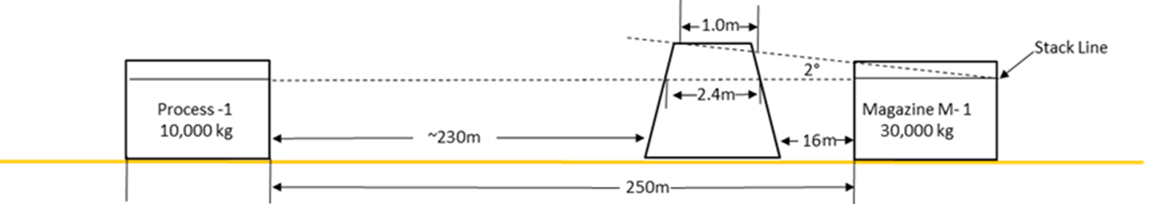
Responses to CEAEC Questions
Item 10 continued…
Each QD evaluation is based on the QD Standard requirements
  Does the following scenario meet QD? Yes.
  M1→P1 The magazine (M1) has an effective barricade, so D-4 distances can be applied.
    For 30,000 kg, D-4 is 250 m so QD is met

Slide 75
CAN/BNQ Magazine Std
Item 8 - The below question was first raised at the spring meeting.
The former 2001 magazine standard contained a table for the calculation of magazine capacities, essentially 1,000 kg for every 1.2m2 / 1,000 detonators per standard 25 kg case. The CAN/BNQ 2910-500/2015 standard is silence on storage capacities, other than ventilation / air exchange for larger magazines.
Can ERD issue a new guidance table that details the allowed capacity and the required free space for product storage within magazines for the various types of explosives?
A Guideline can be issued to reproduce the Table from the former Standard, for information purposes only.
  ------------------------------------------------------

Slide 76
Part 5 – Manufacturing Licences
Item 3 – Site Licencing;
a) Can ERD implement a process that will acknowledge license holders communications, such as license renewals, amendments, AiP to confirm receipt? In addition to the above, can this acknowledgement include the respective inspector assignment? Understandably the eLMS may change this process.
b) The current system for site license communication for larger companies is to receive the signed hard copies from ERD via mail and then scan / email copies to the respective site. Will the new eLMS provide a similar means of communication?
    eLMS is being implemented in 2018 and will address this.

Slide 77
Part 5 – Manufacturing Licences
Item 12 – Is a division 1 factory site to have a fire safety plan as referenced on section 145 (4) or is fire safety expected to be included in the site ERP as per section 60 (8) (b) (iv)?
    A fire safety plan is expected to be included in the site Emergency Response Plan as per section 60.

Slide 78
Part 5 – Manufacturing Licences
Item 7 – The magazine surveillance program, (Directive Letter 61 / Directive 5) has been in-force ~January 2009. Can ERD please detail the benefits of the surveillance program, such as number of thefts that were prevented, caught in the incipient stages or lead to arrest?
    Background information (next slide - from Spring meeting):
    May 2001; new doors for Type 4 / gradual implementation
    2008: Types 6 & 10 being restricted / new surveillance program
    Based on reported incidents for break-in, statistics are as follows:
    2001-2005; 49 reported events / 34 successful
    2006-2016; 33 reported events / 17 successful

Slide 79
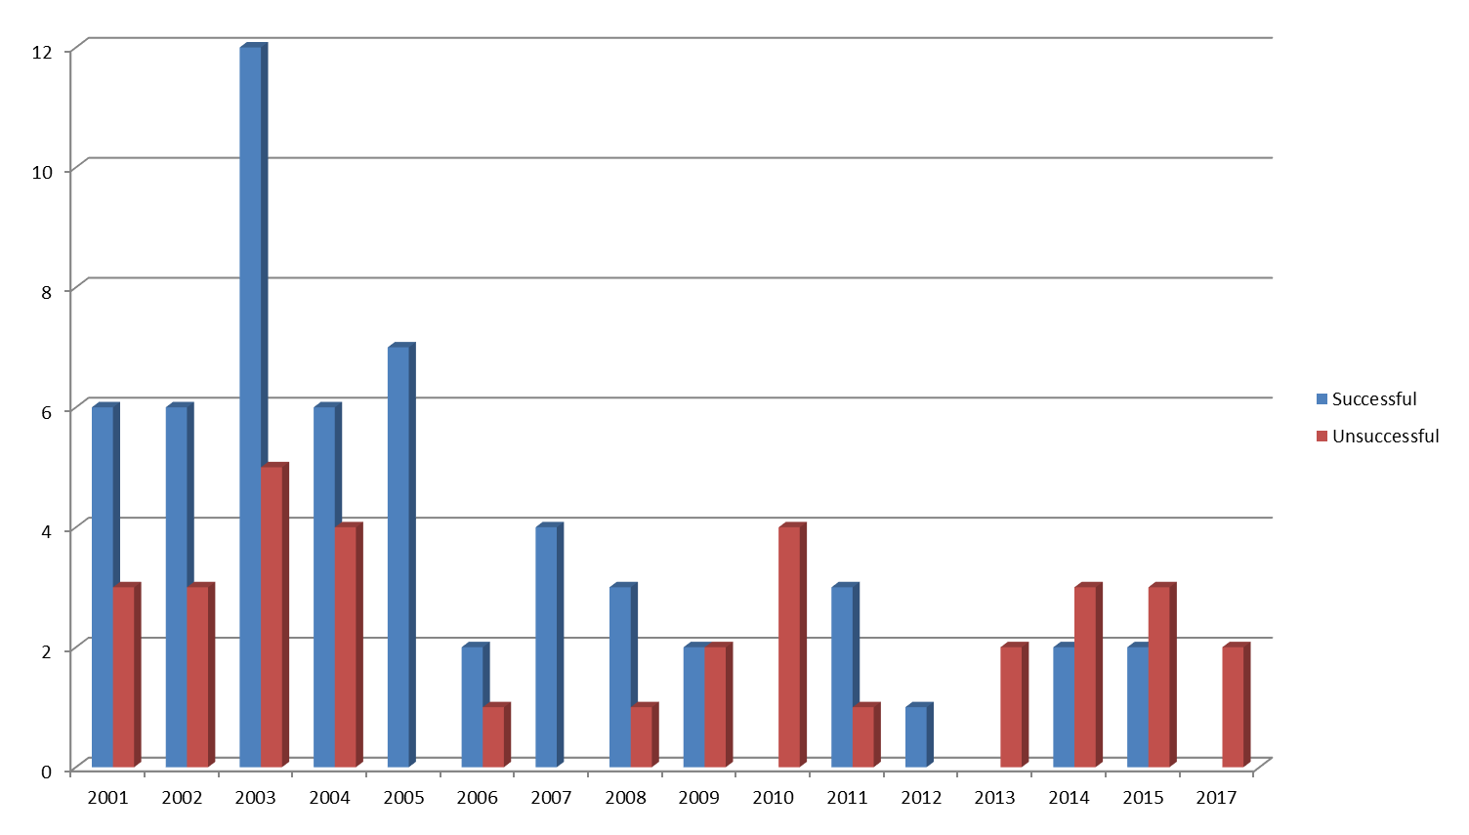
…Part 5
2001 |  | Introduction of the new Industrial Magazine Standard
2008 |  | DL 58 - Stop use of Type 6 Magazines
2008 |  | DL 61 - Introduction of Magazine Surveillance Program for Industrial Explosives
2014 |  | Introduction of new Explosive Regulations, 2013

Slide 80
Part 6 – Magazine Licences
Item 5 – The below question was first raised at the spring meeting. Note that this regulation does reflect current safe work practices, please provide an update as to the steps for revision, specific to commercial explosives.
Part 6, section 150(4), states that only “one case” may be open at any time within a magazine. It is common practice that cases containing detonators are sorted/consolidated into one case within a magazine. The practice of having only “one” package open is not practical or safe as it leads to detonators being placed on a table/ground prior to closing and opening the second case.
  What is the logic behind “one case” only regulation?
To ensure a greater level of safety, we advocate that the regulation be revised to “two cases”
Only storage is permitted in a magazine; the opening of a single package is to allow the taking of a sample. We could consider amendments to the Regulations specific to detonators, but would need safety conditions.

Slide 81
Part 6 – Magazine Licences
Item 14 – The ER-2013 has removed the 8m clearance rule of combustibles around magazines, why?
    This requirement was not in the previous Regulations. It is not a requirement, but a good safety practice as highlighted in the previous Magazine Standard.
    The following provision is in ER, 2013:
    S. 151 (1) – Precautions must be taken that minimize the likelihood of fire in or near a magazine.

Slide 82
Part 9 – Transport
Item 13 – The CEAEC understanding is that risk assessment will be added to the ER-2013, part 9 for explosives handling at ports. Can ERD please speak to the following;
  What risk assessment tools will be accepted?
  Who will be allowed to submit the risk assessments for review, ports / explosives manufacturers / third party contractors?
  Who will assess the risk assessments and to what criteria?
  Will the currently allowed ro-ro activities remain in place?
For allowing its acceptance, a risk assessment tool must take into consideration: type and quantity of explosives, details of structures, distance, type of activities, etc. For example, IMESAFR was used for a Case Study for HPA.
Any competent person can conduct the study, however its outcomes are to be reviewed by an inspector for its acceptance, against globally recognized acceptance criteria; a Guideline document will be issued.
Ro-ro activities remain in place

Slide 83
Part 11 – Industrial Explosives
Item 2 – Site Inspections;
  ERD inspections at user / vendor sites result in the immediate issuance of report, (F06-08). Why is a written inspection report not submitted to the license holder at the completion of a division 1 factory site inspection?
  User/Vendor site inspections are done based on a checklist, and are amenable to immediate responses.
  Factory licences, especially Div. 1 Factories, are more complex, and in many cases, inspections require thought and interpretation before final observations are reported.
  Nevertheless, any important or critical observations are made to the licence holder before the inspector’s departure.

Slide 84
Part 11 – Industrial Explosives
Item 2 – Site Inspections;
  The required “written” action response date from the license holder varies from inspector to inspector. Understandably some actions such as safety related issues are to be addressed immediately, however, is there an ERD protocol as to the expected response times for a license holder?
    There is no formal response time set out in the regulations. The response will be driven by the number and complexity of items. Setting a response time policy will be explored to ensure consistency.

Slide 85
Part 11 – Industrial Explosives
Item 2 – Site Inspections;
  ERD has spoken of the rating system that is applied to site inspections, critical / non-critical. Can ERD provide further information as to the rating criteria and the specifics of the rating system?
    Internal Guideline 05-03 provides guidance to inspectorate on how to score and rate inspections to ensure consistency.
    Scores range from 0 (worst) to 5 (best), based on the number of Minor, Major, and Critical corrective actions.
    The guideline provides examples of what constitutes the different levels of deficiencies.

Slide 86
Rating/Scoring Criteria
Rating | Number of Deficiencies
0 1 2 3 4 5 | 2 or more Critical 1 Critical and/or 3 or more Majors 1 or 2 Majors 6 or more minors Up to 5 minors Fully satisfactory

Slide 87
Part 19 – User Fees
Item 1 – Part 19 of the ER-2013 details the fees associated with product authorization, license permits and certificates. Section 11 of part 19 specifies the cost for user licenses, $140.00 / magazine and a minimum cost of $280.00.
a) when there is a shared U licence within multiple magazines, (>2) is the shared licence holder invoiced $140.00 for each magazine, above the $280.00 minimum ?
A User Fee is for a licence. Even if magazines can be shared, a licence cannot be shared. The User Fee is applicable to all magazines.

Slide 88
Contamination
Item 15 – The Canadian National Fireworks Association has identified an issue with contamination in compositions coming from China that are used in the manufacture of fireworks. Is ERD aware of other contamination issues, for example, compositions being used in the manufacture of other explosives materials such as propellants?
    ERD has reported at regular intervals authorization issues with fireworks articles being imported, including inaccurate technical declarations for compositions.

Slide 89
Explosives Safety and Security Branch (ESSB)
Explosives Regulatory Division (ERD)
Questions?
Headquarters (Ottawa)
Authorization - Import - Export - In-transit
(613) 948-5200
ERDmms@NRCan.gc.ca
Pacific Region (Vancouver)
British Columbia / Yukon
Magazine Licences - Inspections
(604) 666-0366
ERDpacific@NRCan.gc.ca
Western Region (Calgary)
Alberta / Saskatchewan / Northwest Territories
GLF & Magazine Licences - Inspections
(403) 292-4766
ERDwestern@NRCan.gc.ca
Central Region (Ottawa)
Ontario / Manitoba
Factory & Magazine Licences - Inspections
(613) 948-5187
ERDcentral@NRCan.gc.ca
Eastern Region (Varennes)
Quebec / Nunavut / Atlantic Provinces
Magazine Licences - Inspections
(450) 652-0703
ERDeastern@NRCan.gc.ca

