Slide 1
Explosives Safety & Security Branch (ESSB)
ERD Update
Meeting with CEAEC
Vancouver – April 2018
Jean-Luc Arpin Director, CIE
Serge Dionne Manager, Specialists

Slide 2
Agenda
  ERD Personnel / On-going initiatives J-L Arpin
  Organization Charts / Personnel
  New Licence Management System (LMS) – Current Status
  Explosives Regulations, 2013 / Amendment 2
  Explosives Regulations, 2013 / Amendment 3
  General Update (Licensing & Inspections) J-L Arpin
  Activity Statistics / Licences Breakdown
  Accidents / Incidents
  Standards and Guidelines S. Dionne
  Bulk Guidelines
  Compatibility Guidelines
Regulatory Reminders & CEAEC List of items (4)

Slide 3
ERD Personnel
Organization Charts /
On-going Initiatives

Slide 4

ESSB Organizational Chart
Explosives Safety Security Branch
(ESSB)
Explosives Regulatory Division
(ERD)
Canadian Explosives Research Lab
(CERL)
Program Policy and Administration Division
(PPAD)

Slide 5

ERD Organizational Chart
Director / CIE
Restricted Components
Explosives Specialists
Licensing
&
Inspections
Pacific Region
British Columbia /
Yukon
Western Region
Alberta / Saskatchewan / Northwest Territories
Headquarters
Ontario /
Manitoba
Eastern Region
Quebec / Nunavut / Atlantic Provinces
Operational Policies
- Authorization / Import / Export / In-transit
Storage / QD
Standards / Guidelines
Transport
Fireworks Program
Security Screening

Slide 6
ERD Personnel
Director/CIE – Jean- Luc Arpin
National Manager, Licensing & Inspections Daniel Hilliker | Specialists Manager Serge Dionne
Pacific Region Manager – Rod Boulay Inspector – David Murdoch Assistant – Kelp Watson Western Region Manager – David Mohn Inspectors – Rebecca Holmberg Assistant – Wanda King HQ Region Sr. Inspector – Isabelle Gagné Inspectors – Greg Choryhanna Mike Farbod Charles Montpetit Eastern Region Inspectors – Jacques Beaupré Jean-Francois Viger | Security Maurice Pinco Fireworks Rachel Robbins Authorization, Import/Export Mark Wilansky MPU, QD, QRA Sebastian Towler Magazines Michael Lafleur
 | Restricted Components Manager Marie Vachon
 | RC Specialist Meagan Martin Inspector (Fredericton, NB) Greg Buchanan Inspector (Varennes, QC) Louis-Philippe Massicotte Inspector (Hamilton, ON) Carlo Tesone Inspector (Regina, SK) Kala Muthuswamy Inspector (Calgary, AB) Grayson Owen
 | Projects / Regulations Pavel Zraly

Slide 7
New Licence Management System –
Current Status

Slide 8
eLMS
Single Window Initiative – Explosives
Licence Management System (LMS)
New electronic LMS (eLMS)
eLMS/Single Window Initiative Release Schedule
eLMS Enrolment Process
Sample Screen Shots
  Portal Registration
  Explosives Services
  Authorized Products Search
  Enroll a Company
  Enroll Individual
  Enrolment Activation
  My Companies
  Managing “Company” LPCO’s
  Managing “Personal” LPCO’s

Slide 9
Single Window Initiative – Explosives
The SWI Project was part of the “Beyond the Border: A Shared Vision for Perimeter Security and Economic Competitiveness” initiative and focused on integrating, automating and simplifying the process for importing regulated goods (including Explosives) while ensuring appropriate security
The Canadian Border Services Agency (CBSA) was the lead department with nine other participating departments including NRCan
NRCan has successfully implemented all of its regulated importation programs:
  Kimberley Process Rough Diamonds (Kimberley)
  Energy Using Regulated Products (Energy Program)
  Explosives Program (Explosives) – Explosives includes key components of ESSB’s Licence Management System (LMS)
The LMS system is used for the management of licenses, permits/certificates and compliance verification activities mandated by the Explosives Act

Slide 10
Licence Management System (LMS)
The LMS system supports all of ESSB’s licensing, compliance, product authorization and functions:
1863 active licences;
900 annual renewals of licences (including new applications);
900-1200 annual inspections carried out;
100 lab tests for product authorizations;
2,000 authorizations of new articles per year;
350 annual importation permits and 200 general import permits that have been issued to 290 companies. Each year ESSB receives about 50 requests for amendments on existing importation permits;
230 active Mobile Process Units (MPUs) with 15 new requests annually for MPU reviews, and
12,455 active pyrotechnic certificates that are issued with 1000 new requests annually.

Slide 11
New Electronic Licence Management System (eLMS)
The modernization of the LMS system will provide significant benefits to explosives stakeholders. An integrated, easy-to-use secure web application that will allow stakeholders to apply, renew and make adjustments to licences online.
Services include:
  licences and certificates for manufacturing explosives – includes receiving and responding to new requests, amendments, renewals and fee payment;
  explosives storage licences (magazines) – includes receiving and responding to new requests, change of location, renewals and fee payment;
  processing of MPU reviews prior to licensing – includes receiving and responding to new requests and change of location;
  fireworks supervisor and pyrotechnic certification – includes application, certification, renewal course scheduling and fee payment;
  import, export, in-transit and authorizations includes receiving and responding to new requests, amendments, renewals and fee payment;
  security screening for individuals; and,
  24/7 access.

Slide 12
eLMS/SWI Release Schedule
New Functionality In Production
eLMS Release 1 | Single Window Initiative Explosives
Import permit & Product authorization functionality NRCan registration e-Services (eLMS) enrollment Cyber Authentication Receiver General Buy Button | On-line Integrated Importation Declaration (IID) Requires certification with CBSA Pre-clearance IID is validated electronically against Permit Data
eLMS Release 2
Annual Maintenance Fee

Slide 13
eLMS Release Schedule
Scheduled eLMS Releases
Release 3 Early Fall 2017 | Release 4 January 2018
Export In-Transit Security Screening | Fireworks Restricted Components Mobile Processing Units Manufacturing
Release 5 March 2018
Magazines Annual Reporting

Slide 14
eLMS Enrollment Process
Users will require either a Government of Canada GCKey or a Partner User Id and password
Registration will include a ‘Request for Enrollment’ to enroll as either a company or an individual and a confirmation of applicant’s email address for email verification
Once an enrollment request is approved, applicants will receive an Enrollment Letter in the mail that provides the User Access Code needed to complete the enrollment process

Slide 15
eLMS Sample Screen Shots

Slide 16
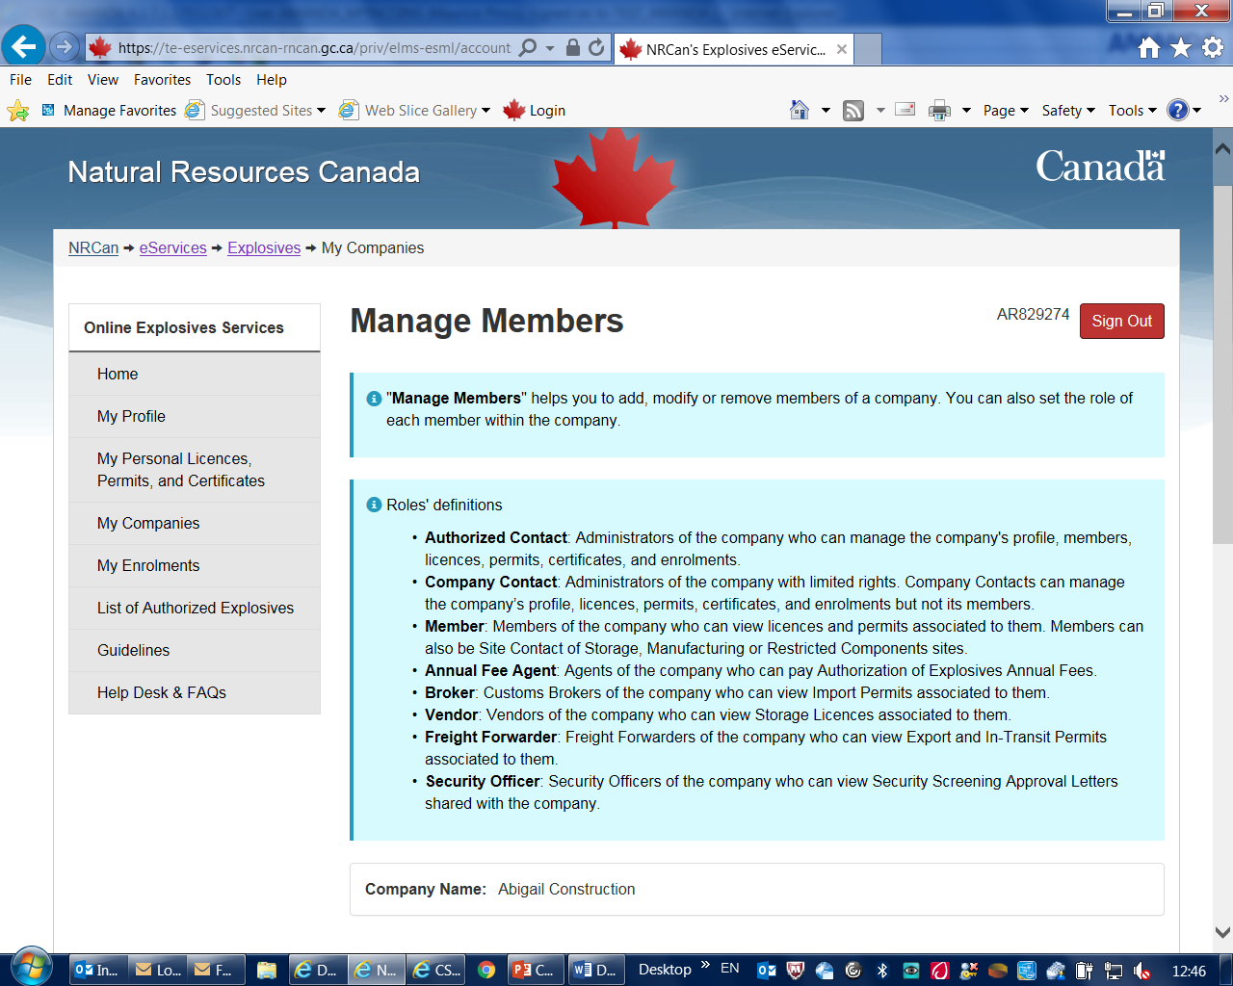
eLMS member types
Member types have unique permissions
All levels are managed by Authorized Contact
Screen shot of overview

Slide 17
eLMS user flow chart
Authorized Contact
Company Contact
All privileges, read, write, manage members, etc.
All read/write privileges Except manage members
Read access to those LPCOs the Authorized Contact has provided them access to; best suited to a Site Manager
Member

Slide 18
eLMS user profiles con’t
Authorized Contact
Freight Forwarder
Broker
Annual Fee Agent
Authorized Contact
View Access to LPCOs Authorized contact added them to.
View Access to LPCOs Authorized contact added them to
Vendor
Security Officer (can see Approval Letters)

Slide 19
eLMS users cont’d
User/Vendor Licence Validation
All licences are assigned to one Authorized Contact regardless of who it was attached to in the old system. It will then be up to this authorized contact (if online) to properly assign company contacts, members, etc. to the licence.
All Licences are placed under one company name (even if there are multiple spellings – Ltd vs Ltd.). If a company has other licences/permits/certificates/etc. and is already in the eLMS, they are attached to that company.
Contact information has been put into the eLMS but may not be accurate as it may have been incorrect in the old system. Contact information cannot be edited and any new contacts must be added as members using the “Manage Member” tab.

Slide 20
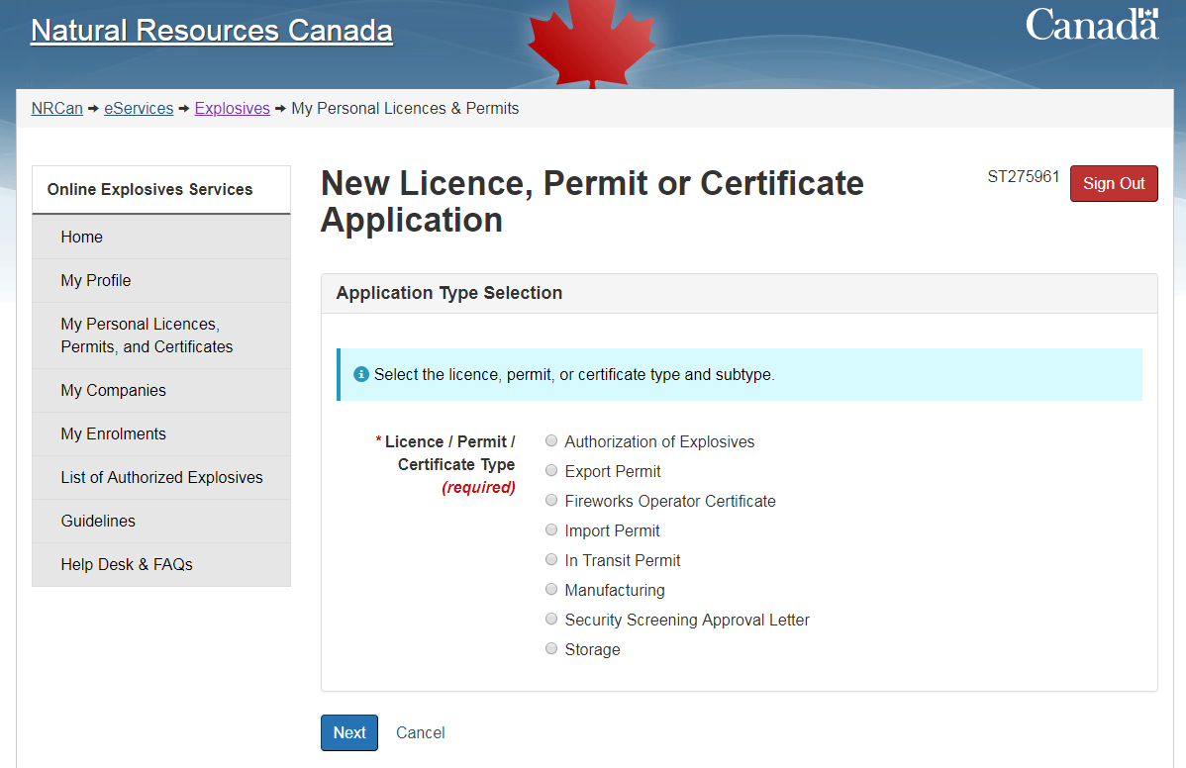
Individual LPCOs
Individuals may apply for the functions shown, Fireworks Operators Certificate and Approval Letter are most common.
Individual functions are a unique enrolment in eLMS

Slide 21
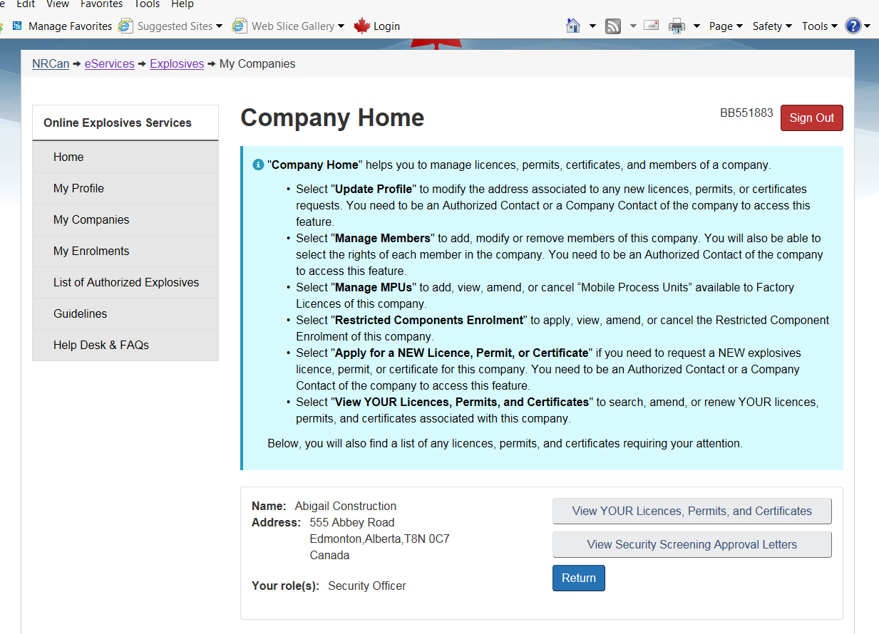
Company Security Officer
Company Security Officer can view security screening approval letters shared with the company
An individual who obtains an approval letter ‘shares’ this with the company.
This person then manages the security screening of the site/companies’ employees
Security Screening Approval Letter is an ‘Individual’ function

Slide 22
Security Screening Approval Letters
How do I apply for an Approval Letter?
To apply for an approval letter, select "My Personal Licences, Permits and Certificates". Select "Apply for a NEW Licence, Permit or Certificate" and select "Security Screening Approval Letter".
How can I let my employer see my approval letter?
As part of the application process, you are asked if you wish to share your approval letter with your employer. There are two options, a copy can be mailed to your employer, or you can share it online with your employer. If you select to share your letter online with your employer, only the employer’s security officer will be permitted to view the letter. If the company has not been enrolled in the Electronic Licence Management System (eLMS) and assigned a security officer, your letter will not be available to your employer to view even if you selected this option.

Slide 23
Security Screening Enhancement
Potential future security screening will require that all individuals with access to high hazard explosives will be subject to :
1) a fingerprint check
2) a criminal background and affiliation check
Your comments are welcome: Send to Kenneth.faulkner2@Canada.ca

Slide 24
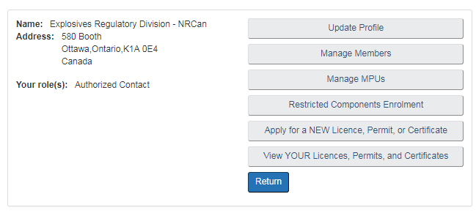
Manage MPU
Manage MPU option is available from Company Main page
To add MPUs to a licence you need to access the licence page ‘View YOUR Licences…’

Slide 25
MPU Functions
Workflows include:
  Create an MPU (new process unit)
    Upload a F05-MPU and supporting documents
  Amend an MPU
    Requires as a minimum F05-MPU
    Large changes: new chassis, new process body
  De-Activate – no user documents required
  Cancel / Close – Permanent deactivation, unit is decontaminated (According to ER, 2013) and scrapped.
  Ro-Open / Re-Activate
    Requires F05-MPU as a minimum and likely supporting documents
    Supporting documents required depends on nature of inactivity: inactive due to road accident requires proof of mechanical inspection.

Slide 26
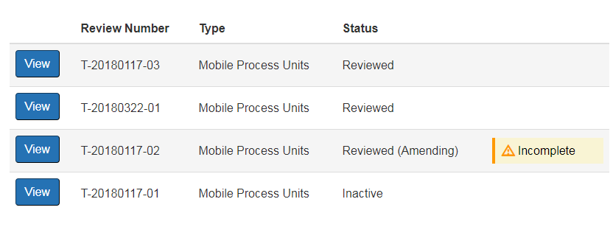
MPU workflow
An MPU must be ‘reviewed’ to be added to a licence –
T-20180117-03 & T-20180322-01 could be added to a licence and made ‘Active’.
A licence cannot be renewed or amended with inactive or closed MPUs associated to it: unit T-20180117-01 associated to it (unit is inactive).

Slide 27
MPU Regulatory Requirements
S.60 (3) (e) Factory licence application must include “a description of each mobile process unit to be used;”
If an MPU moves from Factory A to Factory B for an extended period of time:
  It must be removed from the licence of Factory A (amendment)
  It must be then added to the licence of Factory B (amendment)
An MPU must be removed from Factory A prior to attempting to add it elsewhere as it would not be ‘available’

Slide 28
Single Window Initiative - Overview
SWI allows trade chain partners (TCPs) to provide required information electronically to CBSA.
ERD has interfaced with SWI for Import Permits and product authorisations. Each Import Permit and it’s products are shared.
TCPs can submit Integrated Import Declarations (IID) versus the old OGD PARS (paper-based) system. PARS is going to be shut down 1 April 2019.
TCPs need to apply to CBSA as per the Electronic Commerce Client Requirements Document (ECCRD) to test the interface.

Slide 29
SWI – what it means to CEAEC?
Brokers can submit pre-arrival IID up to 90 days in advance of shipments.
TCP is able to receive recommended border decision up to 90 days in advance (recommended release/detain/refuse entry); issues with the shipment can be fixed prior to arrival at the border.
IID data is shared with ERD
  IID satisfies requirement for reporting transactions to comply with ER, 2013 S.47 (10)
  OGD PARS (old system) still requires Importers report transactions to ERD.
Paper will be accepted – for importers not using a broker.
eLMS Broker function is limited to ‘read access’ only, provided by an Authorized Contact
  If the Broker is set up using IID, they only need a copy of the permit.
Companies who’s broker is not using IID (or who don’t use a Broker) will need to submit transaction reports using F04-02 or eLMS
  More information see ERD website: http://www.nrcan.gc.ca/explosives/importation/16793

Slide 30
eLMS Way Forward
ERD will continue to receive feedback and suggestions from stakeholders on improvements to eLMS
CEAEC should provide a prioritized list for ERD to address.

Slide 31
Explosives Regulations, 2013
Amendment 2 & 3

Slide 32
Explosives Regulations, 2013 / Amendment 2
Main objective is to amend Part 9 for Port Surveys
Current regulatory requirements
  S. 155 of Cargo, Fumigation and Tackle Regulations requires:
    Inspection to be conducted by an Inspector of Explosives as per Q-D manual as if a licence is issued under the Explosives Act
    Issue: assessment of loading/unloading is done as if it were for fixed facilities
Proposed regulations would allow for using Risk Assessment techniques (QRA)
(CFTR will be amended in parallel)
Series of minor amendments were also considered from stakeholders

Slide 33
Explosives Regulations, 2013 / Amendment 2
List of proposals made by CEAEC were incorporated, some examples:
- Site visitors can be unattended, providing specific conditions are met – s.101(2)
- Magazine licence # on packaging exemptions - s.218(2).
- Towing explosives vehicle located at a mine or quarry exception – s.191(3.1).
- Repairs to a vehicle carrying explosives aligned with Part 5 – s.196(6)
Canada Gazette, Part I – published Dec 2, 2017 for comments
- NRCan received comments/questions from seven stakeholders (mostly associations).
QRA approach supported by CEAEC / IME and ACPA.
Majority of comments revolved around s.203.1 (QRAs)
- NRCan drafted QRA guidelines and sent to stakeholders for comments;
- TC/ NRCan clarified intent of 30-minute waiting time “dockside”.

Slide 34
Amendment 2
Process and Timeline
Canada Gazette, Part II process currently underway
TB meeting and Canada Gazette, Part II publication before summer holidays OR in the fall.
Coming into force when published in CG II.

Slide 35
Explosives Regulations, 2013 / Amendment 3
Main objective is to amend Part 20 – Restricted Components
Budget 2017 - enhancing explosives safety (security) including stronger measures / restrictions on commercial explosives and precursor chemicals
Primary focus:
Expand the list of regulated chemicals
Increase the number of inspections of sites enrolled
Conduct more S&T work - specialists and scientists to monitor emerging threats, help support policies and provide assistance
Develop policies, address regulatory initiatives and conduct outreach activities

Slide 36
Part 20 – List of Restricted Components
The following chemicals are regulated as “restricted components” (definition of restricted component included in section 2 of the Explosives Act:
Ammonium nitrate in solid form at a concentration of at least 28% nitrogen
Hydrogen peroxide at a concentration of at least 30%
Nitromethane, UN 1261
Potassium chlorate, UN 1485
Potassium perchlorate, UN 1489
Sodium chlorate in solid form, UN 1495
Nitric acid at a concentration of at least 75%
Potassium nitrate, UN 1486
Potassium nitrate and sodium nitrate mixture, UN 1499
Sodium nitrate in solid form, UN 1498

Slide 37
Restricted Components List Review
Current list is based on a 1995 US study
Being reviewed based on current lists of Allies and organizations e.g.:
  World Customs Organization – Programme Global Shield
  European Union explosives precursors regulated list
  US CFATS
Review is also being done based on recent years incidents
Thresholds being reviewed
List of unregulated chemicals of concern being considered

Slide 38
Proposed List of Regulated Chemicals
Precursor Chemicals | Canada ER, 2013 | World Customs Organization Programme Global Shield | European Union Regulation No. 98/2013
Ammonium Nitrate | X | X | X
Acetic Anhydride |  | X
Acetone |  | X | X
Urea |  | X
Aluminium Powder & Flakes |  | X
Hydrogen Peroxide | X | X | X
Nitric Acid | X | X | X
Nitromethane | X | X | X
Potassium Chlorate | X | X | X
Potassium Nitrate | X | X | X
Potassium Perchlorate | X | X | X
Sodium Chlorate | X | X | X
Sodium Nitrate | X | X | X
Sodium Perchlorate |  |  | X
Calcium Ammonium Nitrate |  | X | X
Hexamine |  |  | X
Sulphuric Acid |  |  | X
Calcium Nitrate |  |  | X
Proposed Regulated Chemicals

Slide 39
RC - Future Initiatives
Ongoing reviews will be required to keep up with emerging threats
  List of components
  Regulatory requirements
  Non-regulatory measures/initiatives
Outreach activities with stakeholders on requirements and best practices for secure commerce

Slide 40
Explosives Regulations, 2013 / Amendment 3
Miscellaneous amendments - input from associations being sought
List of 22 items sent by CEAEC; ongoing discussions
7 items can be resolved via guidelines / clarifications outside of ER, 2013
12 agreed-in-principle to proposed changes, for example:
    2 boxes of initiation systems can be opened at one time;
    adding shippers/drivers as also being responsible under PART 9 s.193, 194;
    eliminate inspection overlap with provinces for vehicle requirements to be in good condition
3 items sent back to CEAEC for more information

Slide 41
Amendment 3
Process and Timeline
Finalize Consultations – end of May 2018
Drafting & Approval process June – Nov 2018
Pre-publication in Canada Gazette – Part I – Dec 2018
Publication in Canada Gazette – Part II – Q1/Q2, 2019
Future Amendments / Review
  Seeking views

Slide 42
U.S. – Canada Regulatory Cooperation Council
Regulatory Partnership
Explosives Classification Initiative
  Workplan was updated (PHMSA / ESSB)
    http://www.nrcan.gc.ca/explosives/regulatory-partnership/17312
  Recent focus:
    Revision of Chapter 2.1 GHS / Explosives
    Revision of UN MTC; amendments for GHS needs

Slide 43
General Update (Licensing & Inspections)

Slide 44
ERD Statistics Activity / Licences
Activity |  | FY 16-17 | FY 17-18
Authorization | Applications received [indefinite period] | 232 | 296
 | Products tested | 73 | 87
 | Products approved | 5237 | 4127
Import Permits | Annual | 304 | 255
 | Single Use | 59 | 105
Restricted Components | Sites | 2085 | 2285
 | Sellers | 1591 | 1785
Mobile Process Units | Active and in operation | 234 | 317
Licences | F&S - Factory & Satellite, Bulk | 160 | 160
 | F&C - Factory & Certificate, Other | 75 | 75
 | F/PE - Factory, Perforators | 60 | 72
 | V - Magazine, Vendor | 101 | 104
 | U - Magazine, User | 765 | 827
 | U/Z - Magazine, User – Zone | 283 | 262
 | P - Magazine, Propellant | 277 | 282
 | X - Magazine, Fireworks | 117 | 120
 | TOTAL | 1838 | 1902

Slide 45
ERD Statistics Inspections
Inspections |  | FY 16-17 | FY 17-18
Inspections by activity | F&S - Factory & Satellite, Bulk | 68 | 48
 | F&C - Factory & Certificate, Other | 19 | 42
 | F/PE - Factory, Perforators | 44 | 26
 | V - Magazine, Vendor | 47 | 50
 | U - Magazine, User | 234 | 202
 | U/Z - Magazine, User – Zone | 52 | 53
 | P - Magazine, Propellant | 134 | 88
 | X - Magazine, Fireworks | 48 | 31
 | Restricted Component sites | 38 | 133
 | Mobile Process Units (MPU) | 47 | 59
 | Unlicensed [provincial magazines, trucks, fireworks events, port surveys, technical inspections, importation or expired licences] | 24 | 15
 | TOTAL | 755 | 747

Slide 46
Inspection Deficiencies
    Operations / Housekeeping:
    Presence of tetra-ammine copper nitrate
    Combustible material in vicinity of explosives / AN hopper
    Mixed storage of contaminated / non-contaminated equipment parts
    Electrical components, non-conforming (non-CEMA 4X, electrical box weatherproof seals)
    Pumps, requiring maintenance (seals)
    Containment dyke, requiring maintenance/repair
    Door, requiring panic hardware
    Support Plans / Administration:
    Plans not up to date / not available at site (fire safety, site security, emergency response)
    Procedures not up to date (maintenance, operating)
    Fire extinguisher monthly checks not conducted/recorded (much better!)

Slide 47
ERD Statistics Accident and Incidents
Activity |  | FY 16-17 | FY 17-18
Accidents / Incidents | Manufacture | 22 | 17
 | Transport | 27 | 19
 | Thefts / Break and Entry | 14 | 5
 | Fireworks | 12 | 7
 | Restricted Components | 3 | 1

Slide 48
Reported Accidents / Incidents
Manufacture (Bulk)
    Inadvertent initiation during manufacturing [ procedural / equipment failure ]
Transport
    Road accidents [ collisions ]
    Breakdowns [ mechanical / electrical ]
Mischief / Criminal Intent
  Theft / Break & Enter – Vehicle Theft
  Magazine stolen (yes, someone absconded with an entire, EMPTY, magazine)

Slide 49
Standards and Guidelines

Slide 50
Bulk Guidelines Update
Current status
  Bulk Guidelines (2014) were reviewed by CEAEC’s Regulatory Committee
  Based on CEAEC’s Regulatory Committee proposals, a draft revision was completed by ERD, for a further review by CEAEC
  New comments were received end of March
  Key changes and clarifications are as presented

Slide 51
Bulk Guidelines Update
Changes / clarifications
  Distances between sites are being reviewed
    Between factory and satellite sites
    Between satellite and client sites
  Reloading of MPUs is to be done at satellite or factory sites
  Administrative
    References to standards (BNQ, CGSB) were updated
    Duplicate Information available otherwise (e.g. MPU and QD principles requirements) is being removed
    Amendments to reflect new eLMS implementation are being made (e.g. location list of MPUs)
  AN storage at satellite sites
    Maximum of 100,000 kg being proposed, rather than a maximum number of silos
  Insulation in buildings
    Group F, Division 1, mechanical protection required on walls and ceiling

Slide 52
Bulk Guidelines Update
Changes / clarifications
  Multi-wall tanks requirements
    Heating may be required (Section 4.5.3)
  Locking requirements at secure, access controlled mine sites reduced
    Bulk ANE
    AN Storage
  Flammable liquids storage
    CSA-Approved storage cabinet
    Cabinet installed and maintained based on manufacturer requirements
  References to 25 kg bags of AN removed from 4.9.4
  Augers
    Requirements of spacing for augers was clarified

Slide 53
Key Comments
Sharing a wash bay
Zone satellite certificate
Include QD in the Guideline
Add direct supervisor as a “worker”
Sample cabinet lock by location

Slide 54
Compatibility Guidelines
Current status
  The document is based on Types of explosives (ER, 2013)
  Compatibility tables for each Type of explosive versus others
  Concepts from ER 2013, old QD Manual, and TDG requirements are integrated
What is ahead?
  Consultation with stakeholders ended
  Presently reviewing comments
  Provide CEAEC with answers to comments and finalize Guideline

Slide 55
Regulatory Reminders

Slide 56
Part 9 - Regulatory Reminder
Section 196(5); “No unnecessary stop, no longer than necessary and far from where people gather”.
Section 196(7); “Maintain 300m distances between vehicles transporting explosives”
Section 199(1); “Vehicle attendance”.
Tanker being washed at licenced factory
ERD has concerns based on a series of observations.
  Is the purpose of base sites/satellite sites still relevant/appropriate?

Slide 57
Part 9 - Regulatory Reminder and Discussion
Section 198(1), tracking is required for explosives transport greater than 2000 kg but not for MPUs
Tracking of movement is being recorded in real time but no alerts are triggered if an something abnormal occurs
  Example of alerts that could be triggered: Prolonged stop, transport going on an unapproved route, Transport stopped in densely populated areas, etc…

Slide 58
Factory Base site and Satellite
Base to service MPUs
Virtual satellite sites to gain km
Sat/Customer
Satellite/ special project
Satellite/ serving many local customers

Slide 59
Underground Bulk
1990’s approximately 3 millions kg
2017, 21 millions kg
Pumping pressures higher than on surface
Bulk ANEs more sensitive than on surface
U/G pumping units owned by mines, contractors and explosives suppliers

Slide 60
Underground Regulatory
Pumping is a manufacturing activity
Manufacturing activities are covered under the Explosives Regulations
Only activities of ER 2013 listed in section 136 are exempted from a licence or certificate
Requirements of Section 136(2) apply and Section 20
U/G MPU must be maintained by a competent person
U/G equipment must be decontaminated at a licenced factory site

Slide 61
Accident/Incident Reporting
Part 5, 139 (1) Spills or accidents
  (c) the Chief Inspector of Explosives must be notified of the accident or spill within 12 hours after the removal or repackaging begins.
Part 5, 140 (1) Emergency response assistance plan (pumping UN0332)
  (d) a copy of the follow-up report that is required under section 8.3 of the Transportation of Dangerous Goods Regulations must be submitted to the Chief Inspector of Explosives within 30 days after the date on which the explosives are pumped.

Slide 62
Accident/Incident Reporting
Part 7, 167 (1) Incidents
  A holder of a licence, permit or certificate must provide the Chief Inspector of Explosives with a detailed follow-up report about the incident as soon as the circumstances permit

Slide 63
Accident/Incident Reporting
Part 9, 192(2) Damaged or deteriorated explosives
  The shipper and the carrier must not transport damaged or deteriorated explosives unless the Minister determines that the explosives must be transported to another location
Part 9, 196(9) Towed vehicle
  The driver of a vehicle transporting explosives must ensure that the vehicle is not towed unless the Minister or a police officer directs that it be towed because of an emergency or a breakdown.

Slide 64
Accident/Incident Reporting
Part 9, 201 (1) Accidents and incidents
  The driver of a vehicle that contains explosives and is involved in an accident or incident that is likely to delay the delivery of the explosives must, as soon as the circumstances permit, notify the police and the carrier of the accident or incident and the delay.
Part 9, 201(2) Report
  The carrier must, as soon as the circumstances permit, report the accident or incident to an inspector

Slide 65
CEAEC - List of Items
1. Licensing update
2. Definitions
3. Review of the changes of the MPU Third party “As-Built” inspection process
4. Review of the TNT –NEEQ equivalency for ANEs

Slide 66
1. Licensing Requirements
Division 1 factory licence means a licence that is issued under paragraph 7(1)(a) of the Explosives Act and authorizes the manufacture of explosives at a factory.
Satellite site certificate means a manufacturing certificate that is issued to the holder of a division 1 factory licence under paragraph 7(1)(c) of the Explosives Act and authorizes the manufacture of explosives at a satellite site.
Explosives Act, paragraph 7 (1) (c) certificates for carrying out, on an occasional and temporary basis, activities relating to the manufacture, testing or storage of explosives or the use of fireworks or the training of persons in the use of fireworks.

Slide 67
Licensing Requirements
What manufacturing activities can be conducted without a satellite licence and where?
Explosives Act section 6(a): Except as authorized under this Act and subject to such exemptions as may be provided by regulation, no person shall:
(a) make or manufacture any explosive, either wholly or in part, except in a licensed factory;
ER, 2013 section 136 (1); A person who complies with subsection (2) may carry out any of the following activities underground at an underground mine or underground construction project:
(a) pneumatically transferring *explosives;
(b) pumping, thickening or gassing either emulsion explosives or water gel explosives while charging boreholes; or
(c) blending emulsion explosives or water gel explosives with ammonium nitrate or ammonium nitrate/fuel oil mixtures while charging boreholes.

Slide 68
2. Definitions
ER 2013, section 6(3)
attended means to be constantly monitored by a person and, unless these Regulations provide otherwise, includes monitoring by a person using electronic means.
There is no definition in the Regulation of “Attended in person”. But, it removes the second part of the definition of attended. Then, attendance has to be in-person and constantly monitored.

Slide 69
3. MPU ‘As Built Inspections’
CEAEC approached ERD to reduce the requirements for a 3rd party ‘As Built’ inspection of new MPU construction.
Noted was the consistent quality controls of fabricators and lack of issues found during inspection or 3rd party reviews.
CEAEC proposed a less-frequent 3rd party review.

Slide 70
Third-Party As Built inspections
ERD accepts the proposal to reduce the frequency of 3rd Party ‘As Built’ inspections.
  Upon construction of a new design: two 3rd party inspections will be required
  Additional 3rd party inspections will not be required if the first two are compliant
  A unit of the same design will be required to undergo a 3rd party review once every 3 years or on the 11th build of that unit type. Whichever comes first.
  MPU manufacturers are to keep track of the number of units being fabricated of each design.

Slide 71
4. NEEQ of ANEs
CEAEC has approached ERD with a proposed Net equivalent explosive quantity (NEEQ) of ANEs that is 75% TNT equivalent.
This would apply to for QD requirements at licensed sites.
Typically TNT equivalency is established from tests. These are not suitable for ANEs.
CEAEC has made a formal proposal for an energy calculation to establish TNT Equivalency.

Slide 72
NEEQ of ANEs cont’d
ERD accepts: NEEQ of 75% for bulk unsensitised emulsions if:
  The product has passed UN Test Series 8; OR
  The MBP for a new product is ≥ 5.6 MPa

Slide 73
NEEQ of ANEs cont’d
Additional criteria to use a 75% TNT equivalency:
  The product does not contain any perchlorates
  The product must be unsensitised (no artificial voids)
  The product is shown to have a calculated energy
  ≤ 75 % of TNT.

Slide 74
NEEQ of ANEs cont’d
ERD acceptance was based on:
  the energy calculations of a representative number of ANEs by a number of CEAEC members that are manufacturers of ANEs.
  Energy calculations were prepared by competent persons with experience in conducting Ideal Detonation Code modeling or Chemical Equilibrium Modeling.
  An agreed upon theoretical TNT energy for comparison and some common modeling assumptions (adiabatic, instantaneous, all reactants are consumed, small reaction zone, etc.)

Slide 75
Explosives Safety and Security Branch (ESSB)
Explosives Regulatory Division (ERD)
Questions?
Headquarters (Ottawa)
Authorization - Import - Export - In-transit
(613) 948-5200
ERDmms@NRCan.gc.ca
Pacific Region (Vancouver)
British Columbia / Yukon
Magazine Licences - Inspections
(604) 666-0366
ERDpacific@NRCan.gc.ca
Western Region (Calgary)
Alberta / Saskatchewan / Northwest Territories
GLF & Magazine Licences - Inspections
(403) 292-4766
ERDwestern@NRCan.gc.ca
Central Region (Ottawa)
Ontario / Manitoba
Factory & Magazine Licences - Inspections
(613) 948-5187
ERDcentral@NRCan.gc.ca
Eastern Region (Varennes)
Quebec / Nunavut / Atlantic Provinces
Magazine Licences - Inspections
(450) 652-0703
ERDeastern@NRCan.gc.ca

