Slide 1
2019 CEAEC Annual Meeting Presented by: Bradley Kushnier, Commercial Insurance Broker
Insurance and Dangerous Goods

Slide 2
Introduction
Brokers are licensed professionals regulated by the government who have a fiduciary duty to their clients. They negotiate with insurers on behalf of their clients.
Purves Redmond Limited is a Canadian insurance brokerage focused on complex and hazardous risks.
We are specialists in high-hazard transportation, waste & recycling, mining, and fireworks & pyrotechnics.
We develop industry specific programs and alternative risk transfer solutions.
Insurance and Dangerous Goods

Slide 3
What Do You See?
Insurance and Dangerous Goods

Slide 4
What is Insurance?
Indemnity – Promise to Pay
1st Party Coverage
Property Loss
Business Interruption
3rd Party Coverage
Liability – Bodily Injury and Property Damage
Negligence and the ABC of Liability
Hazardous goods and Strict Liability
“Occurrence” means an accident, including continuous or repeated exposure to substantially the same general harmful conditions.
Insurance and Dangerous Goods

Slide 5
Why Do You Have Insurance?
Because you have to:
Government Permit requirements
Mortgages/loans have requirements
Automobile insurance is mandatory
Other companies require it – Certificates of Insurance
Because you should:
High-hazard industry with chance for large losses
Insurance and Dangerous Goods

Slide 6
Insurance and Explosives Part 1 - Commercial Automobile
Most regulated coverage
Policy wording is mandated by the government
Rates are filed with the government
Required to purchase it by law
What It Covers
1st Party Component
Accident Benefits
Vehicle Coverage
3rd Party Liability
Insurance and Dangerous Goods

Slide 7
Insurance and Explosives Part 1 - Commercial Automobile cont.
1.8.1 General Exclusion – Carrying Explosives
Permission to Carry Explosives – O.E.F./S.E.F./Q.E.F. 4A
Coverage is voided if carrying explosives without this endorsement
Excluding Operation of Attached Machinery – O.E.F./S.E.F./Q.E.F. 30
No coverage for liability or property damage
New wordings on Ontario policy effective April 1, 2019
Criminal Code violation – Cannabis
Only excludes damage to your vehicle
Insurance and Dangerous Goods

Slide 8
Insurance and Explosives Part 2 - Commercial General Liability
Explosion, Collapse and Underground Hazard Exclusion
Used to require endorsement to include, now excluded by endorsement
Expected or Intended Injury from the standpoint of the insured
How do insurers apply this exclusion?
How do courts?
“You can’t have a negligent assault”
Objective vs. Subjective
Employee vs. Employer
Insurance and Dangerous Goods

Slide 9
Global Loss Trends
Global property insurers concerned about significantly higher proportion of weather related events – there is an expectation that overall global loss from flooding and hurricanes will continue to trend higher
Increased global development drives higher frequency and severity of catastrophic loss including flood and wildfire
Increased cost of losses
Insurance and Dangerous Goods

Slide 10
Canadian Loss Trends
Automobile loss costs rising as vehicles are more prone to damage and repair costs continue to rise
Floods and Water Damage – Number 1 source of loss
Wildfires
Increase in personal injury claims
Overall increase in cost of claims
Insurance and Dangerous Goods

Slide 11
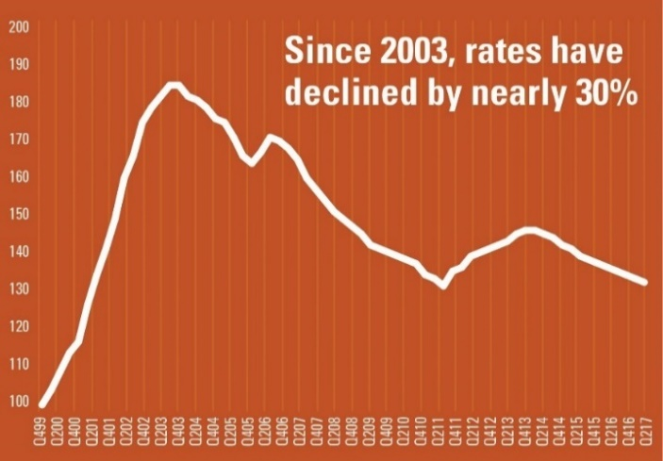
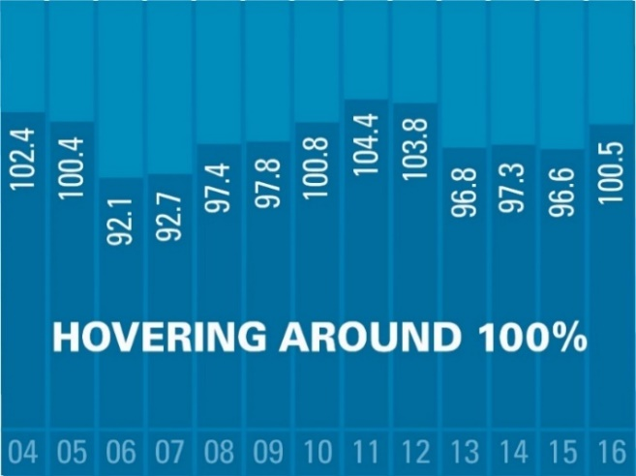
Insurers’ Profitability
Global average property rate history
Average international property insurance rates have declined by 30% in the last 15 years
Insurers loss costs (plus expenses) are presently hovering at approximately 100% of gross written premiums up to 2016
2017 and 2018 have been 2nd and 3rd worst years ever
Lloyds lost 3 billion pounds
US market lost 22 billion USD*
Global historic insurance combined profitability ratios
Insurance and Dangerous Goods

Slide 12
General Implications
Global insurance marketplace currently transitioning to a timeframe of firmer prices
No rate reductions; average insureds facing inflationary increase at a minimum
Insureds with loss experience or higher hazard operations facing more substantial rate increases
Rate increases not limited to Property insurance but is extending to all types of coverage
Insurers are providing more restrictive terms and conditions with a focus on reducing exposure to catastrophic losses due to floods, earthquakes, forest fires, and hurricanes
Insurers are exiting certain classes of business that have performed poorly reducing the capacity in the marketplace
Insurance and Dangerous Goods

Slide 13
Industry Specific Implications
Business Ecosystem
Smaller companies have less negotiating power
Barrier to entry for new companies
Start early on your renewal!
Prepare for challenging negotiations
Risk of non-renewal
Insufficient capacity
Changes in limits and deductibles
Insurance and Dangerous Goods

Slide 14
How To Differentiate An Industry
Educate
Underwriters are insurance experts
Brokers are often industry generalists
Humanize your business
Meet your insurers
Self-Police
Word spreads quickly on bad losses
Demonstrate How Serious You Are About Risk
Self-promotion is key
Insurance and Dangerous Goods

Slide 15
What Do Insurers See?
Insurance and Dangerous Goods

Slide 16
360 Review
Our 360 Review is a deep dive of your insurance program. Our team will audit your coverage structure, policy wording, underwriting information, and loss history.
All findings will be compared to your risk profile. The risk profile will be built by a full analysis of operations, review of all pertinent documents, incorporating engineering reports, Maximum Foreseeable Loss calculations, interviews with key executives and site visits.
No fee
No obligation
Give it to your current broker to implement or engage us to execute the results
Insurance and Dangerous Goods

