Slide 1

CEAEC MEETING
Vancouver 2018

Slide 2

CEAEC MEETING
Vancouver 2018

Slide 3

CEAEC Success Stories
  TNT equivalency for specific bulk ANE’s
  Clarification of the “S” for MPU’s
  MPU third party inspection relief
  Positive influence on the bulk guidelines
  Amendment 02 of ER-2013
  Drafting of an environmental code of standard for ANE’s

Slide 4
CEAEC Participation
  Canadian Standards Representation;
    B620
    TDGR, proposed training standard.
    43_151
  Quarterly meetings with ERD /TDG.
  Amendment 03 of ER-2013.

Slide 5
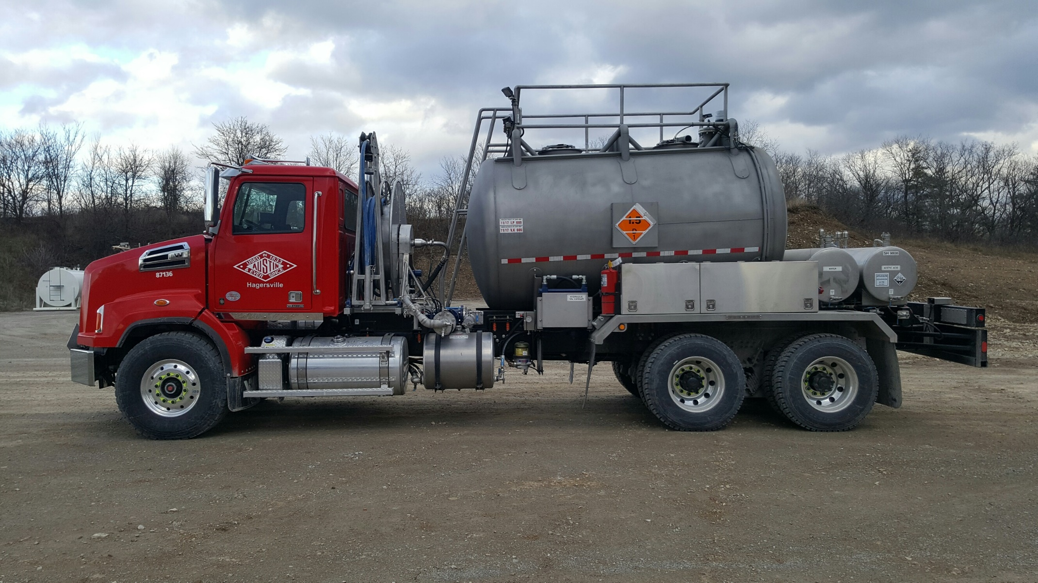
CEAEC Industry Pride

Slide 6
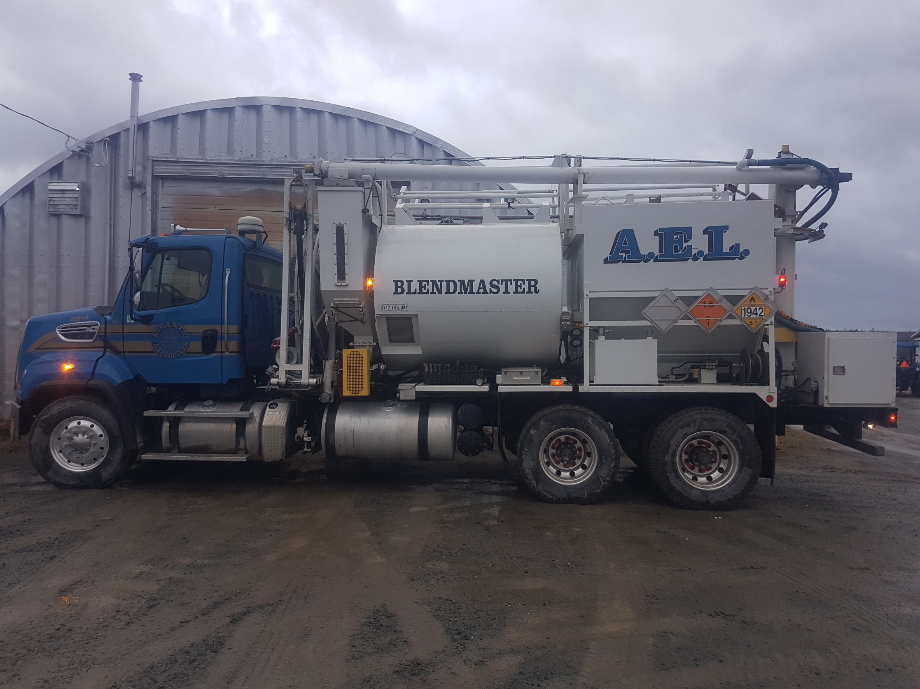
CEAEC Industry Pride

Slide 7
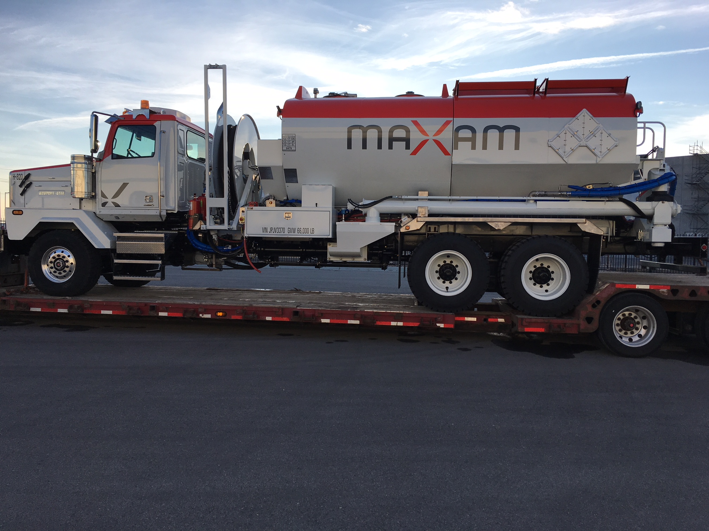
CEAEC Industry Pride

Slide 8
CEAEC Industry Pride

Slide 9
CEAEC Code of Good Practice
Transporting Bulk Emulsion
In 2013, CEAEC began the process to define the activities for the safe transport of bulk ANE’s. The document provided detail on items such as pre-route, permitted enroute maintenance, safety considerations and regulatory requirements.
Drafted document was vetted by ERD in late 2014.
It was decided that CEAEC would consider this document as a Code of Good Practice and support its content. However, the document remained in DRAFT format event though all parties agreed on the contents and message.

Slide 10
CEAEC Code of Good Practice
Going Forward;
Document will be updated to reflect regulatory changes, finalized and translate into French.
Next proposed “Environmental Code of Good Practice for ANE’s used in Blasting” .
Please forward your thoughts for Code of Good Practice topics.
The work of developing such Codes of Good Practice will rest with the relevant subject matter committee (Regulatory, MTT, SSE), the board and the executive.

Slide 11
CEAEC Committees
Committees Currently Active:
- Regulatory – Al Loan
- Manufacturing, Transportation & Technology (MTT) – Aaron Galt
- Safety, Security, and Environmental (SSE) – Benoit Choquette
Committee Chairs selected at Annual Members Meeting.
Typically Committee Chair is for 2-3 years.
Please speak with Nicholas Ebsworth or any of the current Committee Chairs if you are interested in taking on this important responsibility.

Slide 12
CEAEC Presidents
2007 - 2021
2007/2008 – Fred McNeill
2008/2009 – Aaron Galt
2009/2010 – Nicholas Ebsworth
2010/2013 – Al Loan
2013/2015 - Aaron Galt
2015/2017 - Stewart McCallum
2017/2019 - Al Loan
2019/2021 - Aaron Galt (currently VP)
Volunteers for Executive Roles & Committee Chairs?

