Slide 1

CEAEC MEETING
Quebec City, June 6th and 7th, 2019

Slide 2
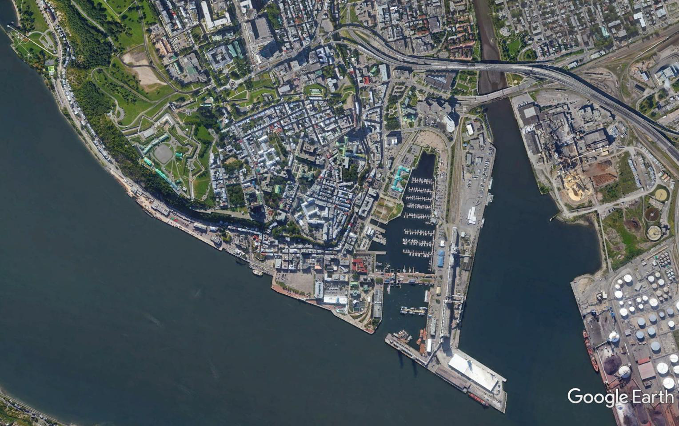
46°48'56.86" N 71°12'22.01" W
CEAEC MEETING
Quebec City 2019
YOU ARE HERE

Slide 3

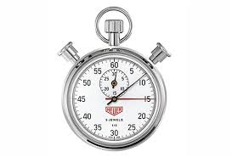
Meeting Agenda
  Presenters
    ERD
    TC
    Membership / Guests

Slide 4
Membership Introduction
  Name
  Company / Association
  One expected result / outcome

Slide 5
CEAEC Ongoing Efforts
  Membership communication,
    Meeting minutes
    Regulatory updates
    Government outreach
  Web-site modernization.
  By-law review / update.
  Membership growth,
    explosives carriers
    explosives accessory suppliers

Slide 6
CEAEC Participation
  Canadian Standards,
    B620,
    TDGR, proposed training standard.
    43_151
    43_150, (TP14850 transition)
    192.3.20xx (Transportation of Dangerous Goods Training assessment and competency Standard)
  Quarterly meetings with ERD /TC.
  Guideline Reviews,
    Bulk
    MPU
  National Fireworks Association attendance
  IME attendance.

Slide 7
CEAEC Committees
Active Committees:
  Regulatory – Al Loan
  Manufacturing & Technology (MT) – Aaron Galt
  Safety, Security, and Environmental (SSE) – Benoit Choquette
New Committees, (fall of 2018):
  Carrier / Transportation – Vacant
  Provincial Affairs – Pierre St Georges

Slide 8
CEAEC Participation
Committee member or Chair (typically 2-3 years).
Please reach out to Nicholas Ebsworth or any of the current committee chairs if you are interested.
CEAEC Presidents 2007 - 2021
2007/2008 – Fred McNeill
2008/2009 – Aaron Galt
2009/2010 – Nicholas Ebsworth
2010/2013 – Al Loan
2013/2015 - Aaron Galt
2015/2017 - Stewart McCallum
2017/2019 - Al Loan
2019/2021 - Aaron Galt (currently VP)
Volunteers for Executive Roles & Committees?

