Slide 1
CEAEC MEETING
Charlottetown, June 2017

Slide 2
Regulatory Committee
Magazine farms
Fabric Shelters
Part 217, Explosives Sales
Surface use of underground equipment

Slide 3
Magazine farms
ERD proposed changes Nashville meeting, April 2016
Requirement for D-6 separation distance.
ERD inspections, with sunset actions for Q/D compliance.
Moratorium on any new license applications.

Slide 4
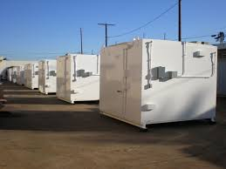
Magazine farms
CEAEC response proposal May 2016
Detailed responsibilities of all license holders
Joint Emergency Response Plan
License Holder Personnel Presence Awareness and Notification

Slide 5
Magazine farms
ERD Request, Fall CEAEC Meeting December 2016
Would one licensee assumes overall responsibility?
CEAEC 2nd response proposal January 2017
Inclusion of one licensee assuming responsibility
Site Plan, Drawings
General Security, ERAP

Slide 6
Magazine farms
ERD Response, May 2017
Ensure that one license holder be identified as responsible for the overall site operations
All license holders within a magazine farm be responsible for their own individually licensed magazine(s); and,
A letter of understanding that would detail direct responsibilities of each license holder is in place

Slide 7
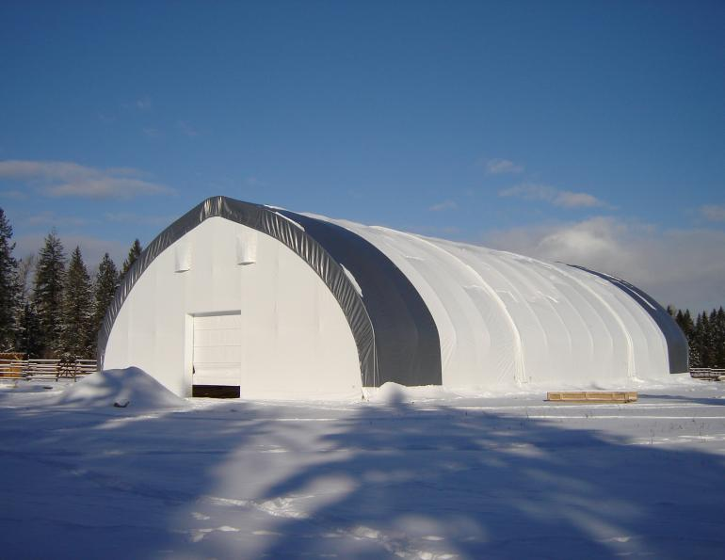
Fabric Shelters
Requirement to meet group F, Div 1 or 2 of the NBC
Requirement to meet flame resistance of part 3 of the NBC

Slide 8
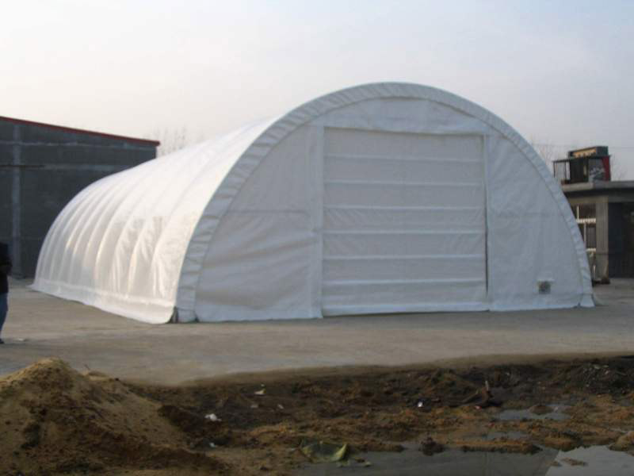
Fabric Shelters
CEAEC position in ‘Draft” mode
Possible avenues for compliance via language contained in part 3.1.5.2 of the NBC.

Slide 9
Explosives sales
Correspondence with ERD to clarify compliance with parts 217 (1-2) of ER-2013
Initial query to ERD via fall CEAEC meeting
CEAEC recommends amendment to part 217 adding of the words “immediate use” or “use” with the word “store”.

Slide 10
Sale — authorized buyer
217 (1) A seller may sell industrial explosives only to a buyer who holds a licence or a manufacturing certificate or who is authorized by a competent provincial or territorial authority to store industrial explosives at a mine site or quarry.
Maximum quantity
(2) A seller must not sell more industrial explosives to a buyer than the buyer is authorized by their licence, certificate or provincial or territorial authorization to store.

Slide 11
Surface Use of Underground Equipment
Proposed operation of underground equipment on the surface for initial portal /shaft deployment.
Initial query to ERD via fall CEAEC meeting.
ERD response “potentially yes…submit formal letter”.
CEAEC letter sent, January 2017
Concept rejected due to the division 3 exemption reference to “underground”.

Slide 12
Surface Use of Underground Equipment
Next steps
Possible form F05-MPU application.
Adding underground equipment to the F05-01B of the respective base division 1 license.
Revision of division 3 exemption to add a definition to “underground”.

Slide 13
Questions?

