Slide 1

CEAEC MEETING
Quebec City, June 6th and 7th 2019

Slide 2

Regulatory Committee
Draft CSGB 43.151 Standard
  Hose testing Alternative
CAN/CSA B620
  60 Day Comment Period
  CEAEC additions / clarifications
ER-2013, Amendment 03 / 04
Other
  Standards
  Guidelines

Slide 3
MPU Hose testing
  Background
  B620, part 7, requires periodic inspection / testing of LMoC.
    “V” External
    “I” Internal
    “P” Pressure
    “K” Leakage
  Part 7.2.10 of B620 requires that all hose assemblies temporarily connected be tested at 120% HAWP.
Notes:
Original recommendations ~100.

Slide 4
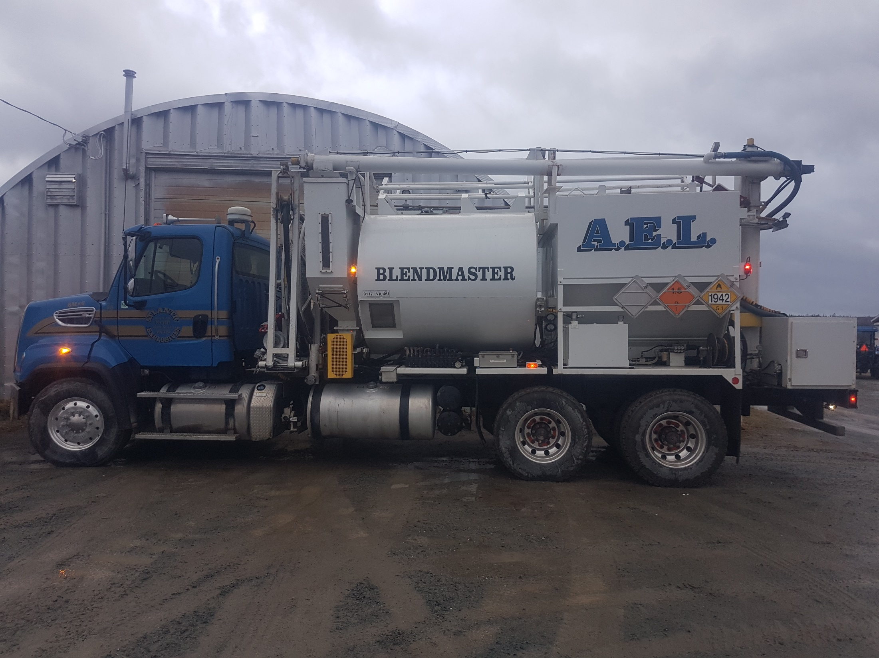
MPU Hose testing
Hoses that may not be tested as part of 7.2.7.7
ANE metering pump to blend auger
  Background
  Hose assemblies to be tested are those not tested as per part 7.2.7.7 (Hydrostatic test).
Product pump to hose reel
Hose reel / loading Hose
Notes:
Original recommendations ~100.

Slide 5

MPU Hose testing
  Background
    And…..
    The first hose used to transfer product at site, (7.2.10.1)
      LMoC to Storage
      Storage to LMoC
This hose requires testing
ANE
Notes:
Original recommendations ~100.

Slide 6
MPU Hose testing
  Background
  T.C Clarification Letter, March 10, 2016
    Reference to visual inspection, clause 7.10 (b) of 43.151-2012.
    Commitment to revise the testing requirements of loading / unloading of class 1 products.
Notes:
Original recommendations ~100.

Slide 7
MPU Hose testing
  43.151 Standard, (Draft)
  Adds an alternate means of compliance to 7.2.10 of B620
    Hoses used for loading and offloading, (clause 7.8.3)
      Annual visual inspection to ensure mechanical fitness.
      Supported by a procedure.
      Written record of the inspection.
ANE
Notes:
Original recommendations ~100.

Slide 8
MPU Hose testing
7.8.3 In lieu of the hose testing requirements in Clause 7.2.10 of CSA B620, hoses and their connectors used to temporarily connect to a highway tank to load or unload Class 1, Explosives, including those used in the explosives manufacturing process, shall be visually inspected annually to ensure mechanical fitness, integrity and compatibility with lading. A written record of the periodic visual inspection shall be made in accordance with procedures established by the holder of a licence or certificate issued under the Explosives Act.
  43.151 Standard, (Draft)
  Adds an alternate means of compliance to 7.2.10 of B620
    Hoses used for loading and offloading, (clause 7.8.3)
      Annual visual inspection to ensure mechanical fitness.
      Supported by a procedure.
      Written record of the inspection.
ANE
Notes:
Original recommendations ~100.

Slide 9
MPU Hose testing
7.8.4 In lieu of the hose testing requirements in Clause 7.2.10 of CSA B620, hoses and their connectors used on a mobile process unit (MPU) in the manufacturing of Class 1, Explosives and connected after the first pump from the emulsion tank shall be visually inspected annually to ensure mechanical fitness, integrity and compatibility with lading. A written record of the periodic visual inspection shall be made in accordance with procedures established by the holder of a licence or certificate issued under the Explosives Act.
  43.151 Standard, (Draft)
  Adds an alternate means of compliance to 7.2.10 of B620
    Hoses used on an MPU for manufacturing, (clause 7.8.4)
      All hoses after the first pump from the AN emulsion tank.
      Annual visual inspection to ensure mechanical fitness.
      Supported by a procedure.
      Written record of the inspection.
Notes:
Original recommendations ~100.

Slide 10
MPU Hose testing
  Standard Blend Truck
    Red indicates hoses that require annual visual inspection.
    -Procedure / written record of the inspection.
FIRST PUMP
Notes:
Original recommendations ~100.

Slide 11
MPU Hose testing
  Standard Repump Truck
    Red indicates hoses that require annual visual inspection.
    -Procedure / written record of the inspection.
FIRST PUMP
Notes:
Original recommendations ~100.

Slide 12
MPU Hose testing
  43.151 Standard, (Draft)
  New clause that supports part 7.2.7.7 of B620
    All hoses before the first pump from the AN emulsion tank must be tested as part of the pressure / hydrostatic test of 7.2.7.7 of B620.
7.8.5 Hoses and their connectors used on a mobile process unit (MPU) in the manufacturing of Class 1, Explosives and connected before the first pump from the emulsion tank shall be inspected and tested as per Clause 7.2.7.7 of CSA B620.
Notes:
Original recommendations ~100.

Slide 13
MPU Hose testing
  Standard Blend Truck
    Red indicates hoses that are to be tested as per clause 7.2.7.7
FIRST PUMP
Notes:
Original recommendations ~100.

Slide 14
MPU Hose testing
  Standard Repump Truck
    Red indicates hoses that are to be tested as per clause 7.2.7.7
FIRST PUMP
Notes:
Original recommendations ~100.

Slide 15
Standard Status
Currently under editor review and formatting / minor editorial corrections, (French and English).
Submitted to the Standards Council of Canada for ratification as a National Standard of Canada (SCC).
Publication ~summer of 2019.
Notes:
Original recommendations ~100.

Slide 16
B620 Standard Update
B620 standard is posted on the Transport Canada Web-site for the 60 day comment period, closes June 11, 2019
Two of the three CEAEC dockets were added to the new proposed standard.

Slide 17
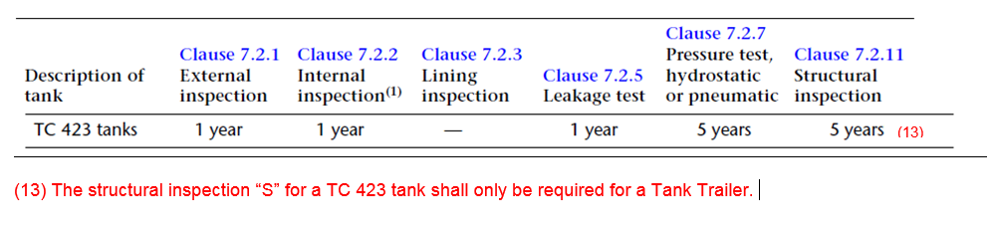
B620 “S” Inspections
Adding of an explanatory note to table 7.1

Slide 18
B620 “S” Inspections
Adding of a MPU pictorial in the TC-423 row of appendix E

Slide 19
Amendment 03
Posted in Gazette 1, May 18th.
Part 20, (Restricted Components).
Addition of four new explosives precursor chemicals.
  calcium ammonium nitrate
  hexamine, UN number 1328
  acetone, UN number 1090
  aluminium powder
30 day consultation, ending June 18th.

Slide 20
Amendment 04
CEAEC Initiatives
Allowance for two detonators cases to be opened at a time.
Adding MPU’s GPS tracking for MPU’s (other than those that remain on mine site).
Clarification on when when police, carrier, ERD need to be notified;
Adding of the words “keep or store” to section 217 (1)
Addition of “type or UN#” for record of explosives sales.
Adding of magazine ID for imported product.
Accepted CEAEC items that did not make amendment 02.

Slide 21
Standards / Guidelines / Other
CGSB-43.150, Small Containers, (replacement for TP14850)
CAN/BNQ 2910.500/2012 Magazine Standard
CAN/BNQ 2910.510/2012 Q/D Standard
Transportation of Dangerous Goods Client Identification Database, (TDG-CID)
CGSB-192.3.20xx (Transportation of Dangerous Goods Training assessment and competency Standard)
Revised MPU Guidelines

Slide 22
Questions?

