Slide 1

CEAEC MEETING
Ottawa, November 15, 2018

Slide 2

Regulatory Committee
Bulk Guideline Review
MPU Guideline Review
Amendment 02 ER-2013
Amendment 03 ER-2013
Other
  Standards
  Guidelines
  Part 136, (underground activities)

Slide 3
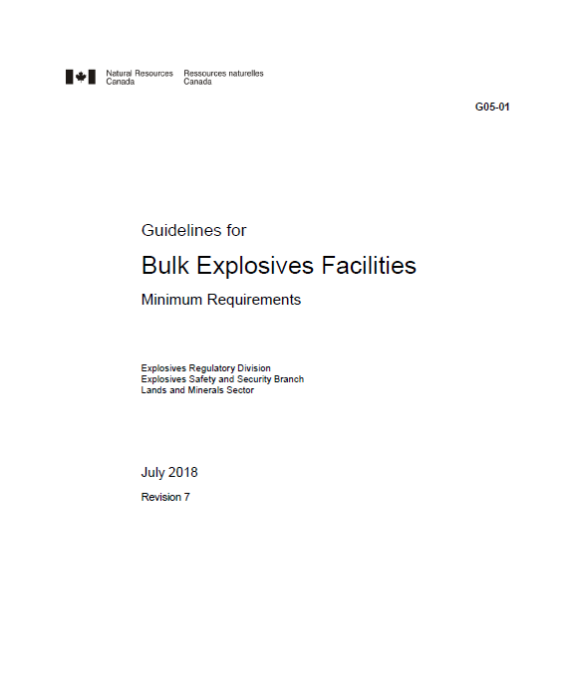
Bulk Guideline Review
ERD request for comment / suggestions
  Initial review of rev 6, late fall 2017
  Review draft rev 7, ~mid 2018.
  Positive acceptance of suggestions.
  G05-01, (July 2018)
Notes:
Original recommendations ~100.

Slide 4
Bulk Guideline Review
Highlights
  Document functionality, searchable index and hyperlinks.
  Better alignment with provincial OHAS, NFPA and federal standards.
  Removal of the ANP “one” container rule for Satellite sites, (now 100,000 kg).
  Removal of the separation distance for Satellite (800 km) and client sites (450 km).
  Consideration of location, (mine sites) for the ANE /ANP security and locking requirements.
  Clarification of man-limits, (visitors / blasters).
ERD request for comment / suggestions
  Initial review of rev 6, late fall 2017
  Review draft rev 7, ~mid 2018.
  Positive acceptance of suggestions.
  G05-01, (July 2018)
Notes:
Original recommendations ~100.

Slide 5
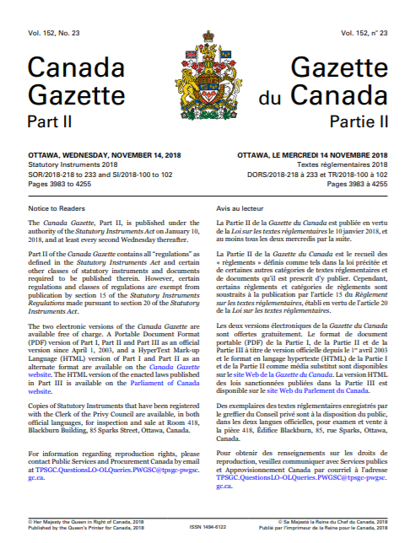
Amendment 02
Gazette 1 publication, December 02, 2017
30 day public comment period.
CEAEC comments, December 20, 2017.
Gazette 2 publication November 14, 2018.

Slide 6
Amendment 02
Highlights
Adding of the use of QRA for NEQ determination at ports / wharfs.
The ability to now have visitors / workers unattended, providing specific conditions are met.
Removal of requirement to mark magazine I.D. codes on 5H4 Small Means of Containment.
Removal of the request for ERD approvals when towing an explosives laden vehicle when located at a mine or quarry.
Clarification on the allowance of repairs to a vehicle carrying explosives whilst in-transit.
Gazette 1 publication, December 02, 2017
30 day public comment period.
CEAEC comments, December 20, 2017.
Gazette 2 publication November 14, 2018.

Slide 7
Amendment 03
Primarily carryover items from amendment 02.
Extensive correspondence + quarterly meetings.
Final document June 01, 2018.
Outstanding items to be carried over into amendment 04.
Template for amendment proposals.

Slide 8
Amendment 03
Primarily carryover items from amendment 02.
Extensive correspondence + quarterly meetings.
Final document June 01, 2018.
Outstanding items to be carried over into amendment 04.
Template for amendment proposals.

Slide 9
Standards / Guidelines / Other
CGSB-43.151, Explosives Packaging
  Public review ended July 31.
  Received 39 comments from 7 organizations.
  CGSB committee review of comments.
CGSB-43.150, Small Containers, (replacement for TP14850)

Slide 10
Standards / Guidelines / Other
Transportation of Dangerous Goods Client Identification Database, (TDG-CID)
  Imports, handles or transports DG.
  Part 1 exceptions, (personnel use, agricultural etc..)
  Stakeholder meetings held early 2018.
  Possible reporting; Company name/location, DG shipped, quantities/volumes and shipment frequency.
  Standard to be drafted / with amendment to the TDG act / regs.

Slide 11
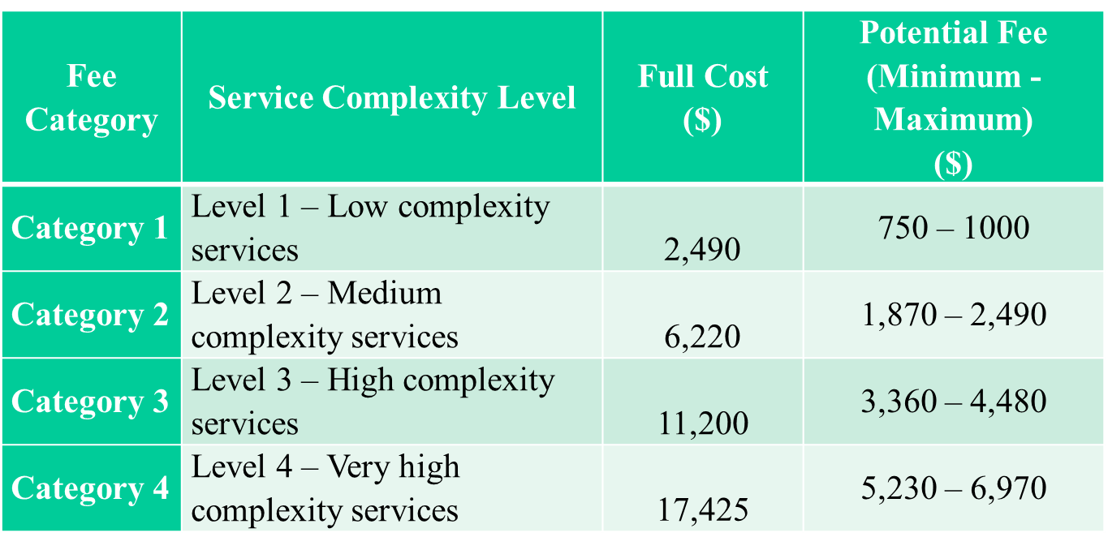
Standards / Guidelines / Other
TDGR training, (new standard being drafted)
TDG fee structure

Slide 12
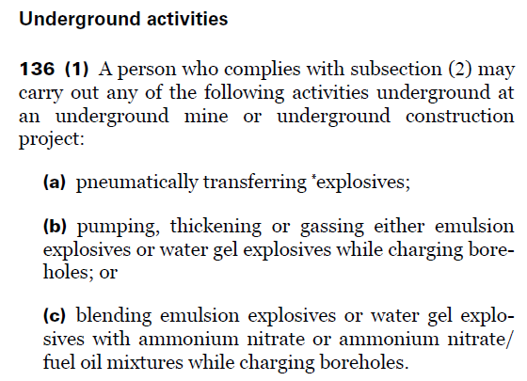
Standards / Guidelines / Other
Part 5 , Division 3, Section 136, Underground Activities
Language does not reflect current practices.
Gear pumps; electrically / hydraulically powered.
Bulk underground storage.

Slide 13
Questions?

