Slide 1

CEAEC MEETING
Ottawa, November 2017

Slide 2

Regulatory Committee
Bulk Guideline Review
Amendment 02 ER-2013
Surface use of underground equipment
Amendment 03 ER-2013

Slide 3
Bulk Guideline Review
ERD request for comment / suggestions
  ~60 day window.
  ~105 recommendations.
  Clarification meeting held mid-October.
  Preliminary draft rev 7.
  Positive acceptance of suggestions.

Slide 4
Bulk Guideline Review
Highlights
  Document functionality, searchable index and hyperlinks.
  Better alignment with provincial OHAS, NFPA and federal standards.
  Removal of the ANP “one” container rule for Satellite sites, (to be 100,000 kg).
  Removal of the 800 km separation distance for Satellite sites.

Slide 5
Bulk Guideline Review
Highlights
  Removal of the 450 km separation distance to a client site.
  Consideration of location, (mine sites) for the ANE /ANP security and locking requirements.
  Allowance for flammable cabinets within explosives areas.
  Clarification of man-limits, (visitors / blasters).

Slide 6
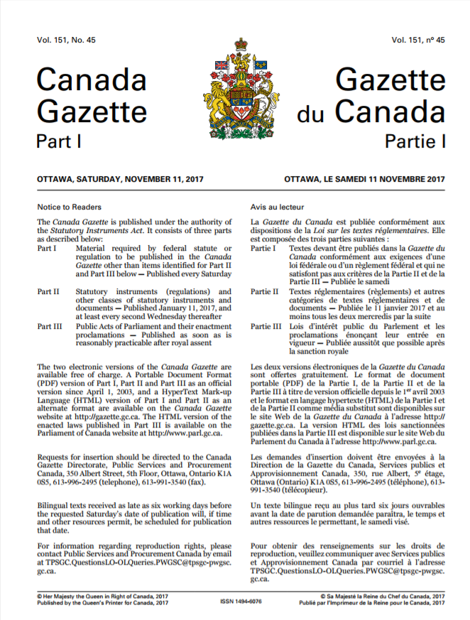
Amendment 02
Waiting for the gazette 1 publication.
Number 46?
30 day public comment period.
http://www.gazette.gc.ca/rp-pr/p1/index-eng.html

Slide 7
Surface Use of Underground Equipment
Concept was rejected due to the division 3 exemption reference to “underground”.
Possible form F05-MPU application.
Adding underground equipment to the F05-01B of the respective base division 1 license.

Slide 8
Surface Use of Underground Equipment
Via amendment 03, request an addition to part 5 / division 3 exemptions for the use of underground equipment on surface.
Request / suggested wording would parallel section 136 with the addition of bulk conditions that are currently on the form F05-03 of a division 1 license.

Slide 9
Amendment 03
CEAEC preparing comments and suggestions.
Submission to ERD by December 2017.

Slide 10
Questions?

