Slide 1
IMESAFR 2.1 and AN Module Overview
CEAEC Meeting, Ottawa, Canada
Nov. 15, 2018 W.B. Evans APT

Slide 2
Topics
Regulatory Overview
  Canada/ERD
  Ports
  CAF
IMESAFR 2.1 Update
  AN Module
  IMESAFR v2.1
Path Forward
  IMESAFR 3.0
  Numerical Criteria
  ISP
  Proposed Test Program

Slide 3
Regulatory Overview
Canada/ERD
  IMESAFR was developed by a US organization with a US focus, but not exclusively so
    Other regulators recognized the potential for such a QRA tool
    Acceptance/Interest was particularly strong in Canada, Australia, and Europe
  Canada was particularly proactive/active and had two people (one from each of ERD and CERL) on the IMESAFR Development Team from the start
  ERD was accepting QRAs for specific specialist applications, e.g., highway twinning, prior to the development of IMESAFR
    This was limited for both company and regulator by the limited capability for estimating consequences
    ERD saw IMESAFR as a critical tool in improving, especially, the consequence side of QRAs

Slide 4
Regulatory Overview
  ERD quotes IMESAFR in both regulations and guidelines as an acceptable QRA tool
  ERD also mandates the use of IMESAFR – or equivalent – for some applications for QD derogations (the equivalent of ATF variances)
  Both CERL and ERD have trained people and use IMESAFR internally
    There is also support in NRCan and the Government for QRA/IMESAFR
Ports
  License limits for Ports has become a topic of significant interest in both Canada (Halifax, Montreal) and the US
    ERD has generated draft guidelines for QRAs for Ports and wharves
      These reference both IME Guidelines for port QRAs and IMESAFR as a tool
      Numerical risk criteria are also quoted

Slide 5
Regulatory Overview
  QRA and IMESAFR as a QRA tool are broadly accepted by the Canadian explosives regulatory agencies
    The initial definition of acceptable risk criteria is particularly promising
CAF
  The Canadian Armed Forces (CAF) were interested in the adoption of a quantified risk assessment tool
    Reviewed the potential of IMESAFR and are now using IMESAFR as part of their Ammunition and Explosives Risk Assessment Safety Case (AERASC) process
    Several members of the CAF were trained at the April 2018 course in Ottawa
    The CAF have been asked to provide a nominee for the IMESAFR Development Team and possibly the ISP

Slide 6
AN Module
The AN Module was developed by APT for the IME with the assistance of the (IME) AN Working Group and the IMESAFR Development Team
  IMESAFR already had the capability to model AN explosions but used the normal ‘TNT engine’ to do so
    The IME community felt that the TNT engine was very conservative compared to reality, i.e. AN explosions would be much less efficient/energetic than the TNT model would predict
  The main thrust of the AN Module development was in the generation of an ‘AN Engine’ to model the explosions
  As well, two new PES Types (railcar and overhead silo) were developed to be included with the AN Module
    The overhead silo will also work with Class 1 materials and the TNT engine (as will railcars but not a probable PES for anything except AN)
  The AN explosion waveform was generated using experimental data from member companies and what was available from government/military sources
    The rest was ‘filled in’ using best physics and engineering models

Slide 7
AN Module
What is different? (Everything)
  Initial explosion
    Energy as per SAFEX Storage of TGAN Guidelines
    Thermal, Pressure and Impulse terms
  Interaction with the PES
    Break up of PES, velocity and throw distance of debris
  Interaction with ES (due mainly to different P and I)
  Interaction with population(s) at risk
As would be expected, the TNT engine is more conservative than the AN engine at most PES/ES combinations at most distances
As might not be expected, for some combinations the AN engine will return higher risk numbers at significant distances (where the individual risk is already below 1 E-08)
  An example of the famous long tail of AN/ANFO explosions?

Slide 8
IMESAFR v2.1
IMESAFR v2.1 is available as a ‘finished’ version, although work is continuing on it and updates are released periodically
There was a delay in the original release due to the version of Java underlying v2.0 no longer being available. which forced the complete recoding of the entire program, not just the upgrade parts
  IMESAFR 2.1 looks different than 2.0 but works exactly the same for the unchanged portions of the program
IMESAFR 2.1 is a significant upgrade based on input/feedback from
  The user community
  The Development Team
  The ISP (IMESAFR Science Panel)
The Development Team prioritized the (long) list of potential upgrades and recommended the list of upgrades/new features to be included
  Accepted by the IMESAFR Subcommittee, Tech Committee, SC/BoG

Slide 9
IMESAFR 2.1
New features (GUI, etc)
  Ability to treat a PES as an ES
  Auto save functionality
  Undo button*
  Allow PTR labels to be moved
  Ability to have risk contours based on pre-defined ESs
  Note fields for PESs and ESs
  Barricade on and off switch
  Ability to conduct parametric studies
  Option to have a visual indicator that an ES is affected by a PES*
  User-defined risk color coding
  Zoom/pan to a specific structure so that a structure can quickly and easily to centered
  Added more keyboard command shortcuts
  IMESAFR will remember window size and position on opening the application
  Multiple updates to reports
  Ability to generate ATF plot maps*
  Ability to import user-defined PES and ES types
  User-defined pressure arcs
  *These features will be included in future updates

Slide 10
IMESAFR 2.1
Upgraded Algorithms, i.e. better (and less conservative) answers
  Ability to populate effective height and distance for a barricade
  Ability to enter a barricade that blocks vertical debris
  Ability to block side-impact debris when defining a barricade
  Updated debris consequence logic that considers a less conservative treatment of mass distribution. Mass distributions will now have a “Bin G” to account for debris that does not have enough kinetic energy to be considered hazardous (very small pieces). This also includes updated nominal and dynamic mass distributions.
  Updated Potential Debris Window Hazard Floor Area (PDWHFA) calculation that removes conservatism for debris coming through windows.
  The floor and ceiling consequence values have been updated to be more consistent.
  Updated (reduced conservatism) tempered glass logic
  PES blast attenuation will now consider pressure and impulse separately
  Poisson distribution fix for high debris density debris
  Updated logic on building response when user changes default roof type
  Ability to choose a frangible wall or a frangible roof or both

Slide 11
IMESAFR Bin G
Test data demonstrate
  Not all debris is recovered
  Much debris is too small to be lethal at any range
  This is highly dependent on the type of debris, e.g. steel (minor effect) vs concrete (major effect)
  IMESAFR 2.0 treated debris generation very conservatively
    All, e.g., walls were assumed to generate potentially lethal debris
    The ‘missing’ debris from test data was distributed across all bins
Bin G accounts for the mass of debris that is considered to pose no hazard to a person after an explosive event because of the very small KE of the fragments.
  Bin G fragments are not tracked in the IMESAFR algorithms because of their non-hazardous nature.

Slide 12
Bin G Nominal mass Distribution
Material Type % Total Mass | Bin 1 | Bin 2 | Bin 3 | Bin 4 | Bin 5 | Bin 6 | Bin 7 | Bin 8 | Bin 9 | Bin 10 | Bin G
Standard Concrete | 0.00 | 0.43 | 2.49 | 5.63 | 5.81 | 5.82 | 4.52 | 4.66 | 4.62 | 5.24 | 60.78
Thick Concrete | 3.64 | 3.35 | 4.63 | 6.31 | 7.56 | 8.1 | 8.06 | 7.77 | 7.51 | 7.52 | 35.55
Wall Rebar | 0.00 | 57.6 | 29.7 | 10.1 | 2.00 | 0.50 | 0.10 | 0.00 | 0.00 | 0.00 | 0.00
Composite Roof | 45.6 | 17.0 | 10.5 | 8.10 | 3.70 | 4.60 | 3.50 | 3.20 | 1.90 | 0.90 | 1.00
AGBS | 0.00 | 4.00 | 4.00 | 8.00 | 32.0 | 8.00 | 4.00 | 4.00 | 4.00 | 12.0 | 20.0
HCT Wall | 0.75 | 1.50 | 2.25 | 3.00 | 3.75 | 4.50 | 6.00 | 4.50 | 3.00 | 0.75 | 70.0
HCT Roof | 0.00 | 0.00 | 1.50 | 1.50 | 1.50 | 4.50 | 6.00 | 7.50 | 4.50 | 3.00 | 70.0
ISO | 34.0 | 12.0 | 10.0 | 10.0 | 8.00 | 9.00 | 6.50 | 5.00 | 2.70 | 1.40 | 1.40
Ship and Steel ECM | 50.0 | 12.5 | 10.0 | 9.70 | 6.30 | 6.20 | 3.10 | 1.60 | 0.50 | 0.10 | 0.00
PEMB | 30.6 | 11.8 | 10.5 | 10.3 | 8.50 | 9.90 | 6.80 | 5.60 | 3.10 | 1.50 | 1.40

Slide 13
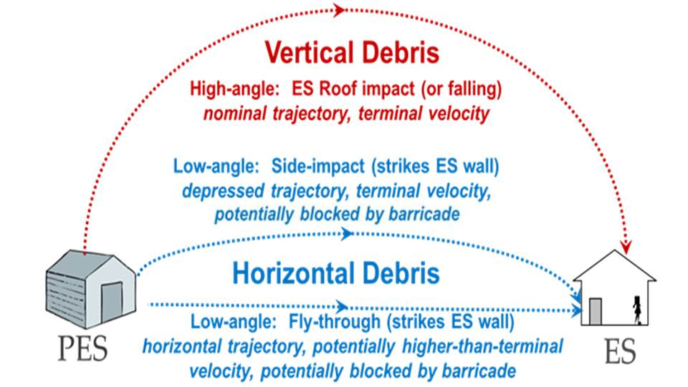
IMESAFR 2.1 Blocking Debris

Slide 14
Debris Treatment 2.1 vs 2.0
In 2.0 (almost) all debris is potentially lethal ‘at range’
In 2.1, Bin G can remove a significant portion of debris from the calculations
In 2.0, barricades can remove all the low angle, fly through debris but this is always a fixed percent of the horizontal debris (maximum 50%)
  Explosives are always considered to be on the floor of the PES
In 2.1 the user can use actual positions of inventories, building height vs barricade height, etc to also remove a realistic percentage of the low angle side impact component of horizontal debris
In 2.0, vertical debris cannot be blocked by barricades
In 2.1, a supplemental KE value can be entered which acts as a primary blockage of vertical debris

Slide 15
Path Forward: Imesafr 3.0
A final decision on ‘2.2’ or 3.0 has not been taken
  IMESAFR 2.x would be an upgrade of 2.1
    There were many features/potential improvements for 2.0 that were not implemented in 2.1
      None would be as impactful as, e.g., Bin G or treatment of horizontal debris
    Some improvements from 2.0 to 2.1 were only partially implemented, e.g., frangible walls/roofs
    Some potential improvements to 2.1 have been identified since release
  IMESAFR 3.0 would include all of the above plus, potentially topography/3D capability, e.g. debris, like golf balls, goes further downhill than uphill

Slide 16
Numerical Risk Criteria
Just like Q/D, QRA requires a pass/fail (possibly with shades of grey) standard
  Three level paradigms, e.g. Pass/ALARP/Fail, are recognized
There is a growing consensus around the pass/fail for public being
  Annual Individual Risk 1 E-06
  Annual Group Risk 1 E-05
Catastrophic Risk Aversion criteria are not widely published/used
The IME proposed the above individual risk level to the ATF and the ISP recommended a three level group risk system (1 E-04 to 1 E-05 as a “Maybe Region”)
The ATF requested an external review of the P_{e} methodology
  This has been completed and the ISP has developed a response document
  The peer review determined the methodology to be sound
During the review of license limits for the Port of Halifax, ERD and the IME discussed numerical risk criteria (as in the IME Guidelines) and these criteria are in the draft ERD Guidelines

Slide 17
IMESAFR Science Panel
ISP was founded at the request of and funding from the ATF
  The desire was to mirror the Science Panel role for the DDESB (SAFER) for commercial explosives
  The ISP is made up of people from IME member companies, APT employees, regulators, and outside experts
  The two components of that role are
    Identify potential improvements to IMESAFR
    Provide technical evidence to support any proposed changes/additions
      This is particularly true when the proposed change will reduce conservatism
  The ISP has provided significant benefit to/improvement of IMESAFR
    Recommendation to add Bin G to v2.1
    Recommendation to add more debris blockage to v2.1
    Review of Event Frequencies (almost complete)
    Currently reviewing the Uncertainty term
    Will add more subjects, e.g. frangible walls
  The ISP provides support for any tests

Slide 18
Test Program
Whenever possible, the IMESAFR algorithms are either based on large scale test data or validated by such data
The Development Team put together a Maturity Matrix several years ago, which has been reviewed since
  The Matrix shows what parts of the program are well supported by test data and where the bigger or more critical gaps are
  From this a desired test program is generated (which is not a synonym for carried out)
    Large scale tests are expensive and difficult to organize and carry out
  The assistance of the ATF on the ISP is hugely beneficial
The current test program includes:
  Iron Warrior IV (completed, IME ‘piggyback’)
  AN Railcar (test carried out/data being analyzed, IME ‘piggyback’)
  Overhead silo (blasting agent, ATF/IME, 2019(?))
  Perforating guns (IME, 2019(?))
  ATF Magazines (relatively small quantities in relatively small magazines)

