Slide 1
Explosives Regulatory Division (ERD) General Update
CNFA Meeting - March 2017
Ottawa, ON

Slide 2
Overview
2017 ERD Personnel
eLMS
Amendments to Explosives Regulations, 2013
Part 9
Part 17, Part 18
Regulatory Cooperation Council
ERD Activities
Review of Incidents
Picking and Assembly Guidelines for Display Fireworks
Display Fireworks Manual – Next Edition
Directive #7 - Transporting Fireworks in Trailers
C.4 – Alternate Provision for Large-Calibre Pyrotechnics Shells and Sound Shells

Slide 3
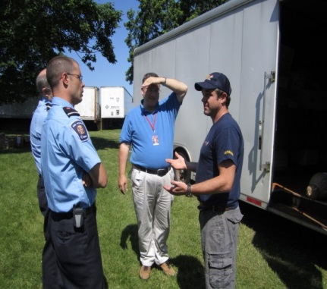
ERD
Director / CIE
Authorization & Classification
Explosives Specialists
Licensing &
Inspections
Pacific Region
British Columbia /
Yukon
Western Region
Alberta / Saskatchewan / Northwest Territories
Central Region
Ontario / Manitoba
Eastern Region
Quebec / Nunavut / Atlantic Provinces
Operational Policies
- Import / Export / In-transit
Storage / QD
Technical
Transport
Fireworks Program
Security Screening
Restricted Components

Slide 4
2017 ERD Personnel
Director/CIE – Jean- Luc Arpin
National Manager – Charles Montpetit (Acting) | Specialists Manager – Serge Dionne
Pacific Region Manager – Rod Boulay Inspector - David Murdoch Assistant – Kelp Watson Western Region Manager – David Mohn Inspector – Tushna Soonawalla Inspector - Rebecca Holmberg Assistant – Wanda King HQ Op. Policies – Isabelle Gagné Inspectors – Greg Choryhanna Mike Farbod Meagan Martin Mark Wilansky Eastern Region Manager – Viviane Dewyse Inspector - Jean-François Viger | Transport, QD, Risk Sebastian Towler Security Screening and Maurice Pinco Restricted Components Fireworks Rachel Robbins Import, Export and Pavel Zraly In-transit In Training Michael Lafleur
 | Authorization – Marie Vachon

Slide 5
New Electronic Licence Management System (eLMS)

Slide 6
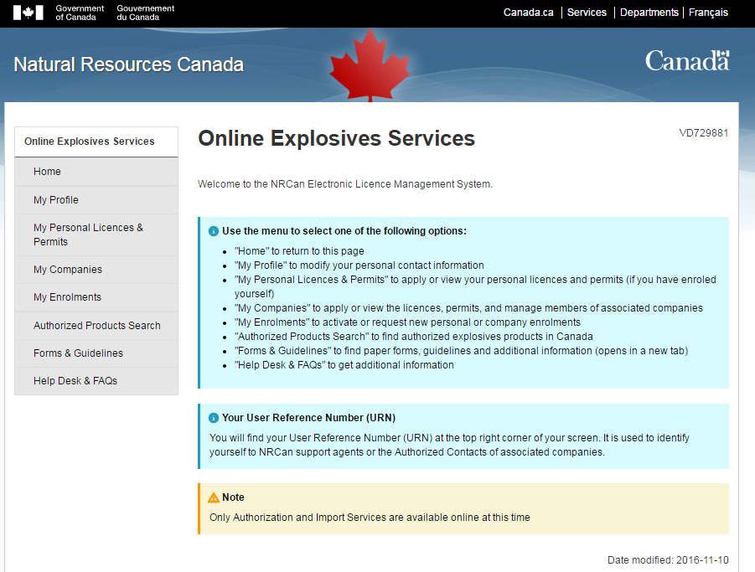
New Electronic Licence Management System (eLMS)
The modernization of the LMS system will provide significant benefits to explosives stakeholders.
An integrated, easy-to-use secure web application that will allow stakeholders to apply, renew and make adjustments to licences online.

Slide 7
Services include:
Licences and certificates for manufacturing explosives – includes receiving and responding to new requests, amendments, renewals and fee payment;
Explosives storage licences (magazines) – includes receiving and responding to new requests, change of location, renewals and fee payment;
Processing of vehicle authorizations – includes receiving and responding to new requests and change of location;
Fireworks supervisor and pyrotechnic certification – includes application, certification, renewals, and fee payment;
Incident reporting – includes receiving and recording incident reports, and
24/7 access.

Slide 8
eLMS Services
The new electronic Licence Management System (eLMS) will improve data integrity, quality and efficiency of explosives services delivered
Benefits include:
Secure web environment that will allow stakeholders to apply, renew and make adjustments to licences online (currently Import permits and Authorization activities are available)
Faster response to requests for explosives services (electronic vs mail)
Track status of applications and amendments
Improved efficiency and tracking
Online payment of fees
Full control of the management of company members
Quick and easy changes to names and addresses
Online incident and annual reporting
Enhanced security and confidentiality of data collected used for administering explosives regulations
Real time Authorized Product list

Slide 9
eLMS Release Schedule
Release 1 March 21, 2017 | Releases 2 to 4 Current Fiscal Year
ePortal: Cyber Authentication NRCan registration (eServices) Explosives Services (eLMS) enrollment eLMS Import permit (apply, amend, renew, reporting) Product authorization (apply, amend) SWI Integration with SWI – Explosives ‘go live’ | Release 2 - Export Permit, In-transit permit, Security Screening Release 3 – Fireworks, Restricted components, Manufacturing (including MPU) Release 4 – Annual Reporting, Incident Reporting, Storage

Slide 10
Single Window Initiative (SWI) Importation Process
The traditional process for importing explosives is a manual, paper-based process which requires duplication of effort by submitting the same information to CBSA (for release) and to NRCan (to satisfy import reporting requirements)
SWI provides a common electronic integrated importation system to support a secure and streamlined pre-border process
Explosives brokers can now complete the required declaration material prior to shipments arriving at the border. CBSA has automated access to the permit data to facilitate import verification and release. Importers do not need to manage paper permits
Reduced burden to industry - replacement of paper forms/permits and elimination of post-border reporting to NRCan
Enable timely border-related decisions and enhance the flow of goods by reducing border transaction costs / wait times

Slide 11
eLMS Enrollment Process
Users will require either a Government of Canada MyKey or a Partner User Id and password.
Registration will include a ‘Request for Enrollment’ to enroll as either a company or an individual and a confirmation of applicant’s email address for email verification.
Once an enrollment request is approved, applicants will receive an Enrollment Letter in the mail that provides the User Access Code needed to complete the enrollment process.

Slide 12
For more information:
https://www.nrcan.gc.ca/explosives/resources/publications/19434

Slide 13
Regulatory Cooperation Council
ESSB has established with PHMSA
Regulatory Partnership Statement
To establish a high-level partnership
Workplan
Classification approval criteria
Harmonization
Establish an ongoing working group
Status
Workplan is underway
ESSB exchanged with PHMSA on 3 UN proposals
Addition of UN entries for SP 347 (test 6 (d) )
Amendments to test series 6 (d) / to cover 1.4 other than S
Amendments to test series 8 (c) and (d) / suggesting MBP
Papers 40, 41 and 42 http://www.unece.org/trans/main/dgdb/dgsubc3/c32015.html
…
…

Slide 14
Upcoming Amendments to ER, 2013
Minor amendments are currently being proposed.
Of specific interest to the Fireworks Industry:
Part 9
Part 17
Part 18

Slide 15
Part 9 – Transportation Port Surveys
Current regulatory requirements
S. 155 of Cargo, Fumigation and Tackle Regulations require:
Inspection to be conducted by an Inspector of Explosives as per Q-D manual as if a licence is issued under the Explosives Act
Issue: assessment of loading/unloading is done as if it were for fixed facilities
Case Study of Port of Halifax, with IMESAFR
Regulatory initiative underway to amend ER, 2013 & CFTR – acceptance of risk based surveys

Slide 16
Part 17 – Special Effect Pyrotechnics
Deletion of requirement to store e-matches in a separate magazine from SFPX
Addition of Type S.1 and Type S.2 to the definition of “special effect pyrotechnics”
Reduce 2 year period to 1 year period between upgrade levels
Reduce 3 letters of recommendation to 1 letter required in an upgrade
Storage limits at the site of use will be the same as un-licenced user (25kg)

Slide 17
Part 18 – Display Fireworks
Revision of wording for record of sale for the seller re: licence or copy of AHJ permission
Revision of wording for requirements for written plan re: product list. I.e. the product list must include the diameter in mm of the largest aerial shell to be used.
Addition of a requirement that the supervisor in charge is obligated to ensure that only certified users may handle fireworks in the danger zone/fallout zone

Slide 18
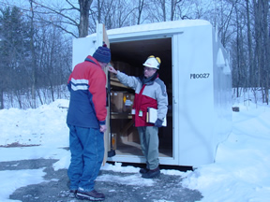
ERD Activities
Authorization
Continuing Authorization / Non-Conformities
Importation/Exportation/In – Transit
Restricted Components
Licences
Fireworks Certification Program

Slide 19
Authorization |  | Q1 | Q2 | Q3 | Q4
 | Year 2015/16 | Apr-May Jun | Jul-Aug Sep | Oct-Nov Dec | Jan-Feb Mar
App. received for indefinite period | 226 | 64 | 52 | 29
App. received for specified period | 43 | 21 | 0 | 1
# Application Received | 269 | 85 | 52 | 30
Product tested at CERL | 38 | 37 | 24 | n/a
Product approved by CIE | 1830 | 826 | 1519 | n/a
Continuing Authorization - via Sampling (products tested) | 43 | 2 | 13 | n/a

Slide 20
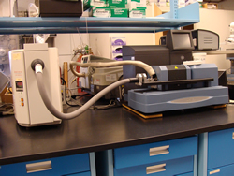
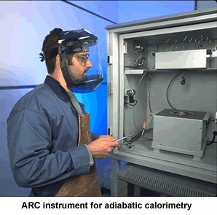
Continuing Authorization Testing
Type of Explosives | Recommended for Continuing Authorization – NO corrective actions required | Recommended for Continuing Authorization – Corrective actions required | Product Recall and Authorization Cancelled
F.1 | 10 / 30 | 17 / 30 | 3 / 30

Slide 21
Non-conformities
Labelling of Articles | 16 / 30
Labelling is not in compliance with s. 47 of ER, 2013
Distance to spectators is not 2X the height of the effects
Safety warnings and instructions for use not consistent with the construction of the article
Physical Integrity | 1 / 30
Pyrotechnic composition falling out of the tube
Signs of breaking or cracking in the casing or composition
Pyrotechnic Composition | 5 / 30
Lead and arsenic detected
Presence of undeclared chemicals or non-detection of declared chemicals
Performance | 6 / 30
Item flipped over during functioning
Item caught alight and continued to burn after completion of the test
Fuse time outside the 3 – 6 s
Physical Measurements / Construction of the Article | 6 / 30
Charge mass or gross weight does not match the declareds
Construction does not meet the technical declaration

Slide 22
New Revision of Guidelines for Authorization of Consumer and Display Fireworks
Revision 6 available online (www.erd.nrcan.gc.ca)
In effect since October 24, 2016
The list of changes and updates was sent to the CNFA and the CPC with a copy of the updated guidelines

Slide 23
Importation Exportation/In Transit |  |  | Q1 | Q2 | Q3 | Q4
 | Year 2015/16 |  | Apr-May Jun | Jul-Aug Sep | Oct-Nov Dec | Jan-Feb Mar
Import - Annual | 302 |  | 305 | 309 | 294
Import - Single-Use | 60 |  | 68 | 63 | 41
Export - Annual | 29 | 31 |  | 33 | 34
Export - Single-Use | 8 | 7 |  | 8 | 7
In Transit - Annual | 10 | 11 |  | 11 | 12
In Transit - Single-Use | 14 | 15 |  | 11 | 9

Slide 24
Restricted Components |  | Q1 | Q2 | Q3 | Q4
 | Year 2015/16 | Apr-May Jun | Jul-Aug Sep | Oct-Nov Dec | Jan-Feb Mar
Restricted Component Sellers | 1603 | 1599 | 1580 | 1584
Restricted Component Sites | 2094 | 2090 | 2070 | 2071

Slide 25
Licences |  | Q1 | Q2 | Q3 | Q4
 | Year 2015/16 | Apr-May Jun | Jul-Aug Sep | Oct-Nov Dec | Jan-Feb Mar
Division 1 Factory Licence | 163 | 154 | 142 | 138
Division 2 Factory Licence | 60 | 77 | 79 | 78
F/PE – Fac. Perf | 59 | 56 | 56 | 62
V - Mag Vendor | 101 | 102 | 102 | 99
U - Mag User | 796 | 820 | 814 | 785
U/Z - Mag User Zone | 222 | 225 | 235 | 266
P - Mag Propellant | 295 | 277 | 275 | 269
X - Mag Firework | 116 | 119 | 119 | 115
# Licences by Type | 1782 | 1830 | 1822 | 1812
18 licences cover Picking and Assembly activities

Slide 26
Fireworks Certification |  | Q1 | Q2 | Q3 | Q4
 | Year 2015/16 | Apr-May Jun | Jul-Aug Sep | Oct-Nov Dec | Jan-Feb Mar
People Certified | 10174 | 10667 | 10677 | 10693
Courses given by Certified Course Providers | 103 | 58 | 11 | 23
Attendees for Courses given by Certified Course Providers | 1033 | 543 | 106 | 184

Slide 27
Incidents
ER, 2013 - Section 167 (2) - A holder of a licence, permit or certificate must inform an inspector as soon as the circumstances permit of any of the following incidents that involves an explosive under their control:
(a) the theft, attempted theft or loss of an explosive;
(b) a fire, spill or accidental explosion;
(c) an injury or death; or
(d) any accidental property damage.

Slide 28
F.1 - Consumer Fireworks – 3 reported since October 2015
Month | Incident
Nov | Property Damage - Fire destroyed two houses and another seriously damaged, which was caused by improper disposal of fireworks. The blaze started in the garage of the house. The homeowners had put on a large-scale fireworks display in their driveway celebrating Diwali that night.
Jul | Injury – Two person were hit by a consumer firework.
Sept | Injury – House fire which may have been caused by careless use of fireworks. Still under investigation by Ontario Fire Marshal’s office. A 21 year old man died in the fire and a woman was in critical condition in hospital.

Slide 29
F.2 - Display Fireworks – 4 reported since October 2015
Month | Incident
Jul | Injury – During hand firing, the effects from a display cake hit the shooter.
Jul | Property Damage – The zip ties holding the roman candle broke and the candle effects fired towards the audience. No injuries.
July | Property Damage – Debris from a display fireworks show travelled much further outside the danger zone. No injuries.
Oct | Injury – Electric match functions while being inserted into plastic connector on fuse. Technician severely injured but making a good recovery.

Slide 30
F.3 - Special Effect Pyrotechnics – 2 reported since October 2015
Month | Accident/Incident
Jul | Property Damage – An effect hits the sound baffling in a ceiling during a demonstration for AHJ. Sound baffling smoldered and slightly melted. No injuries.
Sept | Injury – An effect from a comet board lands in the audience. Effect appeared to burn longer than normal. Minor injury to audience member.

Slide 31
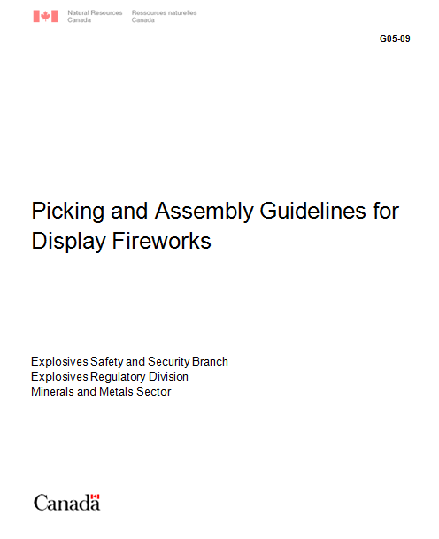
Picking and Assembly of Display Fireworks Guidelines G05-09
Final Draft and review of comments sent to CPC on June 8th, 2016
No further comments received
Final Revision will be sent to fireworks industry – April 2017

Slide 32
Directive #7 - Transporting Fireworks in Trailers
The transport of explosives will be permitted in a towed trailer when the driver of the tow vehicle holds a fireworks operator certificate (display assistant, display supervisor or display supervisor with endorsements) and the explosives being transported are the numbers:
UN 0333, FIREWORKS
UN 0334, FIREWORKS
UN 0335, FIREWORKS
UN 0336, FIREWORKS
UN 0337, FIREWORKS

Slide 33
The driver of the vehicle must ensure the following requirements are met:
No more than 750 kg NEQ of explosives are transported in the trailer;
There is a weight distribution hitch installed between the tow vehicle and the trailer;
The tow vehicle is a rear wheel drive and has a 3000 lb (1360 kg) minimum tow rating; and
The trailer hitch is locked to the receiver using a keyed locking mechanism.
The towing vehicle and trailer must also conform to the respective provincial laws and regulations, including CGVWR (combined gross vehicle weight rating).

Slide 34
C.4 – Alternate Provision for Large-Calibre Pyrotechnics Shells and Sound Shells
As per Section C. 4 in the CAN/BNQ 2910-510/2015 Explosives - Quantity Distances:
“a magazine used to store less than 100 kg gross mass of large-calibre pyrotechnics shells and sound shells (PES classified as PE1) may not have to comply with the requirements of Chapter C.1.”

Slide 35
Alternate Provisions
Alternate provisions are currently being developed and will be sent to the industry shortly for consultation.

Slide 36
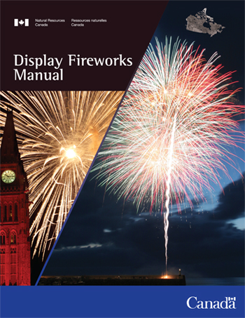
Display Fireworks Manual – Next Edition
Request for comments sent out October 18, 2016
Comments due by February 1st 2017
First Draft will be created and re-circulated to the stakeholders
Final Version will be ready by Spring 2018

Slide 37
Looking Forward…
Implementation of eLMS
Amendments to the Explosives Regulations, 2013

Slide 38
Explosives Safety and Security Branch (ESSB) Explosives Regulatory Division (ERD)
Questions?
Headquarters Ottawa
Authorization - Import - Export - In-transit – Fireworks Certification Program
(613) 948-5200
ERDmms@NRCan.gc.ca
Pacific Region (Vancouver)
British Columbia / Yukon
Magazine Licences - Inspections
(604) 666-0366
ERDpacific@NRCan.gc.ca
Western Region (Calgary)
Alberta / Saskatchewan / Northwest Territories
GLF & Magazine Licences - Inspections
(403) 292-4766
ERDwestern@NRCan.gc.ca
Central Region (Ottawa)
Ontario / Manitoba
Factory & Magazine Licences - Inspections
(613) 948-5187
ERDcentral@NRCan.gc.ca
Eastern Region (Varennes)
Quebec / Nunavut / Atlantic Provinces
Magazine Licences - Inspections
(450) 652-2345
ERDeastern@NRCan.gc.ca

