Slide 1
CEAEC SPRING MEETING
April 27th and 28th, 2022
Regulatory Committee

Slide 2
Regulatory update
Explosives Regulatory Division
ER-2013
Magazine door locks
UN0332 / UN3375
Transport Canada
Supporting standards
Other

Slide 3
ER-2013 (Regulatory Review)
Regulatory Review of the Explosives Regulations, 2013, (late April, 2021)
Request for comments / suggestion, (late May, 2021).
A total of 40 comments / suggests where submitted.
Document design / framework.
Regulatory specific.
Policy related, (license renewal frequency / inventory reporting requirements etc).

Slide 4
ER-2013 (Regulatory Review)
Release of “What we Heard” report.
ERD review, fall meeting November 2021.
Consultation Document for Proposed Amendments, (112 line items).
Regulatory committee has commenced document review.
Positive change
Adoption of many CEAEC recommendations.
Review timelines?

Slide 5
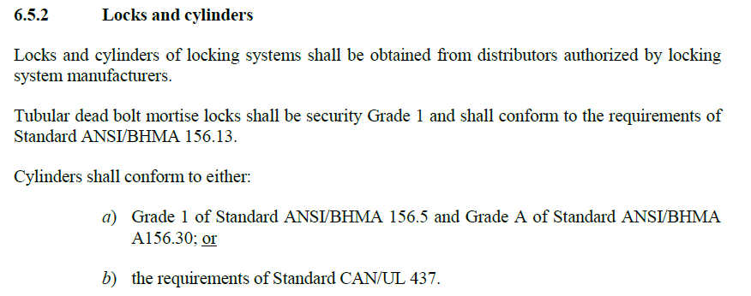
Magazine Door Lock Replacement
Revised letter issued by ERD to CEAEC, November 10, 2021.
Compliance with part with part 6.5 of the CAN/BNQ 2910-500/2015 magazine standard.
Compliance deadline July 31, 2026.

Slide 6
UN0332 / UN3375, (TDG / ERD)
Current TDG regulations will not allow for the transport of UN3375 materials in Canada.
Effort is now underway for the reclassification of specific bulk ANE’s from the current UN0332 to a UN3375, 5.1 oxidizer classification.

Slide 7
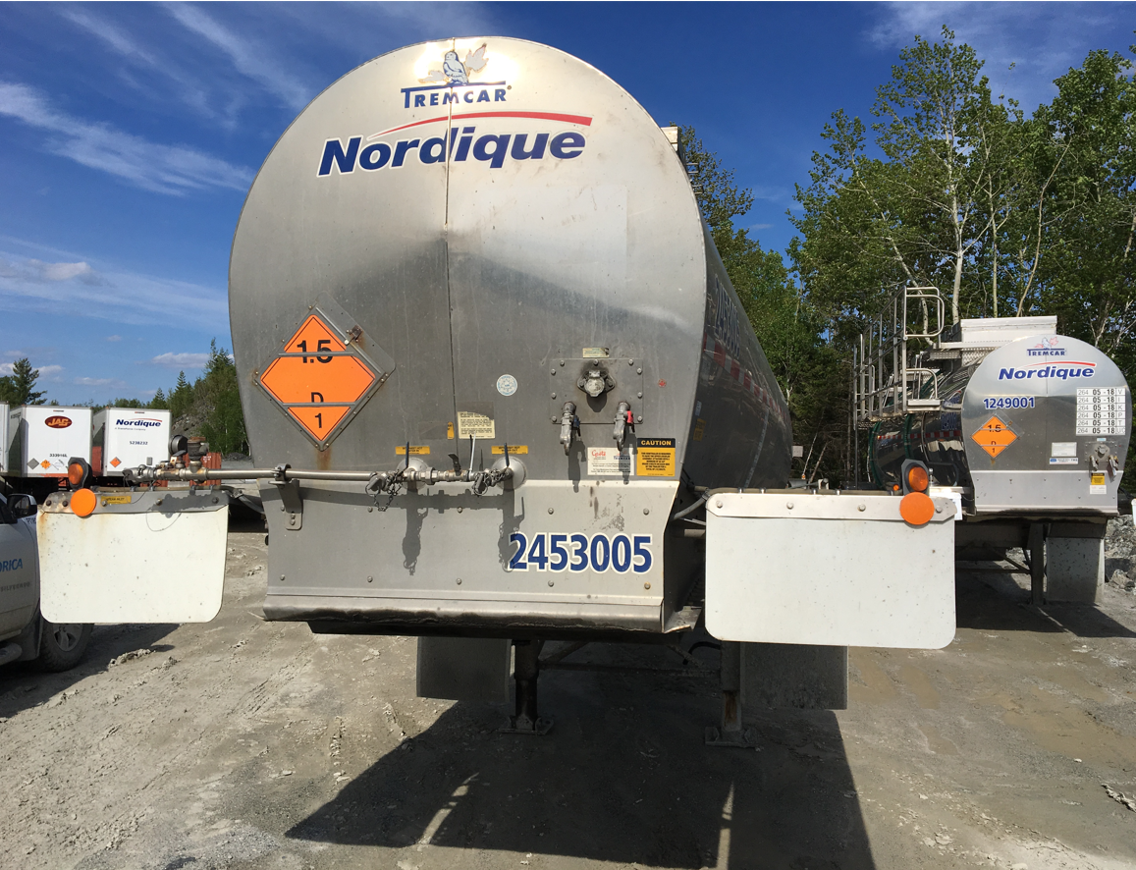
UN0332 / UN3375, (TDGR / ERD)
Via the input of CEAEC member companies, an application, (Equivalency Certificate) was forwarded to Transport Canada, December 14, 2021.
Road transport only, within three means of containment,
road tanker
UN portable
IBC’s

Slide 8
UN0332 / UN3375, (TDGR / ERD)
Potential benefits are;
Positive environmental impact, (larger loads / reduction in travel frequency / reduction in greenhouse gases).
Economic / international competitiveness.
Alignment with CFR 49.
Alignment with the UN Model Regulations.

Slide 9
UN0332 / UN3375, (TDGR / ERD)
The majority of the regulatory / standards revisions needed fall under T.C.’s remit, ~5 standards.
ERD / TC have conducted initial meetings and are reviewing the regulatory framework
UN model regulation alignment.
Material classification.
Global best practice considerations.
Existing regulatory impact.
Timelines?

Slide 10
ERD, (supporting standards)
CAN/BNQ 2910.500/2012, Magazine Standard
Standards committee vote ~April 2021.
CEAEC & other members voted negative.
Revised standard (R 2022) published April 13, 2022.
Reaffirmation.

Slide 11
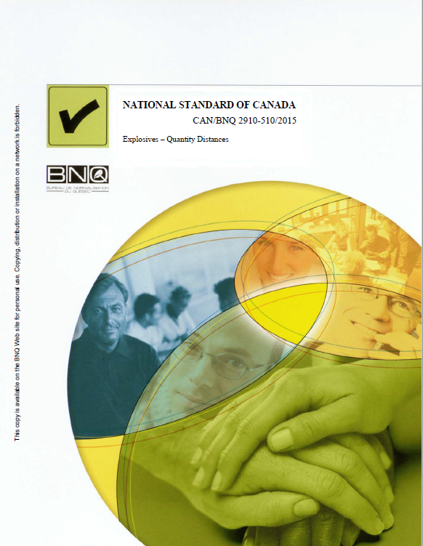
ERD, (supporting standards)
CAN/BNQ 2910.510/2015, Q/D Standard,
Request for committee members April 2021.
No further communications.

Slide 12
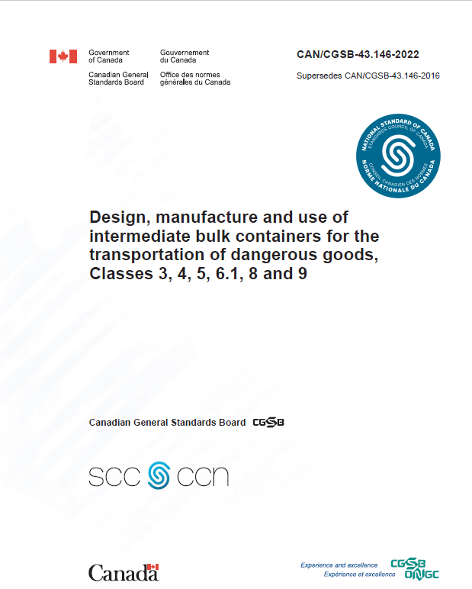
Regulations / Standard Updates
CGSB-43.146-2022: Design, manufacture and use of intermediate bulk containers for the transportation of dangerous goods
CEAEC vote -positive.
Published March 2022.
Available at no cost
In force September 30, 2022.
Canadian General Standards Board Catalogue - Publications - CGSB - PSPC (tpsgc-pwgsc.gc.ca).

Slide 13
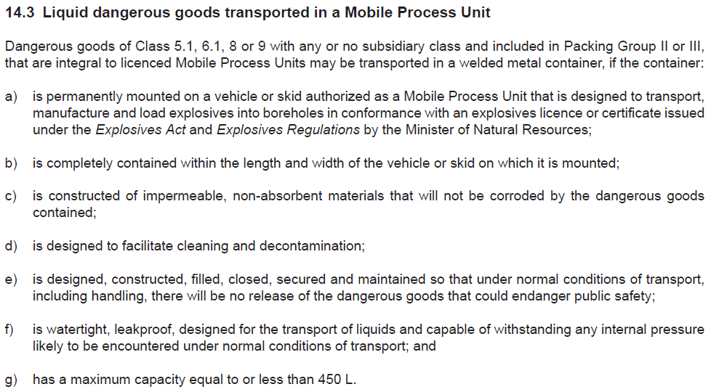
Regulations / Standard Updates
CSGB 43.150-2020, Small Packaging:
A new standard that will replace TC internal TP14850 standard.
Notable highlight is part 14.3 which will allow for non-spec <450L SMoC on MPU’s for class 5.1, 6.1, 8 and 9.
CEAEC vote -positive.
The standard has now been published April 2020.
Requires TDGR amendment, (1.3.1).
Canadian General Standards Board Catalogue - Publications - CGSB - PSPC (tpsgc-pwgsc.gc.ca).

Slide 14
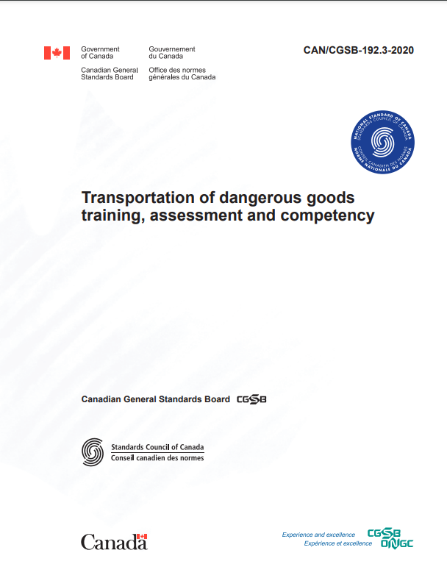
Regulations / Standard Updates
CAN/CGSB-192.3-2020—Transportation of dangerous goods training, assessment and competency, New Standard
CEAEC vote -negative.
Published November 2020.
Available at no cost
Canadian General Standards Board Catalogue - Publications - CGSB - PSPC (tpsgc-pwgsc.gc.ca).

Slide 15
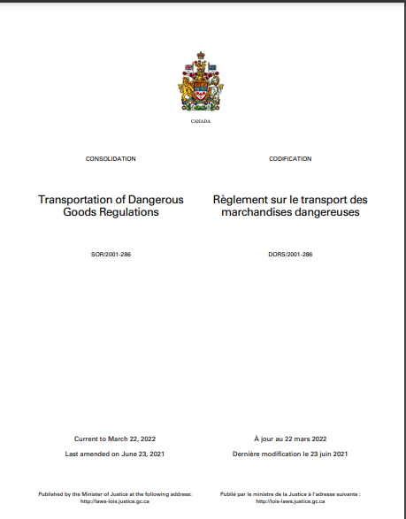
Regulations / Standard Updates
Requires part 1 TDGR amendment 1.3.1 / part 6. Gazette part 1 publication.
Gazette 1 publication / request for comment December 21, 2021.
CEAEC commented January 27, 2022.

Slide 16
Regulations / Standard Updates
“In addition to the TDGR requirements for the handling, offering for transport and transporting of class 1 materials, there are additional requirements contained within the federal Explosives Regulation, (ER-2013)”.
Part 9, Explosives Transportation of the ER-2013 contains special requirements / safe work conditions to ensure safe transport of class 1 materials. Please note that the CAN/CGSB-192-3 standard is silent and does not contain or reference these additional, specific class 1 transport requirements.
To ensure continued, ongoing, safe transport of class 1 materials, the Canadian Explosives Association strongly recommends that a reference to part 9 of the ER-2013 be added to the proposed revision to part 6 of the TDGR.

Slide 17
Regulations / Standard Updates
TDG – CID (Client Identification Database)
New standard currently being developed.
The new standard will require all companies who offer to transport, transport or import, (HOTI) Dangerous Goods to register with TC and report DG movements.
Next Steps
Gazette part I publication, early 2022?
Gazette part II publication, early 2023?
One year grace for company registration / compliance.

Slide 18
Regulations / Standard Updates
TDG – CID (Client Identification Database)
Orica is participating in the program rollout / beta testing.
Testing consists primarily of data entry / feedback.
Further testing scheduled.

Slide 19
National Codes
National Research Council of Canada has released new national codes at no cost.
National Building Code
National Fire Code
National Plumbing Code
NRC's Virtual Store.

Slide 20
Questions?

