Slide 1
CEAEC FALL MEETING
November 02nd and 03rd, 2022
Regulatory Committee

Slide 2
Regulatory update
Topics
UN0332 / UN3375
Magazine Inner Doors Locks
Standard reviews
New standards

Slide 3
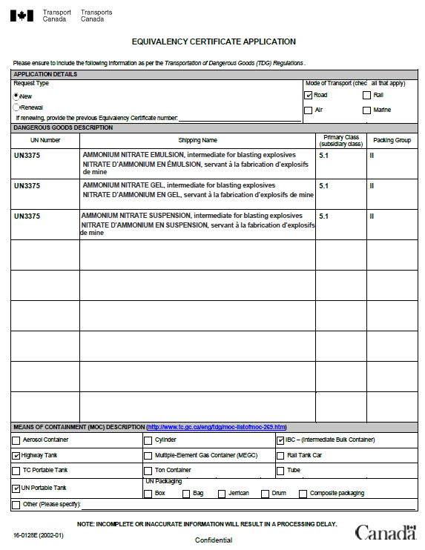
UN0332 to UN3375 classification
3375
Background
All unsensitized bulk ANE’s are considered as a class 1 product.
Current TDG regulations will not allow for the transport of UN3375 materials in Canada.
Formal Equivalency Certificate application submitted mid-December 2021 by the Canadian Explosives Association, (CEAEC) for the reclassification of specific bulk ANE’s from the current UN0332 to a UN3375, 5.1 oxidizer classification.

Slide 4
UN0332 to UN3375 classification
3375
3375
Background
Potential benefits to the product reclassification are;
Positive environmental impact,
larger loads.
reduction in travel frequency.
reduction in greenhouse gases.
Economic / international competitiveness.
Alignment with CFR 49.
Alignment with the UN Model Regulations.

Slide 5
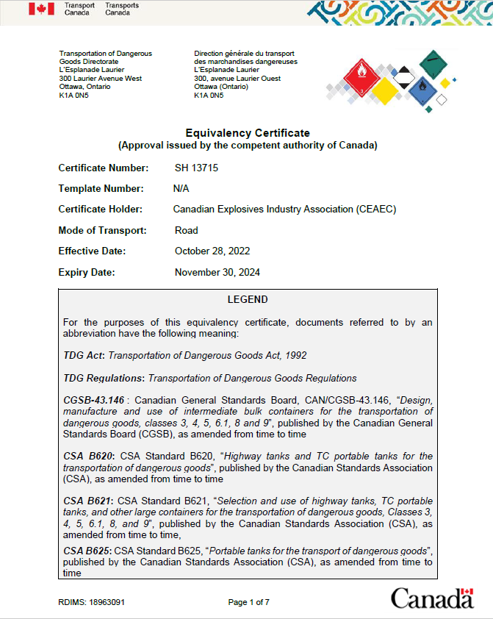
UN0332 to UN3375 classification
3375
Background
Transport Canada and Explosives Regulatory Division with CEAEC membership, worked together towards a positive outcome.
CEAEC received a draft of the EC for review / comment late October 2022.
EC approval / issuance, (SH 13715), October 28, 2022.

Slide 6
SH 13715, EC Conditions
3375
EC Details
Issued to CEAEC for the use of the member companies.
CEAEC to provide formal communication / distribution to all membership companies.
Applies to specific ERD vetted / approved products that meet Special Provision 309 of the UN model recommendations.

Slide 7
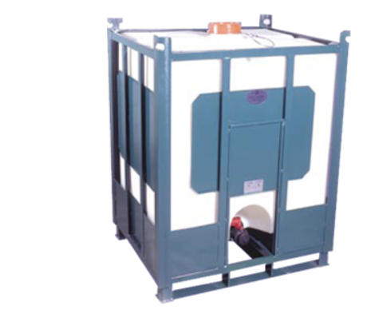
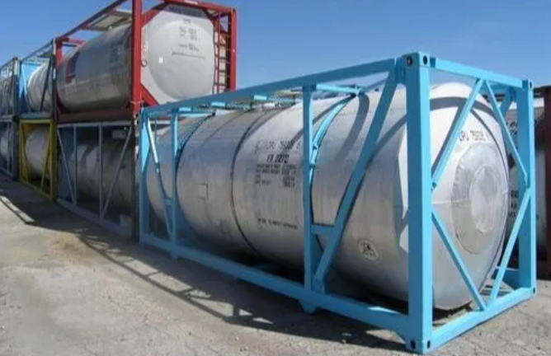
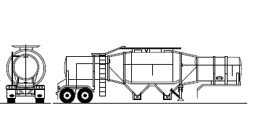
SH 13715, EC Conditions
3375
EC Details
Road transport only, within three means of large means of containment.
UN portable
Tank trailer
IBC’s
A copy of the EC must accompany the shipping documents.
Reference to the EC to be display on the dangerous goods Bill of Lading.

Slide 8
SH 13715, EC Conditions
3375
EC Details
Will require amendment to the individual member companies ERAP to add the new UN number.
All personnel involved in the handling, offer to transport and transport must receive training to ensure,
They are aware of the EC.
Conduct their respective duties in accordance with the EC conditions.

Slide 9
SH 13715, EC Outcomes / Benefits
3375
EC Details
The 20,000 kg limitation no longer applies, weight restrictions are now as per the individual vehicle GVW / RGVW. (part 9.5 (c) TDGR).
Allowance for B-train type transport events by the removal of the towing restriction. (part 196.9, ER-2013).
Removal of the TC-407 sunset clause, (January 01, 2017) for TC-407 LMoC.
- TC-407 MAWP of ≤35psi

Slide 10
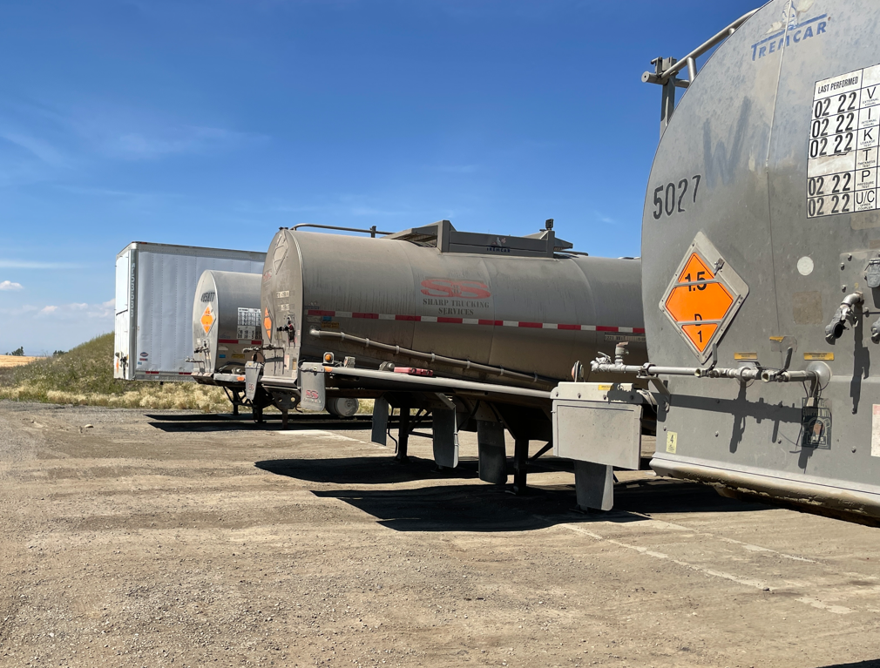
SH 13715, EC Outcomes / Benefits
3375
EC Details
The requirement for load attendance is now removed, (part 199.1, ER-2013).
--Important Note--
When not in transport mode,
ANE product classification is 1.5D.
Explosives Act and Regulations and all supporting standards apply.

Slide 11
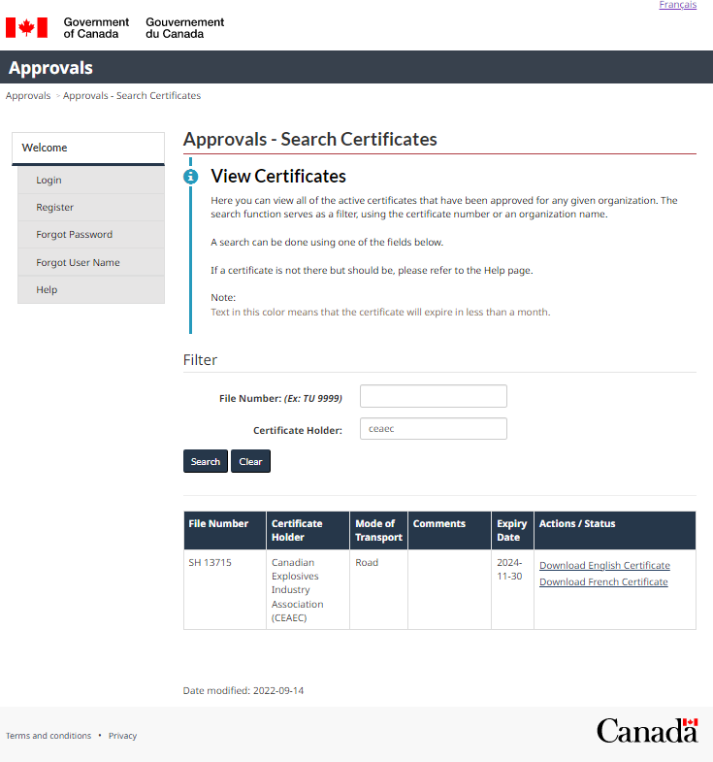
SH 13715
3375
EC Publication
Available on the Transport Canada website.
Equivalency Certificates, use “CEAEC”
French Language
https://wwwapps.tc.gc.ca/Saf-Sec-Sur/3/approvals-approbations/SearchCertificates.aspx?GoCTemplateCulture=fr-CA
English Language
https://wwwapps.tc.gc.ca/Saf-Sec-Sur/3/approvals-approbations/SearchCertificates.aspx?GoCTemplateCulture=en-CA

Slide 12
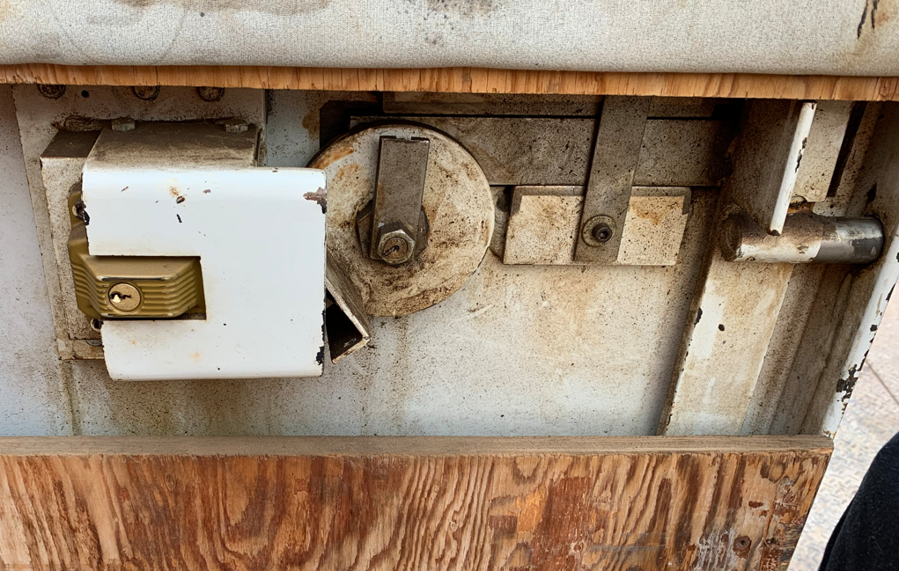
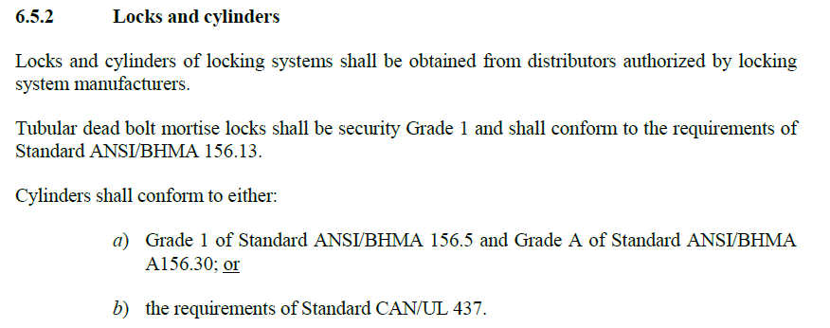
Magazine Inner Door Lock Replacement, (reminder)
Non-compliant
Revised letter issued by ERD to CEAEC, November 10, 2021.
Compliance with part with part 6.5 of the CAN/BNQ 2910-500/2015 magazine standard.
Compliance deadline July 31, 2026.
Compliant

Slide 13
CAN/BNQ 2910-510, Q/D Standard, (Review)
Standard committee members have been selected.
Excellent key stakeholder representation,
federal / provincial governments.
Military.
Commercial explosives.
Fireworks.
Regulatory committee held 4 teams meetings to review standard / provide additional comments.
First two meetings to be held via teams.
Face to Face meetings to be held ~mid-January 2023.

Slide 14
CGSB 43.151 Explosives Packaging Standard, (Review)
Call for committee members.
Anticipated changes to be minor in nature.
Committee meeting venue, (teams / face to face) TBD.

Slide 15
New Standard
TDG – CID (Client Identification Database)
Requirement companies who offer to transport, transport or import Dangerous Goods to register with TC and report DG movements.
Gazette part I publication, late June, 2022, (Comments closed September 2022).
Timelines
Gazette part II publication, early 2023.
One year phase in period for registration.
Annual report / site / UN number
Quantity of DG
- imported
- offered for transport
- transported
Number of consignments

Slide 16
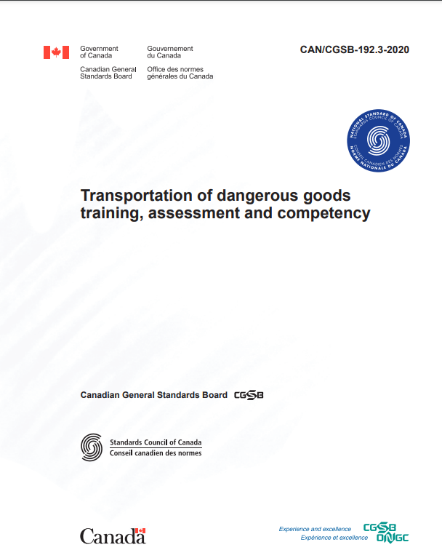
New Standard
TDG Training
CAN/CGSB-192.3-2020—Transportation of dangerous goods training, assessment and competency.
Published November 2020.
Available at no cost
Timelines
Requires part 1 TDGR amendment 1.3.1 / part 6. Gazette part 1 publication.
Gazette 1 publication / request for comment December 21, 2021.
CEAEC commented January 27, 2022.

Slide 17
Questions?

