Slide 1
Ghana Transportation Incident
Jan 20, 2022
Victoria, April 25-27, 2022

Slide 2
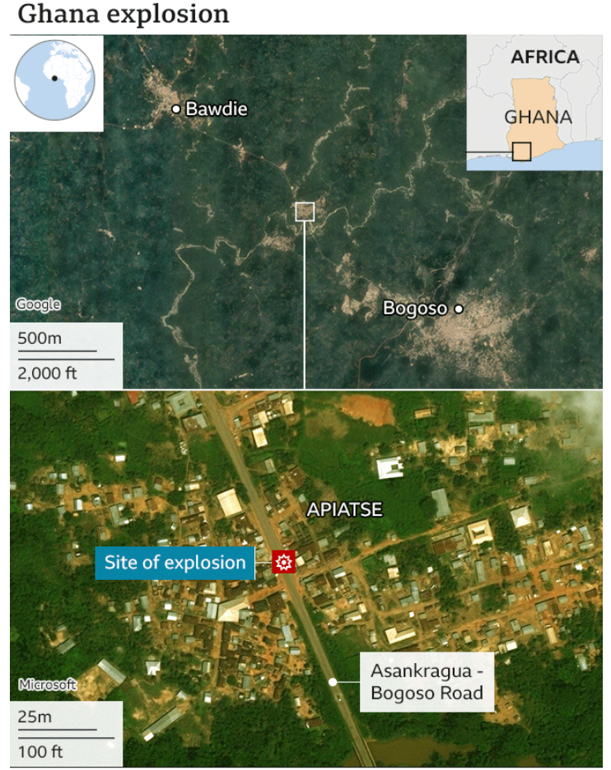
Ghana Incident review – Jan 20, 2022
https://www.africanews.com/embed/1812046

Slide 3
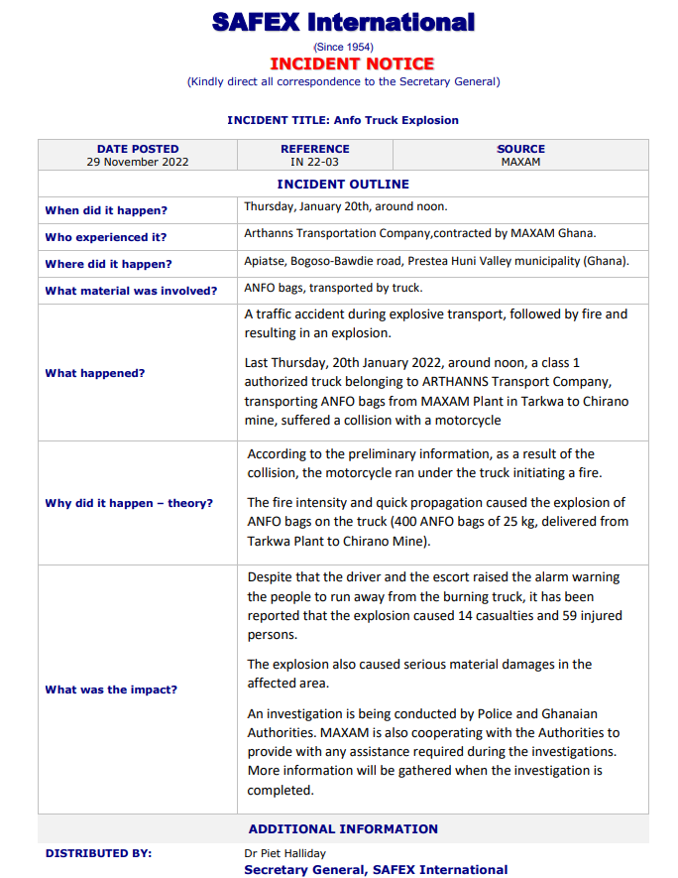
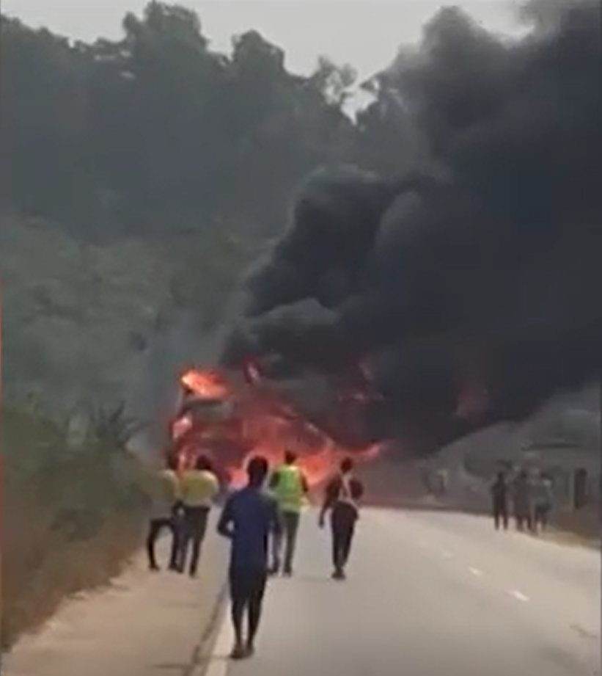

Slide 4
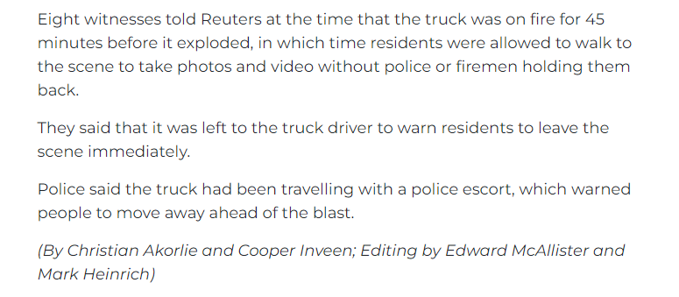
Extract from news reports

Slide 5
Corrective actions taken by the Ghana Government:
Ban on ANFO transportation on a public road to a mine or civil work site unless expressly permitted by the Chief Inspector of Mines.
Explosives guarded by two escort vehicles, one in front and one at the back, both having sirens to warn people about the explosives.
Chief Inspector of Mines notification of their intention to transport explosives 48 hours before the scheduled transportation.
The 14 measures apply fully to all companies involved in manufacturing, supply, transportation, and use of explosives.

Slide 6
Potential root causes and learnings for the Industry :
Insufficient explosives hazards awareness;
Inadequate emergency response and evacuation procedures;
Road safety challenges. Ghana recorded 73 deaths per 1000 collision, making it the second highest road traffic collision prone nation among six West African countries. (US : ~6 deaths/1000 collision); Ghana: 443 deaths/100,000 vehicles. vs .8.9 deaths/100,000 vehicles. – Canada;
Emergency communication challenges.

Slide 7
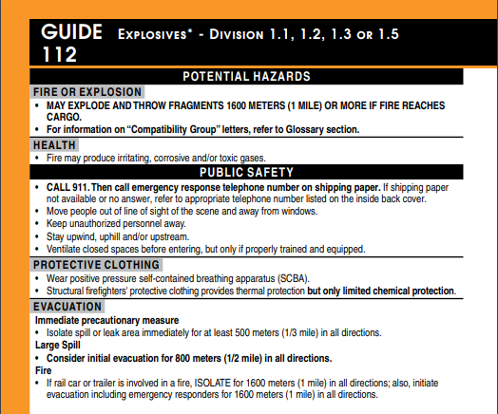
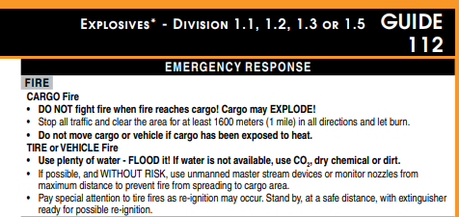
Canadian Emergency Response Guidelines 2020

Slide 8
Frequency of transportation explosion incidents per product type

Slide 9
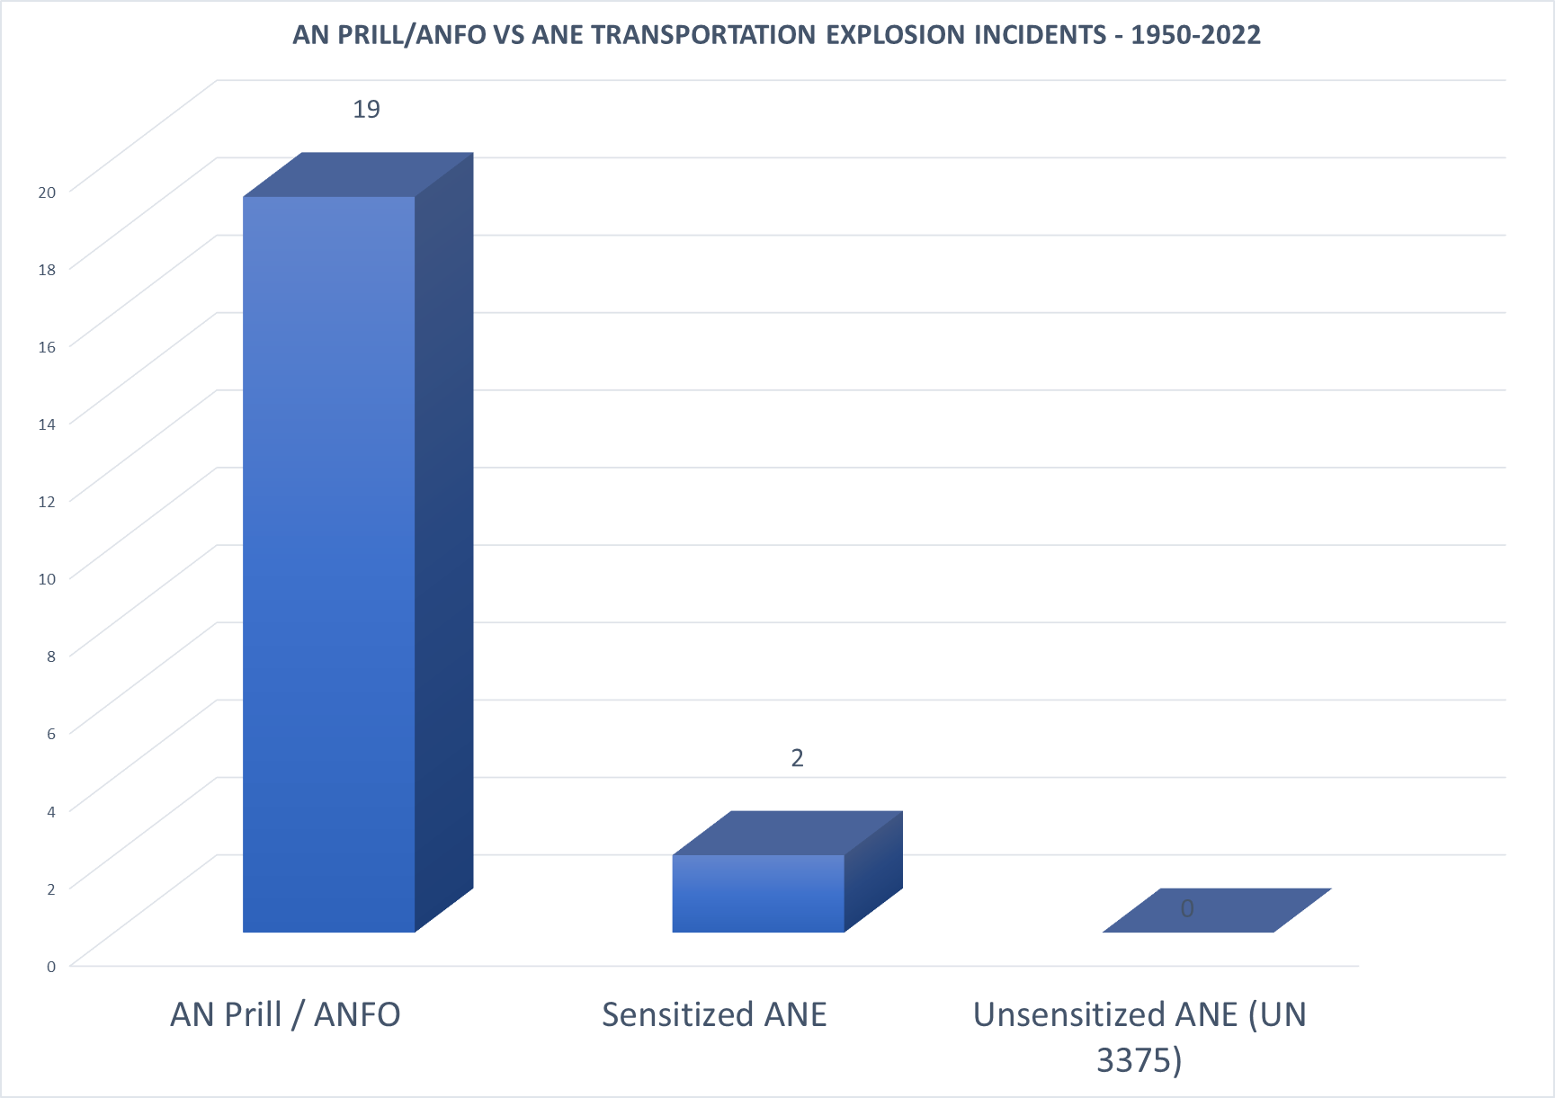
Information Noel Hsu – Orica

Slide 10
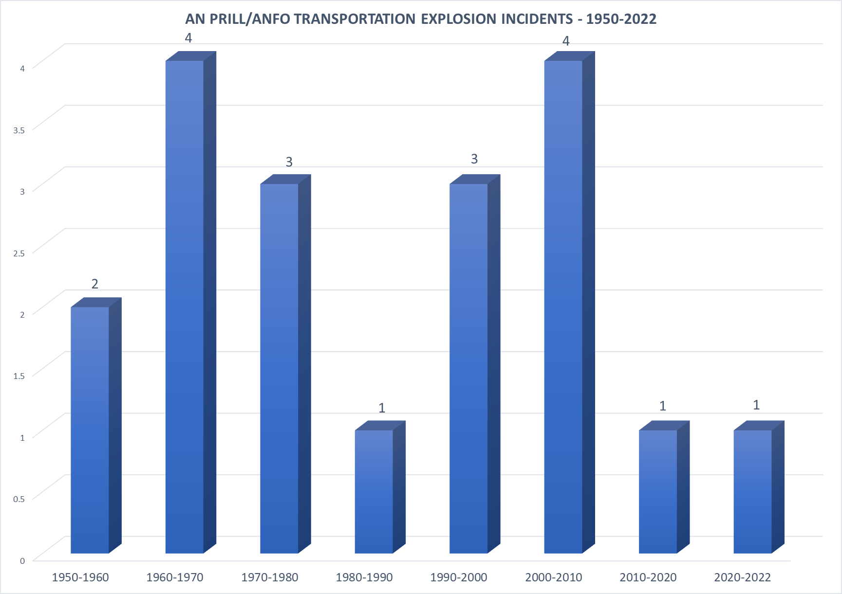
*Information Noel Hsu – Orica

Slide 11
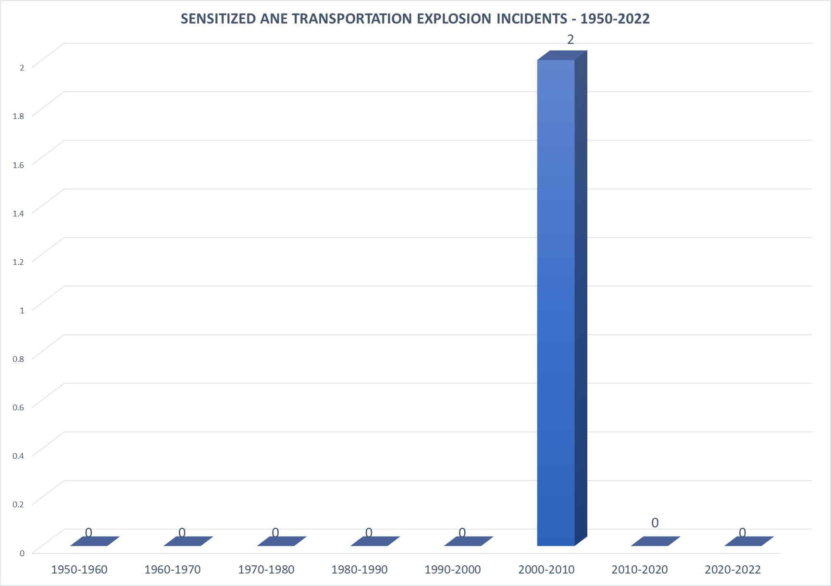
Truck 2004-06-14 Russia ANE Explosion.
MMU 2006-09-15 USA, ASARCO Ray Pit copper mine. ANE Explosion.
*Information Noel Hsu – Orica

Slide 12
What is our 50 %
Explosives transport routes planning
Emergency response simulations & emergency communications systems testing.
Explosives hazards training including evacuation procedures and when it is considered safe to fight fires
Fire suppression systems & fire extinguishers.
Proper truck maintenance (tires, breaks, engines, etc.)
Ensure the truck driver is aware of how to activate the ERAP plan in case of incident.
Driver’s fatigue management program.

