Slide 1
Current U.S. Issues
Canadian Explosives Industry Association
Québec City, QC June 7, 2019

Slide 2
IME Overview
Mission
Members
Safety & Security Materials
Priority Issues

Slide 3
Founded in 1913
Mission:
To Promote the Safety and Security of the Commercial Explosives Industry

Slide 4
What IME Does
  Represents all aspects of the commercial explosives industry: Manufacture, storage, transportation, use, handling, and disposal
  Promotes safety and the protection of employees/users, the public and the environment through publications, advocacy and outreach
  Advocates at all levels of government for the adoption of uniform rules and regulations consistent with the industry’s safety and security best practices

Slide 5
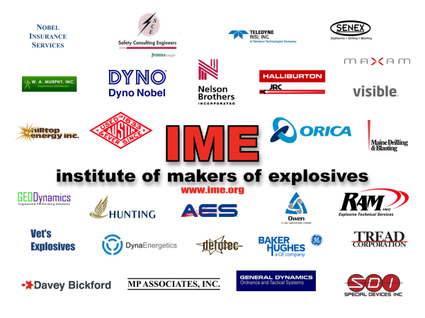

Slide 6
Liaison Members – Other Association Partners
The Brazilian Association of Explosive and Aggregate Materials Industries (ABIMEX)
Australian Explosives Industry & Safety Group (AEISG)
Association of Energy Service Companies (AESC)
Canadian Explosives Industry Association (CEAEC)
Federation of European Explosives Manufacturers (FEEM)
International Society of Explosives Engineers (ISEE)
National Institute for Explosives Technology (NIXT)
SAFEX International
Explosives Safety & Technology Society of India – Visfotak

Slide 7
IME Organization
Board of Governors
  Steering Committee
    LEAD (Young Leaders) Group
  UN Committee
Seven Standing Committees
  Technical
  Transportation & Distribution
  Security
  Safety & Health
  Environmental
  Government Affairs
  Legal Affairs
  Seven (7) Full-time Staff – President reports to the Board

Slide 8
Explosives Jurisdictions in the U.S.
Bureau of Alcohol, Tobacco, Firearms & Explosives (ATF)
Pipeline and Hazardous Materials Administration (PHMSA/DOT)
Federal Motor Carrier Safety Administration (FMCSA/DOT)
Department of Homeland Security (DHS)
Occupational Safety & Health Administration (OSHA/DOL)
Mine Safety & Health Administration (MSHA/DOL)
U.S. Coast Guard (USCG/DHS)
Environmental Protection Agency (EPA)
Office of Surface Mining Reclamation & Enforcement (OSM/DOI)
Federal Bureau of Investigation (FBI)
Transportation Security Administration (DHS)
Customs & Border Protection (DHS)

Slide 9
Safety & Security Materials

Slide 10
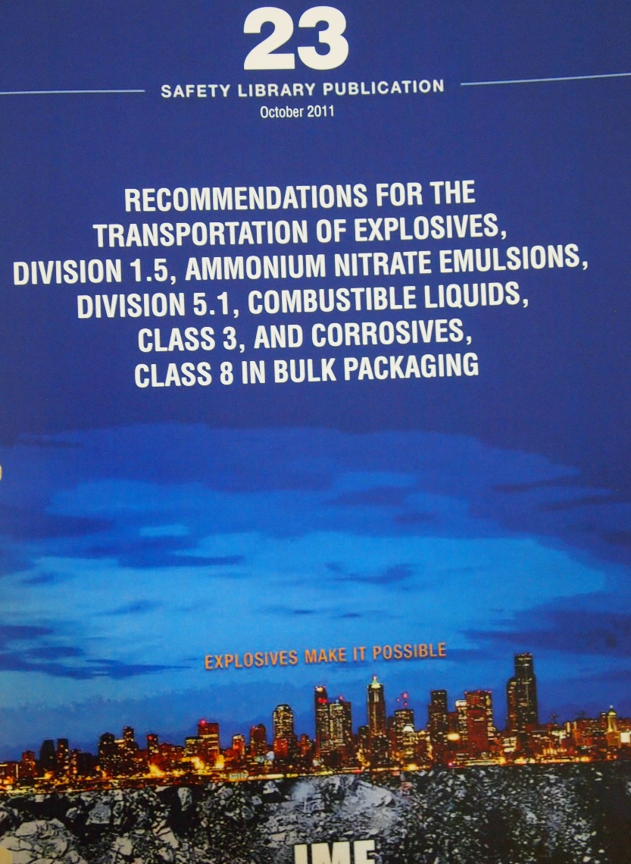
Safety Library Publications (SLPs) www.ime.org – free downloads

Slide 11
Safety Library Publications (SLP)
SLP 1 Construction Guide for Storage Magazines
SLP 2: The American Table of Distances
SLP 3: Suggested Code of Regulations
SLP 4: Warnings and Instructions
SLP 12: Glossary of Commercial Explosives Industry Terms
SLP 14: Handbook for the Transportation and Distribution of Explosive Materials
SLP 17: Safety in the Transportation, Storage, Handling & Use of Commercial Explosive Materials
Notes:
SLPs in BOLD are under revision.
SLPs in RED – 4 and 29 – were revised and approved by the BOG at the 2016 Annual Meeting.
SLP 4 is Published and available from the website.
SLP 29 is undergoing formatting and will be published EOM/Feb or BOM/March.
SLPs in BLUE are in Development.
As of Feb. 21st, the EAC has the SLP for approval on ballot, and then it will go to the BOG for approval. Expected publication this Spring. This is important because we want to provide our AN Handling Best Practices to the NAS precursor study panel.
Example of the importance of participation in IME SLP development: SLP 23 was adopted in whole into the DOT HMR.

Slide 12
SLPs
SLP 20: Safety Guide for the Prevention of Radio Frequency Radiation Hazards in the Use of Commercial Electric Detonators (Blasting Caps)
SLP 22: Recommendations for the Safe Transportation of Detonators in a Vehicle with Certain Other Explosive Materials*
SLP 23: Recommendations for the Transportation of Explosives, Division 1.5, Ammonium Nitrate Emulsions, Division 5.1, Combustible Liquids, Class 3, and Corrosives, Class 8 in Bulk Packagings*
SLP 24: Recommendations for Handling Bulk and Containerized Explosives at Ports
Notes:
SLPs in BOLD are under revision.
SLPs in RED – 4 and 29 – were revised and approved by the BOG at the 2016 Annual Meeting.
SLP 4 is Published and available from the website.
SLP 29 is undergoing formatting and will be published EOM/Feb or BOM/March.
SLPs in BLUE are in Development.
As of Feb. 21st, the EAC has the SLP for approval on ballot, and then it will go to the BOG for approval. Expected publication this Spring. This is important because we want to provide our AN Handling Best Practices to the NAS precursor study panel.
Example of the importance of participation in IME SLP development: SLP 23 was adopted in whole into the DOT HMR.

Slide 13
SLPs
SLP 25: Explosives Manufacturing and Processing Guideline for Safety Training
SLP 27: Security in the Manufacturing, Storage, Transportation and Use of Explosives
SLP 28: Recommendations for Accountability and Security of Bulk Explosives/Security Sensitive Materials
SLP 29: Recommendations for the Environmental Management of Commercial Explosives
SLP 30: Safe Handling of Ammonium Nitrate
SLP 31: Quantitative Risk Assessment
SLP 32: Best Practices in Oil & Gas Operations
SLP 33(?) : Best Workplace Practices; Explosives Manufacturing

Slide 14
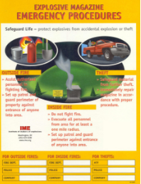
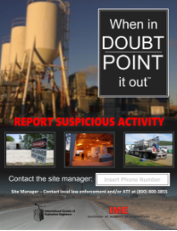
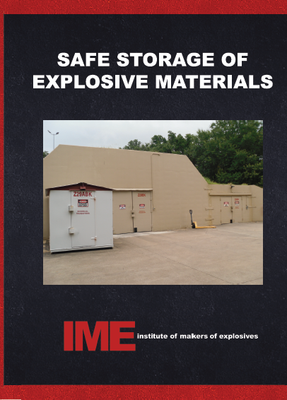
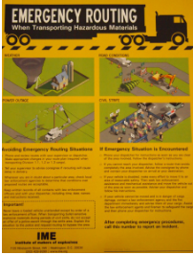
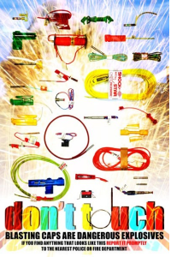
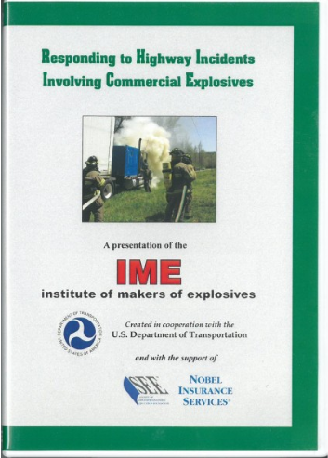
Other Safety & Security Materials
Videos
Posters
Guidelines
Inert Training Aids Program

Slide 15
The Power Tool Video
Revision of the video is a partnership between IME and ISEE, sponsored by Nobel Insurance
Purpose: Educate the Public, New Employees, Regulatory Agencies, and Congress
Theme: “Imagine a World Without Explosives”
Short segments that can be posted to social media platforms or long version for training
Filming conducted in 2018; more filming next week

Slide 16
eLearning
SLP-30 Beta Testing
SLP-4 In Production
SLP-27
SLP-2
SLP-1

Slide 17
Priority Issues & Advocacy

Slide 18
Dept. of Homeland Security: CFATS
Chemical Facilities Anti-Terrorism Standards: Blatant duplication of ATF security regulations
Costs industry Millions
DHS refused to amend regulations to remove explosives from COI/Appendix A
IME took the issue to Congress
115th Congress: Senate HSGAC hosted roundtable (IME had two witnesses) and introduced legislation
116th Congress: New HSGAC efforts for statutory exemption again before short-term reauthorization expires (IME witness testified June 4th)

Slide 19
Study: Ammonium Nitrate
Safe Handling of AN Act: DHS proposed rules on AN that would have greatly harmed the explosives industry with little increase in security.
Following IME advocacy to Congress, DHS “paused” the regulations and sponsored a National Academy of Sciences Precursor Study Panel.
IME and member company experts provided input to the study.
The report “Reducing the Threat of Improvised Explosive Device Attacks by Restricting Access to Explosive Precursor Chemicals” was published November 2017.

Slide 20
NAS Report Recommendations
Stakeholders should focus on both person-borne and vehicle-borne IEDs, and also consider multi-chemical rather than single-chemical strategies,
DHS should engage in a more comprehensive, detailed and rigorous analysis of specific provisions (mandatory and voluntary) to restrict access to precursor chemicals, and
The federal government should provide additional support for voluntary measures, activities, and programs that can contribute to restricting access to precursor chemicals.
DHS has not yet proposed rules based on the report findings.
DHS officials are exploring European models for potential implementation in the U.S.

Slide 21
Ammonium Nitrate: Current Status
This week, DHS released the redacted 2015 Sandia Lab report, AN Security Program Technical Assessment.
No new initiatives introduced/discussed following Camden, Arkansas truck detonation.
EPA did not propose to cover AN in final rule issued Dec. 2015.
U.S. Chemical Safety Board report following West, TX recommended controls on FGAN only.
ATF investigation of the fertilizer distribution site in West, Texas: Determined that the fire was intentionally set.
IME published SLP-30 Safe Handling of AN (2017)
OSHA’s decision regarding covering AN under Process Safety Management Standard (PSM) is pending (several-year process likely).

Slide 22

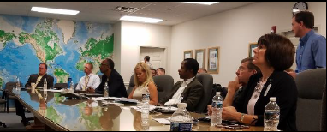
Acceptance of IMESAFR (QRA)

Slide 23
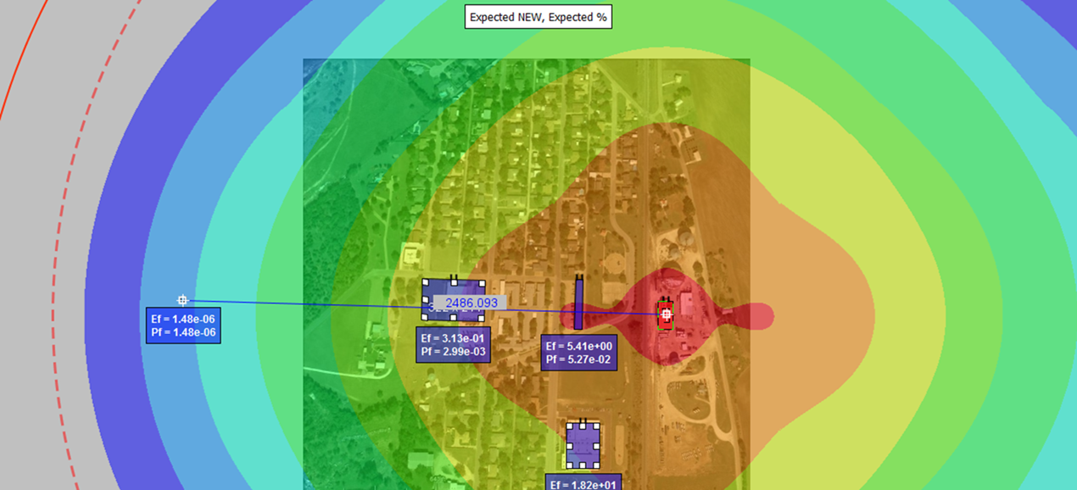
IMESAFR – Quantitative Risk Assessment
IME Safety Analysis for Risk
Probabilistic risk assessment tool used to calculate risk to personnel from explosives facilities
Uses explosives quantity, distance, donor structure, activity at donor, and structure of the exposed sites
AN Module now available

Slide 24
IMESAFR & QRA
1. Bureau of ATF
  Issues variances from American Table of Distances
  ATF Co-Chairs the IMESAFR Science Panel
  Following the Peer Review of Probability of Event, ATF is processing variances based on tolerable risk criteria
2. NRCan - Explosives Regulatory Division
  Implemented Regulations and Guidelines to facilitate the use of QRA for explosives-related loading and unloading operations at Canadian ports
International - Canada, U.S., UK, Singapore, Australia, Norway, Sweden, Finland, South Africa, Israel, Saudi Arabia, Mexico, Australia
Testing & Validation
  Conducted jointly with Government Agencies- VBIED (August 2015), AN Railcar (April 2018), Overhead Bin (proposed), & Perforating Guns (proposed)
  IMESAFR Science Panel
Notes:
HALIFAX – NRCan is proposing regulations to allow QRA at ports. Will be proposed in Gazette in Spring 2017 and expected to be finalized by the end of the year.
WILMINGTON – USCG HQ confirmed that the COTP/Sector NC has the ability per USCG policy to approve historic 650K NEQ using IMESAFR/QRA. Presented to USCG and LEPC. Working with local stakeholders. COTP decision expected March 2017 with a May 2017 implementation.

Slide 25
DOT/PHMSA
Special Permits & Approvals - Processing Times
Policy-Based Approvals
  Detonating cord
  Bi-Directional Boosters
  Blasting Agents
  Igniters for automotive safety systems
  Micro-gas generators for automotive safety systems
Bulk Trucks
  DOT/PHMSA incorporated in full IME SLP 23 into the Hazardous Materials Regulations, effective January 2016
  Industry does not have to obtain Special Permits
  Through the implementation process, IME identified some necessary fixes and have therefore revised SLP 23 (October 2018)
  IME has petitioned DOT/PHMSA for new rulemaking.

Slide 26
DOT/PHMSA
SLP-23 Changes
  Intermodal (IM) 101 and 102 tanks, and Intermediate Bulk Containers (IBCs)
  Change “thoroughly cleaned” to “cleaned to remove incompatible materials”
  Removal of ASTM F883-09 standard for padlocks. “Access points shall be locked w/a padlock to prevent unauthorized entry.”
  Continual monitoring of driver training rather than an “annual audit”
  Requirement for two extinguishers with a rating of at least 4-A:40-B:C changed to require vehicles to carry two “multi-purpose” extinguishers with an “Underwriters’ Laboratory rating of 2A-10B:C or more.”

Slide 27
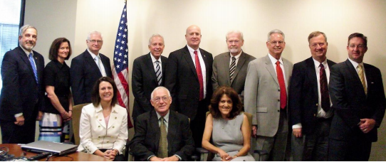
Mine Safety & Health Administration
MSHA-IME Alliance Agreement
IME Proposal to modernize -harmonize MSHA Regs
  Electronic Detonators –
    MSHA acknowledged that their regulations do not address electronic detonators
    IME FAQ forthcoming

Slide 28
United Nations (TDG & GHS)
Supported AEISG’s new classifications for electronic detonators
Review of the test manual in the context of the GHS
See “UN Decisions and the Explosives Industry,” SAFEX Newsletter March 2019
Review of chapter 2.1 (Explosives) of the GHS
Improvement of the UN standard detonator
Harmonized markings added to the model regulations
Minimum Burning Pressure (MBP) test is an option to evaluate ANE candidates that fail the Koenen test

Slide 29
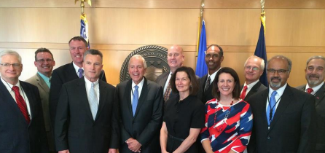
Other Ongoing IME Projects
  Modernization of ATF Regulations
  Electronic Detonators –Survey of Wait Times
  Monitoring WildEarth Guardians petition to the Office of Surface Mining (WEG’s goal is to prohibit visible emissions from blasting (NO_{x})

Slide 30
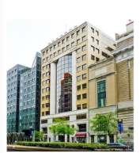


Questions?
Susan Flanagan
Legislative & Regulatory Counsel
c: +1 (202) 674-7123
sjflanagan@ime.org
Deb Satkowiak
President, IME
o: +1 (202) 266-4320
c: +1 (202) 809-4765
dsatkowiak@ime.org
www.ime.org
1212 New York Ave. N.W. Suite 650
Washington, DC 20005
United States

