Slide 1
MTT Committee Updates
MTT Committee Updates
June 7, 2019

Slide 2
Manufacturing, Transport and Technical Committee (MTT):
Aaron Galt - Maxam
Gary Plouffe – Transport Nordiques
Steeve Blais – Transglobe Logistiques
Randy Erb - Amerind
Frank Manson – FKD Contracting
Matthew Archibald – Atlantic Explosives
Gary DeBoer – Austin Powder
Ray Walker - Consbec

Slide 3
TRANSPORTATION
A member company was working with Transport Canada on ERAP revisions when a side conversation was initiated.
A question arose around specific procedures for recovering bulk emulsions (UN0332) and any special handling protocols or PPE requirements.
While the procedures for recovery are somewhat dependent on the scenario, the MTT will lead an exercise to provide special handling protocols and minimum PPE requirements.

Slide 4
Multi Piece Wheel Assembly failure
On January 28, 2019, a Maxam Mechanic was changing a flat tire on an MPU at the Greenhills facility in the Elk Valley, BC.
He had removed the flat tire and was in the process of replacing the flat tire when a catastrophic failure occurred.
The multi-piece wheel assembly separated violently and our Mechanic was struck with pieces of the wheel assembly.

Slide 5
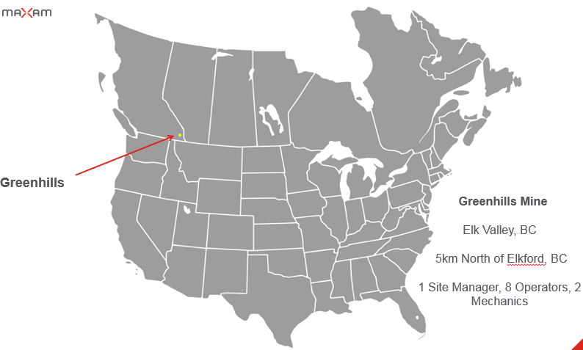

Slide 6
January 28, 2019
12:15 – The accident happens at the Maxam Shop on the TECK Greenhills Minesite
12:30 – Mine rescue receives call of an injured worker and immediately proceeds to the Maxam Shop
12:35 - First Mine Rescue team arrives to begin treatment on injured Mechanic.
12:45 – Second Mine Rescue Team arrives at Maxam to assist with treatment
13:00 – Mechanic was conscious, put on oxygen, and packaged for transport
13:00 – Maxam Sparwood receives call from the TECK mine Loss prevention officer communicating a very serious injury.
13:15 – MNA CEO was notified by OHS Manager en route
13:20 - Global OHS was notified by OHS Manager en route
13:30 - General Manager, Ops Manager, and OHS Manager arrived at the Elkford Medical Centre and begin receiving
brief details from the staff
13:55 – General Manager notifies the employees Wife in Fernie.
14:00 – 15:00 – Conversations with Maxam and Teck Sr. Management
15:00 – Air Ambulance leaves Elkford with Mechanic on board destined for the Foothills Trauma Centre in Calgary.

Slide 7
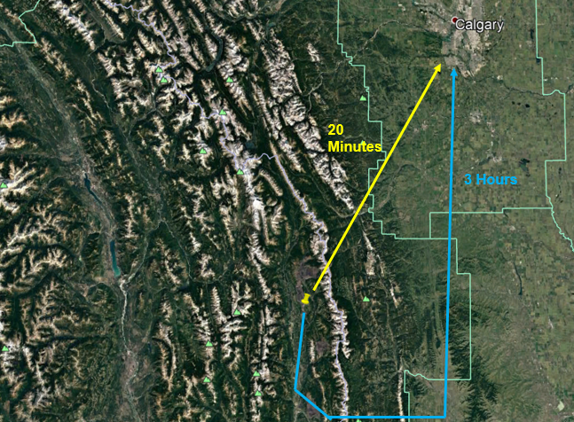

Slide 8
. We learned of the following visible injuries to our Mechanic:
Broken right arm
Broken clavicle
Major head trauma – left side
Major facial lacerations – left side
Eye damage – left
Our Mechanic was placed in a medically induced coma for 4 weeks. During this time, it was confirmed that there was brain damage from the accident.
At approximately 5 weeks, he was brought out of the coma and was beginning to communicate
At approximately 12 weeks, the outward scars and damage had largely healed but there was noticeable memory loss. He spoke about events that happened 8 years ago like they were yesterday.
At week 13, another brain surgery took place to relieve pressure and fluid buildup.

Slide 9
Insert Wheel Assembly Animation

Slide 10
4 separate investigations were started
RCMP (Federal Police)
EMPR (Mines Inspectorate)
Teck Coal
Maxam
Criminal investigations have concluded but Root Cause investigations are ongoing
6 hypotheses have been proposed as possible contributing factors
None have been validated to date as forensic analysis is ongoing.

Slide 11
As members of the Explosives Industry, we are keenly aware of the potential hazards of our products and processes. By and large, we do a very good job to ensure that our Industry is safe and secure.
However, this incident shows us that we also need to focus attention on other aspect of our Industry as they have the potential to cause serious harm to our team members.
If anyone wants to know more about our investigation to date and things we have done in response to this incident, please reach out to me directly.
We will share what information we have in hopes that your Companies do not go through a similar event

Slide 12
CEAEC Committee Chairs
The Chair term for the following Committees are concluded:
- Regulatory
- Manufacturing, Transportation, and Technology (MTT)
- Safety, Security, and Environmental (SSE)
CEAEC would like to propose that new Committee Chairs be selected at this meeting.
The term for the Committee Chair is two years.
Please speak with Nicolas Ebsworth or any of the current Committee Chairs if you are interested in this important responsibility.

