Slide 1

MTT Committee Updates
MTT Committee Updates
November 15, 2018

Slide 2

Manufacturing, Transport and Technical Committee (MTT):
Aaron Galt - Maxam
Gary Plouffe – Transport Nordiques
Steeve Blais – Transglobe Logistiques
Randy Erb - Amerind
Frank Manson – FKD Contracting
Matthew Archibald – Atlantic Explosives
Gary DeBoer - Austin
Ray Walker - Consbec

Slide 3
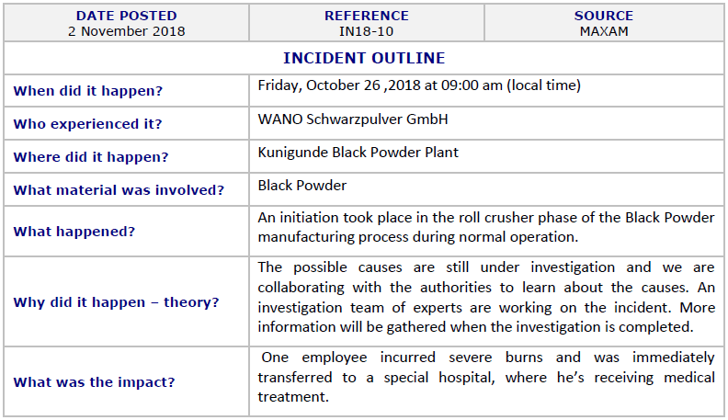
MANUFACTURING

Slide 4
MANUFACTURING
Many of our Companies are developing and implementing complex systems for managing our Health and Safety programs.
The complexity and variety of our business warrants these types of systems to ensure things are done in a consistent manner, but we can sometimes become focused on the systems rather than the people.
It is vitally important that we do not forget about Safety Basics and physical, on-the-ground, workplace safety practices and processes.
Employ the KISS principle (Keep It Simple and Safe).

Slide 5
TECHNOLOGY
At least one Company has successfully applied for and received 75% NEEQ for unsensitized emulsion
NRCan ERD and CEAEC are entering into informal discussions about classifying unsensitized emulsions as Oxidizers (UN3375).

Slide 6
TRANSPORTATION
Efforts are being made by Member Companies to ensure our Carriers understand and adhere to Part 9 of the Explosives Regulations.
Discussions have been held at the CEAEC Board of Directors meeting to introduce a new Committee lead by the Carriers.

Slide 7
CEAEC Committee Chairs
The Chair term for the following Committees are concluded:
- Regulatory
- Manufacturing, Transportation, and Technology (MTT)
- Safety, Security, and Environmental (SSE)
CEAEC would like to propose that new Committee Chairs be selected at this meeting.
The term for the Committee Chair is two years.
Please speak with Nicolas Ebsworth or any of the current Committee Chairs if you are interested in this important responsibility.

