Slide 1
MTT Committee Updates
MTT Committee Updates
April 26, 2018

Slide 2
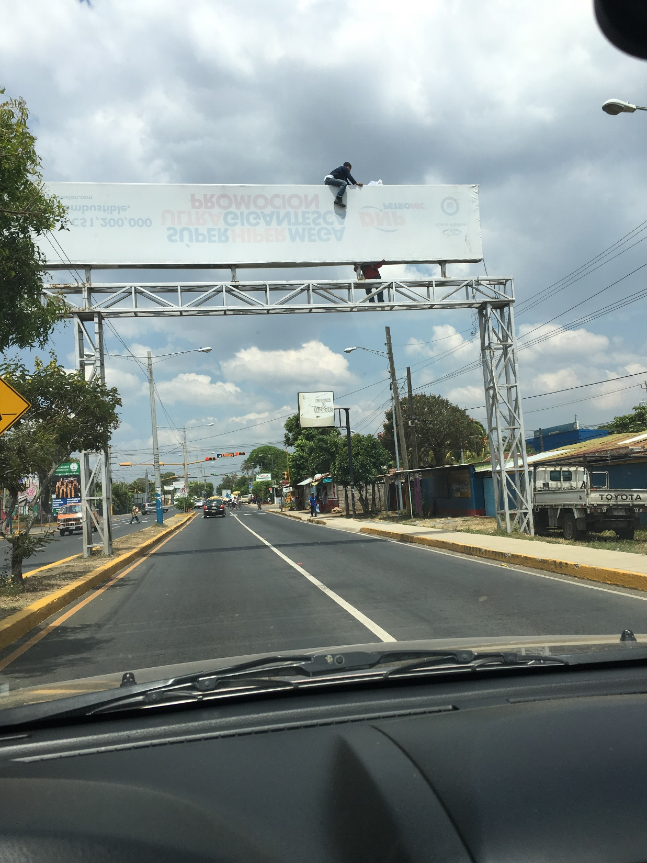

Slide 3
Third Party As-Built Inspections
Given the consistency of MPU/Tank design and construction, and the limited number of inspectors available, CEAEC requested that the Third Party Inspection requirement be relaxed.
CEAEC proposed that upon two positive inspections of an MPU/Tank design and build, the inspection requirement be waived for three years or until the 11th unit is built.
ERD approved our proposal on March 9, 2018.

Slide 4
NEEQ FOR UNSENSITIZED BULK PRODUCTS
ERD has approved our proposal to apply a 75% NEEQ to unsensitized bulk products provided the following criteria can be met:
The product has passed a UN Series 8 test with no negative results, or
MBP is ≥ 5.6 Mpa
The product must also:
contain no perchlorates
be unsensitized (ie. no artificial voids), and
Is shown to have a calculated energy ≤ 75% of TNT
I would like to thank Ivana Alilovic, Lynn Gordon, Margit Chevalier, Bill Evans, and Noel Hsu for their technical expertise and support (Nicolas too!)

Slide 5
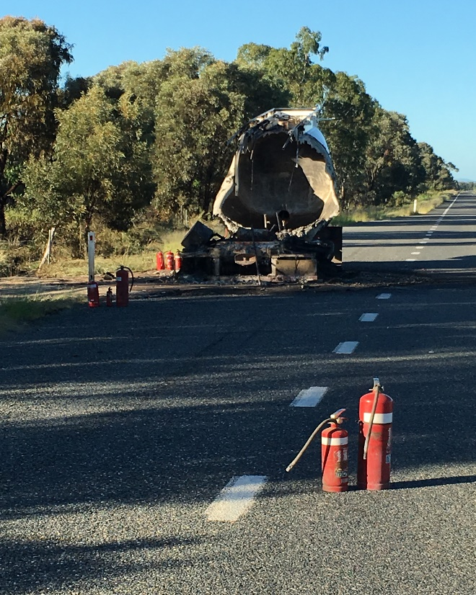
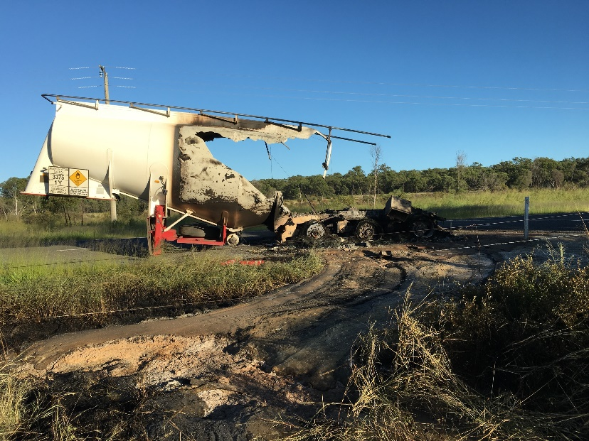
INCIDENT ALERT
ANE Semi-Tractor Trailer FIRE
Queensland, Australia March - 2018

Slide 6
INCIDENT ALERT
ANE Semi-Tractor Trailer FIRE
Queensland, Australia March - 2018
Fire - No injuries – No explosion
Semi-Tractor hauling 2 fully loaded AN emulsion tankers
Tire fire on rear wheels of B tanker / trailer
The driver was able to remove the Semi-Tractor & A trailer.
2km exclusion zone setup.
Tanker burnt out during day - left overnight to cool to ambient temperature before recovery.
Highway closed for ~ 30 hrs
Pre-use Inspection - check tires & brakes

