Slide 1
CEAEC MEETING
Ottawa, November 2-3, 2022

Slide 3
CEAEC Objectives
Promote high HSEC standards for use, handling, storage and transport of explosives
Encourage adoption of uniform legislation for the explosives industry
Promote general interests of distributors, manufacturers and end-users
Develop good working relationship between manufacturers and distributors

Slide 4
Code of Conduct

Slide 5
Highlights
Committee works
New computer & software - ED
Introduction of Monkey Survey
CID MTeams Presentations & Beta Testing
Participation in 2910-510 Q/D standards committee
Quartlerly Meetings with Regulators

Slide 6
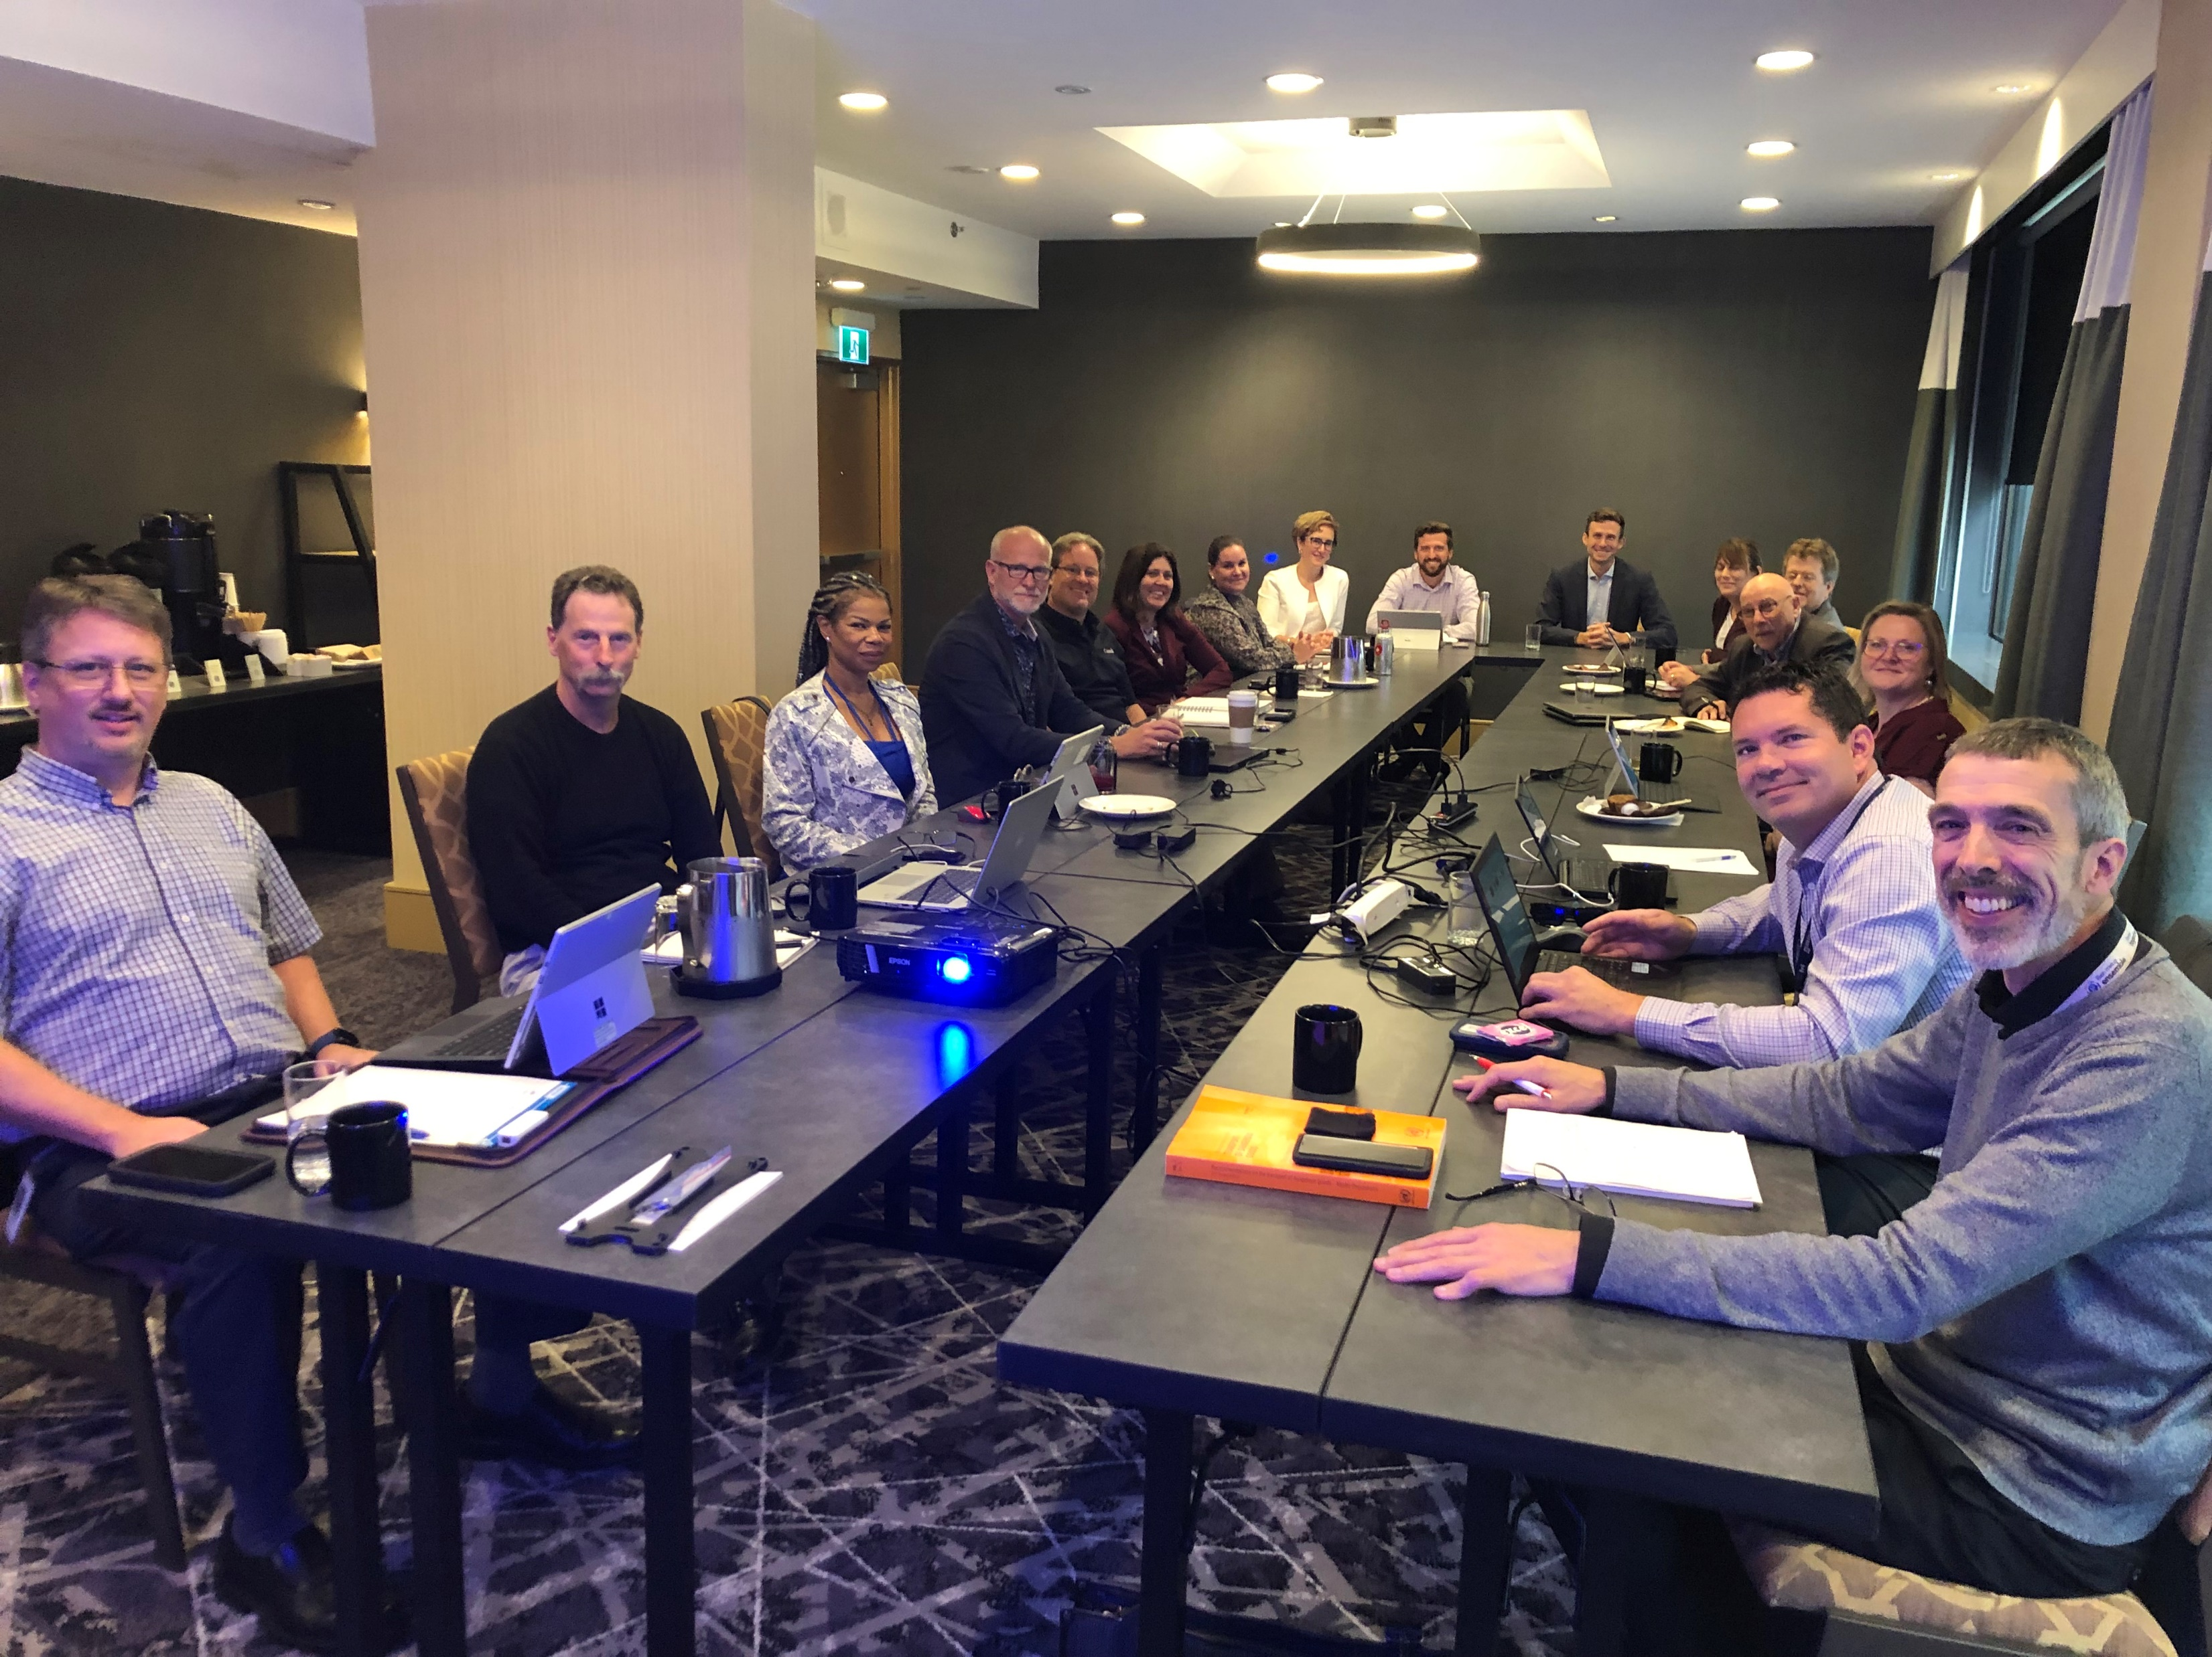
Quarterly meetings with Regulators

Slide 8
