Slide 1
CEAEC MEETING
SSE Committee
Victoria, April 27-28, 2022

Slide 2
Safety, Security and Environmental Committee
Alternatives to open burning of empty packaging
Code of good practices

Slide 3
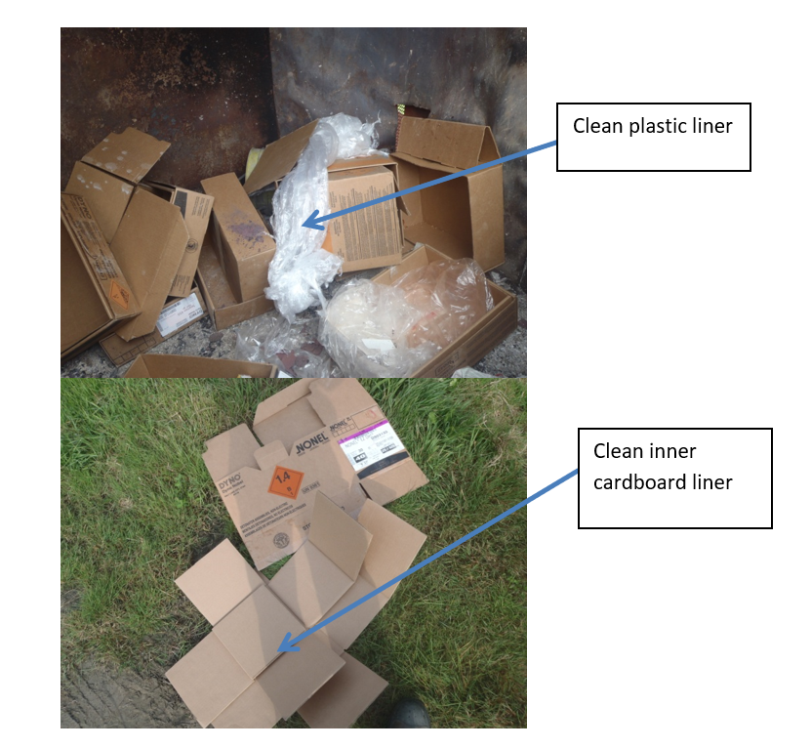
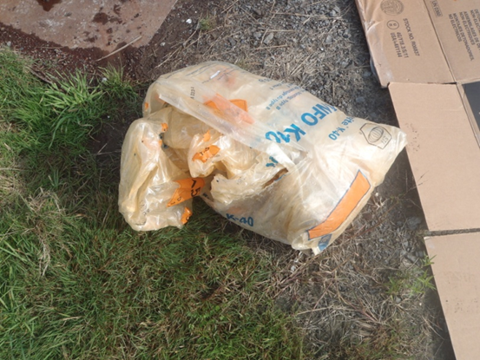
ANFO bags

Slide 4
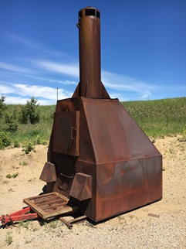
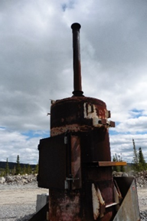
Burners/stoves used to burn packaging

Slide 5
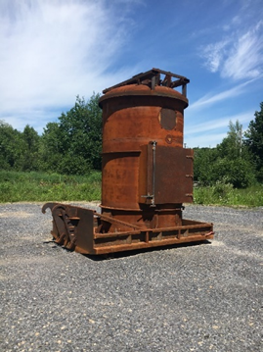
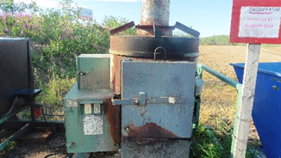
Burners/stoves used to burn packaging

Slide 6
Research Project – Transport Canada
Original scope : 2021
Develop criteria, as well as screening and segregation procedures, for determining if the shredded waste is clean, i.e., has no (or insignificant) explosive residue.
Evaluate potential uses for the shredded waste, particularly in cases where it is found to have explosive residue. For example, residue limitations and proof-of-concept could be developed, for using the shredded waste as padding in other explosives packaging.

Slide 7
Research project – Transport Canada
New CEAEC proposed scope: March 2022
Develop criteria, as well as screening and segregation procedures, for determining if the empty packaging is clean, i.e., has no (or insignificant) explosive residue.
Evaluate potential, sustainable alternatives to open burning, e.g., cardboard fibers recycling when considered safe to do depending on cleanliness of the packaging.
Evaluate and eliminate regulatory burden within TC and NRCan-ERD, which may contribute to the open burning practice
With industry involvement, develop a scope for reusable 4G (fiberboard) and 5H4 (plastic film) explosives packaging.

Slide 8
Empty packaging management options
Steps to ensure no explosives articles are present and packaging is clean:
Visual inspection
Unfolding cases
Metal detectors
Swap tests
Handheld analytical device
Certificate of cleanliness
Other options than burning :
External recycling for paper fibers/plastic recovery
Landfilling
Shredding before external recycling or landfilling
Re-use for the same purpose

Slide 9
TC answer to project scope change request – March 2022
TC realized they do not have a good concept of how many of each type of means of containment (boxes, bags, IBCs, etc.) are currently being used and how they are being disposed of by end users.
TC is looking to start with the state of the industry phase to gather information with two main focuses:
Survey of users, producers and disposal facilities to better understand the life cycle of the MOCs used and associated restrictions/challenges
Regulatory scan of different jurisdictions and different levels of government to have a clear idea on the restrictions on transportation and disposal of explosives packaging

Slide 10
Code of good practices

Slide 11
Disclaimer available;
Insurance company contacted for coverage;
First codes to likely be published:
Environmental Management & Properties of AN based explosives
Transportation of ANE’s in tank vehicles
Use of common carriers;
Best practices for sodium nitrite on bulk sites
Tire fires – how to prevent & extinguish them
Emergency Response Preparedness – Transportation Incidents & Natural Disasters.
Etc.

