Slide 1
CEAEC MEETING
Ottawa, November 7, 2019

Slide 2
Safety, Security and Environmental Committee
Code of good practice – Environmental Management of AN based explosives
New online Reporting system - E2 Regulation 2019
ANSol rail car loss of containment

Slide 3
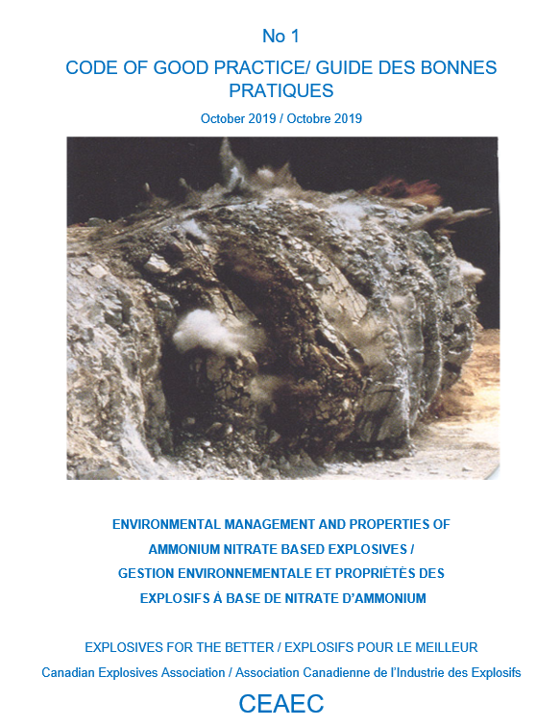

Slide 4
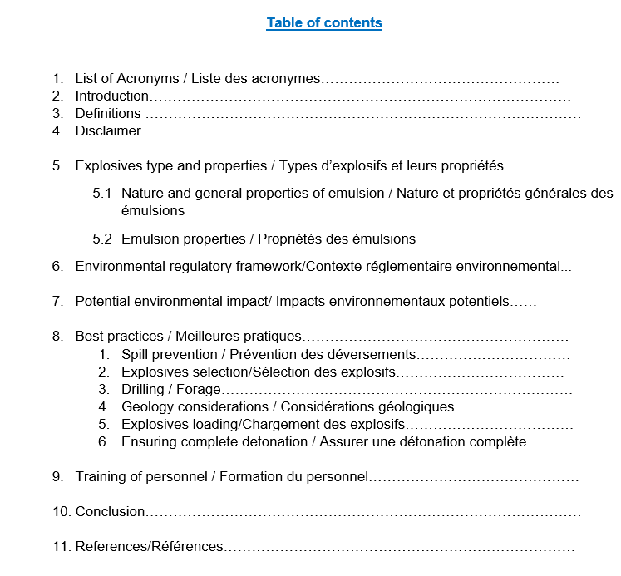
CEAEC Code of good practice development – 20 pages

Slide 5
2- Environmental Emergency Regulation (E2), 2019
Sites storing more than 20 tonnes of AN prill/AN solution in a single container
Came into force on August 24, 2019.
Need to resubmit all required information into the E2 reporting system in SWIM (Single Window Information Manager).
Deadline for schedule 2 submission is November 22, 2019.

Slide 6
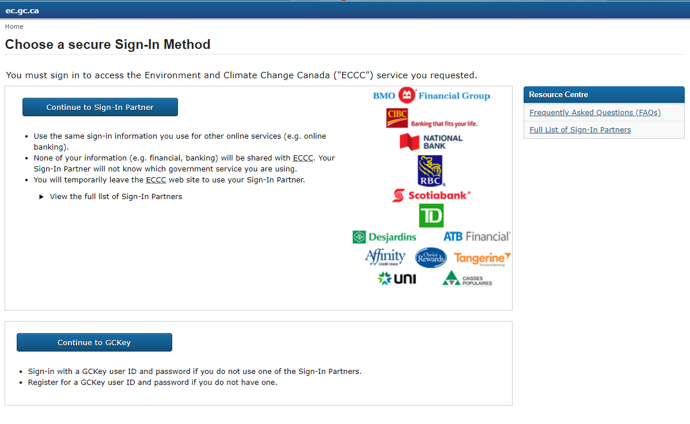
SWIM (Single Window Information Manager)

Slide 7
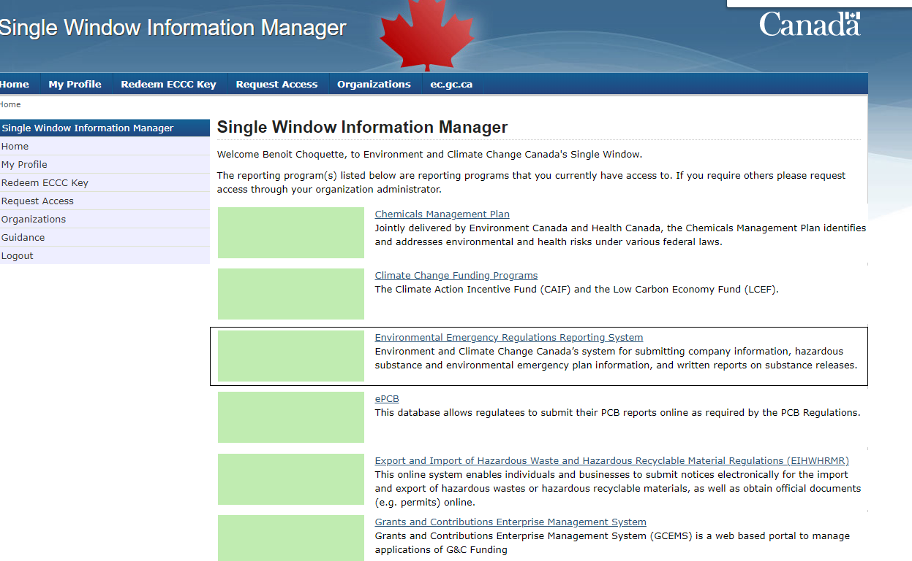
SWIM (Single Window Information Manager)

Slide 8
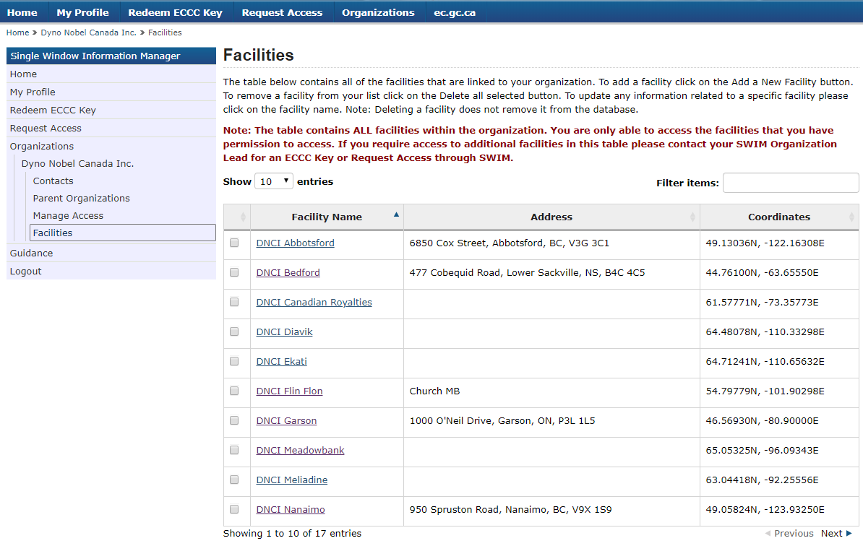
SWIM (Single Window Information Manager)

Slide 9
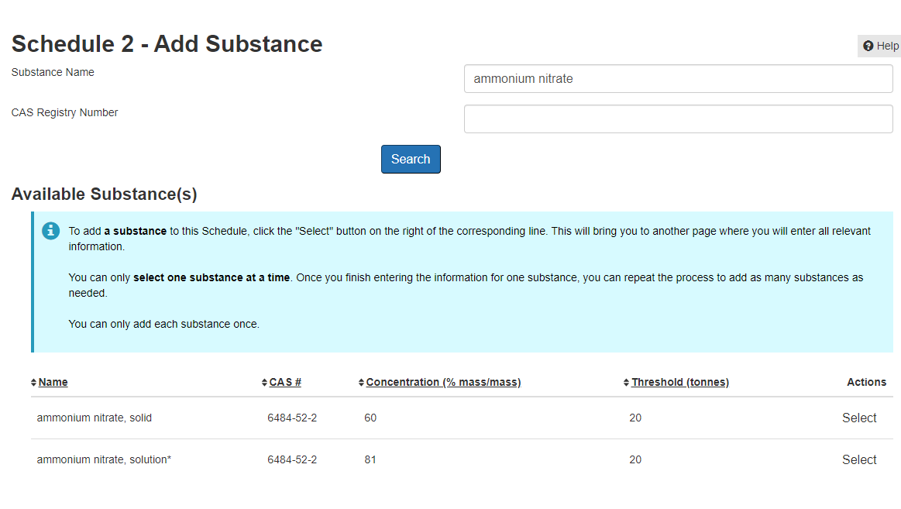

Slide 10
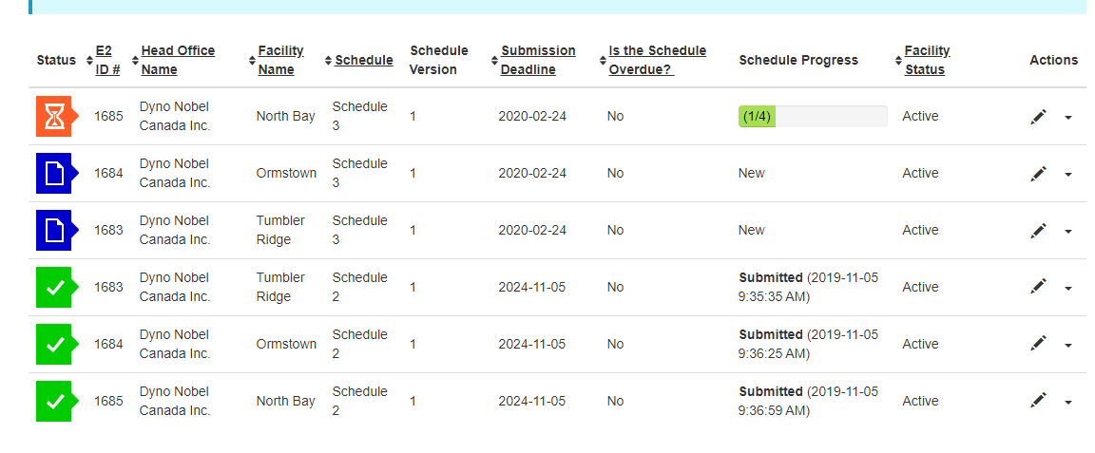

Slide 11
Major steps - E2 - Reminder
Notice : 90 days (November 22, 2019)
Plan preparation : 6 months;
Plan implementation : 6 months;
Plan testing : At least one component of the plan must be included in an exercise at least once a year;

Slide 12
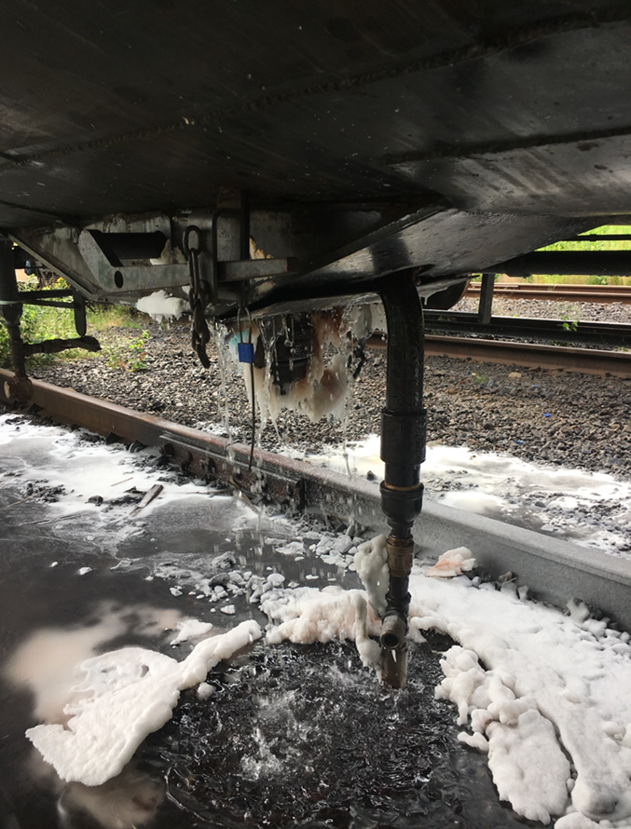
3- ANSol rail car loss of containment (July 2019)

Slide 13
Incident description

Slide 14
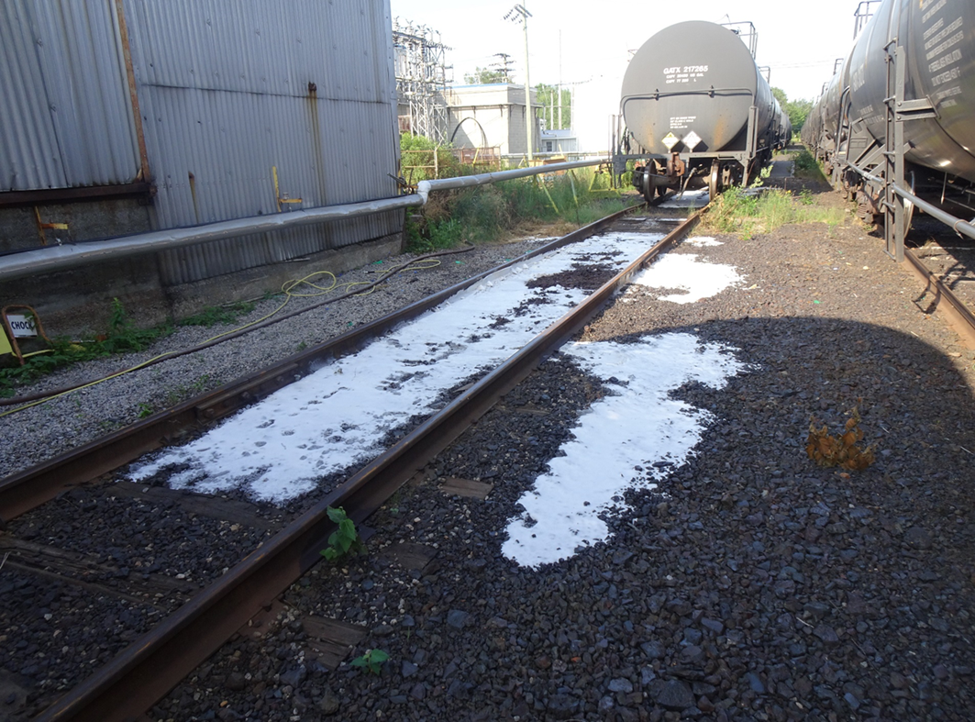

Slide 15
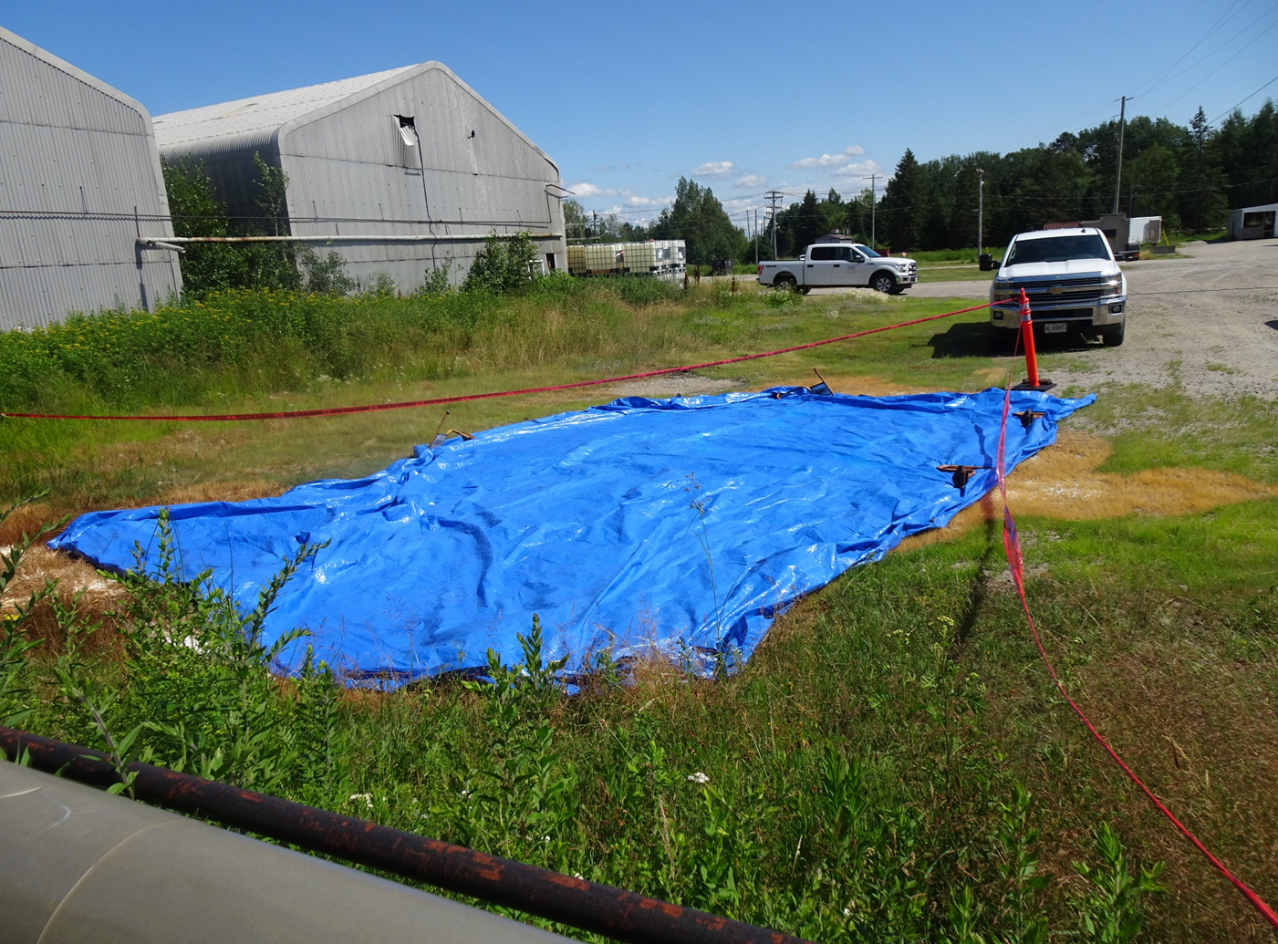
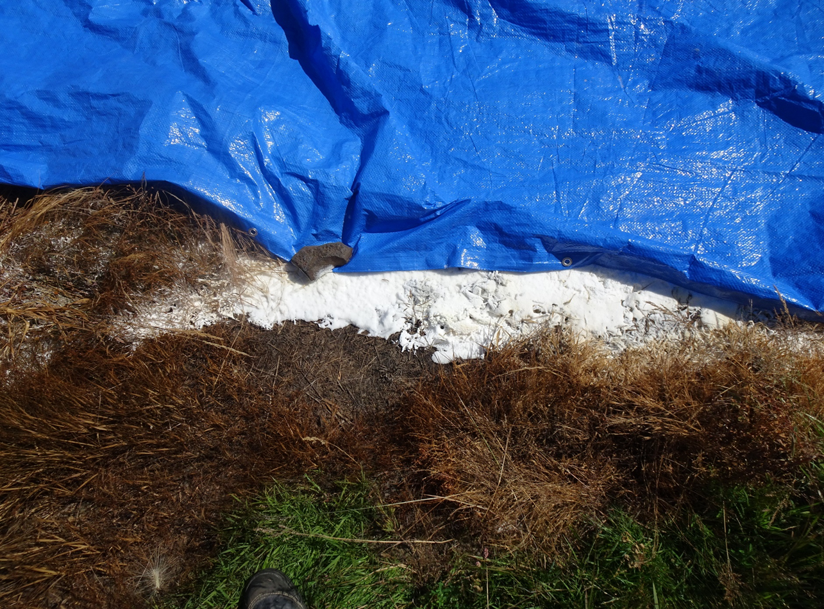

Slide 16
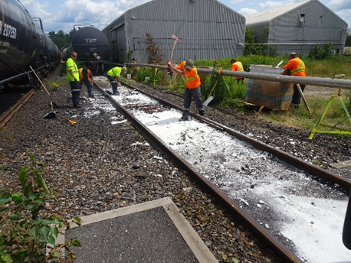
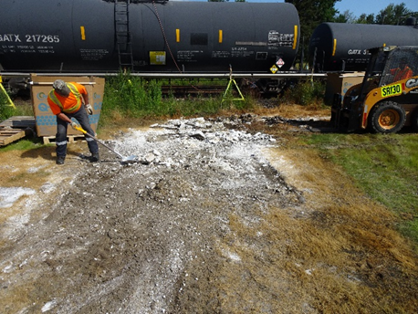
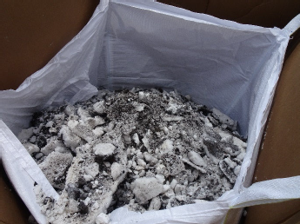
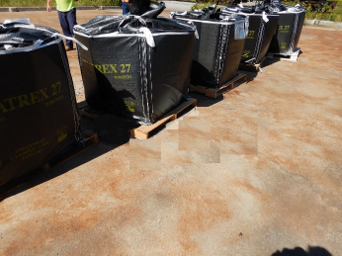
Product recovery

Slide 17
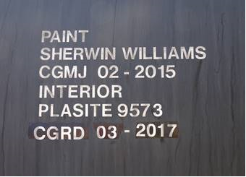
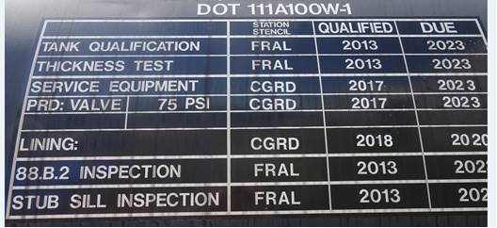
Root cause of the leak
Appears to be a defective bottom outlet valve (BOV) due to human error or innapropriate repair procedure used at the lessor shop.
Investigation revealed that the same rail car leaked in March 2018 and was sent to a repair shop. The cause identified was missing lock washers on BOV and failure to follow internal procedures. This was the first use of the rail car since the repair.
Still under investigation by the rail car lessor.

Slide 18
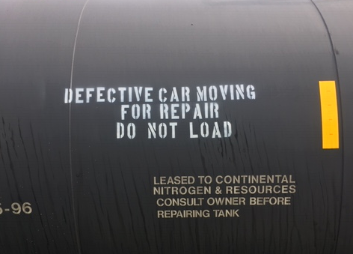
Corrective/Preventative actions
Send car for repair at the closest lessor repair shop. Apply proper stencils on the railcar to prevent re-loading.
Consider ways to ease the clean-up & recovery process in case of a leak
(asphalt, culverts, smooth surface, etc.)
Consider developing a monitoring procedure during the heating process to detect a leak early.
Follow-up with lessor on the exact cause of the failure.

