Slide 1

CEAEC MEETING
Ottawa, November 14-15 ,2018

Slide 2

Safety, Security and Environmental Committee
Prevention of AN leaching with bulk explosives – Code of practice
E2 Regulation – recent developments
Recent Dyno Safety initiative – Dynamite storage

Slide 3
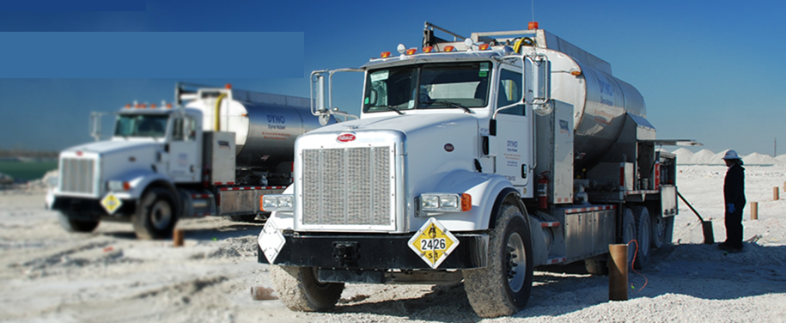
1- Prevention of AN leaching from bulk explosives

Slide 4


Slide 5
CEAEC Code of good practice development

Slide 6
Code of good practice development
Next steps :
Send information to the committee for each topic of the guideline
Who : Technical experts from all companies
When : As soon as possible IN PROGRESS - LITTLE INFORMATION RECEIVED SO FAR
Put together the information and write a draft for each section for submission to the committee members
Who : Committee chair
When : As soon as sufficient information will have been received.
STARTED – 6 PAGES WRITTEN ON 3 TOPICS
Revise the draft and propose modifications/ improvements :
Who : Any CEAEC/Committee members
When : Upon request – WILL BE DONE WHEN MORE ADVANCED

Slide 7
2- Environmental Emergency Regulation (E2) – Environment Canada
    Sites storing more than 20 tonnes of AN prill in a single container -
    Reminder of major changes of 2016 vs 2003 version
    Strengthen provisions requiring that public be provided with information and guidance on actions to be taken before, during and after an emergency.
    More detailed Emergency Plan including list of individuals who are going to respond , their roles and responsibilities and their current and future training.
    Expected to come in force in the spring of 2019.

Slide 8
2- Public information request - E2
2003 | 2016
4 (2) g) : A description of the measures to be taken to notify members of the public who may be adversely affected by an environmental emergency and to inform them of thoses measures and what to do in the event of an environmental emergency. | 4 (2) i) : before an emergency occurs, inform them of : A) the possibility of an environmental emergency, B) the potential consequences of an environmental emergency on the environment and on human life or health, C) measures that will be taken to protect the environment and human life or health ii) : before an emergency and during and after its occurrence, provide information and guidance concerning actions that could be taken by them to reduce the potential harm, including an explanation on how those actions help iii): The position title of the individual who will communicate with the public.

Slide 9
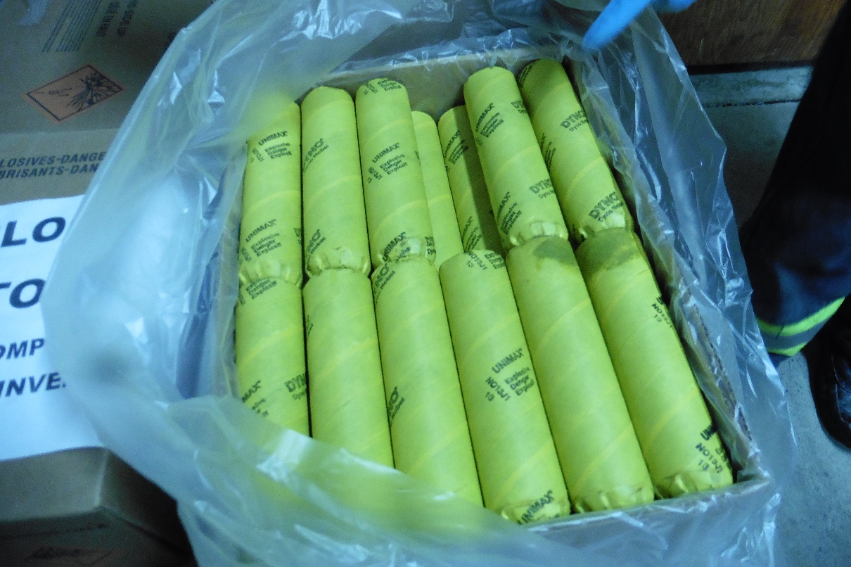
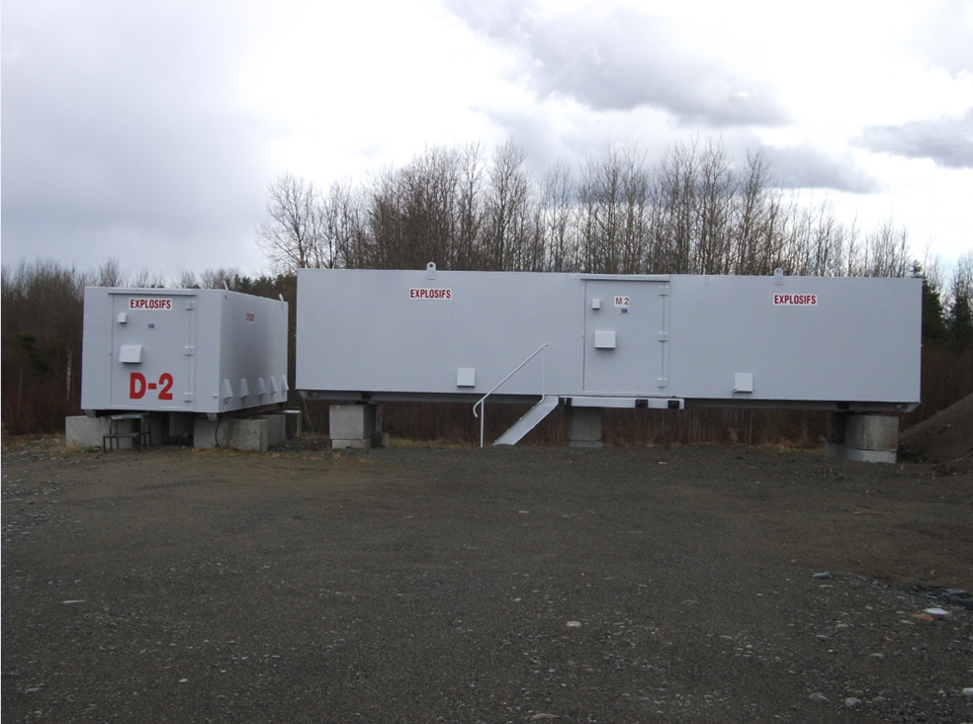
3- Dyno Nobel Health initiative –
Dynamite storage in type 4 magazines

Slide 10
DYNAMITE benefits
Highest velocity and pressure of detonation and therefore is one of the most efficient product for breaking hard and very hard rock.
Excellent water resistance, can function under high pressure and withstand extremely low temperature [-40C] . It is reliable, stable and easy to load.
1.1 explosive (cap sensitive) that doesn’t require a primer and possess the highest energy per weight and volume (RWS and RBS). It is therefore considered a cost effective solution by several customers.
Approved by NRCan as a FUME Class1 product that can also be used in U/G applications.

Slide 11
Dynamite contains… EGDN
Ethylene glycol dinitrate (EGDN), is used in Dynamite to partially replace the nitroglycerin, to create a more stable product, due to its superior shock resistance.
It also lowers the freezing point of nitroglycerin, so that the explosive can be used in industrial applications in cold climates.
EGDN is a colorless volatile liquid when in pure state and its exposure ceiling value in the air is regulated at 1.2 mg/m³.
NO₂-OCH₂CH₂O-NO₂
_{Synonyms : nitroglycol}

Slide 12
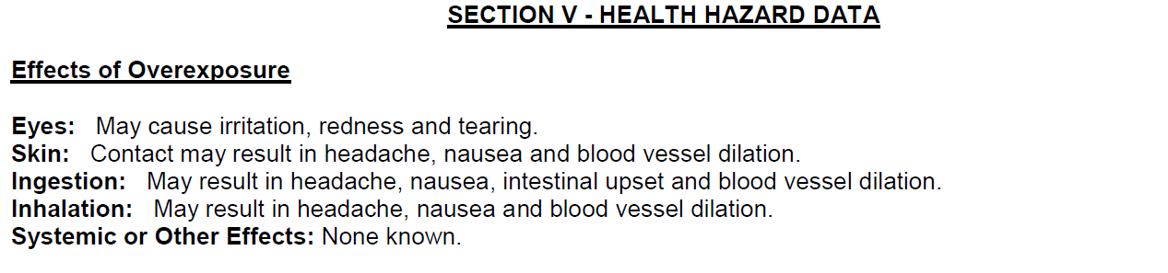
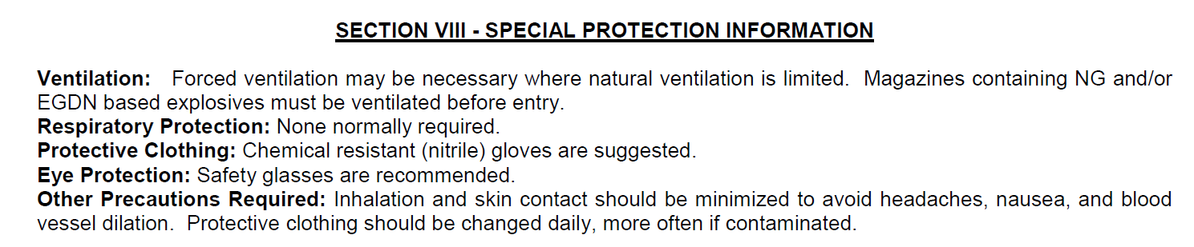
Potential concerns - EGDN

Slide 13
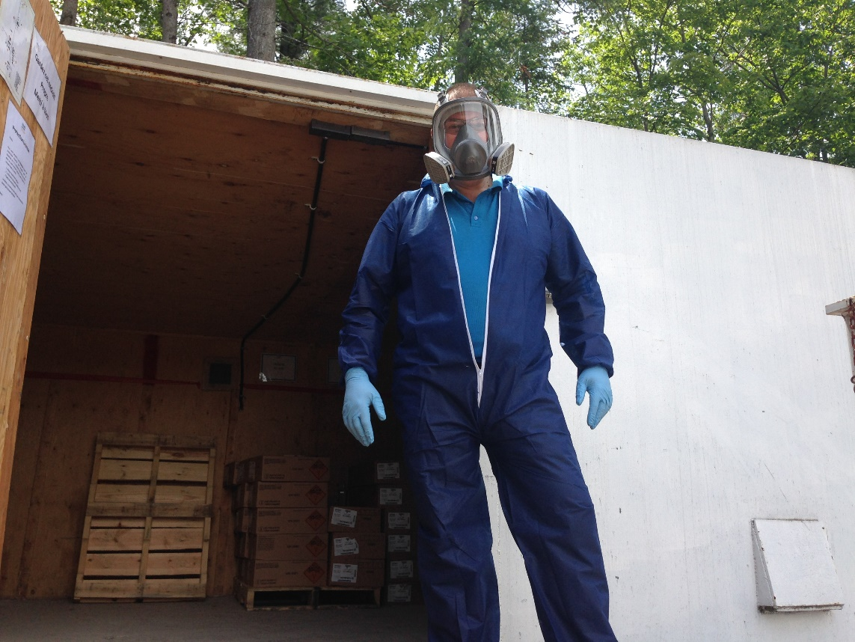
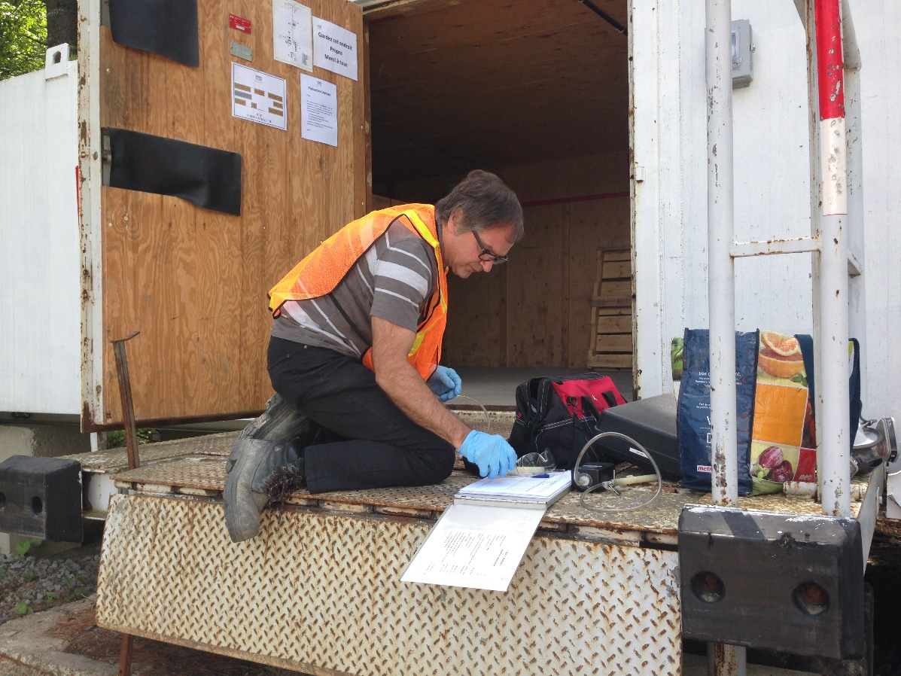
Exposure verification - EGDN

Slide 14
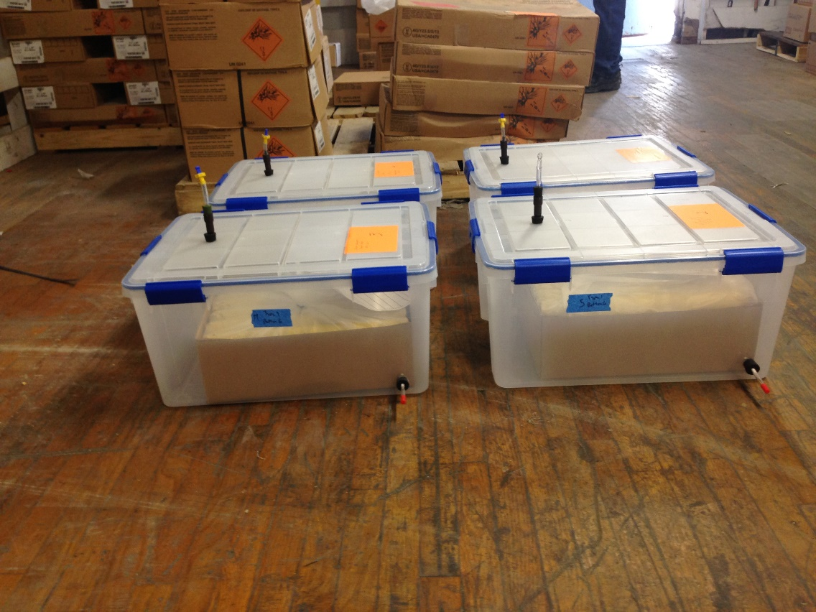
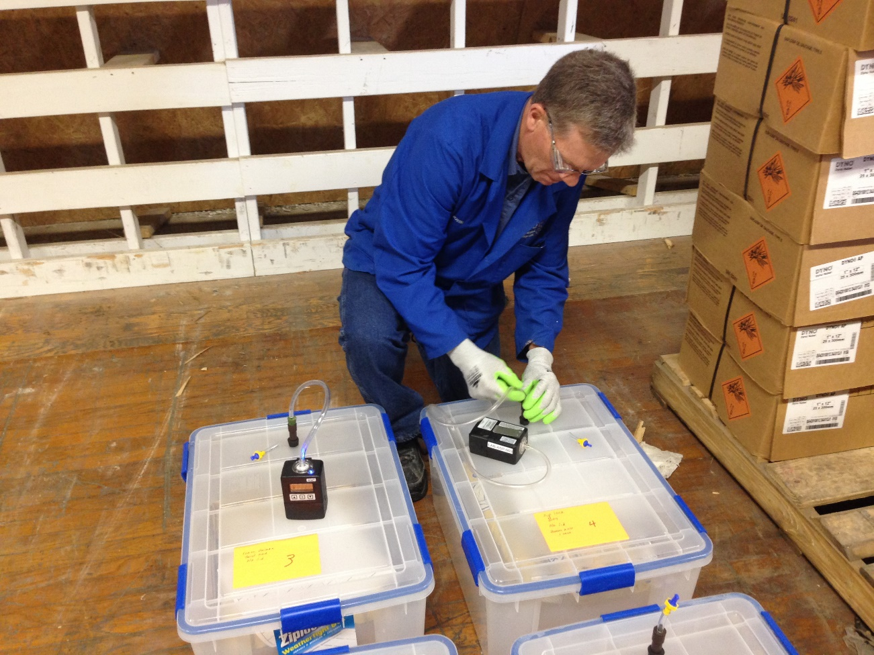
Packaging tests - EGDN

Slide 15
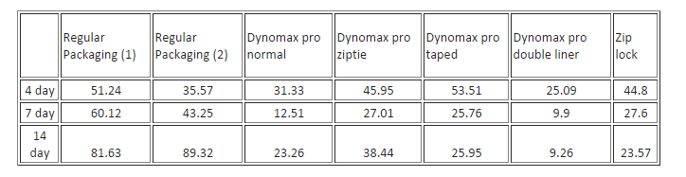
Packaging tests - EGDN

Slide 16
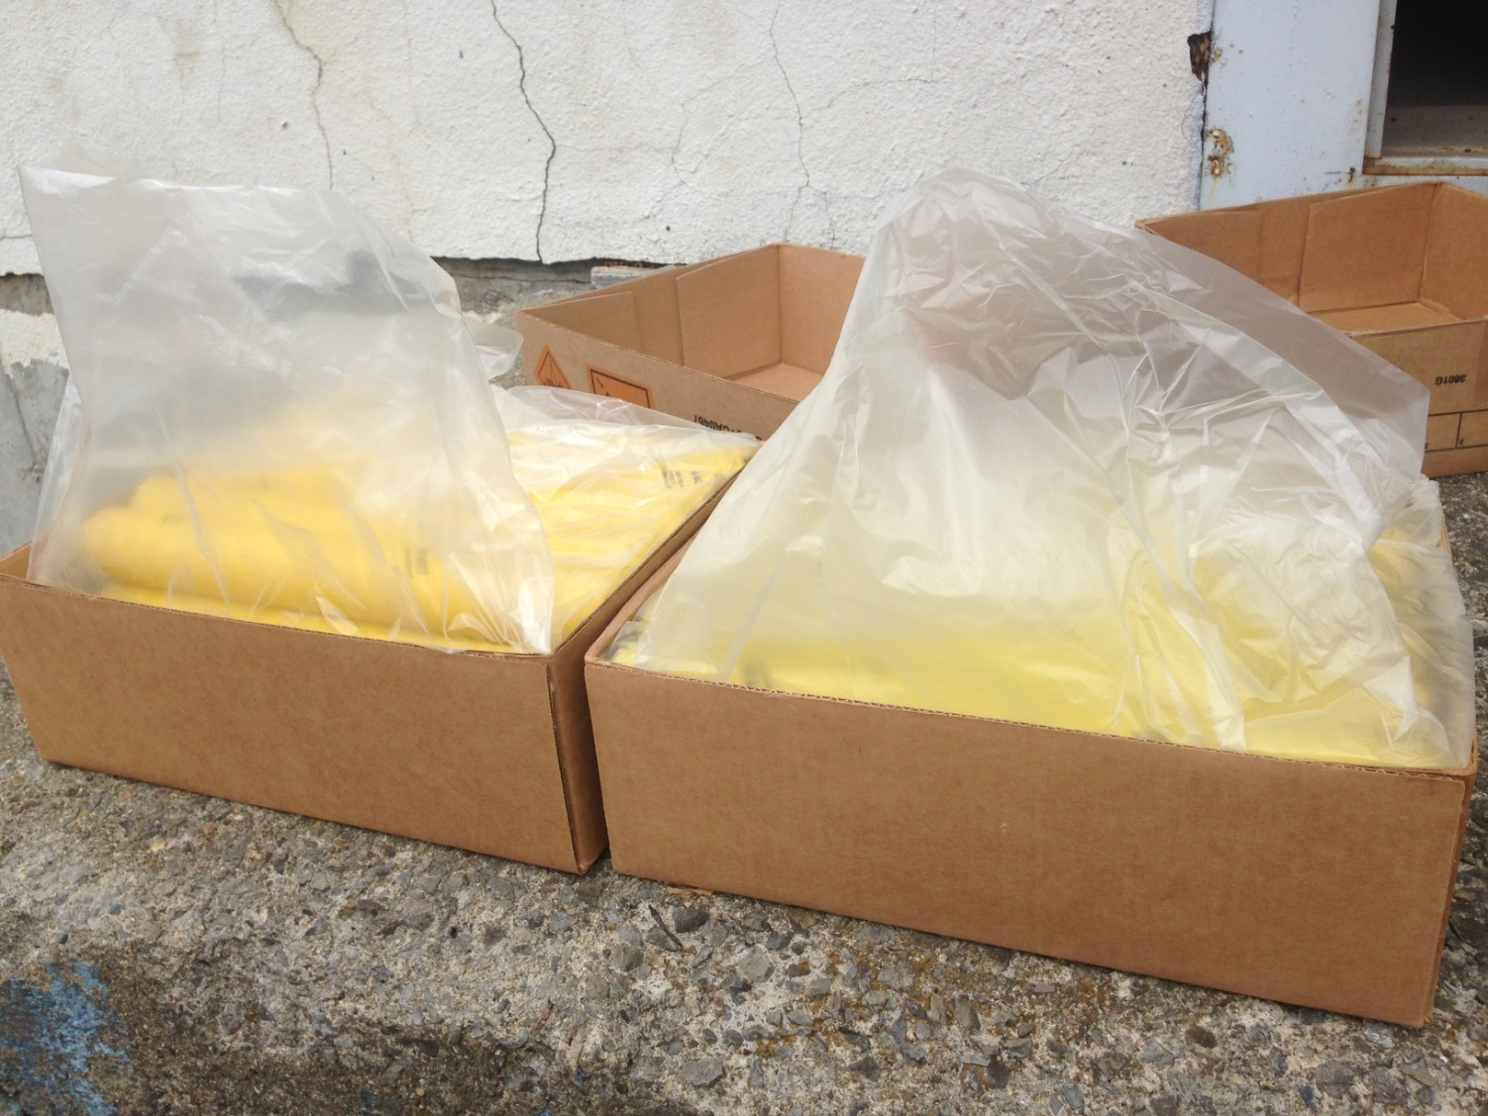
New packaging -Dynamite
  OLD –
  High Density Polyethylene 1.25 mil
NEW –
Clear co-extruded 2.5 mil vapor barrier made of three layers (LDPE/nylon/LDPE)

Slide 17
Implemented solution – EGDN
Elimination at source of EGDN emissions by an improved packaging (March 2016).
75 % reduction in EGDN emissions confirmed by sampling in magazines.
All magazines surveyed compliant except one once in warm temperature – addition of 6 aerators.

Slide 18
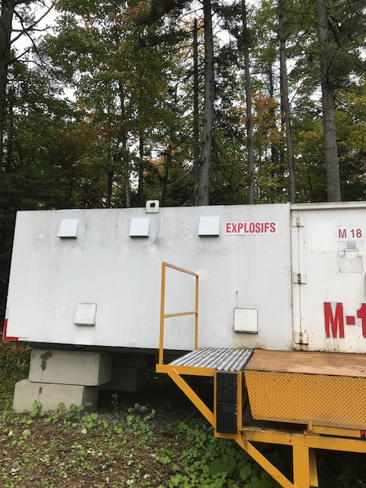
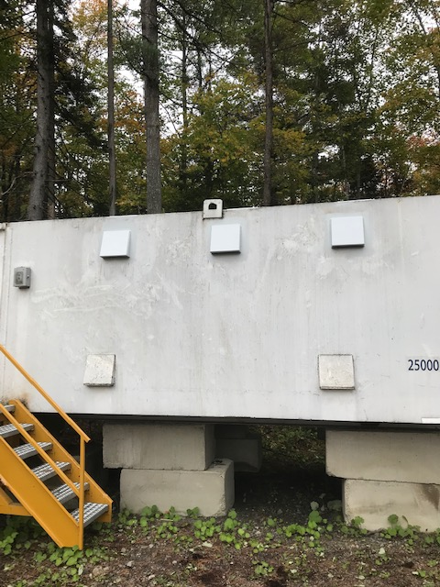
Implemented solution – EGDN

Slide 19
Implemented solution – EGDN
All end-users, carriers and distributors are benefitting from the solution.
No concern for EGDN emissions in cold weather. Remain vigilant in warm weather (+20°C - July to Sept) in Canada.
If active ventilation not possible, ensure magazine aerators are not blocked and keep door open for 15 minutes before entering magazine.
Wear chemical resistant gloves when handling the sticks and additionnal PPE in magazines in case of doubts.
Future work: improved /more visible warning for end-users (gloves, etc.).

