Slide 1
CEAEC MEETING
Ottawa, November 15-17,2017

Slide 2
Safety, Security and Environmental Committee
Explosives water resistance - AN Leaching
Empty explosive packaging management
E2 Regulation – recent developments

Slide 3
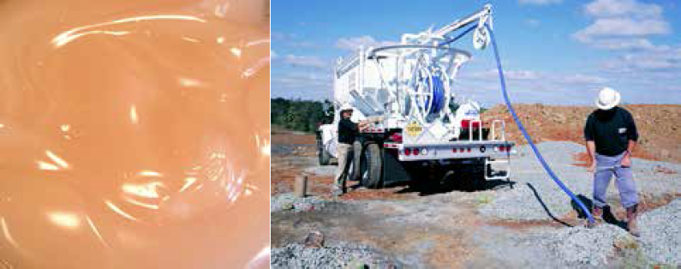
Explosives water resistance AN leaching prevention

Slide 4
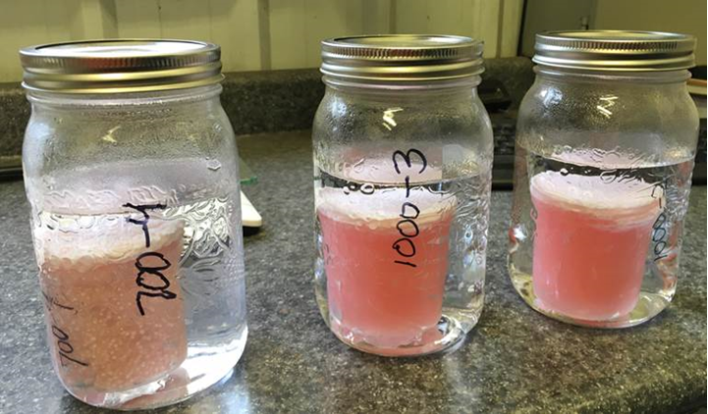
Standard test discussion
Product temperature 25°C.
Water temperature 15°C.
Inner container filled with emulsion.
Excess emulsion removed with a spatula.
Container dropped in 500 ml of water.
Kept at 25°C in a cabinet.
Conductivity readings are made at 24 h, 48 h, 7 days and 15 days.
Inner container removed by lab tongs.
Water is mixed and sent to lab. for nitrates analysis.
Repeatability issues noticed.
Courtesy of MAXAM – Static test

Slide 5
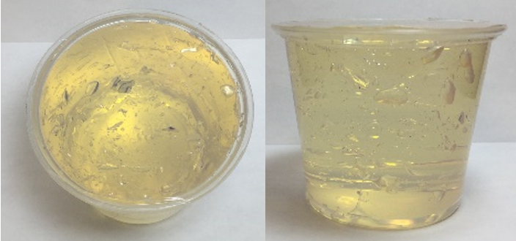
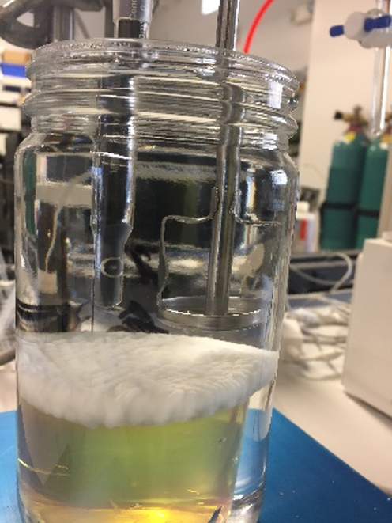
Standard test discussion
5.5 oz plastic cup filled with emulsion.
Emulsion surface leveled.
750 ml of ultrapure water is introduced in jar.
A 1 in Jiffy stirrer is installed offset from cup center – set at 500 rpm for 30. minutes, 1 inch above emulsion surface.
Conductivity probe connected to a data acquisition system.
Probe is checked against standard solution prior to each run.
After the 30 minutes dynamic test, the emulsion is allowed to rest in water for 24 hours.
Courtesy of DYNO NOBEL – Static and dynamic test

Slide 6
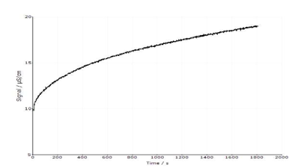
Standard test discussion
30 minutes dynamic test

Slide 7
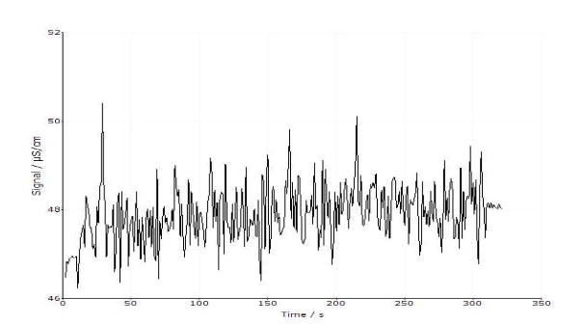
Standard test discussion
24 hours static test

Slide 8
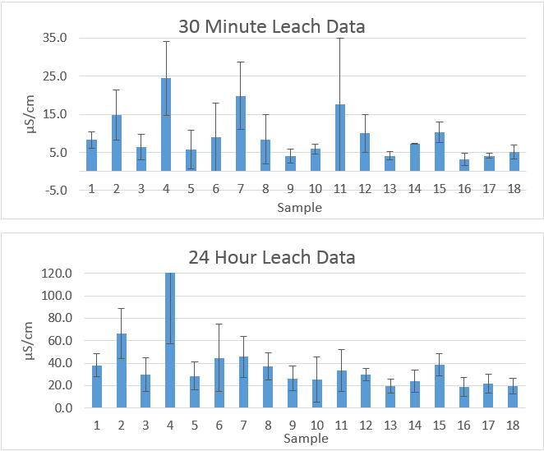
Standard test discussion
Most of 18 different emulsion results fall within the same numbers when taking into account error overlaps !

Slide 9
Standard test discussion
It is difficult to detect statistically significant differences in leach rate due to emulsion differences.
Single tests are unreliable for comparisons, as the range could easily be 100 % or -50 % even with replicate tests.
Leach rate impact from emulsion standing in a borehole is believed to be insignificant compared to product that ends up outside the borehole zone of complete detonation/reaction and ends up as unreacted AN after blast in the muck pile.
Environmental factors, geology and loading practices will be the dominating factors in the migration post-blast of AN into groundwater, as opposed to emulsion choice.

Slide 10
Proposal
Instead of trying to develop a standard test to measure the leach rate, why not simply group bulk explosives per categories based on their relative known leach rates as follows and instead, develop a best practice guideline to control the significant factors.
Product | Leach rate
ANFO | Very high
Heavy ANFO (20-50 % emulsion) | high
Emulsion prill blends (60-80 % emulsion) | Medium
Pure emulsion | Very low

Slide 11
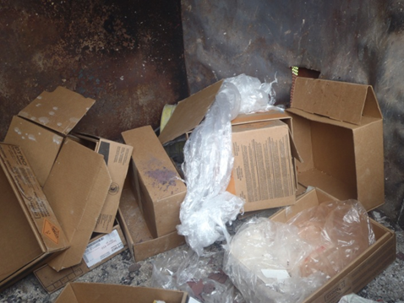
Empty explosives packaging
Reuse of packaging
224 (1) A user must ensure that any packaging or container that has been used for industrial explosives is not reused unless
(a) it is in good condition;
(b) it contains no explosive residue;
(c) it is reused for the same type of explosive that it previously contained; and
(d) all information on the packaging or container remains accurate.

Slide 12
Empty explosives packaging
Packaging — nitroglycerine-based explosive
(2) A user must ensure that any packaging or container that has been used for a nitroglycerine-based explosive or any other explosive that is manufactured from a liquid explosive is destroyed so that it cannot be reused (for example, by breaking the packaging or container) as soon as the circumstances permit after the packaging or container is emptied.
Packaging not in good condition
(3) A user must ensure that any packaging or container that is not in good condition when it is emptied of explosives is destroyed so that it cannot be reused (for example, by breaking the packaging or container) as soon as the circumstances permit.

Slide 13
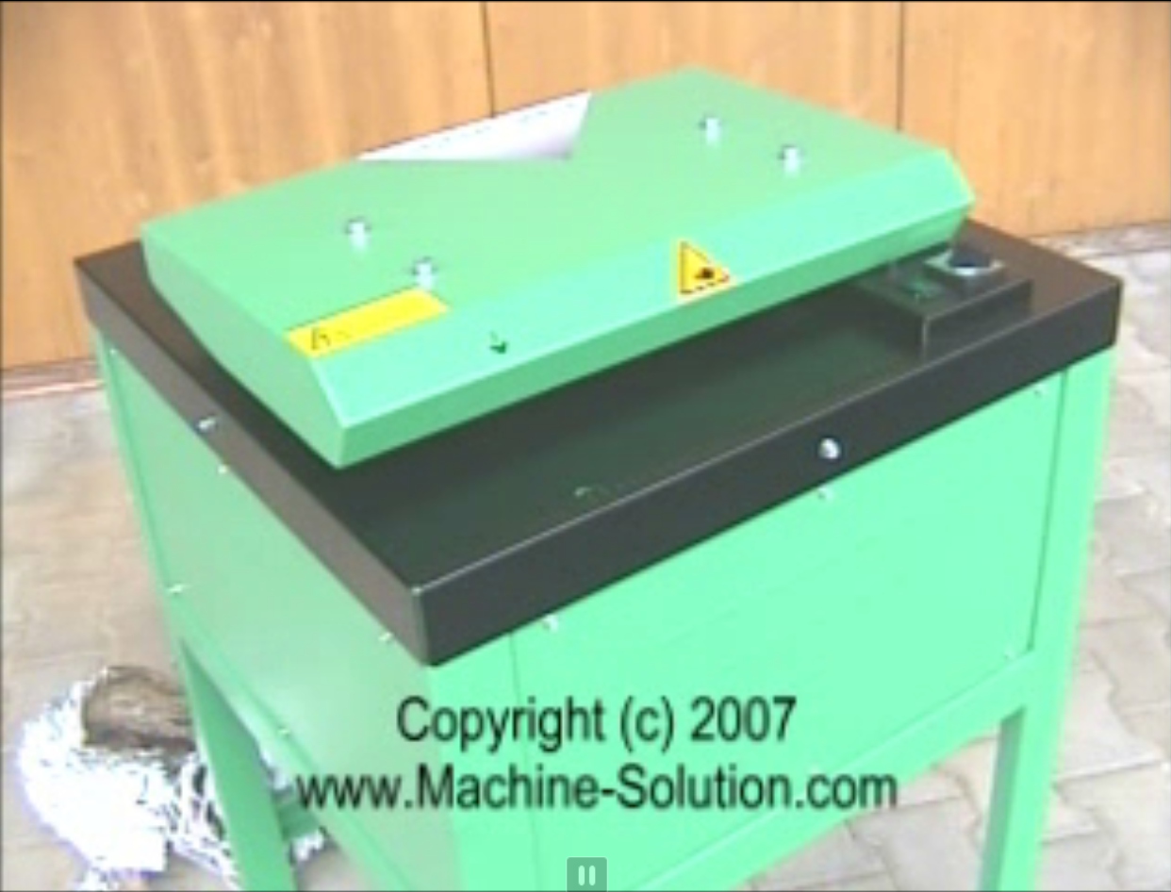
Shredder vs burning
Benefits :
reduced air pollution
reduced complaints from neighbors
potential cardboard recycling
No permitting required
no ash management/disposal
Down sides :
capital costs – 10K$+
cannot shred everything
more manpower required
“clean” criteria & segregation

Slide 14
Shredder
ERD Approval in principle received October 2016 for shredder use.
ERD main concerns are :
Where will the shredder be located (in case of an incident)
Procedure to ensure there are no explosives left in the boxes.
First trial with a shredder will be done early 2018.

Slide 15
E2 Regulation – Environment Canada
New E2 version 2016 with stringent requirements is expected spring - 2018. Stronger pressure is currently put by inspectors on industry to inform neighbors about AN hazards, measures to be taken in case of emergency and notification protocol.
Notice needs to include at least two things :
Measures to be taken by the public in case of emergency
Notification process (How will they be alerted/contacted)

Slide 16
E2 Regulation – Environment Canada
Explosives industry needs to be careful in the way they communicate with population in order to avoid adverse reactions and not jeopardize public safety.
TC 2016 Emergency Response Guidebook recommends a 800 m (1/2 mile) isolation distance in case of fire, however IME SLP30 recommends a 1600 m (1 mile) isolation distance.
Mass communication systems are currently being looked at by some CEAEC members to rapidly notify neighbors of a site in case of emergency (telephone, e-mail, text, etc.). A system was selected and implemented by Dyno Nobel and will be tested shortly (SOMUM Communications).

Slide 17
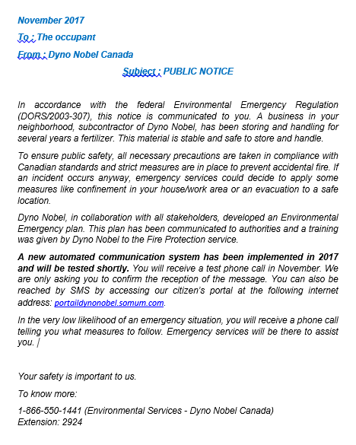
E2 Regulation – Notices (examples)

Slide 18
E2 Regulation – Communication system
https://secure.somum.com/portail/dynonobel/secure/portail/login.aspx?t=40083AE9-CFFF-4275-8930-59366E15EF29
https://secure.somum.com/SW/C/DynoNobel/secure/login.aspx?ReturnUrl=%2fsw%2fc%2fdynonobel

Slide 19
Questions?

