Slide 1

CEAEC MEETING
Quebec, June 6-7, 2019

Slide 2

Safety, Security and Environmental Committee
Prevention of AN leaching with bulk explosives – Code of good practice
E2 Regulation – into force on August 24, 2019
Transportation of Dangerous Goods Research Symposium – Feb 27 & 28, 2019

Slide 3
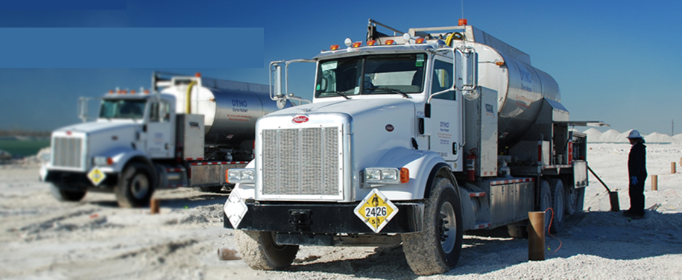
1- Prevention of AN leaching from bulk explosives

Slide 4
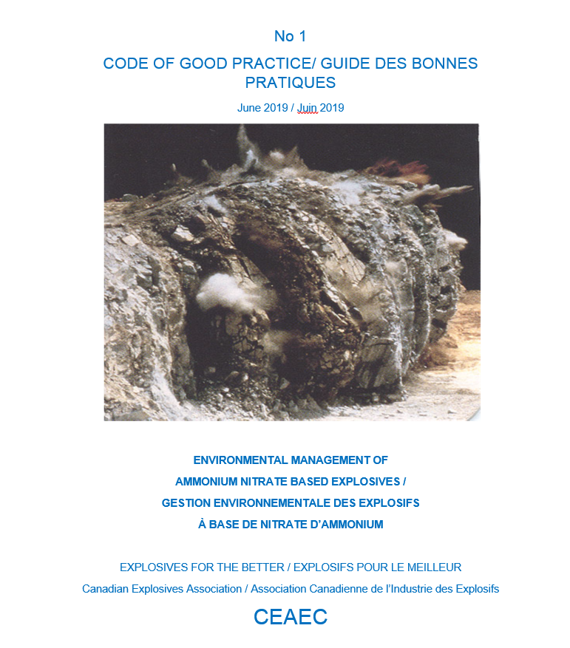

Slide 5
Code of good practice development
Next steps :
Send information to the committee for each topic of the guideline
Who : Technical experts from all companies
When : As soon as possible IN PROGRESS - SOME INFORMATION RECEIVED SO FAR
Put together the information and write a draft for each section for submission to the committee members
Who : Committee chair
When : As soon as sufficient information will have been received.
STARTED – 19 PAGES WRITTEN ON 10 TOPICS
Revise the draft and propose modifications/ improvements :
Who : Any CEAEC/Committee members
When : Upon request – WILL BE DONE before fall meeting

Slide 6
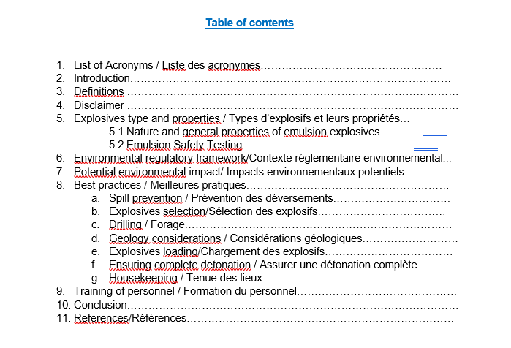
CEAEC Code of good practice development
6 pages
1 page
1 page
5 pages
3 pages

Slide 7
2- Environmental Emergency Regulation (E2) – Environment Canada
    Sites storing more than 20 tonnes of AN prill/AN solution in a single container
    Will come into force on August 24, 2019.
    Strengthen provisions requiring that public be provided with information and guidance on actions to be taken before, during and after an emergency.
    More detailed Emergency Plan including list of individuals who are going to respond , their roles and responsibilities and their current and future training.

Slide 8
Public information request - E2
2003 | 2016
4 (2) g) : A description of the measures to be taken to notify members of the public who may be adversely affected by an environmental emergency and to inform them of thoses measures and what to do in the event of an environmental emergency. | 4 (2) i) : before an emergency occurs, inform them of : A) the possibility of an environmental emergency, B) the potential consequences of an environmental emergency on the environment and on human life or health, C) measures that will be taken to protect the environment and human life or health ii) : before an emergency and during and after its occurrence, provide information and guidance concerning actions that could be taken by them to reduce the potential harm, including an explanation on how those actions help iii): The position title of the individual who will communicate with the public.

Slide 9
Excluded quantities - E2
2003 | 2016
Quantities of the substance that are temporarily stored for 72 hours or less in a container not normally located at the place, if the person keeps evidence of the date… | Quantities of the substance that are located at the place for a period of 72 hours or less, unless the substance is loaded or unloaded at the place if, during the period, the person keeps evidence of the date and time…

Slide 10
Major steps - E2 - Reminder
Notice : 90 days;
Plan preparation : 6 months;
Plan implementation : 6 months;
Plan testing : At least one component of the plan must be included in an exercise at least once a year;
49 hazardous substances added to Schedule 1 of the Regulations including fuel oil (No 2,4 and 6).
Substances | Minimum Quantity (tonnes)
fuel oil, No. 2 | 2500
fuel oil, No. 4 | 2500
fuel oil, No. 6 | 2500

Slide 11
Major steps - E2 - Reminder
Periodic reports :
Every 5 years : Schedule 5 (sections 1-3) for sites requiring only a notice regarding substances located at a place;
Every 3 years : Schedule 5 (complete) for sites requiring an Environmental Emergency Plan

Slide 12
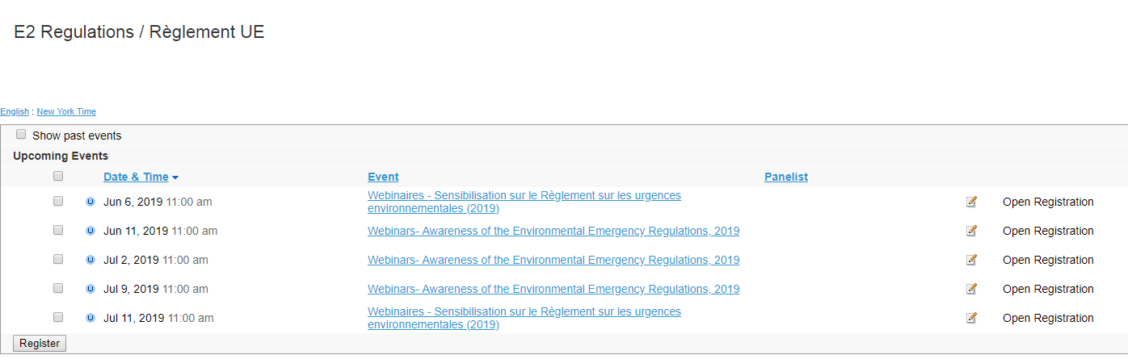
Webinars

Slide 13
3- Transportation of Dangerous Goods Research Symposium
Goal :
Presentations and discussions to explore innovative areas of research or to consider expanded scopes of on-going research.
Will help to establish short- to medium-term research priorities over the next 5 years.

Slide 14
3- Transportation of Dangerous Goods Research Symposium
One of the topic presented was :
Disposal of explosives packaging – Wali Sagaf, Transport Canada

Slide 15
CURRENT STATUS - SHREDDER
Pilot project commenced Spring 2018

Slide 16
RESEARCH OPTIONS
Improve the “clean” screening procedure
Expand the shredder pilot program
Analyze the shredded waste to determine residual content of explosives
Explore potential uses for the shredded waste
Explore any other proposed solutions

