Slide 1
CEAEC MEETING
SSE Committee
Niagara On The Lake- May 31, 2023

Slide 2
Safety, Security and Environmental Committee members
Hughes Brassard
Joey Viljoen
Seamus Kilcommons
Bruce Powell
Jessica Simon
Bill Evans
Brian Wilson
Benoit Choquette (chair)

Slide 3
Safety, Security and Environmental Committee
Safety share
Open Burning Alternatives
Code of Good Practices
Emergency Response Plan requirements– Ontario MECP vs Env. Canada (E2)
World Environment Day

Slide 4
Safety share

Slide 5
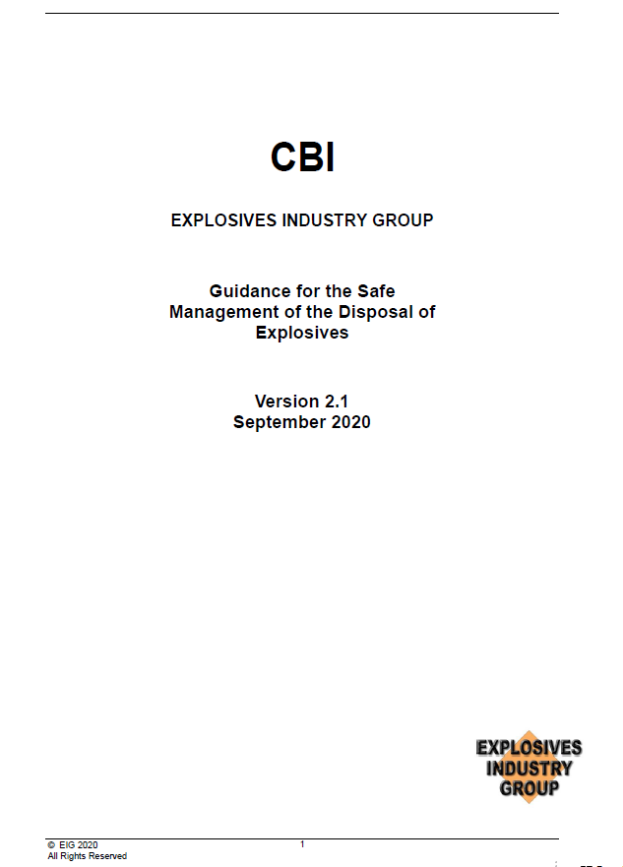
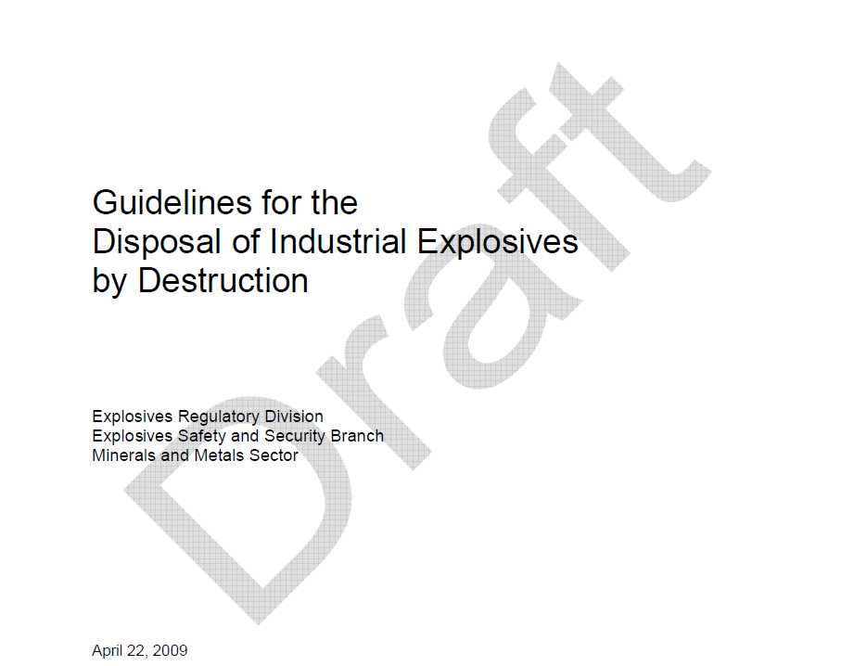
Safety share
References for safe handling and destruction of waste explosives and empty packaging of explosives :

Slide 6
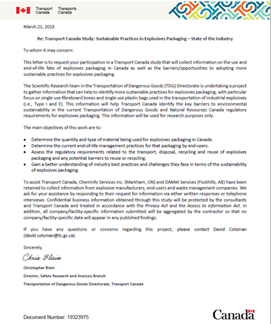
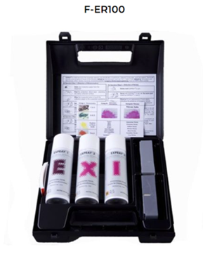
Open burning alternatives
Transport Canada Study: Sustainable Practices in Explosives Packaging – State of the Industry
Explosives traces test – Dyno Nobel
Path forward

Slide 7
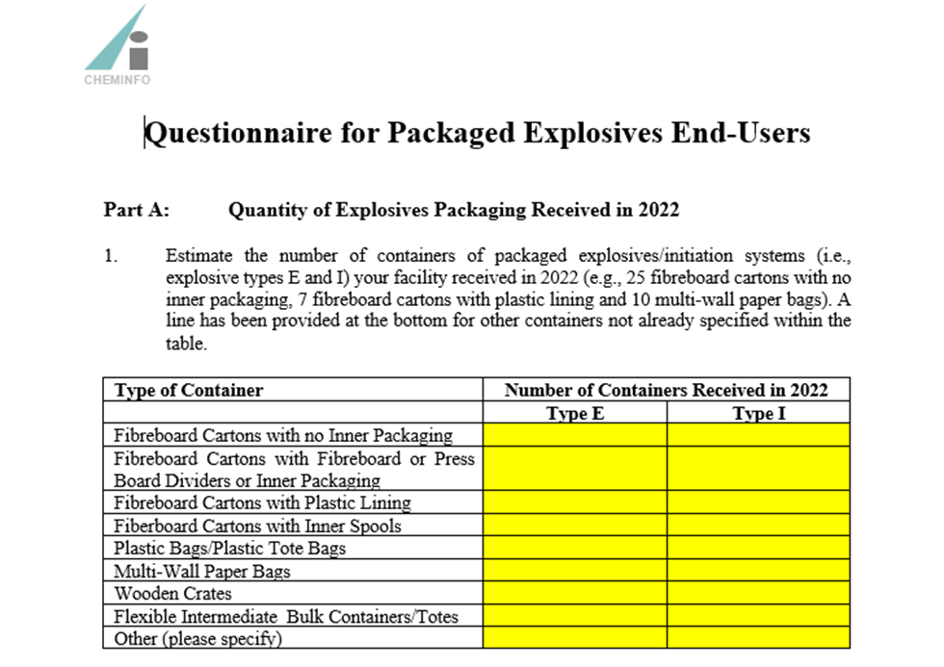
Transport Canada Survey

Slide 8
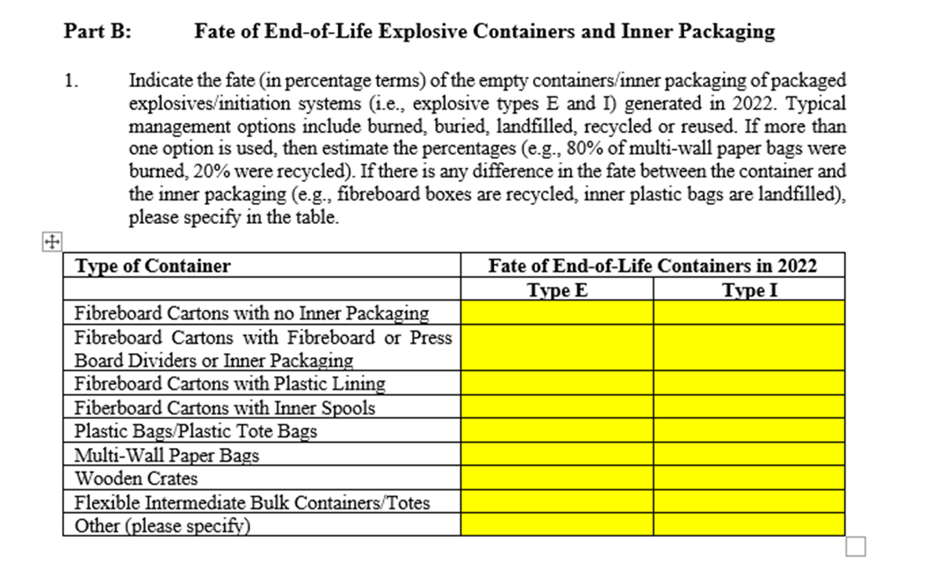
Transport Canada Survey

Slide 9
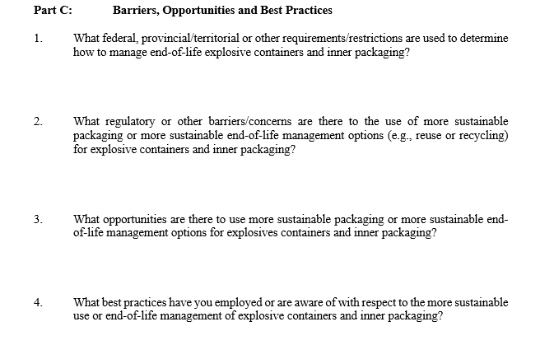
Transport Canada Survey

Slide 10
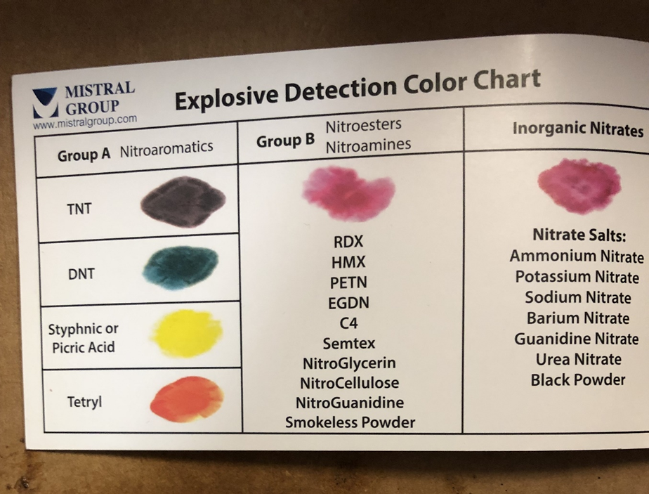
Open Burning Alternatives

Slide 11
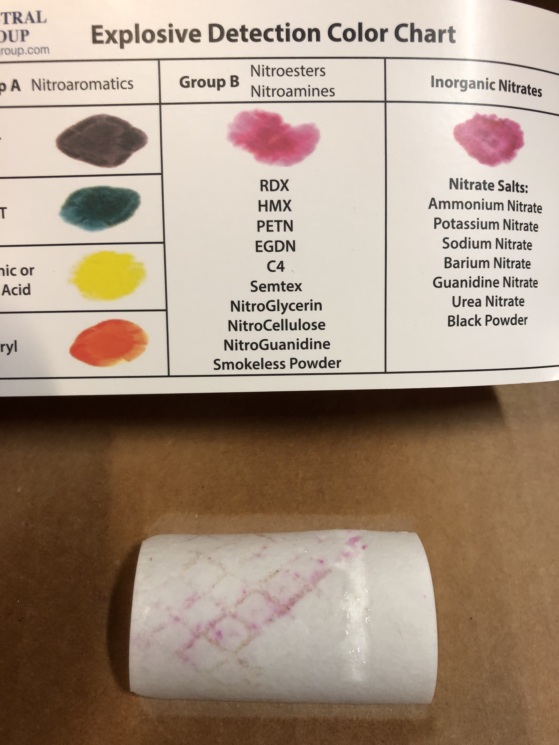
Open Burning Alternatives
Positive
Negative

Slide 12
Open Burning Alternatives
Empty cardboard cases tested | Results for Group A | Results for Group B | Results for Group C | Conclusion for presence of explosives traces
Dyno AP | Negative | Positive (cross-contamination ?) | Negative | Negative
Unimax | Negative | Positive | Negative | Positive
Nonel EZTL | Negative | Negative | Negative | Negative
Nonel EZ Det | Negative | Negative | Negative | Negative
Electric Super | Negative | Negative | Negative | Negative
Spartan 450 g | Strong Positive – bag Negative -Box | Negative | Negative | Positive – bag Negative- Box
Blastex | Negative | Negative | Negative | Negative
Digishot | 2 Negative | Negative | Negative | Negative
Blastgel 1070 | 3 Negative | Negative | Negative | Negative

Slide 13
Path forward
Establish a "clean" criteria
Finalize an empty packaging inspection method
Talk to landfill operators about landfilling option
Talk with cardboard recyclers about recycling cardboard option
Consider composting option
Seek manufacturer’s interest to develop a recyclable container for ANFO and/or push for use of bulk trucks/pots
Apply for an Equivalency Certificate with TC to allow for the transportation of empty packaging of explosives.
Work with ERD to remove all legal hurdles for new management methods.

Slide 14
3- Code of good practices

Slide 15
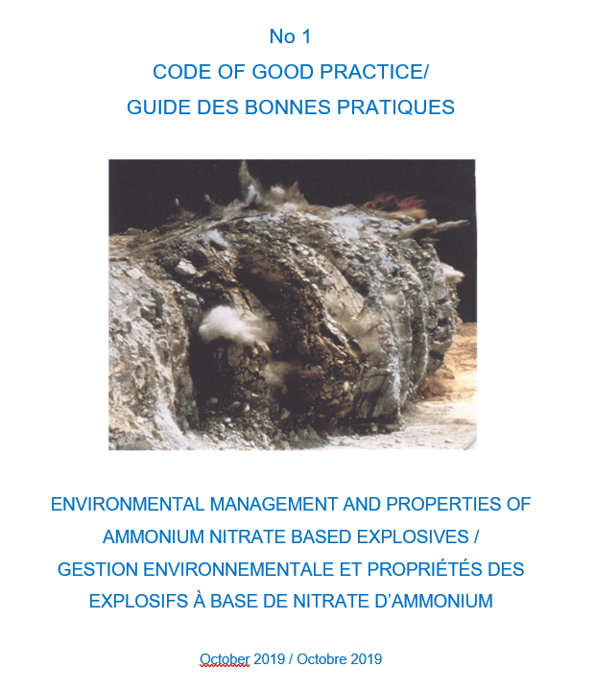
First code : Environmental Management & Properties of AN based explosives
Disclaimer – available.
Insurance Coverage - available
Bilingual – To be translated
Standard format - to be finalized
References – To be finalized
Other codes to likely be published by CEAEC:
Empty packaging inspection method;
Emergency Response – Fires near explosives;
Use of common carriers;
Transportation of ANE’s in tank vehicles.

Slide 16
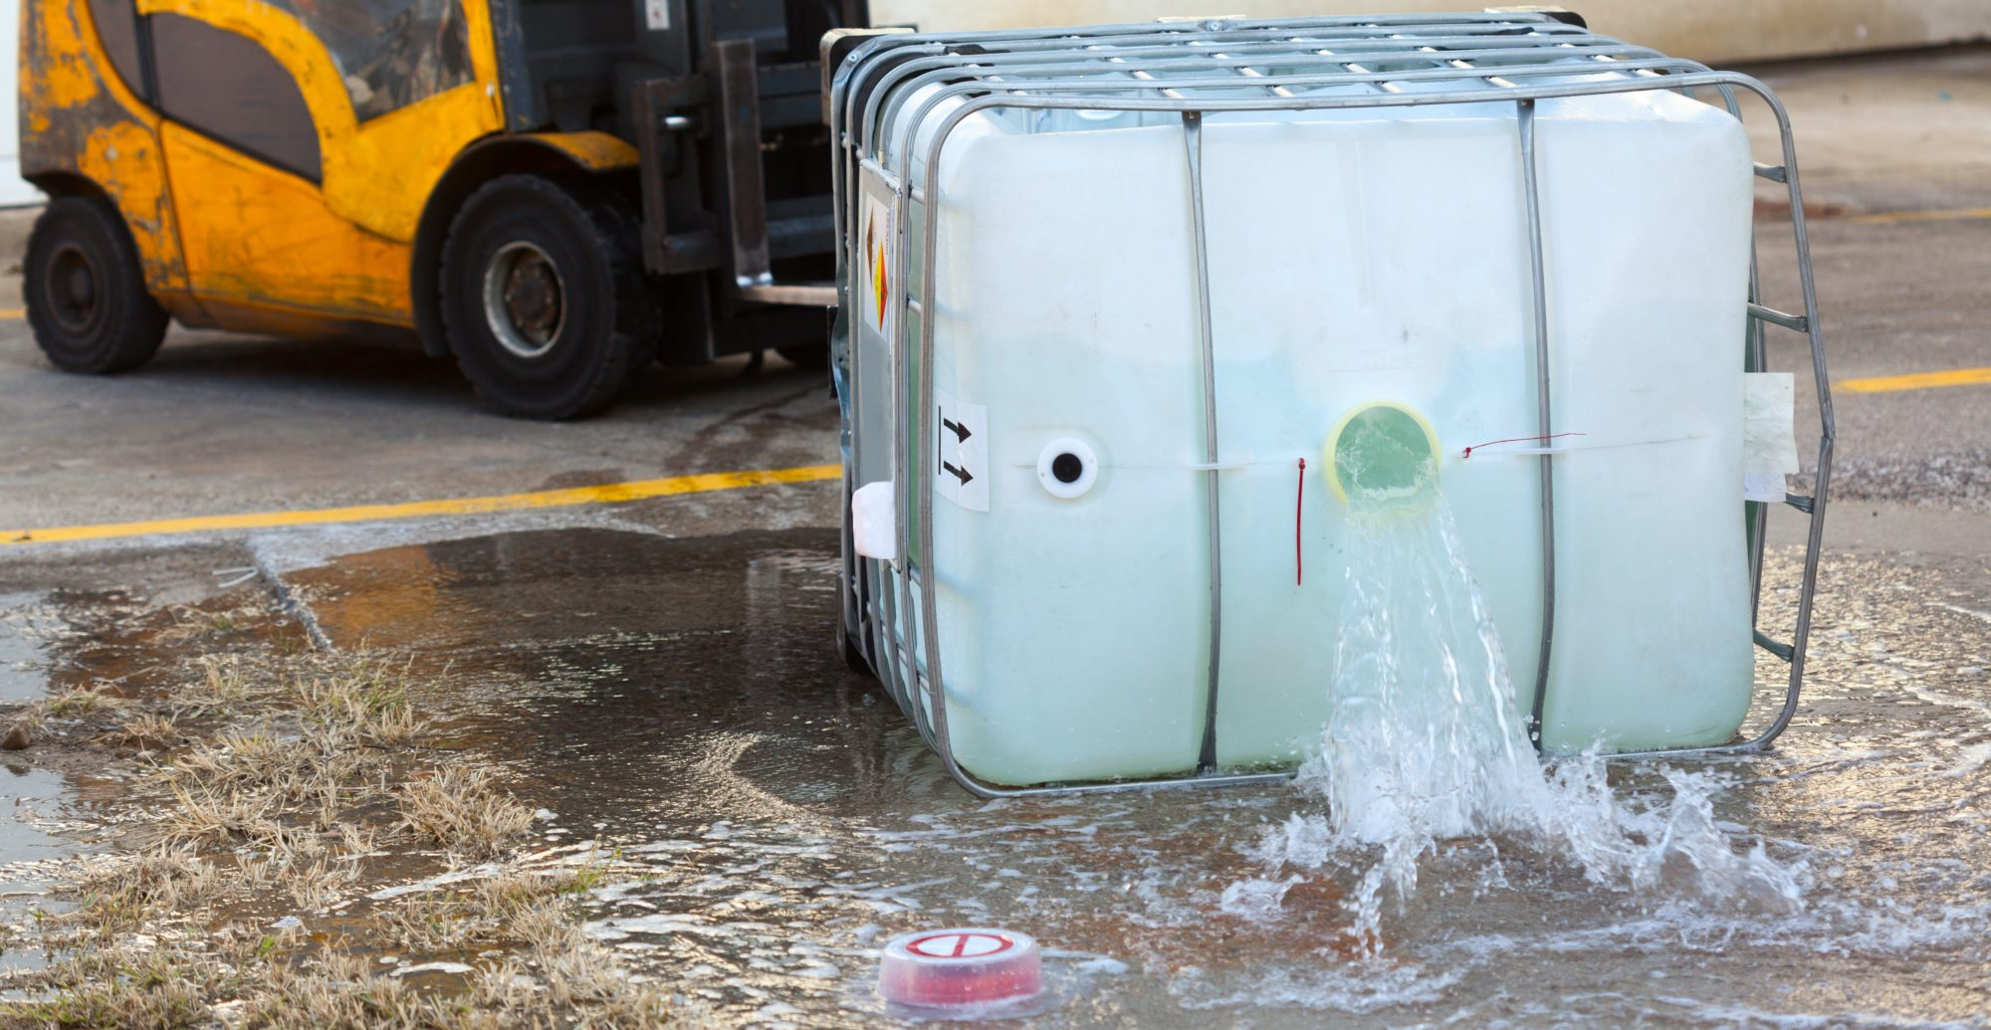
ERP requirements comparison
Ontario MECP SPCP & Env. Canada (E2)

Slide 17
Requirement ERP | Ontario SPCP - O. Reg. 224/07 | Environment Canada - E2 Regulation
Documented ERP annual testing
Documented live exercise | Every 2 years | Every 5 years
5 years to cover the entire plan with testing
Site Entry procedure
Plans and drawings of the plant and each property on which the plant is located that are drawn to scale and that accurately show property boundaries, discharge points, tanks, floor drains, loading and unloading areas, sump pumps, test holes, ground water and surface water supplies, water treatment plants, ponds, catch basin, etc.

Slide 18
Requirement ERP | Ontario SPCP - O. Reg. 224/07 | Environment Canada - E2 Regulation
Communication with the members of the public who may be adversely affected by the environmental emergency to inform them, before the environmental emergency occurs
A map of the area around the plant identifying all of the following places that are within the area that may be affected by a spill
Identification of possible steps that could be taken to prevent or reduce the risk of the spill from occurring
Plan testing reporting | Annual statement | Schedule 5 – every 5 years
Statement of accuracy

Slide 19
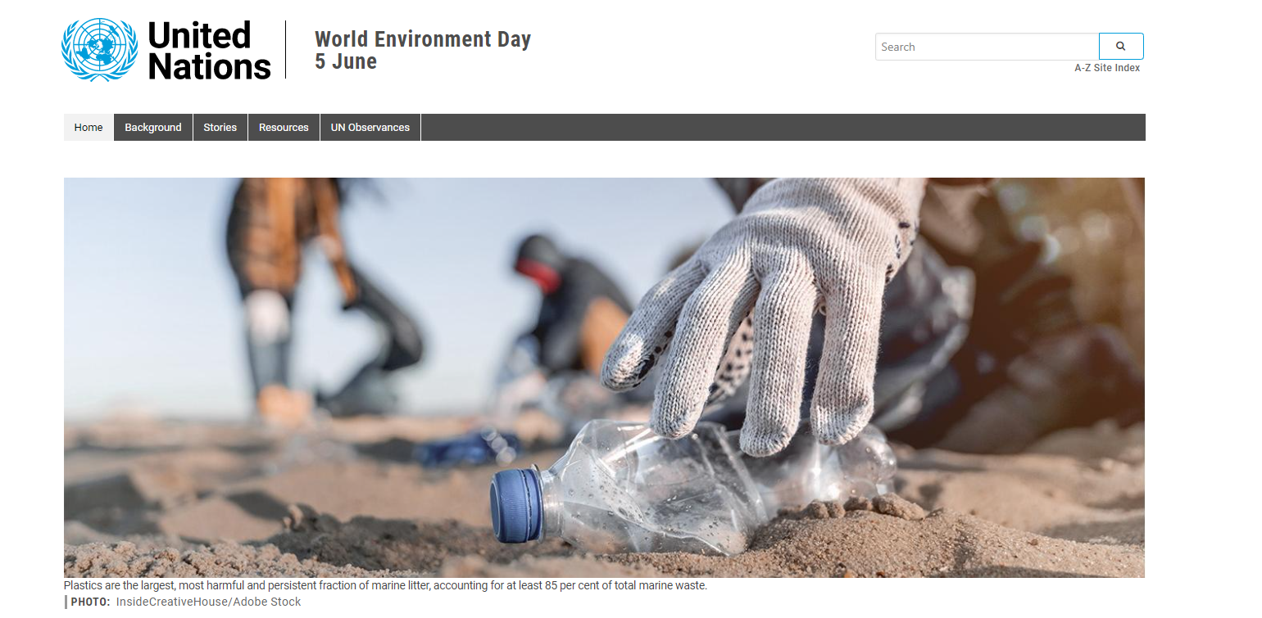
World Environment Day

Slide 20
