Slide 1
Transport Canada TDG Standards and Regulatory Update
Shaun Singh, Means of Containment Specialist 2018 CEAEC Annual Meeting
TDG Regulatory Affairs Branch
April 2018
RDIMS # 13986357

Slide 2
Purpose
To provide an update on recent standards and regulatory activities regarding the transportation of dangerous goods that pertain to the explosives industry.

Slide 3
Topics
CGSB-43.151
CSA B620
Other Means of Containment (MOC) Standards
Contraventions Regulations (Ticketing)
TDG Marine Provisions
Part 6 (Training) of the TDG Regulations

Slide 4
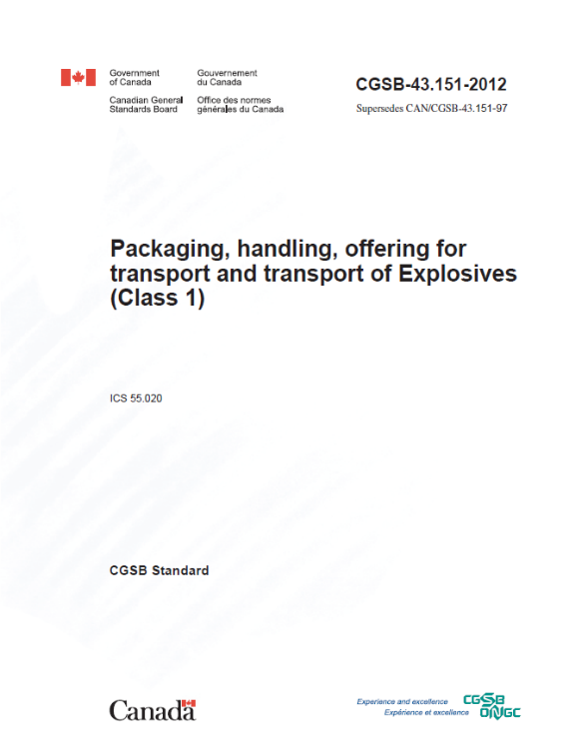
CGSB-43.151
Packaging, Handling, Offering of Transport and
Transport of explosives (class 1)
Proposal
Update list of explosives and packing instructions to align with the 20th edition of the UN Recommendations.
Update references for container standards to reflect dynamic referencing.
Add large packaging: ELP01 & ELP02.
Specify packaging for jet perforating guns.
Reorganization and incorporation of regulatory overrides and policy clarifications to minimize confusion:
Main section vs. annexes;
Reg. SP147, hose testing letter to CEAEC.

Slide 5
CGSB-43.151
Committee meeting – February 2018
Gate valve restriction removed.
Reuse of packaging harmonized with Explosives Regulations, 2013.
Highlight domestic packing instructions which have no UN equivalent.
New CEP01 for jet perforating guns; CEP02 replaces EP17.
Start-to-discharge pressure set for pressure relief devices on IBC (5 – 9 psi).
Consider replacing periodic hose testing with annual visual inspection.
Inspection report.
Replaced Maximum Allowable Working Pressure (MAWP) thresholds with T-codes for permitted UN portable tanks.
T1 to T10.
Standardized approval process for rail transport of bulk explosives.

Slide 6
CGSB–43.151
Status
2nd draft being prepared for public consultation.
2nd committee meeting after public consultation.
Anticipated publication date – Spring 2019.

Slide 7
CSA B620
Highway tanks and TC portable tanks for the transportation of dangerous goods
Committee Meeting – January 2018
TC423 can be in either a tank truck or tank trailer configuration.
Structural integrity inspection (“S”) only applies to TC423 tank trailers.
Insulation is optional for TC423.
If employed, TC423 insulation must be made of non-combustible material:
Must be non-combustible and inorganic, regardless of flame spread rating;
Need not be rigid and may be porous; but must be protected from ingress of any spillage (e.g., vapour barrier and tight jacket);
Material would no longer require ERD approval.
Status
Final Draft Consultation – Summer 2018.
Publication – Spring 2019.

Slide 8
Other MOC Standards - CSA B625
Portable tanks for transport of dangerous goods (UN/IMO/IM)
What’s New?
Updated to align with the 20th edition of the United Nations Model Regulations on the Transport of Dangerous Goods;
Restructuring of Chapter 9 concerning registration types and requirements.
Status
Next committee meeting: June 2018.
Propose definition for “decontamination”; review pressure vessel codes.
Final Draft Consultation – Fall 2018.
Publication – Summer 2019.

Slide 9
Other MOC Standards - TP14850
Small containers for transport of dangerous goods, Classes 3, 4, 5, 6.1, 8 & 9
What’s New?
Revisited packing instructions to improve structure, presentation and usability;
Added requirements where manufacturers will now have to periodically retest a representative sample of a container at an interval of no more than five years;
Incorporated a new special case for the transport of liquid dangerous goods in a mobile process unit;
Clarified requirements of special cases for the transportation of dangerous goods waste.
Status
3rd / Final Public Consultation – January 30 to March 30, 2018.
Publication – Summer 2018.
Static Regulatory Reference – 2019.

Slide 10
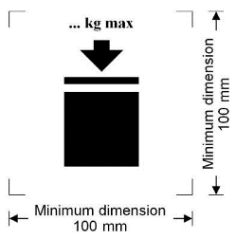
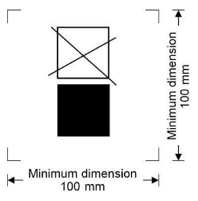
Other MOC Standards - CGSB–43.146
Design, manufacture and use of intermediate bulk container for TDG, Classes 3, 4, 5, 6.1,8 & 9
Published April 25, 2016.
Came into force July 12, 2017; 6-month transition period ended January 12, 2018.
What’s New?
All sizes of IBC must be leak tested and inspected, including those under 450 L;
Lightweight IBC must be leak tested and inspected before each use;
Metal IBC: inspection and testing of reclosing pressure-relief devices;
“W” marking no longer required for IBC larger than 3000 L made after July 12, 2017;
Maximum Permissible Stacking Load
and Non-Stackable IBC Symbols.

Slide 11
Other MOC Standards - CGSB–43.145 (New)
Design, manufacture and use of large packagings, Classes 3, 4, 5, 6.1 ,8 & 9
What’s New?
Harmonize TDG Regulations with United Nations Model Regulations for the transport of dangerous goods. Large Packagings (LP) have been permitted since the 11th revised edition (1999);
Allow the manufacture, selection and use of another type of means of containment that is more convenient to transport certain dangerous goods;
LP can be used to transport articles or inner packagings such as bags or boxes;
LP are mainly used to transport waste dangerous goods and large articles.
Status
Committee member review of the draft standard (following the meeting of November 14th, 2017) took place from January 31 to February 13, 2018.
A public review of the draft standard just commenced in April 9th 2018 for 60 days to June 8th.
Expected publication at the end of 2018.

Slide 12
Contraventions Regulations (Ticketing)
Contraventions Regulations – Schedule XV
Amended February 2018.
Improved enforcement capability to issue tickets for offences related to MOC facilities, as well as TDG security, releases and emergency response.
New or revised offence descriptions
Facility-related offences
Failing to comply with safety and security requirements: $700
Failing to comply with safety standards or to display safety marks: $500
Failing to comply with means of containment safety requirements: $500
Affixing or displaying a misleading compliance mark: $500
Failing to keep supply records: $500

Slide 13
Contraventions Regulations (Ticketing)
New or revised offence descriptions
Other offences
Failing to accompany dangerous goods with required documents: $500
Failing to use required or permitted means of containment: $500
Affixing or displaying a misleading dangerous goods mark: $500
Engaging in an activity in respect of a means of containment without required safety marks: $500
Failing to report release or anticipated release of dangerous goods: $1000
Failing to take reasonable emergency measures in respect of release: $1000
Failing to report loss or theft to prescribed person: $1000

Slide 14
TDG Marine Provisions
Amended December 2017.
Consult TDG FAQ page and the Canada Gazette, Part II:
http://www.tc.gc.ca/eng/tdg/faq-amendments-marine-provisions-tdg-regulations-part-11.html

Slide 15
Part 6 (Training) of the TDG Regulations
Progress to Date:
Policy consultations took place over 2016-2017 on options to amend Part 6.
A competency based training and assessment (CBTA) standard with a general awareness training component will be incorporated by reference into the amended regulations.
CBTA standard is being developed by the Canadian General Standards Board;
Two technical committee meetings held to-date (December 2017 and March 2018);
Membership includes 34 technical committee members;
Six working groups have been created to develop the standard content.
Next Steps:
Technical committee meetings in June and October 2018.
Canada Gazette, Part I in Spring/Summer 2019 (target).
Notes:
Speaking points:
Three phases of policy consultations took place over 2015-2017 on policy options to amend Part 6 (i.e., adopt a competency based training and assessment approach, develop a standardized curriculum and tests, certification of individuals and accreditation of training institutions).
Based on feedback Transport Canada proposed a two-prong approach to amend Part 6:
General awareness course and a mandatory TDG 101 online test with the issuance of a TDG 101 certificate of completion bearing a unique identifier number; and
Job-specific competency-based training and assessment.
In Summer 2017 stakeholders expressed concerns about the mandatory TDG 101 test (COSTHA, IVOGDA).
At the Fall 2017 GPAC meeting, members also expressed strong concerns with the proposed mandatory TDG 101 test as an option for general awareness training in the amended regulations.
To address these concern, TC suggested that a sub-group of GPAC members be formed to identify alternative approaches to general awareness training. TC met with the sub-group on Jan 11, 2018 to determine how best to address general awareness training, TDG 101 aside.
The outcome of this meeting was to incorporate TDG general awareness training into the CGSB Standard on competencies for the transportation of dangerous goods.
In partnership with the CGSB, TC has begun developing a CBTA standard that would be incorporated by reference into the TDGR.
The first Technical Committee meeting was held December 11-12, 2017 in Gatineau QC. The Committee is comprised of 34 members from industry, training institutions, and government.
The second Technical Committee meeting took place on March 8th, 2018, where each of the working group chairs presented on their respective work to date. Existing WG are on Assessment and Task Lists. Three new working groups were added: definitions, general awareness training, drafting of the standard.
The third Technical Committee meeting is scheduled for June 13-14, and the fourth for October 3-4, both will be held in Ottawa/Gatineau.

