Slide 1
Transportation of Dangerous Goods (TDG) Standards and Regulatory Update CEAEC Fall Meeting Ottawa, ON – November 15, 2018
Presented by:
Wali Sagaf, Team Lead – UN, Rail and Explosives Packaging
RDIMS: 14659587

Slide 2
Outline
Personnel Update
Standards Update
CGSB 43.151 / TP 14850
CGSB 43.145 / CGSB 43.146 / CSA B620 / CSA B625
Regulatory Update
Part 6
Contraventions Regulations
Client Information Database
Fee Modernization

Slide 3
Personnel Update

Slide 4
TDG – Explosives Packaging Program
Benoit Turcotte
DG of TDG
Michel Béland
ED of RAB
France Bernier
Superintendent – Explosives Packaging Program
Shaun Singh
Team Lead – Explosives Packaging Program
Wali Sagaf
Team Lead – Explosives Packaging Program
Nicholas Roy
Means of Containment Specialist

Slide 5
Standards Update

Slide 6
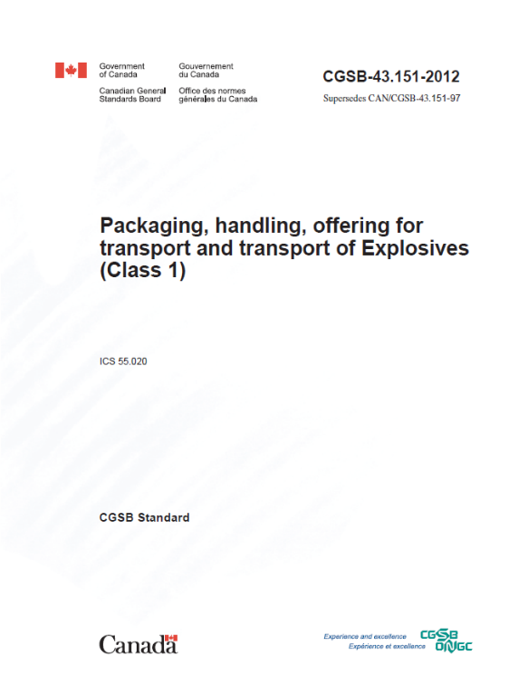
CGSB 43.151
Packaging, Handling, Offering FOR Transport and
Transport of explosives (class 1)
What’s new?
Updated list of explosives and packing instructions to align with the 20th edition of the UN Recommendations.
Updated references to other packaging standards to reflect ambulatory referencing.
Specified packing instructions for large packaging (ELP01 & ELP02).
Specified packing instruction for jet perforating guns (CEP01).
Reorganized and incorporated regulatory overrides and policy clarifications to minimize confusion.

Slide 7
CGSB 43.151
Committee meeting – February 2018
Removed gate valve restriction.
Reuse of packaging harmonized with Explosives Regulations, 2013.
Specified domestic packing instructions with no equivalent in the UN.
CEP01 for jet perforating guns; and
CEP02 for bulk explosives (currently EP17).
Set start-to-discharge pressure for IBC pressure relief devices (5 – 9 psi).
Replaced temporary hose assembly testing with annual visual inspection.
Inspection report
Replaced Maximum Allowable Working Pressure (MAWP) thresholds with T-codes for permitted UN portable tanks.
T1 to T10
Standardized approval process for rail transport of bulk explosives.

Slide 8
CGSB 43.151
Status
Final Public Consultation – June/July 2018
Upcoming committee meeting / teleconference to discuss comments from public consultation - Winter 2018/2019
Planned Publication - Spring 2019

Slide 9
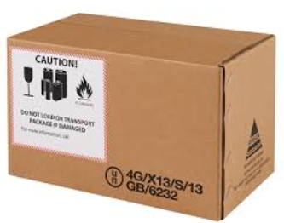
TP 14850
Small containers for transport of dangerous goods, Classes 3, 4, 5, 6.1, 8 & 9
What’s New?
Improved alignment with the 20th edition of the UN Model Regulations;
Revisited packing instructions to improve structure, presentation and usability;
Added requirements where manufacturers will now have to periodically retest a representative sample of a container at an interval of no more than five years;
Incorporated a conditional exemption for the use of plastic drums and jerricans past 60 months of the date of manufacture; and
Clarified requirements for transporting dangerous goods waste.
Status
Final Public Consultation – February/March 2018
Planned Publication – Spring 2019
Next Edition will migrate towards CGSB 43.150

Slide 10
CGSB 43.145 (New)
Design, manufacture and use of large packagings, Classes 3, 4, 5, 6.1 ,8 & 9
What’s New?
Setting out the requirements for designing, manufacturing and marking of UN standardized large packagings (LPs) and for selecting and using large packagings (LPs) for the transportation of dangerous goods of Class 3, 4, 5, 6.1, 8 and 9.
Harmonize TDG Regulations with United Nations Model Regulations for the transport of dangerous goods. Large Packagings (LPs) have been permitted since the 11th revised edition (1999);
LPs can be used to transport certain explosives articles through CGSB 43.151.
Status
Final Public Consultation – April/May 2018
Planned Publication – Spring 2019

Slide 11
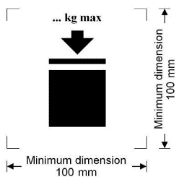
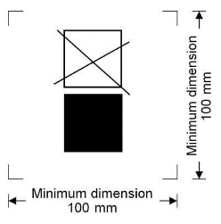
CGSB 43.146
Design, manufacture and use of intermediate bulk container for TDG, Classes 3, 4, 5, 6.1,8 & 9
What’s New?
All sizes of IBC must be leak tested and inspected, including those under 450 L;
Lightweight IBC must be leak tested and inspected before each use;
Metal IBC: inspection and testing of reclosing pressure-relief devices;
“W” marking no longer required for IBC larger than 3000 L made after July 12, 2017;
Maximum Permissible Stacking Load and Non-Stackable IBC Symbols.
Status
Publication – April 2016
Coming into Force - July 12, 2017
End of Transition Period - January 12, 2018

Slide 12
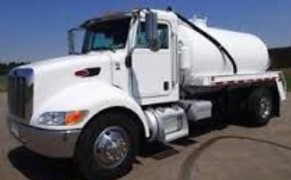
CSA B620
Highway tanks and TC portable tanks for the transportation of dangerous goods
Committee Meeting – January 2018
TC423 can be in either a tank truck or tank trailer configuration.
Structural integrity inspection (“S”) only applies to TC423 tank trailers.
Insulation is optional for TC423.
If employed, TC423 insulation must be made of non-combustible material:
Must be non-combustible and inorganic, regardless of flame spread rating;
Need not be rigid and may be porous; but must be protected from ingress of any spillage (e.g., vapour barrier and tight jacket);
Material would no longer require ERD approval.
Status
Final Public Consultation – Summer 2019
Planned Publication – Winter 2019

Slide 13
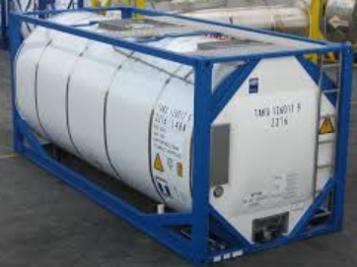
CSA B625
Portable tanks for transport of dangerous goods (UN/IMO/IM)
What’s New?
Updated to align with the 20th edition of the United Nations Model Regulations on the Transport of Dangerous Goods;
Restructuring of Chapter 9 concerning registration types and requirements.
Limit the pressure vessel code acceptability of foreign-approved tanks to ASME Sec. VIII, Div. 1 or 2. Foreign-approved tanks built after 2018 to Div. 1 and used for Class 2 or TIH dangerous goods will need to be U-stamped.
Status
Final Public Consultation – October/November 2018
Publication – Spring 2019

Slide 14
Regulatory Update

Slide 15
Training Requirements – Part 6
Why is Part 6 being updated?
To increase compliance and improve public safety by:
Ensuring that people who transport dangerous goods have the knowledge and skills to perform their jobs; and
Increasing clarity of the regulatory requirements.

Slide 16
Training Requirements – Part 6
Progress to Date
Policy consultations took place over 2016-2017 on options to amend Part 6.
A competency based training and assessment (CBTA) standard with a general awareness training component will be incorporated by reference into the amended regulations:
CBTA standard is being developed by the Canadian General Standards Board;
Three technical committee meetings held to-date (December 2017, March 2018 and June 2018);
Membership includes 34 technical committee members; and
Six working groups have been created to develop the standard content.
Next Steps
Technical committee meetings in October 2018.
Canada Gazette, Part I planned for Spring 2020.

Slide 17
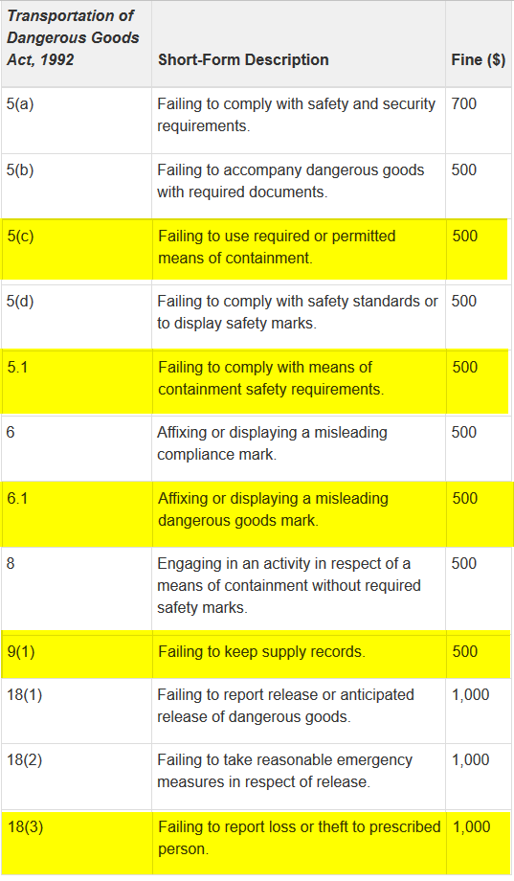
Contraventions Regulations
TDG schedule of the Contraventions Regulations – Published in Part II of the Canada Gazette on February 21, 2018
Identifies offences designated under the TDG Act and allows inspectors to issue a contraventions ticket with a prescribed amount.
Updated to reflect changes that were made to the TDG Act in 2009, such as security related concepts, reporting requirements for lost or stolen dangerous goods and requirements regarding the manufacture and certification of Means of Containment (see yellow in chart).
The TDG Contraventions Web Page has been updated with information regarding the amendments and contains a new table of offences as well as the fine amounts. http://www.tc.gc.ca/eng/tdg/ticketing-menu-205.htm
The changes came into force on March 14th 2018.

Slide 18
Transportation of Dangerous Goods Client Identification Database (TDG CID)

Slide 19
Client Identification Database (CID)
TDG CID will identify regulated parties throughout the supply chain and collect information on their activities in order to facilitate risk-based assessment of dangerous goods sites across Canada.
Transport Canada (TC) has adopted a phased-approach to developing/implementing TDG CID:
Phase 1 – Policy Development
Phase 2 – Legislative and Regulatory Development
Phase 3 – Platform Development & Launch
To conclude Phase 1 – Policy Development, TC is currently compiling a “What We Heard” report summarizing the main concerns raised by stakeholders. This report will be published online in Winter/Spring 2019.

Slide 20
Fee Modernization for the Transportation of Dangerous Goods Means of Containment Facilities Registration Program (TDG MOC)

Slide 21
Fee Modernization for the TDG MOC
TC is modernizing fees for many services it provides to Canadians by introducing new fees, modernizing existing fees and streamlining fees for some services across the department.
Efforts include proposed new fees and service standards for the Transportation of Dangerous Goods (TDG) MOC Facilities Registration Program.
Timeline:
Phase 1 – Fee Proposal (2017/18 – 2018/19); Ministerial approval anticipated by January, 2019
Phase 2 – Regulatory Process (2019/20 – 2020/21)
Phase 3 – Implementation, Reporting, Monitoring (2020/21 – Ongoing).
Preliminary feedback consultations are presently taking place, until November 7th 2018.
Email feedback to TDG Policy Proposal / Proposition politiques TMD (TC) TC.TDGPolicyProposal-PropositionpolitiquesTMD.TC@tc.gc.ca

Slide 22
Thank you for your time!
Any Questions?

