Slide 1
Transportation of Dangerous Goods (TDG) Standards and Regulatory Update CEAEC 2019 Fall Meeting Ottawa, ON – November 7, 2019
Presented by:
Chris Nowak – Team Lead, Highway Tanks
Wali Sagaf – Team Lead, UN, Rail and Explosives Packaging
RDIMS: 15908365

Slide 2
Outline
Organizational Structure
Standards Update
CSA B620 / B621 / B625
CGSB 43.145 / 43.146 / 43.150 (TP 14850) / 43.151
Regulatory Update
Compliance Issues
TDG Safety Awareness Program
Regulatory Sandbox
TDG Contacts

Slide 3
Organizational Structure

Slide 4
Government of Canada
Transport Canada
Safety & Security
Transportation of Dangerous Goods
Air
Marine
Rail
Road
Ottawa, HQ
Regions
Regulatory Frameworks and International Engagement
Atlantic
Safety Research & Analysis
Quebec
Compliance & Response
Ontario
Management & Resources Services
Prairie and Northern
TDG Secretariat
Pacific
CANUTEC

Slide 5
TDG – Explosives Packaging Program
Benoit Turcotte
Director General of TDG
Madona Radi
Exec. Dir. of RAB
France Bernier
Manager – Explosives Packaging Program
Shaun Singh
Team Lead – Explosives Packaging Program
Wali Sagaf
Team Lead – Explosives Packaging Program
Nicholas Roy
Means of Containment Specialist

Slide 6
Standards Update

Slide 7
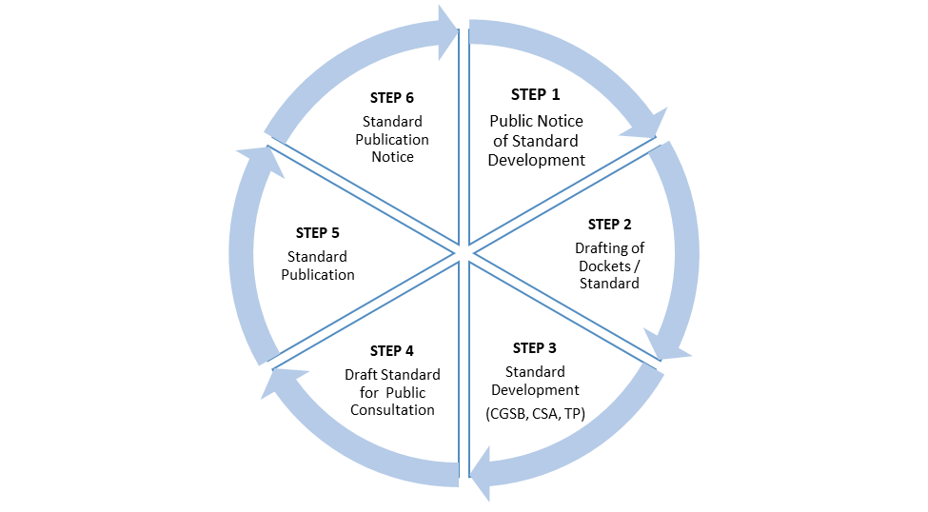
Consultation Process for Standard Development
What is the process?
Step 1: Publish Standard Development Notice (30 days)
Step 2: Draft the Dockets/Standard (preparation phase)
Step 3: Standard Development (CGSB, CSA, TP) (participation in the Standard Development Committee)
Step 4: Draft Standard for Public Consultation (60 days)
Step 5: Publish Standard
Step 6: Publication Notice (including coming into force date)
Notes:
To be added

Slide 8
CSA B620-20 / CSA B621-20 Current Status

Slide 9
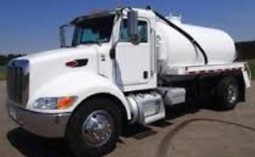
CSA B620-20 and CSA B621-20 Current Status
Highway Tanks and TC Portable Tanks
CSA B620-20 and CSA B621-20
CSA Public Consultation concluded June 11, 2019
CSA editors completing ballot draft edition for committee members
Target publication date - March 2020
Comes into effect when published. Mandatory compliance 6 months after publication.
Notes:
Info reviewed/approved by Pascal Verville – Oct 27, 2019 RR

Slide 10
CSA B620-20 and CSA B621-20 Pending Changes

Slide 11
CSA B620-20

Slide 12
CSA B620-20 Pending Changes
Highway Tanks and TC Portable Tanks
CSA B620-20 changes
Updated ASME code referencing dynamically to the latest edition of the ASME code.
Revised tank securement requirements for all tanks.
New pressure gauge selection and calibration requirements for pressure tests.
Revised thickness testing requirements.
Revised pressure testing requirements.
Revised Inspection and Test reporting requirements.

Slide 13
CSA B620-20 Pending Changes
Highway Tanks and TC Portable Tanks
CSA B620-20 changes
Revised insulation requirements for TC 423 tanks (insulation already optional with B620-14).
Updated tank Inspector and Tester training and qualification requirements.
New Training Organization registration for qualification of Inspectors and Testers.

Slide 14
CSA B620-20 Pending Changes
Highway Tanks and TC Portable Tanks
CSA B620-20 changes
TC 423 Insulation changes
No longer require Chief Inspector of Explosives to approve compatibility.
No longer require rigid or non-porous insulation. Must be inorganic and protected.
No longer required to meet fire endurance rating per ASTM E119 or CAN/ULC S101 or flame spread ratings per ASTM E84 or CAN/ULC S102
Insulation shall be non-combustible in accordance with ASTM E136 or ULC CAN4-S114.
Tanks with insulation still require jacket and vapour barrier.

Slide 15
CSA B621-20

Slide 16
CSA B621-20 Pending Changes
Highway Tanks and TC Portable Tanks
CSA B621-20 major changes
Non-rectangular TC44 tanks are no longer limited to diesel fuel only. Permitted for transport of other dangerous goods, similar to TC 406 and equivalent tanks.
Revised requirements for tanks with an intermediate bulkhead.
Emergency shutoff marking requirements for manually activated remote shutoff device.
Revised dangerous goods table sorted by UN number.
At least two chock blocks required when using chock blocks to prevent unintended vehicle movement.

Slide 17
CSA B625-13

Slide 18
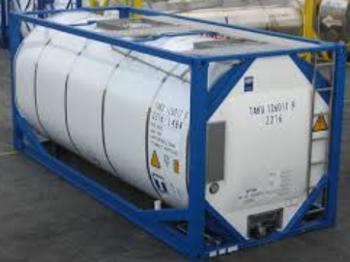
CSA B625-13
Portable tanks for transport of dangerous goods (UN/IMO/IM)
Current Status
CSA B625-13 is the safety standard that is in force
Progress to Date
60-day public review concluded of CSA B625-19 in December 2018
Target publication date – Fall 2019
Pending Changes
2013 edition until 2019 edition is published with a 6-month transition period
CSA B625-19 includes a definition for decontamination similar to CSA B620

Slide 19
CGSB 43.145-19

Slide 20
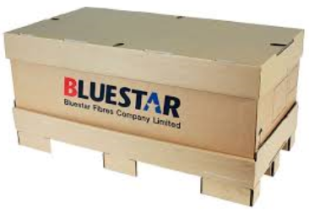
CGSB 43.145-19 (New)
Design, manufacture and use of large packagings, Classes 3, 4, 5, 6.1 ,8 & 9
Current Status
Set out requirements for the design, manufacture and marking of UN standardized large packagings (LPs)
Progress to Date
60-day public review concluded of CGSB 43.145 in December 2018
Published during Summer 2019
Pending Changes
Canada Gazette, Part I (CGI) is planned for Summer 2020
Explosives Large Packaging (ELPs) will have to be covered by equivalency certificates

Slide 21
CGSB 43.146-16

Slide 22
CGSB 43.146-16
Design, manufacture and use of intermediate bulk containers for the transportation of dangerous goods, classes 3, 4, 5, 6.1, 8 and 9
Current Status
CGSB 43.146-16 is the safety standard that is in force
Progress to Date
30-day public review concluded of CGSB 43.146 in October 2019
Target publication date - Fall 2021
Pending Changes
No major changes planned for Class 1, Explosives

Slide 23
CGSB 43.150 (TP 14850)

Slide 24
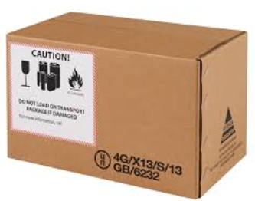
TP 14850 / CGSB-43.150
Small containers for transport of dangerous goods, Classes 3, 4, 5, 6.1, 8 & 9
Current Status
New TP14850 edition published October 2018
Previous 2010 edition still in force
Progress to Date
Target publication date - Fall 2019
Pending Changes
Next edition will migrate from TP 14850 to CGSB-43.150
Canada Gazette, Part I (CGI) is planned for Summer 2020

Slide 25
CGSB 43.151

Slide 26
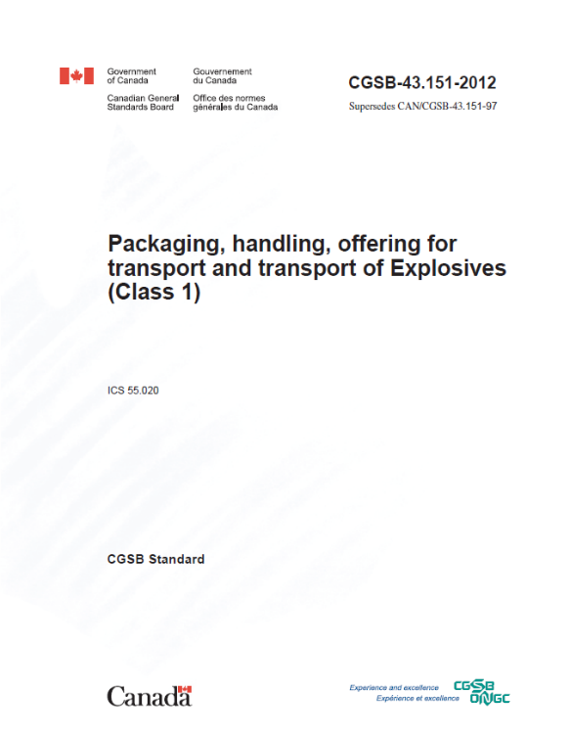
CGSB-43.151
Packaging, Handling, Offering FOR Transport and
Transport of explosives (class 1)
Current Status
CGSB 43.151-19 is the safety standard in force
Progress to date
CGSB 43-151-12 has been replaced by CGSB 43.151-19
Next steps
Address the following issues:
Reuse of packaging
UN3375

Slide 27
Compliance Issues

Slide 28
Highway Tank Certification and Testing Issues
Inspections across the country have revealed facilities performing unsanctioned assembly, modifications, repairs, testing and inspection of highway tanks.
These facilities:
Are not registered with Transport Canada to perform these activities;
Have lapsed their registration to perform these activities, or;
Do not have in place acceptable procedures or appropriate measures to ensure work is done correctly.
Tanks that are assembled, modified, repaired, tested or inspected by these facilities are non-compliant with the TDG Regulations.
Transport Canada advises highway tank owners to verify the status of Transport Canada registered facilities to ensure that those performing work are authorized.
23

Slide 29
TDG Safety Awareness

Slide 30
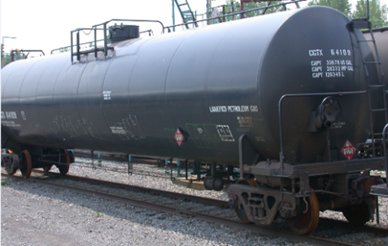
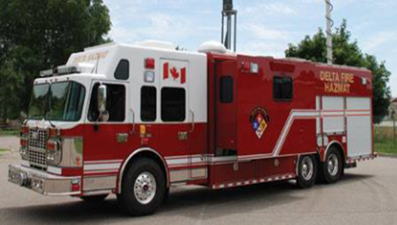
Recently Completed Amendments
1. Containers for Transport of Dangerous Goods by Rail
Published on April 3, 2019;
came into force on July 2, 2019
2. Emergency Response Assistance Plan (Part 7)
Published on May 1, 2019;
came into force on June 1, 2019
Notes:
Containers for Transport of Dangerous Goods by Rail
This amendment:
Requires all tank cars used to transport toxic inhalation hazard (TIH) substances to be constructed of normalized steel.
Enhances alignment between Canada and the United States for One-Time Movement Approvals (OTMA).
Aligns with best practices by permitting 304L and 316L stainless steel varieties as acceptable construction material for tank cars and accounting for mileage into the stub sill inspection requirements.
Emergency Response Assistance Plan amendment:
Designed to improve the ERAP program and enhance the emergency response capacity for dangerous goods transport emergencies.
Addresses Emergency Response Task Force (ERTF) recommendations to address the following issues:
Who can implement an ERAP and when;
ERAP response;
Updating application requirements; and
Providing clarifications where needed (e.g., ERAP telephone number, aligning regulations with the Act, responsibilities when allowing another party to use ERAP).
Highlights of Amendments
ERAP incident report- mandatory notification made by the person who has the charge, management or control of dangerous good (i.e. carrier) to the person with the ERAP in the event of a release or anticipated release.
Two tiers of ERAP implementation:
A person who implements an ERAP to tier 1 must:
provide technical or emergency response advice within 10 minutes of a request for advice; and
Remotely monitor the response
A person who implements an ERAP to tier 2 must:
provide technical or emergency response within 10 minutes of a request for advice
monitor the response to the release or anticipated release; and
send ERAP emergency response resources to the location of the release or anticipated release

Slide 31
Amendments in Progress
Training Requirements (Part 6);
Fee Modernization: TDG Means of Containment Facilities Registration Program
Client Identification Database (CID);
Formatting Changes
Air (Part 12) and International Harmonization Updates

Slide 32
Amendments in Progress
Consultation
CGII - Final
Development
CGI - Consultation
Revision
Training Requirements – Part 6
Purpose
Introduce new training requirements into the TDG Regulations, including development of a competency-based training and assessment (CBTA) standard.
Progress to Date
Policy consultations during 2016-2017 on options to amend Part 6.
The Canadian General Standards Board was chosen to develop a standard in collaboration with TC.
60-day public review concluded on 24, 2019.
Next Steps
Next technical committee meeting is in December 2019 to discuss comments received through the public review.
Publication in Canada Gazette, Part I (CGI) is targeted for spring 2020.
Notes:
TC undertook three phases of consultations from 2015-2017 to discuss and determine policy options to amend Part 6 of the TDG Regulations (i.e., adopt a competency based training and assessment approach, develop a standardized curriculum and tests, certification of individuals and accreditation of training institutions).
Based on feedback from stakeholders, TC is developing a competency-based training and assessment standard to be incorporated by reference into Part 6 of the TDG Regulations.
The competency-based training and assessment standard has been developed in partnership with the Canadian General Standards Board. A Technical committee including 34 representatives of Transport Canada (TC), industry, provinces and training organizations was established to develop standard, and five technical committee meetings have been held to-date;
Currently, the draft standard is undergoing a 60-day Public Review, that begun on August 26th 2019 and closes on October 24th, 2019.
We intend to retain foreign carrier requirements (as found in section 6.4 of the TDG Regulations, titled Foreign Carriers) except that the expression “training certificate” would be replaced by “certificate of competency”.
That is, a document that is issued to a driver of a road vehicle licensed in the United States or to a member of the crew of a train subject to 49 CFR for the transportation of dangerous goods and that indicates that the driver or the crew member is trained in accordance with the CFR 49 is a valid certificate for the purposes of the these Regulations what that document is valid in the United States.
In terms of next steps, the sixth technical meeting on the CBTA standard will be held in December 2019. Publication in Canada Gazette Part 1 (CG1) is targeted for spring 2020.

Slide 33
Amendments in Progress
Consultation
CGII - Final
Development
CGI - Consultation
Revision
Fee Modernization: TDG Means of Containment Facilities Registration Program
Purpose
Introduce new fees and service standards for TDG’s Means of Containment (MOC) Facilities Registration Program.
Progress to Date
Development of a Fee Proposal is underway.
Preliminary consultations with key stakeholders took place in October-November 2018 via email and webinar; reactions were neutral.
Next Steps
Web-based consultation on Fee Proposal targeted for 2020, including new proposed fees and service standards.
Regulatory amendment process targeted for 2020-21.
Notes:
The Transportation of Dangerous Goods (TDG) Means of Containment (MOC) Facilities Registration program ensures that all MOC used in transporting dangerous goods are designed, manufactured, certified, repaired, and maintained according to the safety standards referenced in the TDG Regulations (TDGR).
Transport Canada (TC) currently administers the program as a service to Canadians and provides MOC registration services to individuals and industry free of charge.
New fees in Canada may impact MOC market in the U.S., given close proximity and reciprocity agreements.
The development of new fees and new service standards for the program is currently in the first of three phases: Phase 1 – Fee Proposal.
The US does not charge fees for most MOC-related services, but has a regulatory regime that is very similar to that of Canada.
TDG is proposing to group TDG MOC services into four categories, based on the complexity and level of effort necessary to process each type of application. Pricing Ranges would represent an average annual revenue of 30%-40% of the total annual cost of the program.
Given our close geographical proximity, and due to the existence of reciprocal agreements between Canada and the US with respect to a number of MOC standards, MOC manufactured in the US can easily be sold in the Canadian market. These reciprocal agreements mean that a MOC manufactured to a US standard will automatically be accepted in Canada and vice-versa.
As a next step, we intend to action a public consultation on a Fee Proposal in early 2020.

Slide 34
Amendments in Progress
Consultation
CGII - Final
Development
CGI - Consultation
Revision
Client Identification Database (CID)
Purpose
To identify an accurate and reliable inventory of regulates, and sites where dangerous goods activities is taking place in Canada.
Progress to date
Development of a policy approach is underway.
Next Steps
Exploring digital solutions for an online stakeholder platform.
Legislative and regulatory amendments are targeted for 2020-21.
Develop guidance materials and awareness activities.
Notes:
Identify an accurate and reliable inventory of regulates under the Transportation of Dangerous Goods Regulations (TDGR), and sites where handling, offering for transport, transporting, and importing of dangerous goods is taking place in Canada.
CID will not require registration fees, and will apply regardless of commercial activities, as opposed to PHMSA’s Registration of Hazardous Materials program.
Development of a policy approach is underway following extensive stakeholder consultation in 2018.
Collaboration will take place within TC and with other government departments to identify and pursue opportunities to leverage information.

Slide 35
Amendments in Progress
CGII - Final
Development
Consultation
Formatting Changes
Purpose
To modernize the format of the TDGR, allowing an official consolidated version of the regulations to be posted on the Justice Laws Website.
Next Steps
TC intends to ease the transition by producing guidance materials.
Planned to be published in the Canada Gazette, Part II in fall 2019.
Notes:
Having an official consolidated version of the Regulations available on the Justice Laws Website will make it easier for Canadians and US stakeholders to access the Regulations.
Transport Canada intends to ease the transition by producing guidance materials with information mirroring the italic texts found currently in the TDGR.
What will change:
Removal of tables of content and italicized explanatory text, which currently help with interpretation, but do not form a legal part of the regulations.
What can stakeholders expect once the new format is published on the Justice Laws Website?
Changes are administrative only and do not include any new proposed requirements that would involve a cost to stakeholders.
It is anticipanted that awareness material will be available aound the time of publication.

Slide 36
Amendments in Progress
Consultation
CGII - Final
Development
CGI - Consultation
Revision
Air (Part 12) and International Harmonization Updates
Purpose
Modernize outdated domestic requirements for the transport of dangerous goods by air.
Align the TDGR with updates from international codes (United Nations (UN), International Civil Aviation Organization (ICAO), IMDG) and harmonize with the 49 Code of Federal Regulations (CFR).
Progress to Date
Two phases of consultations (2016 and summer 2017) have occurred, which will form part of the amendments.
Early web-based consultation from March 4 – May 27, 2019 on alignment with international codes and the 49 CFR.
Next Steps
Publication in the Canada Gazette, Part II planned in spring 2020.
Notes:
The latest amendments propose to update several parts of the Regulations and include a proposal to rewrite the domestic provisions for transportation by air.
They also includes proposals to improve reciprocity with the US – an objective that was identified in the latest RCC workplan.
During preliminary consultations, TDG received 20 submissions, the majority of which were in favour of reciprocity proposals with the 49 CFR.

Slide 37
Amendments in Progress
Air (Part 12) and International Harmonization Updates (cont’d)
What We Heard – Proposals to Align
Labelling and Placarding | Regulatory Cooperation Council
1. Allow the display of text on labels and placards. Feedback - 75% in favour | 1. Reciprocity for transportation by Road and Rail. Feedback – 75% in favour
2. Introduce more labelling and placarding options for oxidizing gases to align with the UN Recommendations and the 49 CFR. Feedback - 83% in favour | 2. Small Quantities Exemption by highway or rail. Feedback - Lack of consensus (50%-50%)
3. Allow the display of labels and placards for Class 2.3 and Class 6.1 except for Anhydrous Ammonia. Feedback - 73% in favour
4. Allow the display of markings on an empty means of containment. Feedback - 69% in favour
Notes:
This slide shows some of the main proposals we are recommending to align with the US.
What we heard on amendments to labelling and placarding requirements:
1. For example, 75% are supporting texts in placards currently forbidden in Canada. Few concerns were raised; some stakeholders have expressed that more options could be confusing for first responders.
Concerns of bilinguialism were also raised since the text that would be allowed in placards would either be in French and English which would not necessarily be understood by all.
83 % of respondents support the introduction of labelling and placarding options for oxidizing gases. What we heard was that more options could cause confusion.
TC will evaluate the impacts and plan for transition measures to ease implementation of these new reciprocity clauses to assist first responders and the dangerous goods community as a whole.
3. This proposal sought comments on possible reciprocity of labels and placards for toxic gases and toxic substances to further reduce the compliance burden. Stakeholders are mainly supportive.
4. What we heard regarding the display of markings on am empty means of containment is that it could be challenging for first responders if packages are ejected outside the means of transport, however, the majority of stakeholders are in favour.
What we heard on Regulatory Cooperation Council alignments:
The majority of respondents are in favour of reciprocity for transportation by road and rail
There was a lack of concensus on aligning the small quantities exemption with the US. The safety concern is that if there is an incident with a packing group I, there is no requirement for reporting. For this reason, the proposal is deferred to a future regulatory amendment.

Slide 38
Regulatory Sandbox: Electronic Shipping Documents
Status update
Objectives
Benefits
Collect data to inform future regulatory policies
Safety impacts
Barriers and costs
Notes:
At the PHMSA-TDG face to face meeting in June, a status update was presented on TDG’s proposal to study the feasibility and safety impact of allowing electronic shipping document during transport.
Funding for this project was confirmed in late June and the TDG Regulatory sandbox on electronic shipping document will officially launch in April of next year (2020).
Notes for Madona : June 25, 2019, meeting with PHMSA to discuss UN Sandbox Paper (presented July 2019):
Duane Phund from PHMSA suggested that TDG draft another UN paper for the next session in November to explain lessons learned (positive/negative) depending on how much input was received.
TDG is ready to work with the US, however, did not commit to writing another paper. The sandbox will only be launched in April 2020 and more time is needed to analyze data and consider the Canadian context before reaching out again to the international community.
An initial survey published in early summer on TC’s website revealed that the dangerous goods community is supportive of testing e-documents as it will allow for carriers, shippers and government to work together in finding solutions that are cost effective for industry and that allow for the information to be readily available for first responders and inspectors.
Preliminary Consultations with other authorities such as the European Union (EU) revealed that carriers and shippers are working together to identify an integrated solution that takes into account multi modal and multi jurisdiction considerations and that imposing data entry in a government repository was not an effective solution.
*Placeholder – Debrief Madona on October 10, 2019 meeting organized by PHMSA with UN*

Slide 39
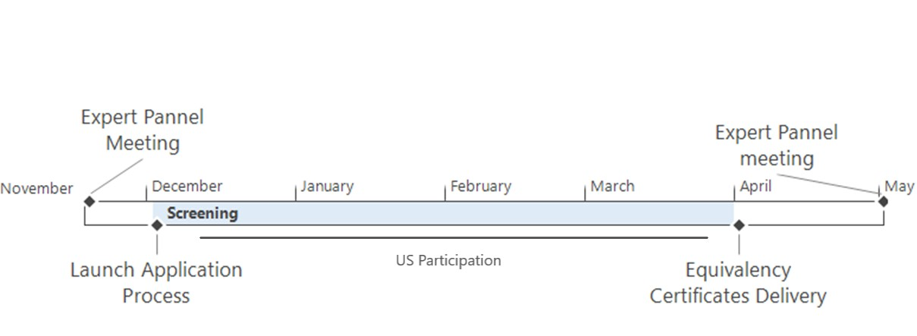
Regulatory Sandbox: Electronic Shipping Documents
Next steps
Notes:
Next steps;
The sandbox team will host it’s first expert panel meeting on November 20, 2019, in Ottawa.
PHMSA’s Approvals and Permits Division have been invited to attend as an official panel member.
Regarding the US, there will be ongoing discussions with PHMSA’s Approvals and Permits Division from December 2019 to April 2020, when the sandbox will officially launch. During this time, we will discuss the terms and conditions of equivalency certificates for cross-border shipments and any other details relevant to the US.
PHMSA Approvals and Permits Division have also expressed interest in participating in an emergency simulation involving a cross-border shipments.

Slide 40
TDG Safety Awareness Program
TDG SAFETY AWARENESS KITS
Aimed at four specific audiences: First Responders, Communities/Municipalities, Industry and the General Public.
Kits include information on:
Emergency preparedness and response;
Protective Direction No. 36;
Safety Advisories (e.g., lithium batteries);
Bulletins;
CANUTEC;
And much more!
Updated regularly and available online at: http://www.tc.gc.ca/eng/tdg/awareness-materials-and-faq-1159.html.

Slide 41
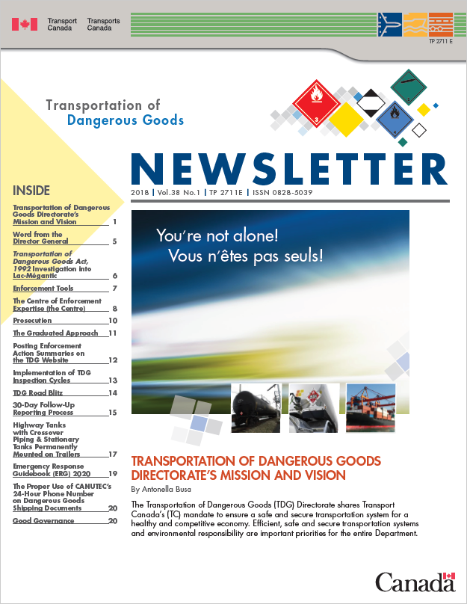
TDG Safety Awareness Program
TDG NEWSLETTER
Available upon request and distributed electronically free of charge to more than 9,400 subscribers in Canada and abroad.
Provides useful information on the safe transportation of dangerous goods.
Subscribe now at: http://www.tc.gc.ca/eng/tdg/newsletter-menu-268.htm.

Slide 42
TDG Contacts
For general TDG information: TDG-TMD@tc.gc.ca
Safety Awareness Team:
TC.TDGSafetyAwareness-SensibilisationalasecuriteduTMD.TC@tc.gc.ca
Response Operations Team:
TC.ChiefResponseOperations-ChefOperationsDeReponse.TC@tc.gc.ca
Engineering Services: TDGMOC-TMDcontenants@tc.gc.ca
For emergencies (24 hours a day, 7 days a week) dial:
1-888-CANUTEC,
(613) 996-6666 or
*666 on a mobile phone (in Canada only).
Websites: www.tc.gc.ca/tdg
www.tc.gc.ca/canutec
http://www.tc.gc.ca/eng/tdg/erap-menu-72.htm

Slide 43
TDG Contacts
TDG Regional Offices
Region | Telephone Number | Email address
Atlantic | 1-866-814-1477 | TDG-TMDAtlantic@tc.gc.ca
Quebec | 1-514-633-3400 | TMD-TDG.Quebec@tc.gc.ca
Ontario | 1-416-973-1868 | TDG-TMDOntario@tc.gc.ca
Prairie & Northern Region | 1-888-463-0521 | TDG-TMDPNR@tc.gc.ca
Pacific | 1-604-666-2955 | TDGPacific-TMDPacifique@tc.gc.ca

Slide 44
Questions?

