Slide 1

CEAEC SPRING MEETING
May 31st and June 01st, 2023
Regulatory Committee

Slide 2

Regulatory update
  Topics
  UN0332 / UN3375
  ER-2013
  Magazine Inner Doors Locks / Magazine doors
  Bulk Guidelines
  Transport Canada
  Standard reviews
  New standards

Slide 3



UN0332 to UN3375 classification
3375
Background
Bulk ANE’s, (sensitized / unsensitized) are considered for transportation as a class 1.5D product.
Current TDG regulations will not allow for the transport of UN3375 materials in Canada.
CEAEC worked with ERD and TC for the potential transitioning of specific UN0332 ANE’s to UN3375 ANE’s for transport.
The potential benefits CEAEC was proposing included:
  Ability to transport larger loads.
  Reduction in travel frequency.
  Increase in storage flexibility, (75% NEEQ).
  Reduction in greenhouse gases.
  Economic / international competitiveness.
  Alignment with the US and UN Model Regulations.

Slide 4
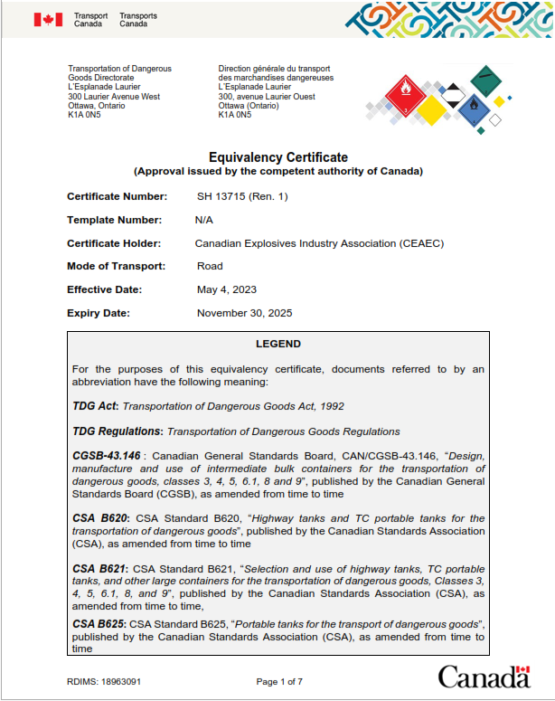
UN0332 to UN3375 classification
3375
Transport Canada
Formal Equivalency Certificate application submitted mid-December 2021 by CEAEC to allow for the transportation of specific ANE’s.
EC approval / issuance, (SH 13715), October 28, 2022 so ANE’s can be transported as UN3375 in Canada
EC amendment 1 (SH 13715 (ren 1)) was issued May 04th, 2023. Clarification of part 9.5 (c) of the TDGR.

Slide 5
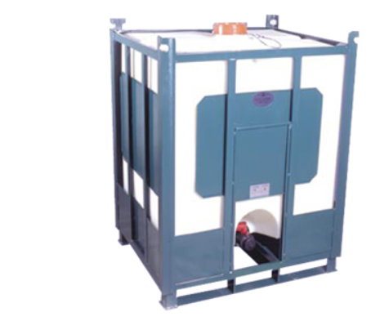
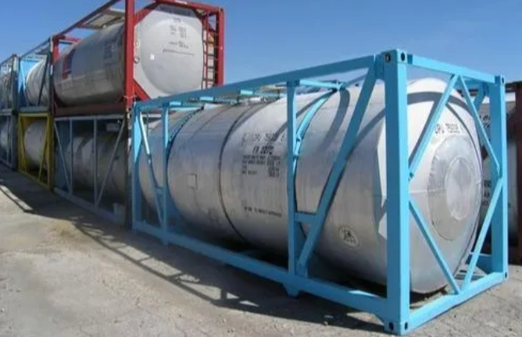
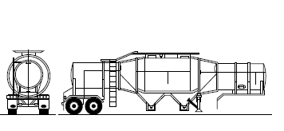
UN0332 to UN3375 classification
3375
EC Details
Issued to CEAEC for the use of the member companies.
  Applies to specific ERD vetted / approved products that meet Special Provision 309 of the UN model recommendations.
  Will require amendment to the individual member companies ERAP to add the new UN number.
  All personnel involved in the handling, offer to transport and transport must receive training to ensure,
  - They are aware of the EC.
  - Conduct their respective duties in accordance with the EC conditions.
  Road transport only
  - IBC’s
  - UN Portables
  - HWY Tankers

Slide 6
UN0332 to UN3375 classification
3375
Explosives Regulatory Division
Application for UN3375 classification to be conducted via the government eLMS portal.
UN3375 will be a Type E.1 / PE-1 explosives.
Federal Explosives Regulations, (ER-2013) apply to UN3375 in transport.
No changes to ANE’s in storage, ER-2013, supporting guidelines and standards remain applicable.
Gazetted amendment to the Federal Explosives Regulations, (ER-2013) includes.
  The addition of UN3375 to part 6, (Type E.1 / PE-1).
  Allowance of second drawn vehicle.
  Addition of electronic monitoring.

Slide 7
Outcomes, (UN3375)
3375
Transportation of >20,000Kg of ANE.
- Single tank
- B-train configuration, (second drawn vehicle)
Electronic surveillance will allow for single driver / long duration transport (specific conditions to be adhered too)
  Locked.
  Parked in a secure / access controlled.
  Video surveillance.
  Vehicle immobilization, (with alarm to carrier and driver).
  Any emergencies must be reported appropriate authorities.

Slide 8
ER-2013, Regulatory Amendments
Amendment package #1: (Economic Growth and Enhancing Safety)
  The majority of CEAEC’s suggestions for Amendment Package #1 were accepted. This was of significant benefit to the Industry
Includes many CEAEC regulatory suggestions.
  Allowance of two packages to be open at one time in a magazine.
  Removal of the annual inventory report, (explosives and ANP).
  Revision to part 217, (sales for “use” and bulk exemption).
  Alignment with provincial vehicle fitness.
  Removal of the MPU tracking exemption, (remains for M&Q)

Slide 9
ER-2013, Regulatory Amendments
Amendment package #1: (Economic Growth and Enhancing Safety)
  Removes MPU attendance when waiting for towing, (M&Q w conditions).
  Removes the requirement to request towing for return to road, (specific conditions apply).
  UN3375 initiative, second drawn vehicle / emergency response.
Timelines.
  Gazette 1, (May 27, 2023)
  30-day comments period, (closes June 26, 2023)
  Gazette 2, (summer / fall 2023)
  Amendment package #2: (Program modernization) --Consultation Document?

Slide 10
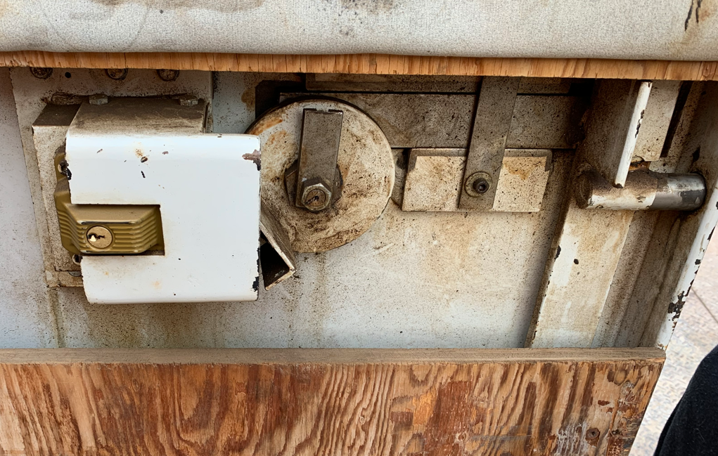
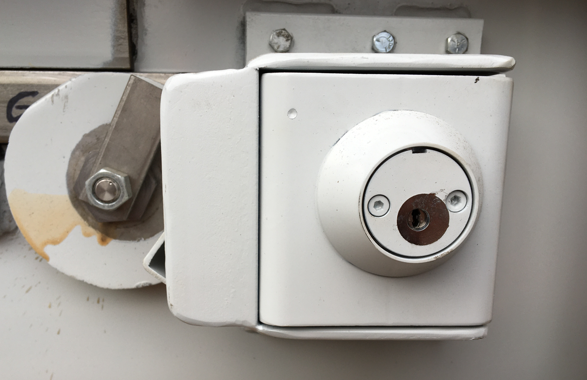
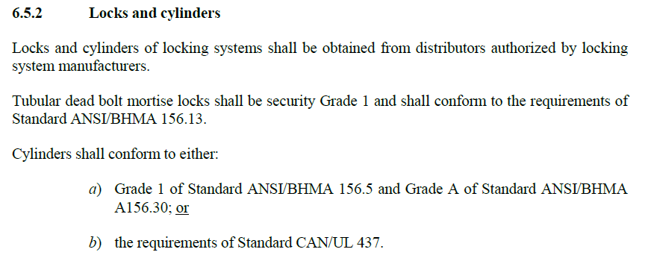
Magazine Inner Door Lock Replacement, (reminder)
Non-compliant
Revised letter issued by ERD to CEAEC, November 10, 2021.
Compliance with part with part 6.5 of the CAN/BNQ 2910-500/2015 magazine standard.
Compliance deadline July 31, 2026.
Compliant

Slide 11
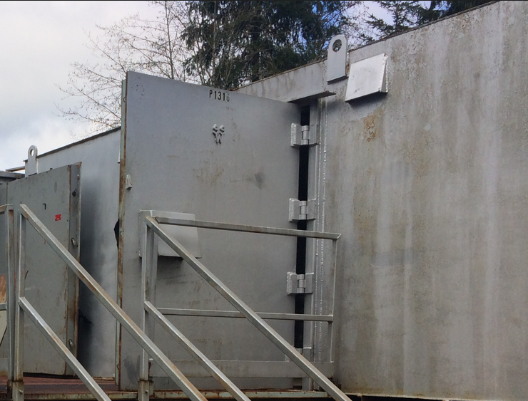
Noncompliant Magazine Doors
Letter issued by ERD to CEAEC, November 23, 2022.
Compliance with part with part 6.4 of the CAN/BNQ 2910-500/2015 magazine standard.
Compliance deadline July 31, 2026.

Slide 12
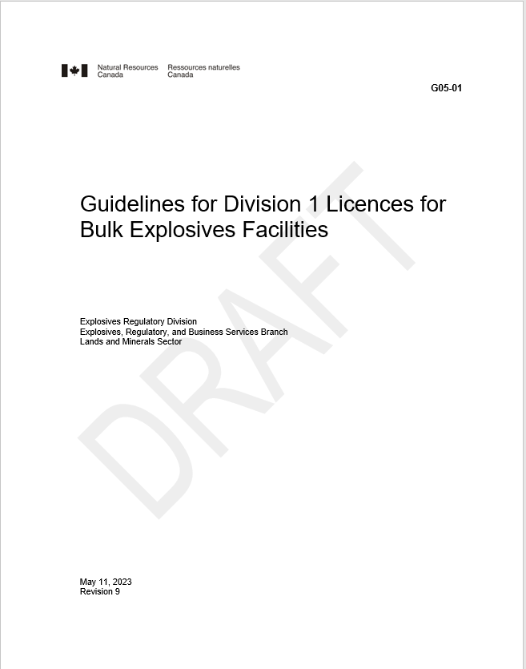
Bulk Guidelines, (G05-01 rev 09)
Received for review / comment, (May 19, 2023)
Removal of redundant / overlapping information. (58 to 20 pages).
More performance based.
Direct ties / explanation to regulatory language and the expected outcomes.
“We hope that this revision will provide CEAEC with more flexibility and opportunities for innovation, and that it will be easier for CEAEC’s members to use.
Please provide feedback from your association in the next 30 days. Let us know if you require additional time”.

Slide 13

CAN/BNQ 2910-510, Q/D Standard, (Review)
Combination of face to face and Teams meetings.
Committee review / revision process ongoing.
Public review summer 2023.
  Many positive changes that are a direct reflection of industry best practices.
  Clarification on existing gaps / areas of silence.
  Addition / revision of definitions.

Slide 14

CGSB 43.151 Explosives Packaging Standard, (Review)
All meetings via Teams.
Committee review / revision process completed.
Public review to commence, (Late June 2023).

Slide 15

Transport Canada
TDGR Amendment: (Part 12 and International Harmonization Update)
  Adding standard CAN/CGSB-43.150, Design, manufacture, and use of UN packaging, (new standard).
    Allowance to carry <450L of gassing solutions without an EC
  Revision to part 12, Air Transport to be clarify the conditions of air transport of class 1 materials.
  Adding of the new UN numbers for electronic detonators, (UN0511, UN0512 and UN0513).
  Removal of the requirement for the display of packing group for class 1 materials, (alignment with US).
Consultation period ended February 2023.
Gazette 2 pending.

Slide 16
TDG Client Identification Database (CID)
Requires companies who offer to transport, transport or import Dangerous Goods to register with TC and report DG movements.
Annual report / site / UN number
  Quantity of DG
- imported
- offered for transport
- transported
  Number of consignments
Timelines
  Gazette part I, late June 2022, (Comments closed September 2022).
  Gazette part II publication, 2023, (One year phase in period for registration.

Slide 17
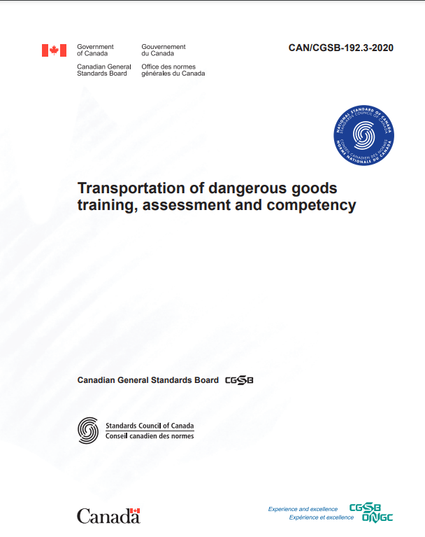
TDG Training Standard
CAN/CGSB-192.3-2020—Transportation of dangerous goods training, assessment and competency.
  Published November 2020.
  Available at no cost
Requires part 1 TDGR amendment 1.3.1 / part 6. Gazette part 1 publication.
Gazette 1 publication / request for comment December 21, 2021.

Slide 18
Questions?

