Slide 1
TDG STANDARDS AND REGULATORY UPDATE
CEAEC Fall Meeting, November 16, 2017, Ottawa, ON
Shaun Singh
Means of Containment Specialist, TDG Regulatory Affairs Branch
RDIMS # 13492536

Slide 2
PURPOSE
To provide an update on recent standards and regulatory activities regarding the Transportation of Dangerous Goods that are relevant to the explosives industry

Slide 3
TOPICS
International Harmonization Update
MOC Standards
CGSB-43.151
TC 423
Training (Part 6)

Slide 4
INTERNATIONAL HARMONIZATION UPDATE (IHU)
Regulations Amending the Transportation of Dangerous Goods Regulations (International Harmonization Update, 2016) published in Canada Gazette Part II on July 12, 2017
Main objectives
Dynamic referencing for MOC standards
Harmonize with international requirements
Increase reciprocity with US
Notes:
Our approval does not conflict with international regulations that might reference a newer edition

Slide 5
INTERNATIONAL HARMONIZATION UPDATE (IHU)
Other changes
Shipping name can include “WASTE” for waste dangerous goods
Specified size and contrast for “OVERPACK” marking
And no longer required if safety marks inside are visible
Manufacturers of SMOCs and IBCs must provide a “notice” to the initial user
DOT SPs accepted up to 1st destination in Canada by road or rail
Doesn’t apply to TDG forbidden dangerous goods
Marine pollutant listing harmonized with IMDG
Notes:
Our approval does not conflict with international regulations that might reference a newer edition

Slide 6
STANDARDS REFERENCING
TDG ACT
TDG REGULATIONS
Part 5 – Means of Containment
Safety Standards
CSA, CGSB, TP…etc.
Publications
ISO, ASME…etc.

Slide 7
STANDARDS’ REFERENCING
Static Referencing
Refers to the incorporation of a document as it exists at the time it is made part of the regulation
Update requires regulatory amendment
Dynamic Referencing (Ambulatory)
Refers to the incorporation of a document in such a way as to include any future changes to that document without a need to remake the regulation
Update does not require regulatory amendment

Slide 8
INTERNATIONAL HARMONIZATION UPDATE (IHU)
MOC Standards / Requirements with a Dynamic Reference
CGSB, CSA, 49 CFR, ICAO, IMDG, UN
Transition Period
6 month transition period started on July 12, 2017
Option of complying with either the previous version or new version of the safety standard
January 12, 2018 – End of 6 month transition period
Must use the latest published version of the safety standard

Slide 9
INTERNATIONAL HARMONIZATION UPDATE (IHU) – CGSB / CSA
General Period (After January 12, 2018)
Individual 6 month transition period will start on date of publication of specific CGSB / CSA safety standard
Option of complying with previous edition or newly published edition of CGSB / CSA safety standard
Must use the latest published version 6 months after its publication

Slide 10
INTERNATIONAL HARMONIZATION UPDATE (IHU) – CGSB / CSA
STANDARD | PREVIOUS VERSION | LATEST PUBLISHED VERSION | TRANSITION PERIOD ENDS
CGSB-43.126 DRUM RECONDITIONING | SEPTEMBER 2008 | REAFFIRMED 2014 | N/A
CGSB-43.146 IBC | JANUARY 2002 | APRIL 2016 | JANUARY 12, 2018
CGSB-43.151 EXPLOSIVES | OCTOBER 2012 | OCTOBER 2012 | N/A
CSA B620 / B621 / B622 HIGHWAY / TC PORTABLE TANKS | JANUARY 2009 | JANUARY 2014 | JANUARY 12, 2018
CSA B625 UN PORTABLE TANKS | JULY 2008 | FEBRUARY 2013 | JANUARY 12, 2018

Slide 11
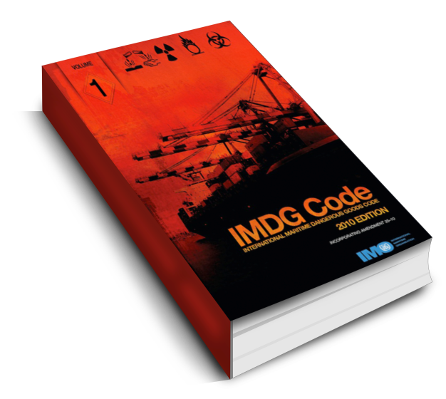
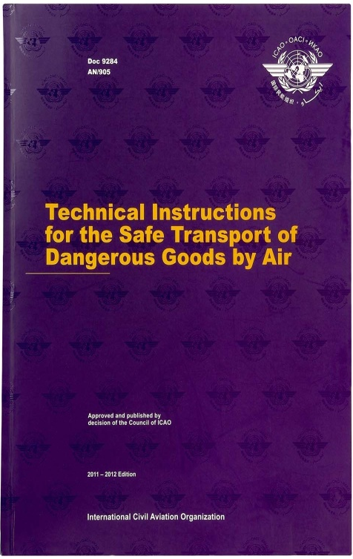
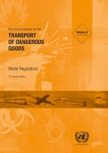
INTERNATIONAL HARMONIZATION UPDATE (IHU)
49 CFR, ICAO, IMDG, UN
Transition period stipulated within the latest published version
E.g. IMDG Code has transition period of one year
May use the latest published version during transition

Slide 12
STANDARD DEVELOPMENT
STEP 5
Publish notice of standard publication including the date compliance is to take effect.
STEP 1
Publish notice of standard development and solicit proposals for change to the standard.
STEP 1
Public Notice of Standard Development
STEP 2
Drafting of Dockets / Standard
STEP 3
Standard Development
(CGSB, CSA, TP)
STEP 4
Public Consultation
STEP 5
Standard Publication Notice
STEP 4
Publish notice of public consultation and solicit comments to the standard.
STEP 2 / STEP 3
MOC Engineers and Standard Development Committee work on developing the standard.

Slide 13
MOC STANDARD STATUS
ALREADY PUBLISHED
CGSB-43.146 – IBCs
SOON TO BE PUBLISHED
TP14850 – Small Packaging
UNDER DEVELOPMENT
CSA B620 / B621 / B622 – Highway and TC Portable Tank
CSA B625 – UN Portable Tanks
CGSB-43.126 - Drum Reconditioning
CGSB-43.145 – Large Packaging (NEW)
CGSB-43.151 – Explosives

Slide 14
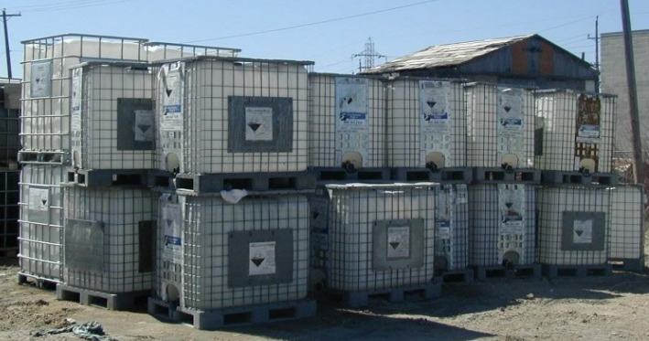
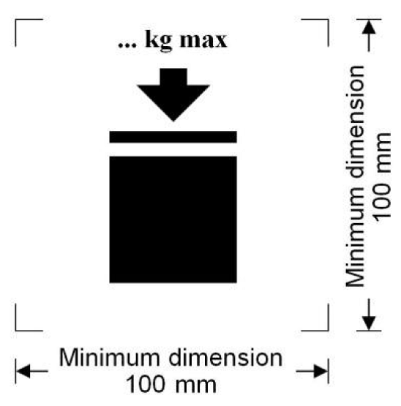
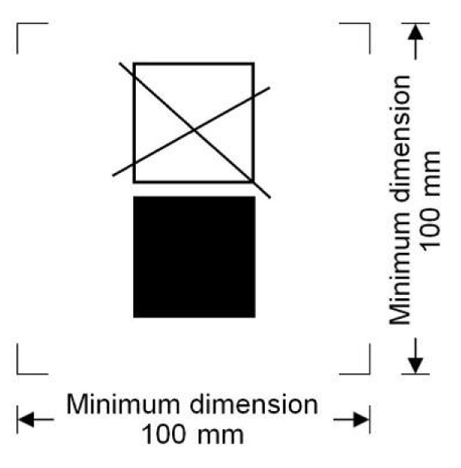
CGSB-43.146
CAN/CGSB-43.146-2016 - Design, Manufacture and Use of IBC’s for the Transport of Dangerous Goods
Published April 25, 2016
Came into force July 12, 2017 with 6-month transition period
What’s New?
All sizes of IBCs must be leak tested and inspected, including those under 450L
Lightweight IBCs must be leak tested and inspected before each use
Metal IBCs: inspection and testing of reclosing pressure-relief devices
“W” marking will no longer be required for IBCs manufactured after July 12, 2017
Maximum Permissible Stacking Load
and Non-Stackable IBC Symbols

Slide 15
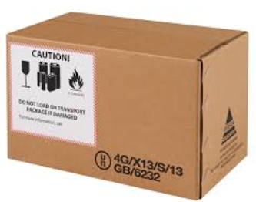
TP14850
TP14850 - Small Containers for Transport of Dangerous Goods, Classes 3, 4, 5, 6.1, 8 and 9
What’s New?
Revisited packing instructions to improve structure, presentation and usability;
Added requirements where manufacturers will now have to periodically retest a representative sample of a container at an interval of no more than five years;
Incorporated a new special case for the transport of liquid dangerous goods in a Mobile Process Unit;
Clarified requirements of special cases for transport of dangerous goods waste.
Status
Final Public Consultation – End of November, 2017
Publication – Summer 2018
Static Regulatory Reference – Canadian Update - 2019

Slide 16
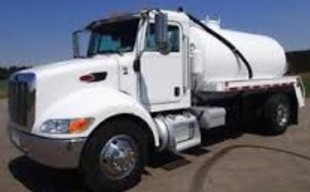
CSA B620 / B621 / B622
CSA B620 / CSA B621 / CSA B622 - Highway Tanks and TC Portable Tanks
What’s New?
Revised to reflect Regulatory Cooperation Council (RCC) initiatives;
Emergency discharge control requirements added for new liquefied compressed gas tanks (except class 2.2);
Increased pressure testing frequency for nurse tanks;
Prohibited the manufacture of new non-specification nurse tanks;
Increased documentation requirements for tank repairs and added mobile tank repairs; and
Developed requirements specific to tanks made of fiber reinforced plastic.
Status
Final Draft Consultation – Summer 2018
Publication – Spring 2019

Slide 17
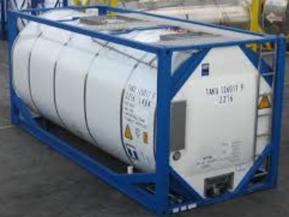
CSA B625
CSA B625 - UN Portable Tank Design and Manufacture for the Transportation of Dangerous Goods
What’s New?
Updated dangerous goods list to align with the United Nations Model Regulations on the Transport of Dangerous Goods;
Restructuring of chapter 9 concerning registration types and requirements; and
Updated permitted design variations for Multiple Element Gas Containers (MEGC’s) in the dynamic longitudinal impact test.
Status
Final Draft Consultation – Fall 2018
Publication – Summer 2019

Slide 18
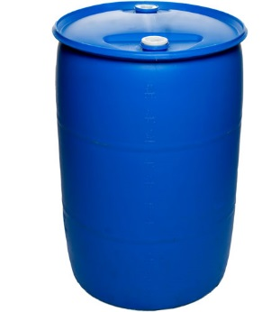
CGSB 43.126
CGSB 43.126-2008 (reaffirmed 2014) Reconditioning, Remanufacturing and Repair of Drums for the Transportation of Dangerous Goods
What’s New?
Harmonize with the most recent edition of the UN Model Regulations
Correct and improve upon problematic requirements and inconsistencies in the current Standard
Status
Public Notice – Fall 2017
Publication – Spring 2019

Slide 19
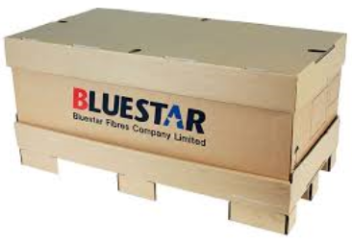
CGSB-43.145 (NEW)
CGSB 43.145 - Design, Manufacture and Use of Large Packagings, Classes 3, 4, 5, 6.1, 8 and 9
Large packagings (LPs) are similar to Intermediate Bulk Containers (IBCs) as they both have a maximum capacity of 3000 L, similar construction and test methods.
However, IBCs are destined to transport dangerous goods in direct contact with the means of containment, whereas LPs are used to transport articles such as batteries or inner packagings such as bags, pails or boxes. Large packagings are mainly used to transport waste dangerous goods.
LP standards have been in service in other countries for more than a decade but have never been referenced in the TDG Regulations.

Slide 20
CGSB-43.145 (NEW)
Objectives:
Harmonize TDG Regulations with United Nations Model Regulations for the Transport of Dangerous Goods. LPs have been permitted since the 11th revised edition (1999).
Eliminate the need to issue equivalency certificates for the transport of waste dangerous goods transported in bins that would fall under the LP standard.
Allow the manufacture, selection and use of another type of means of containment that is more convenient and in some cases safer to transport certain types of dangerous goods, such as Ebola contaminated waste.
Status:
Public Notice - April 2017
Committee Meetings – Winter 2017

Slide 21
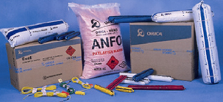
CGSB-43.151
CGSB 43.151-2012 Packaging, Handling, Offering for Transport of Explosives, Class 1
Proposals
Update list of explosives and packing instructions to align with 20th edition of the UN Recommendations
Update references for container standards to reflect dynamic referencing
Add large packaging
Specify packaging for jet perforating guns
Reorganization and incorporation of regulatory overrides and policy clarifications to minimize confusion
main sections vs. annexes
TDGR SP147, hose testing letter to CEAEC

Slide 22
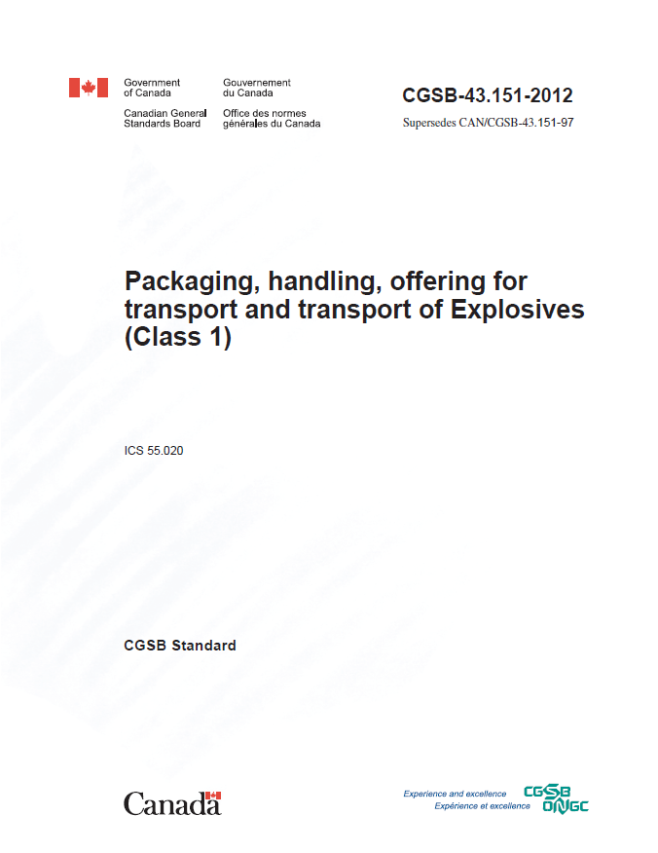
CGSB-43.151
Status
Technical committee formed to develop next edition
Chair to be elected
First draft reviewed and comments received
Face-to-face meeting planned for January 2018
Anticipated publication date – Spring 2019

Slide 23
HIGHWAY TANK SELECTION
CSA B620-09/-14 – Highway Tanks and TC portable tanks for the transportation of dangerous goods
CGSB 43.151-2012 – Packaging, handling, offering for transport and transport of Explosives (Class 1)
TC 423
Mandatory spec. for tanks manufactured starting Jan. 1, 2017
TC/DOT 407 or TC/DOT 412
If manufactured before Jan. 1, 2017
MAWP ≤ 241 kPa (35 psi)
Other highway tank specifications such as TC/DOT 406 are not permitted for the transport of Class 1, Explosives

Slide 24
TC 423 SPECIFICATION
Intended for emulsion and water-gel explosives
35 kPa (5 psi) ≤ MAWP < 103 kPa (15 psi)
Hopper style configuration permitted
May be insulated
Tank trailers require structural inspection every 5 years

Slide 25
TC 423 SPECIFICATION
Structural Inspection
Manufacturer to provide procedure with drawing(s)
Critical joints and areas of high stress / stress concentration
Welds in critical areas require PT or MT
Not applicable to MPU tanks
Concerns on structural inspection
Challenges and necessity with certain designs
CEAEC invited to present docket at CSA B620 meeting in January 2018

Slide 26
TC 423 SPECIFICATION
Insulation
Optional
Compatible as per ERD-approved test methods
Non-porous
Non-combustible, ≥ 15 minute fire endurance and/or flame spread rating ≤ 25
Concerns on insulation
Precludes desirable materials for transport tank insulation and permits materials with poor fire survivability characteristics
Compatibility requirement requires more definition
TDG & ERD to submit a joint docket for CSA B620 meeting in January 2018

Slide 27
CONTACTS
Shaun Singh, Means of Containment Specialist
613-991-2065, shaun.singh@tc.gc.ca
Wali Sagaf, Engineer, Dangerous Goods Transport Containers
613-991-2514, wali.sagaf@tc.gc.ca
Inquiries pertaining to application for registration
MOCregister-Registrecontenant@tc.gc.ca
Technical inquiries
Tdgcontainers-tmdcontenants@tc.gc.ca
Equivalency Certificates (Permits)
tdgapprovals@tc.gc.ca

Slide 28
TRAINING (PART 6)
Purpose
To increase compliance and improve public safety by:
ensuring that people who import, offer for transport, handle, or transport dangerous goods have the knowledge and skills to perform their jobs; and
increasing clarity of the regulatory requirements.

Slide 29
TRAINING (PART 6) – Continued
Progress to Date
Phase 1 targeted stakeholder consultation took place in fall 2015 to winter 2016.
Phase 1 stakeholder comments were reviewed and analyzed. A White Paper laying out TC’s proposals was developed in fall 2016.
Phase 2 online public consultations took place in fall 2016 to winter 2017 :
Replace the term “adequately trained” with what it means to be a “competent person;”
Develop:
a competency framework to identify the skills needed for particular job functions;
standards and guidelines to help training institutions/employers; and
a general TDG 101 test (a basic level test).
Over 60 responses were received from industry (67%), government (17%), trainers (10%) and “others” (6%).

Slide 30
TRAINING (PART 6) – Continued
Proposed Approach
Two key components would need to be met to satisfy the requirements in the TDGR for a “competent person”:
General online TDG awareness training with a pass mark on a TDG 101 test; and
Job specific competency-based training and assessment (CBTA) by employers.

Slide 31
TRAINING (PART 6) – Continued
Consultation – Phase 1
Revision
CGII - Final
Consultation – Phase 2
CGI - Consultation
Development
Next Steps
Development of the general awareness course and TDG 101 online test as well as the CBTA standard.
Proposed amendments planned for publication in the Canada Gazette, Part I for public consultation in spring/summer 2019.
For more information, please contact:
TC.TDGRegulatoryProposal-TMDPropositionReglementaire.TC@tc.gc.ca

Slide 32
For more information on Training (Part 6),
please contact:
Amira M. Sultan
Manager, Science Policy and International Engagement
Transportation of Dangerous Goods
Transport Canada / Government of Canada
Amira.sultan@tc.gc.ca

