Slide 1
Process to Review Emergency
Response Assistance Plan (ERAP)
Criteria and Update the TDG Schedule I list
TDG Response Operations Group

Slide 2
Eraps overview
What is an ERAP?
Describes what to do in the event of a transportation incident involving higher-risk dangerous goods (DGs)
Reviewed and approved by TDG Response Operations Group
DGs and quantities identified in Schedule I of the TDG Regulations
Which DGs represent a higher risk?
Widespread hazard to public safety
Specialized knowledge or equipment
Quantity

Slide 3
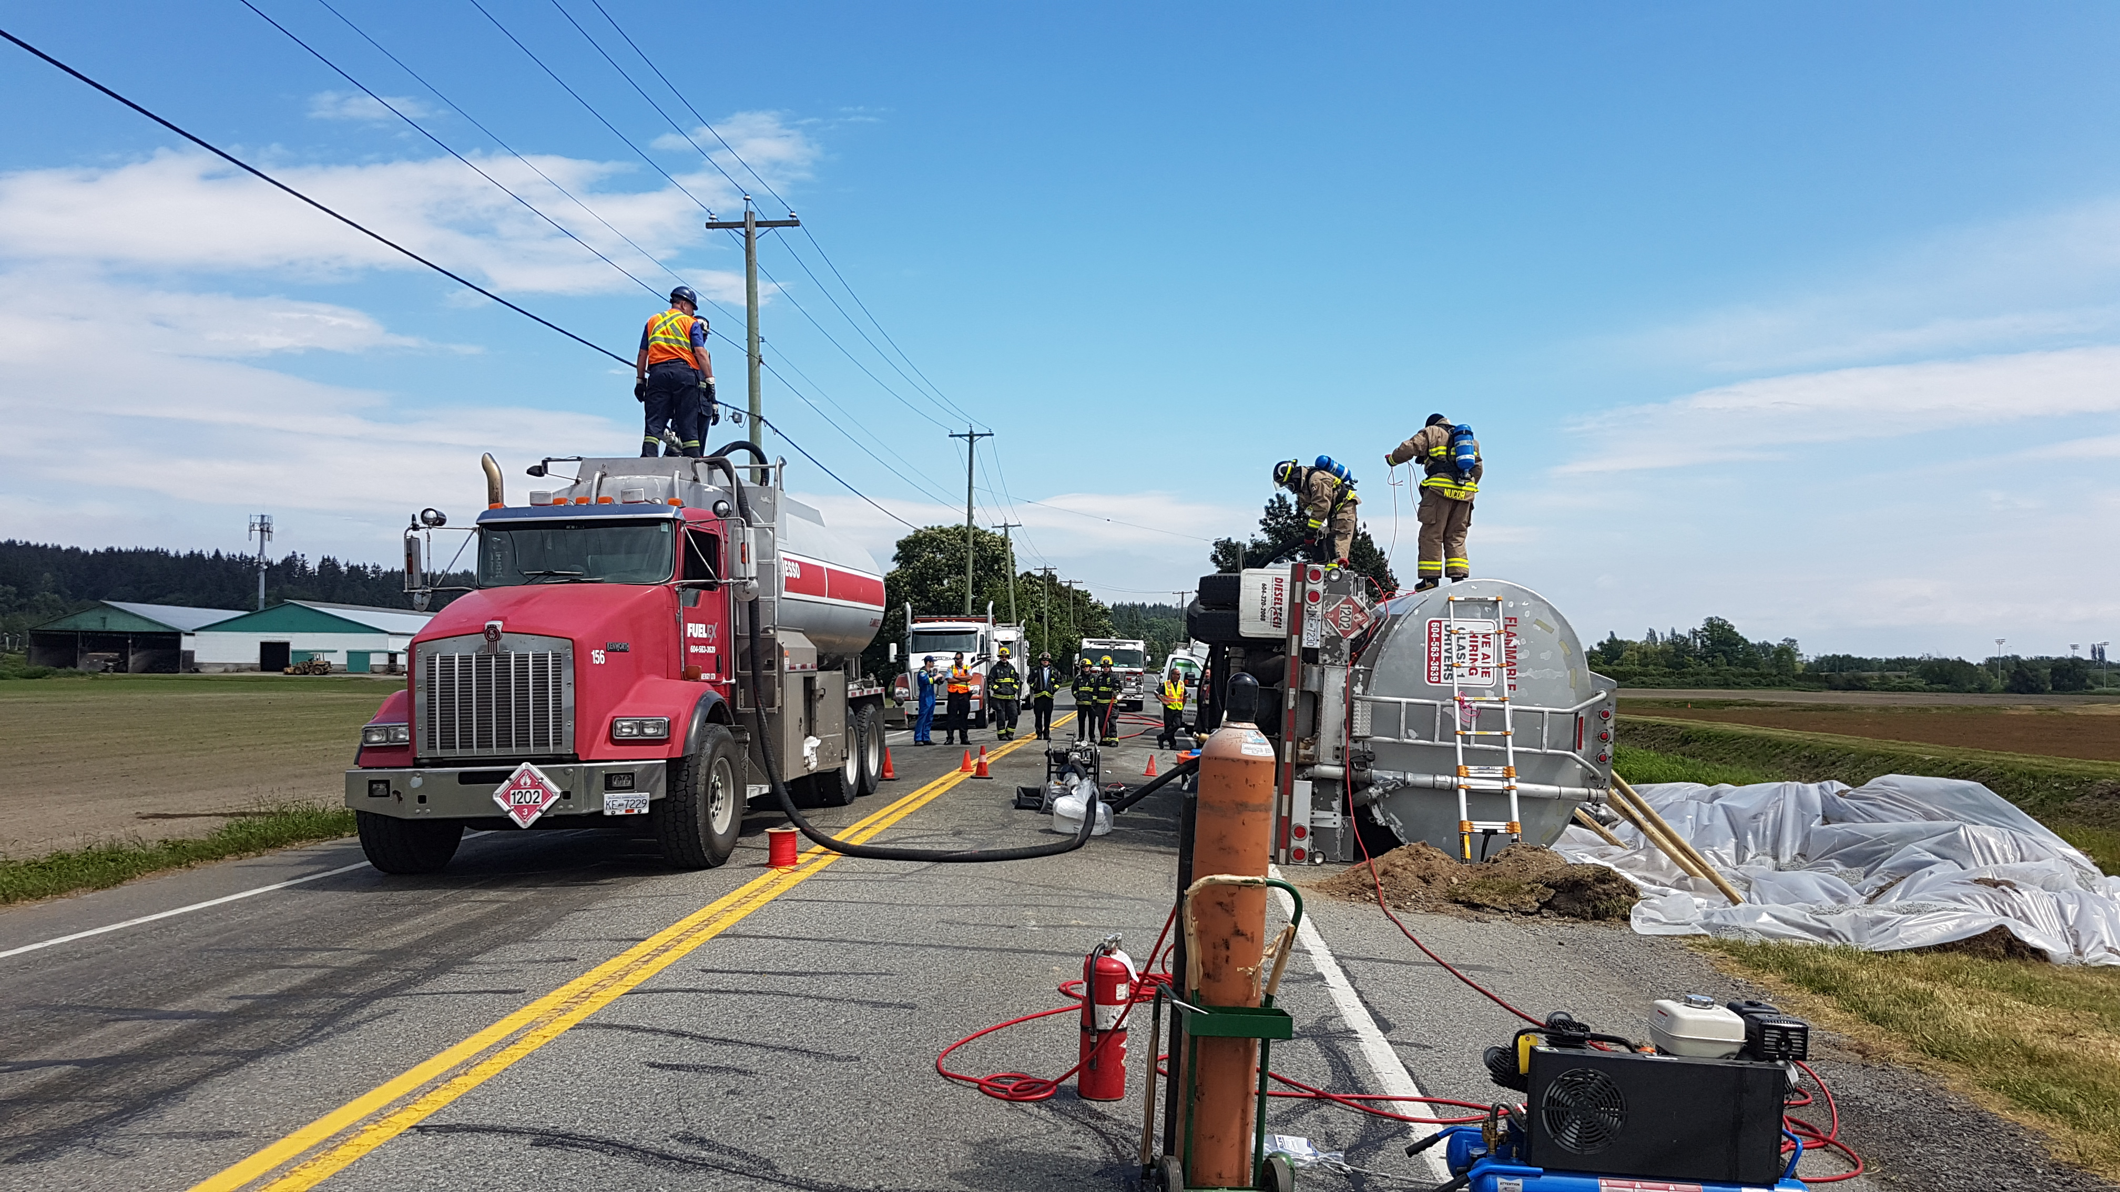
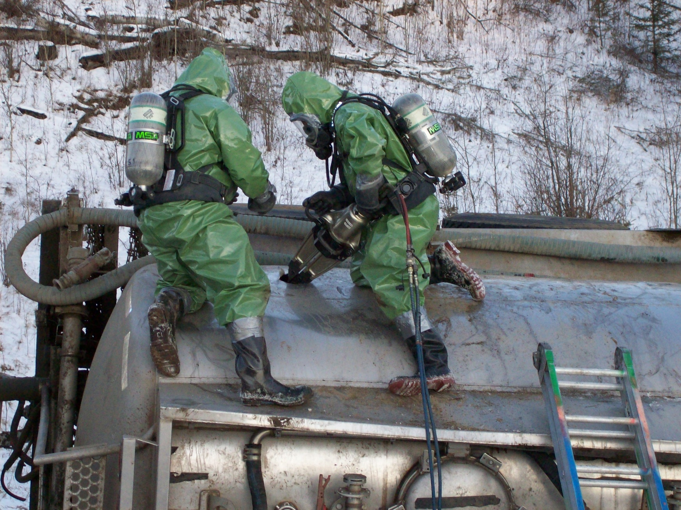
Examples
Photo courtesy of Nutrien
No ERAP required
ERAP required

Slide 4
Why update schedule I?
Last full review done in 1995
Schedule I may not reflect today’s TDG landscape
New UN numbers added to Schedule I
Inconsistencies in requirements
Emergency response network and training
New shipping trends

Slide 5
What do we want?
Re-evaluate what is a higher-risk DG:
Which DGs should require an ERAP?
At what threshold?
Which MOCs / modes?
Desired outcomes:
Objective and systematic tool that applies to all classes
Solid rationale for why a DG requires an ERAP
Data driven decision/policy making
Increased transparency for stakeholders and the public

Slide 6
Review started with class 3
Significant increase in flammable liquid transportation by rail around 2012
In 2013-2014: Major incidents showed requirements for ERAPs were outdated
First Responders not equipped to deal with large scale incidents in transport with Class 3
Protective Direction 33 required ERAPs for some Class 3
Emergency Response Task Force (ERTF) Subgroup 3 charged with evaluating ERAP requirements for other flammable liquids

Slide 7
Development of algorithm
July 2015: Risk Assessment on Class 3 without subclasses
Risk Assessment expanded internally to Class 3 with subclasses 4.3, 6.1 or 8
Algorithm:
Risk = Likelihood x Severity
Volumes
Hazards + Complexity of response
Toxicity
Water-reactivity
Flammability
Corrosivity
Etc.
Damage assessment
Equipment
Knowledge/Training
MOCs
Etc.

Slide 8
Are we on the right track?
Is each criterion weighted correctly?
Can the method be applied to all classes?
Do we have all of the expertise in house?
Classes 2, 3, 4, 5, 6.1 and 8
Classes 1, 6.2 and 7
Is a flow chart more appropriate? Or other model?

Slide 9
What about thresholds?
Algorithm focused on rail (tank cars)
What models could be used?
Could we use isolation distances from Emergency Response Guidebook (ERG)?
Could we use modelling software (PEAC, ALOHA, etc.)?

Slide 10
Moving forward
Development of a tool to update Schedule I of TDG Regulations
Objective
Systematic
Reviewable and adaptable
Challenges
Method validation
Expanding to other classes
Determining the thresholds
Next steps
Involve 3rd party in research
Involve industry

Slide 11
ERAP Program Update
Monique Lavoie, TDG Remedial Measures Specialist Fall 2019 CEAEC Meeting
RDIMS # 15333978

Slide 12
Outline
ERAP amendments to the TDG Regulations (Part 3, 7 and 8)
2

Slide 13
Context of Regulatory Update
Nearly 1000 approved ERAP, covering nearly 400 dangerous goods
TDG Emergency Response Task Force (ERTF) created in April 2014
40 recommendations from the ERTF report in 2016 aimed at:
clarifying the processes for implementing an ERAP, and
collecting meaningful data to foster the continuous improvement of the ERAP program

Slide 14
Objective of the Regulatory Update
The amendments:
Clarify ERAP implementation
Enhance emergency preparedness and response
Make administrative changes
Most changes are to Part 7 (ERAP) and Part 8 (Reporting) of TDG Regulations

Slide 15
Important Dates
Canada Gazette Part II published on May 1st 2019
Came into force on June 1st 2019
Transition period of 9 months
Until March 1, 2020 to comply

Slide 16
Where to Find Information
For rationale of changes, read the Regulatory Impact Analysis Statement (RIAS)
Consolidated text now on Website (includes PDF)
Consult ERAP website and guides
Notes:
Show where to find the info and explain the RIAS

Slide 17
Part 3 – ERAP Info on Shipping Document
Subsection 3.6(1) modified to restrict options to identify an ERAP on a shipping document
Before: reference number of the ERAP issued by TC preceded or followed by the letters “ERP” or “ERAP” or “PIU”
Now: can no longer use the letters “ERP”
Example: “ERP 2-9999 1-800-555-5555” or “ERAP 2-9999 1-800-555-5555” or “PIU 2-9999 1-800-555-5555”

Slide 18
Section 7.2 – ERAP Requirements
What dangerous goods need an ERAP?
All ERAP requirements remain the same except for infectious substances
How to find out if your dangerous goods need an ERAP?
Who needs an ERAP?
No longer just applies to the person who “offers for transport” or “import”
Now refers to 7(1) of the TDG Act
Notes:
Go to find out if you need an ERAP webpage, and show the ERAP questionnaire.

Slide 19
Section 7.2 – Who needs an ERAP?
A person in Canada requires an approved ERAP when they:
A. import certain dangerous goods, or
B. offer for transport certain dangerous goods
Only when A or B does not apply, the person who requires an approved ERAP is the one who:
C. handles certain dangerous goods while in Canada, or
D. transports certain dangerous goods while in Canada
How do I find out if I need an ERAP?
Notes:
Go to the page find out if you need an ERAP and go to the guide to find out if you need an ERAP

Slide 20
Section 7.3 - ERAP Application Requirements
Updated to reflect what we ask for in ERAP Online Services (EOS)
Potential Accident Assessment (PAA) is replaced with Potential Incident Analysis (PIA)
Must include analysis of at least 4 scenarios:
an anticipated release of dangerous goods
the release of less than 1% of the dangerous goods in a means of containment
the release of more than 50% of the dangerous goods in a means of containment, and
the exposure to fire of a means of containment that contains dangerous goods

Slide 21
Section 7.3 – PIA
Each scenario must include:
the possible consequences of the release or anticipated release
the measures, organized by tier, to be taken in response to the release or anticipated release for each scenario
the identification of the persons responsible for taking the measures
Format and example of a PIA
Notes:
Go to before you apply webpage and show the format and example of a PIA

Slide 22
Section 7.7 – Authorized Users
Replaces Permitted Users
No longer need to notify TC when permission is given or rescinded
Person with an approved ERAP must give a written authorization to an authorized user
Authorized user must be able to produce a copy of the authorization:
for 2 years after the day on which the authorization is no longer in effect, and
within 15 days after the day on which the authorized user receives a written request from the Minister

Slide 23
Section 7.7 – Authorized User Conditions
Similar conditions as before :
Authorized user is not the producer of the dangerous goods
ERAP applies to the mode of transport, means of containment and geographical location
Person with the approved ERAP agrees to take measures to respond to a release or anticipated release

Slide 24
Section 7.8 – ERAP Implementation
Formerly “activation”
A person with an approved ERAP must implement to tier 1 or 2 in response to a release or anticipated release of dangerous goods
Tier 1 | Tier 2
provide technical or emergency response advice as soon as possible after a request for the advice | provide technical or emergency response advice as soon as possible after a request for the advice
remotely monitor the response to the release or anticipated release | monitor the response to the release or anticipated release
 | send ERAP emergency response resources to the location of the release or anticipated release

Slide 25
Part 8 – ERAP Incident Report
8.20 ERAP Incident Report
Person who has the charge, management or control must call the ERAP number on the shipping document if the release or anticipated release of dangerous goods are or could be in excess of:
Any quantity of Class 1, 2, 3, 4, 5, 6, or 8
Level established in section 39 of the PTNSR, 2015 for Class 7
An ERAP Incident report does not implement an ERAP.
Notification to the person who has the ERAP
Does not substitute any other reporting requirements

Slide 26
Part 8 – ERAP Incident Report
8.21 list information to be included in an ERAP incident report
General information about the incident to the ERAP holder can make an informed decision on if and to what tier the ERAP must be implemented

Slide 27
Part 8 – ERAP Implementation Report
8.22 ERAP Implementation Report
Must be made by phone to CANUTEC when a person implements an approved ERAP to tier 1 or tier 2
8.23 Information to be Included in an ERAP Implementation Report
General information about the incident
Information about the ERAP implementation and emergency measures taken

Slide 28
Summary of Reporting Requirements
Person who has charge, management or control of the means of containment | Emergency Report (8.2) to local authority responsible for responding to emergencies | Release or anticipated Release report (8.4)* to CANUTEC | Dangerous Goods Accident or Incident Report — Air (8.9)* to CANUTEC | ERAP Incident report (8.20) to the person who has the ERAP, buy calling the ERAP phone number
Person who has an ERAP |  |  |  | ERAP Implementation Report (8.22) to CANUTEC
*A 30-Day Follow-up report must then be made by the same person or the person’s employer
How does this all come together?
Notes:
Go to having an ERAP page, then click on the ERAP implementation link on the page to go to the guide for persons who have an ERAP and show them the images.

Slide 29
ERAP Webpage Recap
All new ERAP Webpage
Now has up to date information about the ERAP program
Walk you through the entire ERAP application process
Supported by 4 guides found at bottom of each page
Find out if you need an ERAP
Prepare your ERAP
Apply for approval of an ERAP
Once you have an approved ERAP
Sets what we expect from you and what you can expect from us

Slide 30
ERAP Online Services (EOS)
Launched January 28th 2019
Online application process for submitting or updating an ERAP
Transport Canada will no longer accept PDF Forms, emails or telephone calls to change or submit an ERAP
Connect via your online banking login or GCKey
Once connected, you can:
Add or edit contacts and delegated ERAP writers
Create, view or edit an ERAP application
Retrieve a copy of your approval document

Slide 31
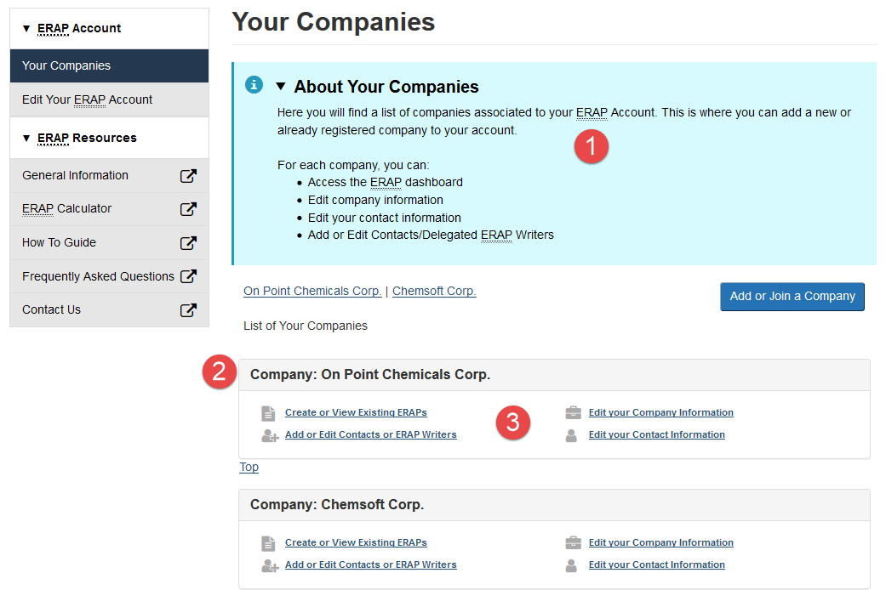
ERAP Online Services (EOS)

Slide 32
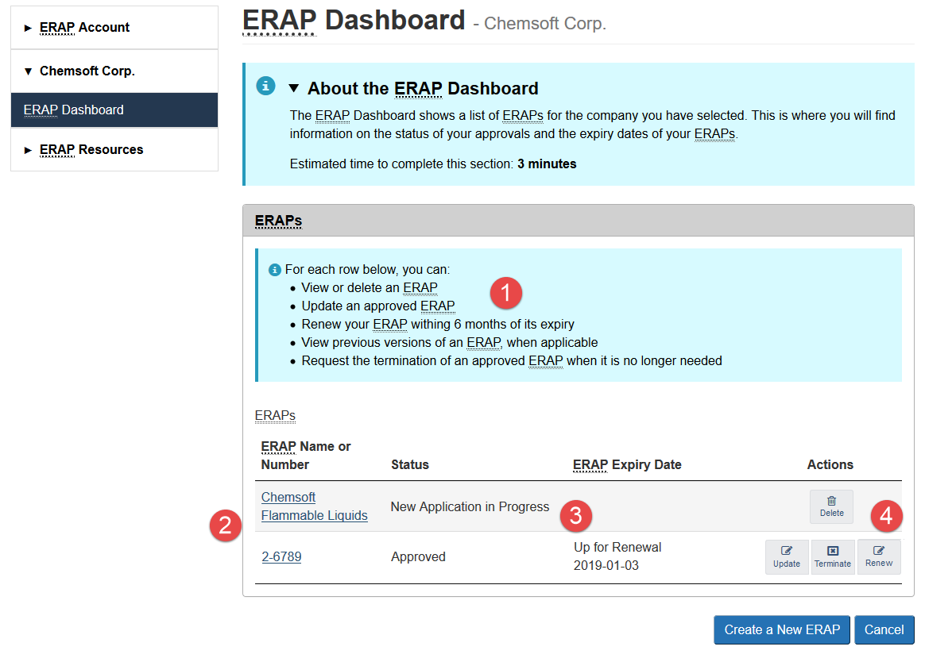
ERAP Online Services (EOS)

Slide 33
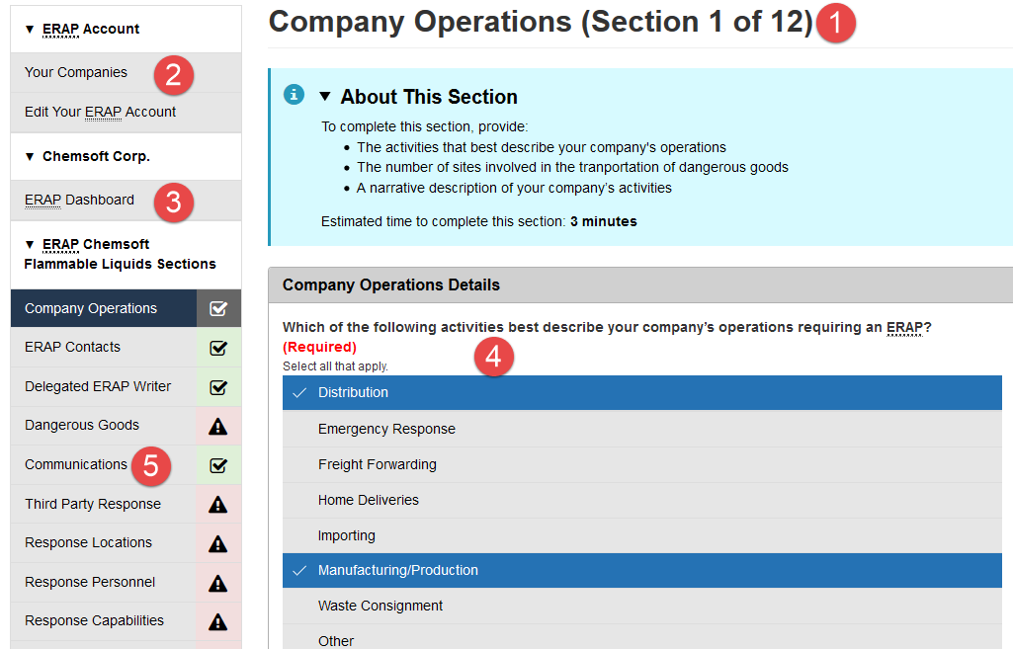
ERAP Online Services (EOS)
Notes:
Prior to doing demo go to the apply for approval of an ERAP webpage and show the guide.

Slide 34
ERAP Online Services (EOS)
Is there a guide to help you apply for approval of an ERAP using EOS?
Notes:
Prior to doing demo go to the apply for approval of an ERAP webpage and show the guide.

Slide 35
ERAP Online Services (EOS)
Demo
Notes:
Explain what GC Key is – show the webpage
What’s a delegated ERAP writer
Log into the system, show a dummy company
- Stress the importance of finding the right company and using the right email address
- Show the information that is there (limited) and explain that they need to refill all the info
show how they must click update to update their information
Show the 3 sections they must complete

Slide 36
When to Update Your Application in EOS
If you have an approved ERAP, you will need to reapply online using EOS:
When any of the information in section 7.3 of the TDG Regulations changes during your approval period
At least 20 business days before your ERAP expires, if you still require your ERAP
By January 2021 (within 2 years of the release of EOS), even if your approval period extends beyond that date

Slide 37
Third Party Agreements for ERAPs
If you are using third parties for response, agreements must be included with your ERAP application as per the TDG Regulations
A third party responder agreement is an agreement between the ERAP holder and a third party (ER contractor or mutual aid partner) listed in the ERAP that will provide technical or emergency response advice and/or provide resources to respond to a release or anticipated release on the ERAP holder’s behalf
Notes:
This is all found on our website guides

Slide 38
Important Definitions
A primary emergency response contractor manages a response network that includes emergency response sub-contractors and/or mutual aid partners
An emergency response sub-contractor is an ER contractor that is part of a response network for an ERAP
Mutual aid partners are, for example, organizations that share and exchange resources with each other to facilitate the response at the site of a release or anticipated release
Notes:
PERC may be a delegated ERAP writer, an ER contractor, mutual aid partner or just a broker.

Slide 39
What an Agreement Looks Like
An agreement should describe the nature of the services provided, be a signed document and should include, for example:
The person providing the services or support
The person receiving the services or support
The date the agreement is signed
The date the agreement expires, if applicable
The dangerous goods, modes of transport and means of containment that apply
The geographical areas covered
The conditions of the agreement
The ERAP reference number, if available
The phone numbers to initiate the services or support

Slide 40
Agreements Signatures
An ERAP holder may have one or many agreements
All third party responders listed in the ERAP must be part of an agreement
A response contractor agreement must be signed by both the ERAP applicant and one or many emergency response contractors depending on the nature of the agreement
A mutual aid agreement must be, at minimum, signed by the person offering the mutual assistance

Slide 41
Agreement Types and Options
For example, an agreement can be a document signed by the applicant and:
a single response contractor per response location
a single response contractor for multiple response locations
several response contractors for multiple response locations
the primary response contractor and the response sub-contractors for multiple locations
the primary response contractor that is signing on behalf of response sub-contractors
These sub-contractors must be listed in the agreement
This agreement must refer to one or many agreements signed between the primary contractor and the sub-contractors, which must be included in your ERAP application

Slide 42
Agreement Purpose and Updates
During the review of the ERAP application, signed agreements serve as evidence that there are measures in place to respond to a release or anticipated release
All agreements must remain valid throughout the approval period of the ERAP and reflect the actual resources that can be provided
If conditions of the agreement change, the ERAP holder must update their ERAP application in EOS
Unless a change has been made, Transport Canada will consider these documents as applicable until the next renewal period

Slide 43
TDG Safety Awareness Program
TDG SAFETY AWARENESS KITS
Aimed at four specific audiences: First Responders, Communities/Municipalities, Industry and the General Public.
Kits include information on:
Emergency preparedness and response;
Protective Direction No. 36;
Safety Advisories (e.g., lithium batteries);
Bulletins;
CANUTEC;
And much more!
Updated regularly and available online at:
http://www.tc.gc.ca/eng/tdg/awareness-materials-and-faq-1159.html.

Slide 44
TDG Safety Awareness Program
TDG NEWSLETTER
Available upon request and distributed electronically free of charge to more than 9,000 subscribers in Canada and abroad.
Provides useful information on the safe transportation of dangerous goods.
Subscribe now at: http://www.tc.gc.ca/eng/tdg/newsletter-menu-268.htm.

Slide 45
TDG Contacts
For general TDG information: TDG-TMD@tc.gc.ca
Safety Awareness Team:
TC.TDGSafetyAwareness-SensibilisationalasecuriteduTMD.TC@tc.gc.ca
Response Operations Team:
TC.ChiefResponseOperations-ChefOperationsDeReponse.TC@tc.gc.ca
For emergencies (24 hours a day, 7 days a week) dial:
1-888-CANUTEC,
(613) 996-6666 or
*666 on a mobile phone (in Canada only).
Websites: www.tc.gc.ca/tdg
www.tc.gc.ca/canutec
http://www.tc.gc.ca/eng/tdg/erap-menu-72.htm
35

Slide 46
TDG Contacts
TDG Regional Offices
Region | Telephone Number | Email address
Atlantic | 1-866-814-1477 | TDG-TMDAtlantic@tc.gc.ca
Quebec | 1-514-633-3400 | TMD-TDG.Quebec@tc.gc.ca
Ontario | 1-416-973-1868 | TDG-TMDOntario@tc.gc.ca
Prairie & Northern Region | 1-888-463-0521 | TDG-TMDPNR@tc.gc.ca
Pacific | 1-604-666-2955 | TDGPacific-TMDPacifique@tc.gc.ca

Slide 47
Questions?

