Slide 1
UN0332 to UN3375 classification
3375
Background
All unsensitized bulk ANE’s are considered as a class 1.5D product.
Current TDG regulations will not allow for the transport of UN3375 materials in Canada.
CEAEC invested significant time and resources in the transitioning of UN0332 ANE’s to UN3375 ANE’s for transport.
The potential benefits CEAEC was proposing included:
Ability to transport larger loads.
Reduction in travel frequency.
Increase in storage flexibility, (75% NEEQ).
Reduction in greenhouse gases.
Economic / international competitiveness.
Alignment with the US and UN Model Regulations.

Slide 2
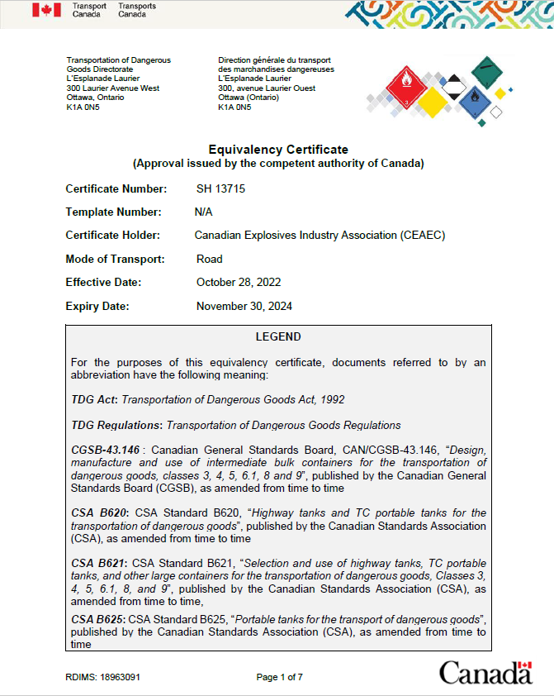
Transport Canada Position
3375
Formal Equivalency Certificate application submitted mid-December 2021 by CEAEC for the reclassification of ANE’s from UN0332 to UN3375.
EC approval / issuance, (SH 13715), October 28, 2022 so ANE’s can be transported as UN3375 in Canada (with conditions)
EC Details
Issued to CEAEC for the use of the member companies (similar to the former SP process).
Applies to specific ERD vetted / approved products that meet Special Provision 309 of the UN model recommendations.
Road transport only (Tankers, UN Portables and IBC’s).

Slide 3
ERD Position
3375
ANE’s will continue to be considered a 1.5D explosive for storage in Canada.
UN3375 will be considered as a Type E.1 / PE-1 explosives.
Application for UN3375 classification to be conducted via the government eLMS portal.
Upcoming amendment to the Federal Explosives Regulations, (ER-2013) will include.
The addition of UN3375 to part 6.
Allowance of two drawn vehicles.
Addition of electronic monitoring.

Slide 4
Results of the initiative
3375
While CEAEC was not 100% successful in our initiative to reclassify UN0332 to UN3375, the following changes were agreed by all parties:
We can now transport more than 20,000Kg of ANE in Canada in single tank and B-train configurations.
Electronic surveillance will allow for single driver / long duration transport (to be defined).
The use of QRAs for the vetting of locations for unattended parking (to be defined).

Slide 5
New Committee Chair
Gary Deboer is assuming Chair of the TM Committee
There is not much activity in this committee at the moment
Any Technology or Manufacturing topics that the membership feel important to address, please reach out to Gary.

