Slide 1
CEAEC MEETING
Niagara on the Lake, May 31, 2023
TRANSPORTATION COMMITTEE

Slide 3
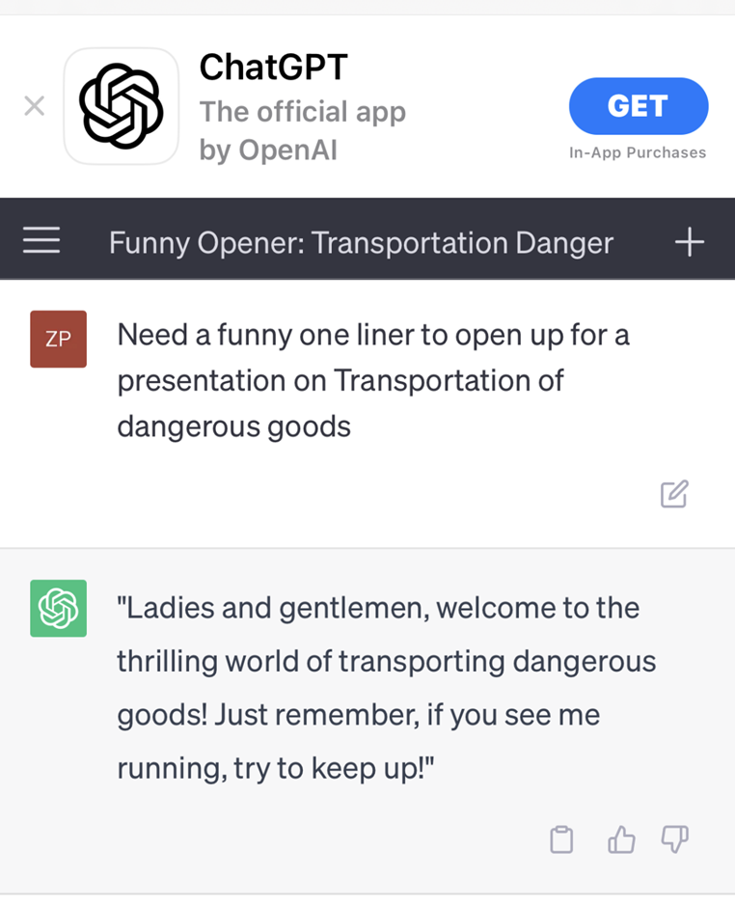

Slide 4
Transportation Committee
LTL
“Less Than Truckloads”
Shipments of explosives that are less than 2000kgs
Addressed in Amendment Package 2 – Lines 82 through 93

Slide 5
Marine Shipments
Industry handles and offers for transport class 1 products for inland marine/water voyages in Canada.( barges )
IMDG does not apply as the voyages are within 120 nautical miles from shore (part 11 (1) (a) ( i) TDGR).
ER-2013 speaks to transportation by vessel with two available options,
Row / row ( last on, first off , 30 mins dock side) with a maximum of 20,000 kg per event, (part 203 (1) (a))
Application of a risk assessment, (part 203 (1) (b))

Slide 6
Marine Shipments
Current industry best practice is not correctly described in ER-2013. This includes.
Offers to transport by inland water voyage.
Offers to transport by air.( IATA & ICAO )
-
CEAEC will continue to work with the ERD to establish a regulatory path forward

Slide 7
Emergency Response
Possible exemption for contaminated equipment to be transported via Emergency Response Trailer back to base of operations for decontamination.
Pumps, Transfer Hoses, waste bags with Residue Last contained
-
Would eliminate the requirement for additional manpower and resources from adjacent sites.

Slide 8
EV Prime Movers…on the horizon!

Slide 9
LIB Pallet Jacks – Possible??
In an attempt to mitigate industry wide ergonomic injury events stemming from packaged product delivery, electric pallet jacks could be a potential solution for use.
Existing Permit to Transport Non-Explosive Items with Explosives – Materials handling equipment, manual pallet jacks, hand carts, conveyors and empty packaging.
Removable Lithium Ion Batteries could be removed from pallet jack and stored separate from the Explosive body in a purpose built, laminate burn barrier enclosure on the chassis of the delivery truck.
-

Slide 10
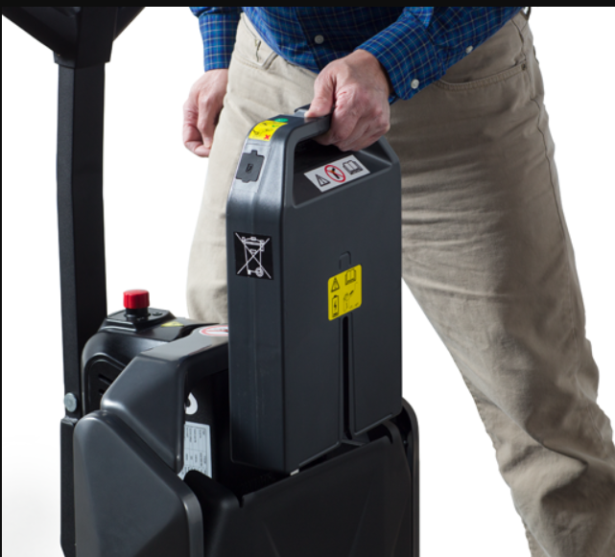
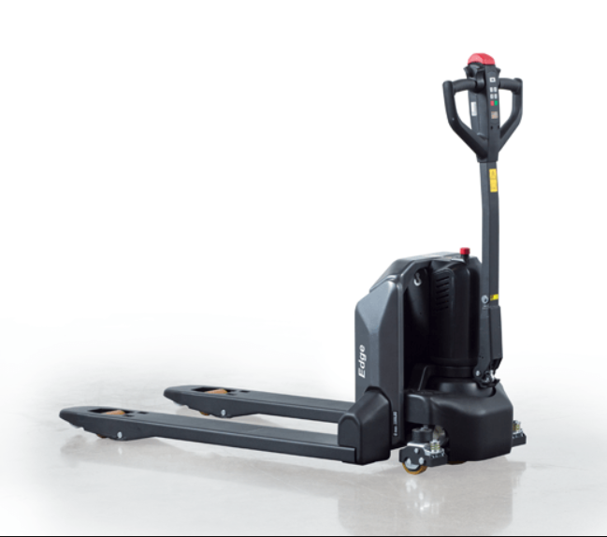

Slide 11
