Slide 1
CEAEC SPRING MEETING
April 27th and 28th, 2022
Transportation Committee

Slide 2
LTL( less than truck load) explosive shipments
There is reasonable confidence in carriers offering to transport full trucks loads
( detonators, packaged explosives & bulk emulsions).
There have been incidents with these carriers in the past where regulations where not followed.

Slide 3
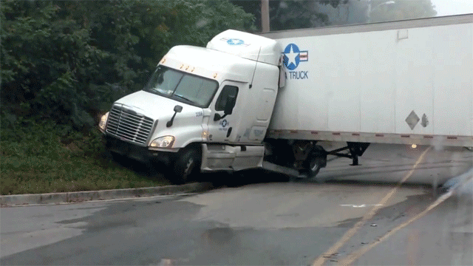
Common Carriers offering to transport LTL ( boxes to several pallets) are less knowledgeable of specific requirements ( TDG,ERD,ERAP ).

Slide 4
Like Prime Contractor Law in Canada which states “ You can not contract away the risk” , carrier agreements do not allow you too “contract away the negligence…”
Contract carrier agreements involve the public interest.
Failing to properly vet motor carriers can result in claims for breach of contract and/or negligence where same resulted in loss or damage.
This “vetting list” must be followed uniformly by those conducting the vetting and should be revised accordingly where contractual obligations or industry standards change. Committing to the due diligence process set out in the vetting list is ultimately just as important as creating one.

Slide 5
It is critical to maintain proof of this due diligence by creating an organized record-keeping system.
This duty does not end once a carrier has been vetted but is ongoing.

Slide 6
Current Regulations Include

Slide 7
Part 9 of the Explosives Regulations, 2013 outlines the requirements for the transport of explosives in Canada. These include requirements for the vehicles; for example, the vehicle must be locked, not overloaded, have appropriate fire extinguishers, and the explosives container must be either intermodal, or enclosed and fire resistant. The heaters, lights and climate controls must not increase the chances of accidental ignition. The vehicle must also have appropriate dangerous goods safety marks. (ER, 2013. S.191 ss.1-12)***
When transporting detonators and explosives in the same shipment there are requirements to be met, for example the detonators must be separated from the explosives. (ER, 2013. S.192 ss.1)****
The vehicle transporting explosives must be in sound mechanical condition. There are many specific requirements for this, including brake checks, tire pressure checks etc. (ER, 2013. S.193 ss.1-4)
There are specific precautions to be observed when the explosives are being loaded or unloaded. For example, once loading or unloading begins it should continue without stopping until it is completed. (ER, 2013. S.194 ss.5)***

Slide 8
There are requirements for the shipper and carrier to meet, for example the shipper must confirm the explosives destination is appropriate before delivering to the carrier (ER, 2013. s.195).***
There are requirements for the driver regarding age, smoking and prohibition of performance-diminishing substances. There are requirements for the driver to travel directly to the destination and not stop unnecessarily. (ER, 2013. S.196 ss.1-9)***
There are provisions for assistance of a driver, such as a co-driver or pilot car or escort vehicle. (ER, 2013. S.197)
Based on the nature of the explosives transported there may be requirements for a tracking and communication system, GPS for example. (ER, 2013. S.198 ss.1-4) ELD ***
When shipping explosives with other cargo(over 2000kgs) a permit is required from the ERD that outlines the carrier's responsibility to take all foreseen measures to mitigate added risks from cargo that make increase the chance of a fire or be otherwise a risk to the explosives. This is in addition to standard TDG segregation rules( 1.1D & 1.4B for example). (ER, 2013. S.192 ss.3-4)
There is a requirement for the vehicle to be attended when it is not at a licensed factory site. (ER, 2013. S.197), including precautions to be taken where the vehicle is parked overnight.
Lastly, any accidents or incidents are to be reported to the Explosives Regulatory Division.

Slide 9
There are requirements for the shipper and carrier to meet, for example the shipper must confirm the explosives destination is appropriate before delivering to the carrier (ER, 2013. s.195).
There are requirements for the driver with regard to age, smoking and prohibition of performance-diminishing substances. There are requirements for the driver to travel directly to the destination and not stop unnecessarily. (ER, 2013. S.196 ss.1-9)
There are provisions for assistance of a driver, such as a co-driver or pilot car or escort vehicle. (ER, 2013. S.197)
Based on the nature of the explosives transported there may be requirements for a tracking and communication system, GPS for example. (ER, 2013. S.198 ss.1-4)
When shipping explosives with other cargo(over 2000kgs) a permit is required from the ERD that outlines the carrier's responsibility to take all foreseen measures to mitigate added risks from cargo that make increase the chance of a fire or be otherwise a risk to the explosives. This is in addition to standard TDG segregation rules( 1.1D & 1.4B for example).
There is a requirement for the vehicle to be attended when it is not at a licensed factory site. (ER, 2013. S.197), including precautions to be taken where the vehicle is parked overnight.
Lastly, any accidents or incidents are to be reported to the Explosives Regulatory Division.

Slide 10
Arrears of Particular Concern Are:
Training ( 1.1D, 1.1B,1.4B, 1.5D, 5.1 )
Insurance ( 10 million minimum )
Directly shipped or passing thru terminals/cross loaded ?
Delivery/Pick up ( distributing/pick up freight from surrounding areas)
Cross Loaded ( add/remove freight )
Overnight or Day Storage( waiting for freight )
Bumped( removed for more profitable cargo)
MoC Correct Tank ( Bulk) ****Decontamination & Storage Considerations
No Exposed Ferrous Metal( Sparking )
Detonator Compartment ( Schedule IV or IME) Recommend Sced IV
No Refrigeration Units ( unless fuel is removed )

Slide 11
Arrears of Particular Concern Are:
ERAP
Manufacture/Distributor offers to ship( ERAP )
Client arranged shipping( No ERAP )
Quantity does not meet ERAP threshold in Schedule 1 of TDG
UN0081 for example is 75 kgs
Several shipments of non-ERAP quantity would require the carrier to have an ERAP
60 kgs Company A + 20 Company B > 75 kgs
Actions:
As part of the current ERD regulatory review, CEAEC recommended that Part 9, Section 192(3) & (4) be amended to lower the 2000kg threshold for mixed shipments to 10kgs. ( permit to transport non- explosives items with explosives).
10 kgs is the quantity at which a placard is required.
Does not prevent LTL shipments but rather requires carriers wishing to transport Class 1 products with other cargo to obtain the correct permit from the ERD. ***
Suggest alignment with Sced 1 ERAP thresholds

Slide 12
CEAEC will take items discussed within the committee and release an Industry Recommended Best Practice( IRP).
Parallel Actions that will increase public safety
ERD Enhanced Security Screening V2.0
CID*** TC TBA
Additional items to consider are adjusting the heel amount for unloaded emulsion trailers.
Newer trailers are practically empty once pumped out. 250 kgs is more suited for MPU’s

